Slide 1
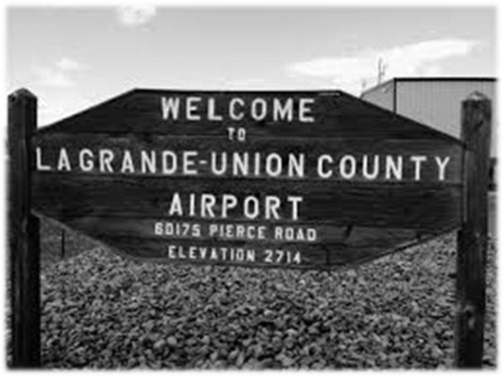
Team Members
Bob Harmon, Vanessa Church, Candice Castro, and Trevor Smith
Notes:
Team members Bob Harmon, Vanessa Church, Candice Castro, and Trevor Smith
The project we have been assigned is the La Grande/Union City Airport

Slide 2
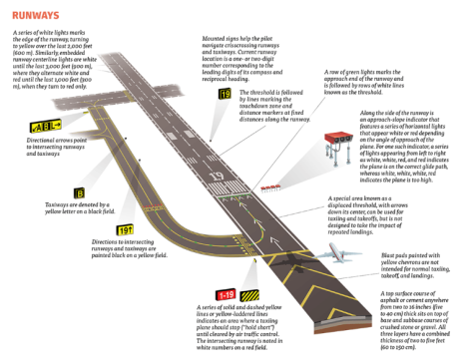
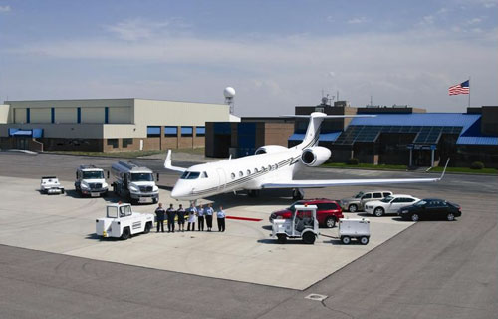
Airport Configuration and Supported Activity
Notes:
In this project our team has been tasked with looking at the current configuration of the airport to see what type of commercial traffic it can support and how FAA/TSA regulations impact it. In addition we have been asked to explore what types of additional government (federal, state, local) subsidies might be available, explore some hybrid offerings such as hauling freight on commercial flights collect other options that may have the potential to boost the economic impact of the airport.

Slide 3
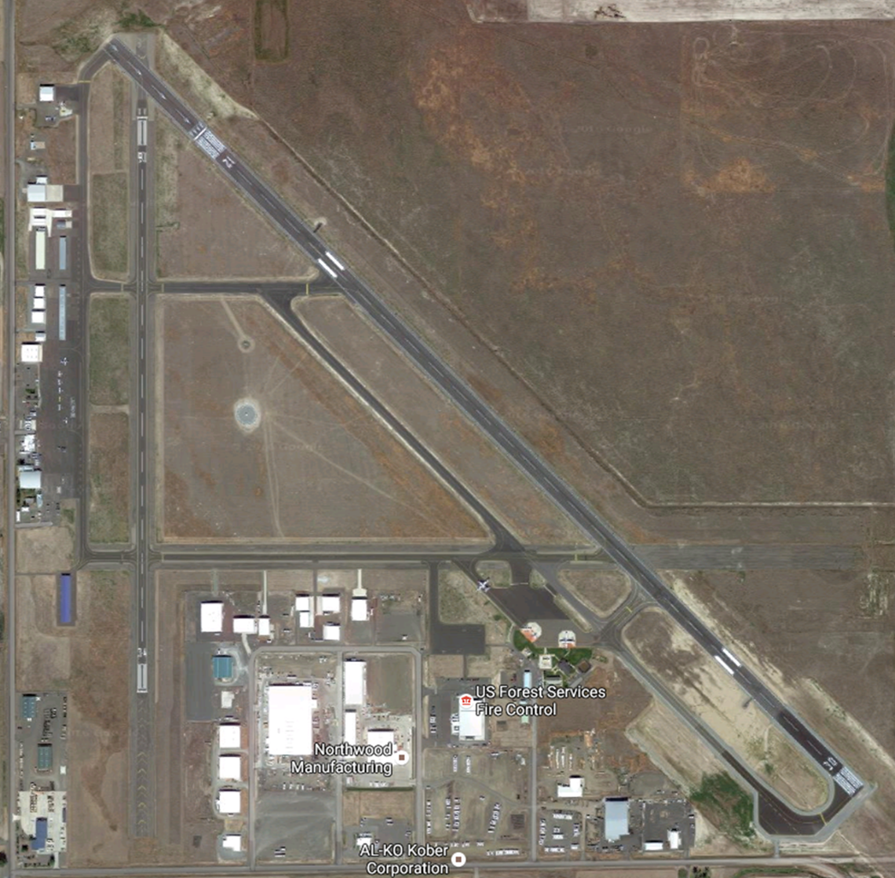

Notes:
La Grande/Union County Airport is a public airport located in the Northeast part of Oregon on a 640 acre parcel of land that is currently used by private pilots and for storage of their planes. The site is also used by FedEx, Ameriflight, and Life Flight for transportation of cargo and patients. The airport sees an increase in usage during the summer's fire season as it has a U.S. Forest Service Fire Control facility onsite. Commercial airline services were previously available, but currently this is not an option and in order for a person to catch a commercial flight, they have to travel to Boise, ID, Spokane, WA, or Portland, OR. La Grande/Union County Airport is currently enlisting the help of Eastern Oregon University (EOU) to research and analyze the economic feasibility of bringing back commercial passenger airline services to the area.

Slide 4
Flight Services
General Aviation Airport Category (Cat III, Regional GA)
No Air Traffic Control Tower at Airport
Flight Service Station (FSS) support provided by McMinnville FSS (MMV)
Approach/Departure radar service provided by Seattle Air Route Traffic Control Center (ARTCC)
Rwy 12-30: 6,260’ x 100’
Rwy 16-34: 3,876’ x 60’
Aviation Gas (AvGas) and Jet Fuel (Jet-A) on site
Major Airframe & Power plant Services on site
Notes:
The airport is classified as a category (3) Regional General Aviation Airport that has roughly 57 based aircraft and about 16,000 operations annually. The Airport services include Aviation Gas, Jet A fuel, an Automated Weather Observing System (AWOS), and major airframe & Powerplant services available.
A General aviation one with the operation of civilian aircraft for purposes other than commercial passenger or freight transport, including personal, business and instructional flying.
Current airport set up has no air traffic control tower on site, but approach and departure radar services are provided by Seattle Air Route Traffic Control Center (ARTCC) and flight service support (FSS) is provide by McMinville Municipal Airport (FSS)
The airport has two runways - the primary being Runway 12-30 with a length of 6,260 feet and a width of 100 feet – the secondary runway 16-34 is 3,876 feet and a width of 60 feet.

Slide 5
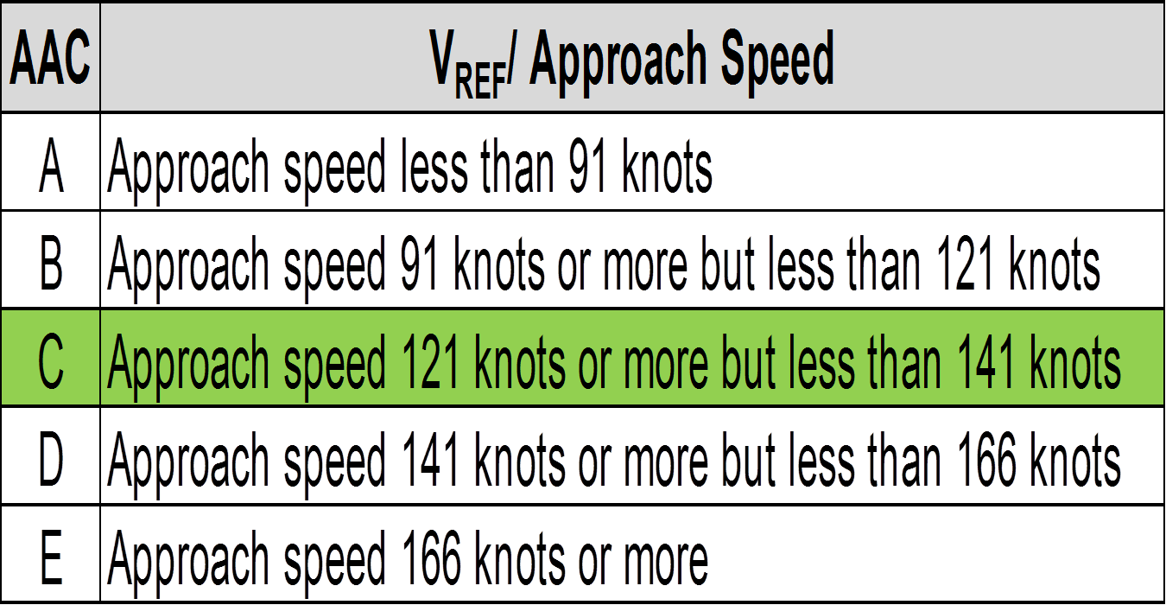
Runway Design Code
Table 1-1 Aircraft Approach Category
(La Grande/Union County Airport qualifies for section in green)
Notes:
The airport falls under the Runway design code of C-IV which means plane approach speeds can range from 121 to 141 knots.
“Runway Design Code (RDC). The selected AAC, ADG, and approach visibility minimums are combined to form the RDC of a particular runway. The RDC provides the information needed to determine certain design standards that apply. The first component, depicted by a letter, is the AAC and relates to aircraft approach speed (operational characteristics) (see Table 1-1).” (FAA-Runway)

Slide 6
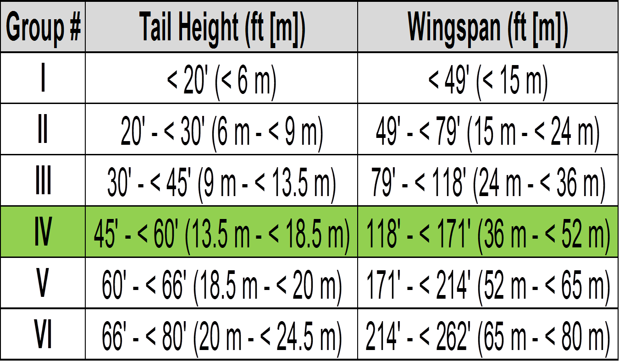
Runway Design Code
Table 1-2 Airplane Design Group
(La Grande/Union County Airport qualifies for section in green)
Notes:
The airplane tail heights can be in the range of 45 – 60 feet off the ground and the wingspan can be in the range of 118 – 171 feet wide.
“The second component, depicted by a Roman numeral, is the ADG and relates to either the aircraft wingspan or tail height (physical characteristics); whichever is most restrictive, of the largest aircraft expected to operate on the runway and taxiways adjacent to the runway (see Table 1-2).” (FAA-Runway)

Slide 7
Runway Design Code C-IV
La Grande/Union County Airport Qualifies as a Runway Design Code of C-IV
Normal Code for C-IV Mandates the Runway width of 150 ft
Having Aircraft under a maximum certified takeoff weight of 150,000 lbs or less allows for a runway width of 100 ft width a 20 ft shoulder width
Notes:
Normally for an airport to qualify as a Runway Design Code C-IV you would need a runaway that is 150 feet wide, but due to some sub-rules, La Grande/Union County Airport qulifies with having a runway with a 100 foot width providing the maximum certified takeoff weight is 150,000 pounds or less and has 20 foot widths on the shoulders of the strip and a runway blast pad width of 140 feet.

Slide 8
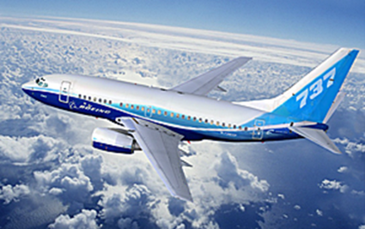
Boeing 737-600
Airport in its current set up could accommodate Boeing 737-600
A passenger certified seating capacity of 149
Maximum Take Off Weight of 145,500 lbs
Required Take Off Distance is 5,300 ft (1,616 m)
Required Landing Distance is 4,402 ft (1,342 m)
Notes:
Based on current airport configuration, the main runway (12-30) could accommodate a Boeing 737-600 airplane. This airplane has a max seating capacity of 149 people and a maximum takeoff weight of 145,500 pounds. It requires a distance of 5,300 feet for takeoff and a distance of 4,402 feet for landing. Less distance for landing is needed as the plane is lighter than that of takeoff due to fuel used up during flight. The addition of a plane of this caliber would drastically increase the foot traffic through the airport. This would allow for associated business operating within and around the airport to benefit greatly.

Slide 9
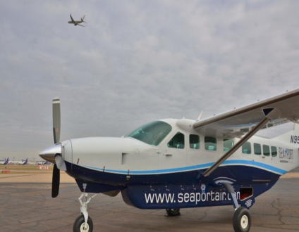
Cessna 208B Caravan
Commercial service plane recommendation would be the Cessna 208B Caravan – the same type of plane that is flying daily between Pendleton and Portland
Less than 10 passengers per flight would not require TSA security screening
Has a Max Take Off Weight of 8,000 lbs – providing the ability to carry both passengers and mail or other cargo at the same time
Seaport Air may be able to add La Grande/Union County Airport into their flight schedule
Seaport Air receives money funded from a government Essential Air Service Subsidy of $1.8 million each year so this service can be provided
Notes:
Seaport Air out of Portland currently uses a Cessna 208B Caravan airplane to providing daily service to Pendleton Airport. If the La Grande/Union County Airport starting providing flights for customers again, this would be the best suited plane for the job, and deal might be able to be made with Seaport Air to extend services since they are doing several runs a day to Pendleton.
The plane carries nine passengers which would not require TSA security screening. It also has a maximum take-off weight of 8,000 pounds, which means that even with a full load of passengers and luggage, the plane has the ability to hall additional cargo, like mail, at the same time.
Seaport Air receives money funded from a government Essential Air Service Subsidy of $1.8 million a year to provide service to Pendleton. If Seaport could qualify for additional funding to cover the La Grande/Union County Airport it could be a win-win for everyone involved.
Seaport Air currently provides flights four times a day between Portland, Oregon and Pendleton, Oregon Monday through Friday, and once a day on Saturdays and Sundays with tickets averaging $100 - $150 each way.
The medium security airports are typically the larger general aviation fields and/or the smaller commercial/airline fields. If your aircraft is based at one of these airports you will typically have reasonably unfettered access to it (subject to a few restrictions, such as the need for a background check and ID badge) (Security & Baggage Check)
If you're not based at the field (for example on the return leg of a business trip) you may be allowed to drive out on the ramp with an escort from someone at the airport who is authorized to do so, but visiting crew and passengers will be under some level of supervision from airport personnel (either directly escorted or visual observation). (Security & Baggage Check)

Slide 10


Additional Government Subsidies
Notes:
In this section, we will explore any additional federal, state, and local government subsidies available regarding funding for commercial airline flights at the La Grande/Union County Airport. Options in this section include funding from the Essential Air Service, Alternative Essential Air Service, Connect Oregon, and grassroots funding from local organizations.

Slide 11
Essential Air Service (EAS)
Guarantees that small communities in the U.S. maintain commercial service (USDOT 2016)
Aimed at maintaining a minimal level of scheduled air service to communities that otherwise would not be profitable (USDOT 2016)
Regulated by the United States Department of Transportation (USDOT)
Notes:
This information is provided on a hypothetical basis, as to if/how a federally funded subsidy could provide commercial airline services to the La Grande/Union County Airport. The Airport would see numerous benefits by offering commercial services funded by the Essential Air Service by guaranteeing service throughout the La Grande/Union County Airport as well as facilitating service for connecting/neighboring flights at similar airports such as those in Pendleton, OR or Nampa, ID. In addition, the EAS is aimed at maintaining a minimal level of scheduled air service to communities that otherwise would not be profitable, in turn, providing a consistent source of revenue not only for the airport but the entire surrounding community as well. Since the EAS is a federally funded subsidy, it is regulated by the United States Department of Transportation to ensure safe, ethical, and strategic operational management.

Slide 12
Alternative EAS
Designates funds directly to the municipality or airport authority instead of the airline (USDOT 2016).
This would allow La Grande to recruit services on an as-needed basis rather than a contractual agreement
Legalized through a public charter arrangement (USDOT 2016).
Notes:
Comparable to the EAS, the Alternative EAS designates funds directly to the municipality or airport rather than the airline itself. This would allow the La Grande/Union County airport to operate sustainably by recruiting services on an as-needed basis rather than by a bonded contractual agreement with the federal government. The Alternative EAS is legalized through a public charter agreement.

Slide 13
State Subsidies
Connect Oregon
Promotes strong, diverse, and efficient initiatives for Oregon’s transportation industry (ODOT 2016).
La Grande airport may be eligible for funding due to state fuel tax revenues, i.e. high profit vs. margin percentage for people to buy fuel and use facilities at the facility
Notes:
In addition to the aforementioned federally funded subsidies, state subsidies provide numerous benefits to small communities like La Grande regarding the capacity and capabilities for commercial airline service. Connect Oregon is a service designed to promote strong, diverse, and efficient initiatives for Oregon’s transportation industry. The La Grande/Union County Airport may be eligible for funding due to state fuel tax revenues, evident of the margins associated with the amount of people buying fuel and utilizing services at the facility today.

Slide 14
Local Subsidies
Community-based Pilot Association – make connections within the region of Northeast Oregon to decrease costs and increase awareness for commercial flight services (McGlynn 2016).
Union County Chamber of Commerce – Tourism
Notes:
Due to the current tightly knit nature of Union County as a community, the airport would benefit greatly by taking advantage of funding from local subsidies. Drawing off of the idea of the Oregon Pilots’ Association, pilots from around Northeastern Oregon could form a community-based Pilots’ Association to make connections, decrease costs, and increase awareness for commercial flight availability in the region. The Union County Chamber of Commerce could also serve as a marketing resource, promoting the beauty of Eastern Oregon as an attractive tourism figure to help fill commercial flights to and from the area; bringing in revenue as a result.

Slide 15
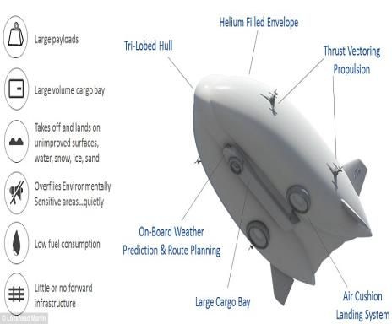
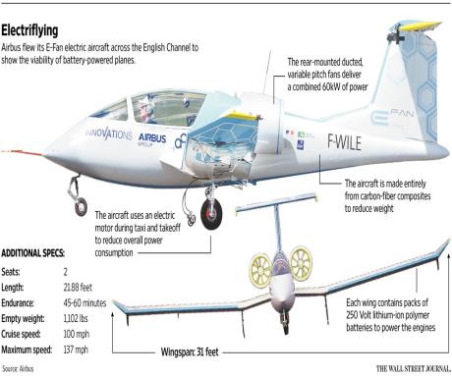
Hybrid Offerings
Notes:
Everyday technology is making streamline advances, and there is no different when it comes to that of things that can fly. Hybrid based offerings are now available for planes. As we can see in these two images, there are many features that are boosting the economic activity along with the air efficiency. Some other features that are offered with a hybrid plane are large payloads, large volume cargo bay, takes off and lands on unimproved surfaces, overflies environmentally sensitive areas quietly, low fuel consumption, little or no forward infrastructure, carbon-fiber composite structure, and using an electric motor during taxi and takeoff to reduce overall power consumption. All of these fascinating elements of a hybrid plane that would be a great addition to the La Grande/Union Airport. Only time will tell if we make the advances we need and actually bring in hybrid options, along with other cargo and passenger offerings to this airport.

Slide 16
Airline Operations
The government classifies airlines as "major," "national," "regional," and various others. About 40 national airlines have annual revenue between $100 million and $1 billion, and 90 regional airlines have annual revenue under $100 million. The remainder of the industry consists of small air companies that generally have annual revenue between $5 and $50 million.
The basic operations of airlines include acquiring and maintaining airplanes, acquiring and operating airport facilities, acquiring passengers or freight, managing staff, and operating flights.
Notes:
As we can see, the government classifies airlines into 3 basic categories by size and revenue; major, national, and regional. These are the larger airlines that range from under $100 million to $1 billion. However, that is no where near where this airport sits. The La Grande/Union Airport would fit into the “small air companies.” Which would normally see an annual revenue between $5-$50 million. This is something that could benefit not only the airport but the entire region as well. As it could have the potential to add value and bring in numerous passengers and hopefully add to the surrounding communities.
The ability of the airport to run and operate has basic components of the overall structure. As this already being a functioning airport, there shouldn’t be any issues when running and operating it to its full potential. Maintaining the aircraft, operating the airport facilities, managing staff, and operating various flights are already being done. The only thing now needed is to acquire are passengers or freight. By doing so, this would really take it to the next step and give it the edge it need to be a fully functioning airport with passengers and cargo!

Slide 17
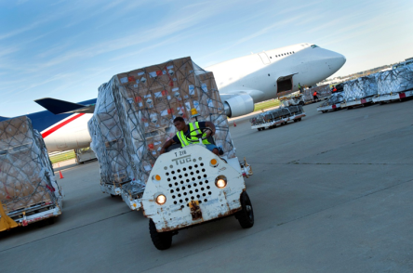
Hybrid Offerings
Air transportation’s share of world trade in goods is only 2% measured by weight but more than 40% by value
International operations, freight can account to 45% of the revenue of a regular airline
Air cargo has a niche market for emergency situations where the fast delivery of supplies prevails over cost issues
Regular passenger airlines, cargo usually account for less than 5% of total revenues
Notes:
By bringing in such offerings, we can see here, some benefits of doing so. By having the ability to offer air transportation in different ways, we can see that it adds value in more ways than one.
Air transportation is a very common way to boost up the revenue for the airline. With all of the international operations that account for 45% of their revenue and regular passenger airlines, cargo usually accounts or less than 5% of total revenues for that airline Try and imagine how much of an increase that could be for for our local airport.
Next, we can see how crucial having air cargo available has a niche market for emergency situations. The ability to provide fast delivery of supplies, people, and necessities all prevail over any cost issues related.
Also, efficient and affordable air freight has contributed to changes in diet by making available new products or products in seasons during which they would not be available, to changes in retailing and correspondingly to changes in manufacturing. The increased importance of time-based competition ensures that air cargo augurs well for the future growth of air transportation. And in this area, this is vital. With all the farmland, forest, and mountain ranges in our area there is always the need for such offerings.

Slide 18
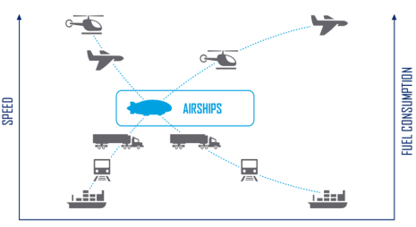
Hybrid Air
With unlimited access to isolated locations around the globe, Hybrid Airships safely and sustainably support a wide range of activities in areas with little to no infrastructure. The airship offers the simplicity of a pickup truck by carrying cargo loads and personnel in and out of remote areas daily, not just certain seasons or only after major road, rail or airport infrastructure is developed.
“When you realize half of the world’s population doesn’t have access to paved roads, you can get a real sense of the opportunities that the Hybrid Airship opens up.”- Chief Executive Rob Bins
Notes:
In a small airport, we can really benefit from the new and different offerings that are out there. Hybrid Airships is an alternate way of air travel. These ships offer simple ways to move people, cargo, and much more. It does so by combining technology from an airplane and a helicopter which bring new capabilities to aircraft. The company was founded in 2007, and is making vast improvements daily to give these airships a “lighter-than-air” experience. Chief Executive Rob Bins says, “When you realize half of the world’s population doesn’t have access to paved roads, you can get a real sense of the opportunities that the Hybrid Airship opens up.” This statement couldn’t be more true for this airport and our region in general. By adding aircraft like these to our airport, we are also adding so much value and opportunity as well.

Slide 19

The Possible “Hybrid” Future
NASA Glenn Research Center leading an effort to develop a hybrid-electric airplane
Less noise
Less drag
Less Pollution
Hybrid plane would produce less noise and less air pollution
A few companies are already developing small electric passenger planes
Two-seater built by Airbus flew across the English Channel in July 2014
Severe technical problems that need solving for all electric craft
Issues involve battery size and overall technology
Notes:
As said previously, with the ever-changing technological advances, changes in aircraft structure is a real thing. By 2025, NASA aims to create a single-aisle hybrid plane that could travel 4,000 miles with 150 passengers on board. (Picture a Boeing 737, with smaller jet engines and a powerful electric fan on the tail.) They are working hard at the NASA Glenn Research Center to develop a fully hybrid-electric airplane. These aircrafts would help reduce noise and air pollution and would have less drag. There have been significant improvements already in their research. Smaller planes have gone electric, like a two –seater built by Airbus which flew across the English Channel in July 2014. However, for the bigger planes, the biggest issues are with the battery size and overall technology that needs to be solved in order to make them fully electric. In only years time, we may see fully-functioning electric (hybrid) planes!

Slide 20
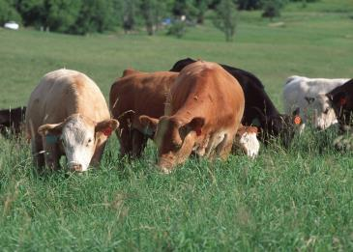
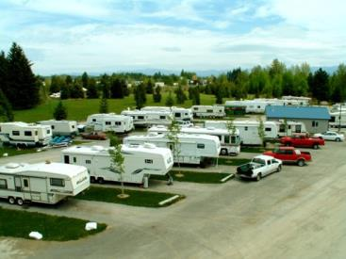
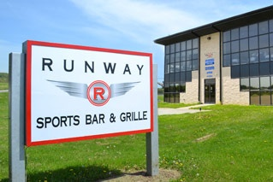
Potential Economic Boosters for Airport
Notes:
Other than the aviation business itself through the La Grande Airport, we have compiled a few other options for potential additional revenue for the organization. Understanding that the Union County Airport sees most of its income from fuel sales, there are a few other ways the airport could attract more visits and overall usage of the facilities as well as boost the organizations economic impact overall. Our ultimate goal is to come up with ways for the airport to increase revenue and by doing so increase the sale of fuel due to the rise in business and overall traffic through the airport (foot or vehicle).

Slide 21
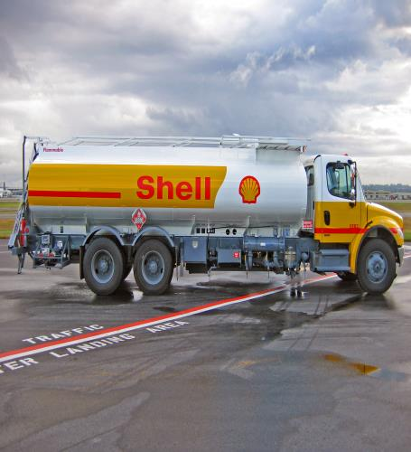
Aviation Fuel Services
Notes:
According to the La Grande/Union County Airport Financial Statement the biggest revenue generator for the airport is the sale of aviation fuel. Based on average fuel prices of aviation gas in the northwest region of the country of $6.11 per gallon the airport sold nearly 136,000 gallons of fuel in 2015. The average aviation gas price for 2016 in the Northwest Region of the country is currently $5.19 per gallon. Based upon projected revenue of aviation fuel sales the airport is looking at selling nearly 234,000 gallons of fuel which would mean an increase in foot traffic to the airport. Since fuel is averaging a lower price than last year, this could be the reason for projecting higher revenue as more private pilots traffic or it could be the expectations of bigger fire season and the increase in firefighting plane traffic.

Slide 22
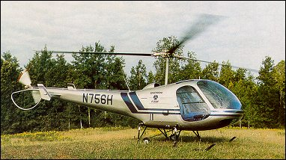
Helicopter Touring
Helicopter Touring Industry might be a viable business option for the airport.
Building a hanger to support this business and then charging rent to the occupants.
Fuel & oil sales increase as the Enstrom 280FX/F28F burns through 16 gallons of fuel and ¼ quart of oil per hour.
Providing daily tours to the town of Joseph/Wallowa Lake area or flying people into the back country for fishing or hiking excursions.
Increase foot traffic to the airport due to the touring business creating another reason for adding a gift shop and/or restaurant to increase revenue
Notes:
Union county, along with neighboring Wallowa county, is some of the most rugged but beautiful country in the Northwest. There would be a lot of opportunity to bring in business through the sale of tours or drop offs, which would simultaneously result in higher fuel sales. Many avid outdoor enthusiasts from some of the surrounding urban areas, would be willing to pay a premium for such a tour or drop off to a special adventure destination. Once such a business was established, the airport could easily see more business from all over the nation. This business could be the perfect way to take advantage of the beautiful terrain surrounding the La Grande area, and turn it in to a solid income producer for the airport.

Slide 23
Restaurant or Café on Site
Could bring in more jobs and interest to the Airport
If placed in a position where runway viewing is possible- attraction/visitation site a possibility
Locals of the area would likely show interest in such a facility
Business from current users such as fire crews and freight companies would bring in extra revenue for the airport
Possible funding from local subsidies
Notes:
The addition of a Restaurant or Café could be a very effective supporting business to the Airport. The placement or position of this entity could be placed strategically for aviation viewing, adding a scenic value to such an operation. This type of operation would have the potential to attract business from local residents, drivers coming off the interstate, and flight passengers as well. Adding to the attraction value of the site will encourage increased visitation by multiple travel methods, which would increase business for fuel sales as well as other relations to the La Grande Airport.

Slide 24
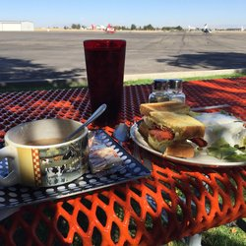
Other Small Airports benefiting from Café on site
Other small airports such as Nampa Municipal Airport, benefit from the public who enjoy a café style dining experience
In addition, many customers of the café will mostly be attending to enjoy the sights of the airport itself
View from Nampa, ID Airport Cafe
Notes:
Other small airports such as Nampa Municipal Airport, benefit from the public who enjoy a café style dining experience. Business at this airport comes from not only those who utilize the airports aviation facilities but also the general public as well. The view from this café has attracted a customer base from all over the surrounding valley. Many current customers have reported flying into this little airport to get a bite to eat and “gauk” about planes with other enthusiasts. Pictured in this slide is the view from the patio seating at a small airport café in Nampa Idaho. This view itself attracts many customers to the sight bringing in business that many other conventional cafes may miss out on.

Slide 25
Union County/La Grande Gift Shop
Adding a gift shop could boost revenue with purchases of souvenir-type items
Fire Crews are often brought in from other states and would be potential customers for this type of shop
Other than fire crews, virtually any customer using the La Grande-Union County Airport could be a possible customer for this type of business.
Notes:
Adding a gift shop would be another possible attraction that could boost revenue with purchases of souvenir-type items. Business from fire crews is often brought in from other states and would be potential customers for this type of shop. Other than fire crews, virtually any customer using the La Grande-Union County Airport could be a possible customer for this type of business. Anything that would allow the airport to take advantage of sales from existing customers should be considered.

Slide 26
Union County/La Grande Gift Shop
A small shop could bring in at least a few openings for part time work
Product within the shop could offer opportunities for locals to sell products and share revenue with the La Grande Airport itself
There would be many opportunities for consignment sales as well as small “trinket” type items which many airports provide
Local subsidies could be a possible funding source
Notes:
Implementing small gift shop could bring in at least a few openings for part time work for local residents. Product within the shop could offer opportunities for locals to sell products and share revenue with the La Grande Airport itself. There would be many opportunities for consignment sales as well as small “trinket” type items which many airports provide. Local subsidies could be a possible funding source to get a small shop underway. Having local contributions to inventory would allow for inexpensive stocking.

Slide 27
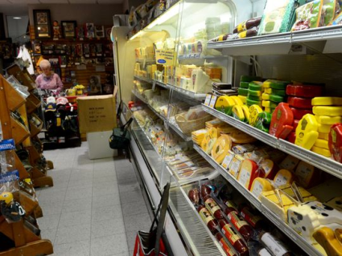
Gift Shop’s Effect on Local businesses
Businesses within the area could assist in merchandising
Customers who may never reach the actual town would be exposed by gift shop
The sharing of local culture provides attraction for visitors to return
Wisconsin airport gift shop selling variety of local cheeses.
Notes:
Again, businesses within the area could assist in merchandising to bring in native product as well as keep the inventory start-up costs rather low. Customers who may never reach the actual town would be exposed by gift shop, which would make this a win-win situation for the La Grande Airport as well as the local businesses. The sharing of local culture provides attraction for visitors to return, in turn providing more incentive for the usage of the airport, resulting in higher fuel consumption. The picture featured in the current slide is based out of an airport in Wisconsin, where the local cheeses from local businesses are sold to customers from a large variety of origins. Simple spreading of culture such as this example can lead to future visits and usage of a facility.

Slide 28
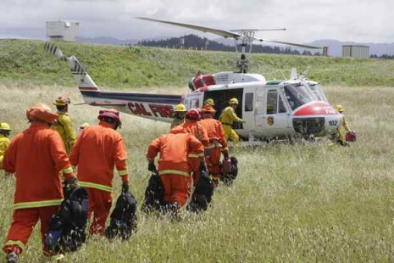
Land Leasing/Space Rental
Areas of the Airport property could be leased out for warehousing
Temporary structures such as commercial grade tents could rent storage space
Leasing land for animal storage or grazing rights for local livestock owners
Camp area could be developed to allow a group setup for fire crews continuously needing to be on site
Notes:
Areas of the Airport property could be leased out for additional warehousing operations. Temporary structures such as commercial grade tents could rent storage space Leasing land for animal storage or grazing rights for local livestock owners would be another possible money maker on the side. A more permanent camp area could be developed to allow a group setup for fire crews continuously needing to be on site. This type of construction or usage on the existing area would encourage increased visitation to the premises, adding to the economic value of the La Grande, Union County Airport as a whole. Along with camping areas, the possibility for RV hookups is definitely an option. If the airport was to start attracting more visitors for flight tours, gift shops, and/or a restaurant, the chance to see revenue from RV enthusiasts would be tremendous. The short distance from I84 would make the location an ideal pit-stop for many long-distance travelers.

Slide 29
References
"AirportMPCh1." Union County Oregon. N.p., Jan. 2015. Web. 24 Aug. 2016.
"AirportMPDraftChapters." Union County Oregon. N.p., n.d. Web. 24 Aug. 2016.
"Federal Aviation Administration." Federal Aviation Administration. N.p., n.d. Web. 24 Aug. 2016.
"How Does Security and Baggage Checking Work in Regards to a Private Jet?" Airport. N.p., 18 Nov. 2014. Web. 24 Aug. 2016.
Essential Air Service. (2016, May 17). Retrieved August 5, 2016, from https://www.transportation.gov/policy/aviation-policy/small-community-rural-air-service/essential-air-service
Transportation Development - Planning. (2016). Retrieved August 5, 2016, from http://www.oregon.gov/ODOT/TD/TP/Pages/ConnectOR.aspx
McGlynn, K. (2016). What OPA Membership Does for You! Retrieved August 5, 2016, from http://www.oregonpilot.org/Index.html
Alternate Essential Air Service. (2016). Retrieved August 5, 2016, from https://cms.dot.gov/office-policy/aviation-policy/alternate-essential-air-service
Fly2lunch.com Nampa Runway Cafe Restaurant Information. (n.d.). Retrieved August 23, 2016, from http://www.fly2lunch.com/restaurant.php?rest_id=2679
Plothoff, G. (2014, January 24). Young Entrepreneur's New Helicopter Business Takes to the Skies Above Santa Barbara. Retrieved August 25, 2016, from https://www.noozhawk.com/article/santa_barbara_native_launches_nanco_helicopters_business_20140124
Rubenstein, R. (2016). How to Start a Business in an Airport. Retrieved August 24, 2016, from http://smallbusiness.chron.com/start-business-airport-43159.html
Ryman, R. (2015, January 13). Hills, airport gift shop and Packers have long history. Retrieved August 23, 2016, from http://www.greenbaypressgazette.com/story/money/2015/01/10/hills-airport-gift-shop-packers-long-history/21519385/
W. (2012). Economic Impact: Central Wisconsin Airport. Retrieved August 16, 2016, from http://wisconsindot.gov/Documents/projects/multimodal/air/cwa-eis.pdf
NASA Glenn takes aim at developing a hybrid plane. (2016). Retrieved August 5, 2016, from http://www.crainscleveland.com/article/20160131/NEWS/160129764/nasa-glenn-takes-aim-at-developing-a-hybrid-plane
Indianapolis International Airport. (n.d.). Retrieved August 1, 2016, from http://business.ind.com/employment_business/airService.aspx
Air Transport. (n.d.). Retrieved August 4, 2016, from https://people.hofstra.edu/geotrans/eng/ch3en/conc3en/ch3c5en.html
Air Cargo Industry. (n.d.). Retrieved August 5, 2016, from http://www.dot.ca.gov/hq/tpp/offices/ogm/key_reports_files/National, Technical studies/Air_Cargo_industry_overview.pdf
About Us. (n.d.). Retrieved August 2, 2016, from https://www.hybridairvehicles.com/about-us

