Slide 1

O U T D O O R T R A C K & F I E L D F A C I I L I T Y
Morgan Babcock, KT McMurray, Tanner Yarbrough, & Kathlyn Welch

Slide 2
Objective
The primary goal of this project will be to develop a pitch and business plan for EOU’s Advancement Program to use as they source funding for the track facility project.
Notes:
The objective for our project, as outlined in the statement of work, is as follows: The primary goal of this project will be to develop a pitch and business plan for EOU’s Advancement Program to use as they source funding for the track facility project.

Slide 3
Vision
Our vision is to develop a track and field facility that is regionally, nationally, and internationally recognized as the best of its kind to benefit EOU and the surrounding area by embodying
a strong community spirit and supporting
an active lifestyle.
Notes:
Our vision is to develop a track and field facility that is regionally, nationally, and internationally recognized as the best of its kind to benefit EOU and the surrounding area by embodying a strong community spirit and supporting an active lifestyle.

Slide 4
Why is a New Track Needed?
Current track installed in 1980
Resurfaced in 1997
Main cause for shin splints/injuries among track and field athletes during fall and spring
Currently not usable for collegiate track meets
New high quality facility will attract higher quality athletes
Current track is similar hardness as concrete sidewalk and asphalt road
Notes:
The estimated lifespan of a track is 10-15 years depending on continued maintenance of the surface.
Shin splint/injuries as reported by EOU athletes. During spring season sprinters and jumpers often practice in the grass infield in order to practice on a softer surface. Having a new high quality track and field would allow coaches to recruit higher quality athletes which would increase chances to win conference and national championships. EOU track and field is currently one of the most successful athletic programs on campus with an average of 6 national All-Americans per season (indoor, outdoor). Increasing the quality of the track would allow coaches to recruit more athletes which would increase enrollment for the University.

Slide 5
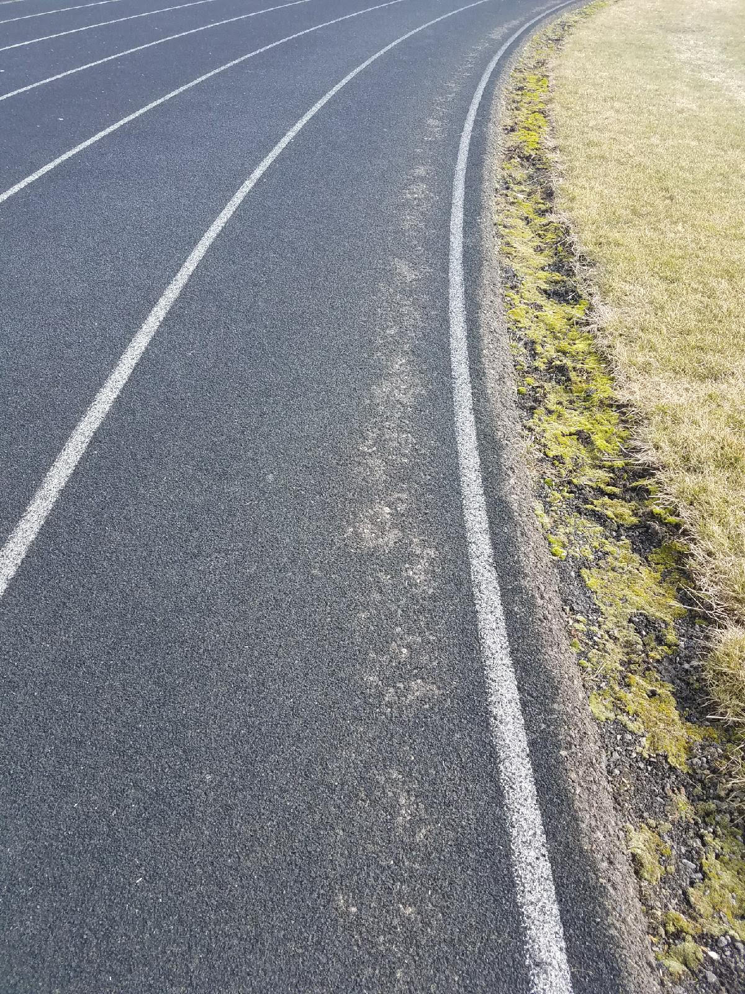
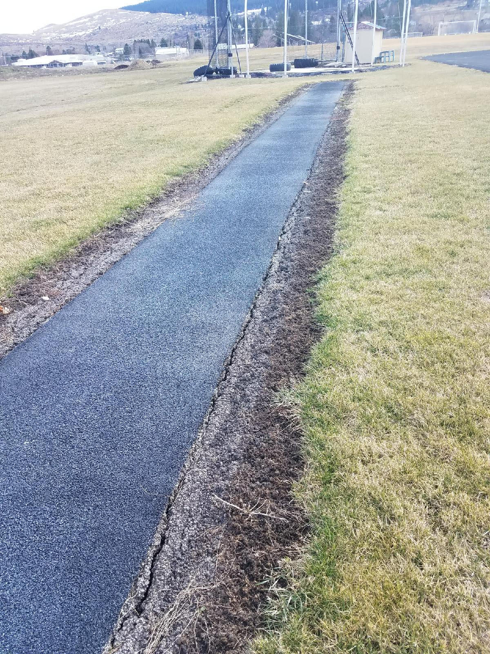
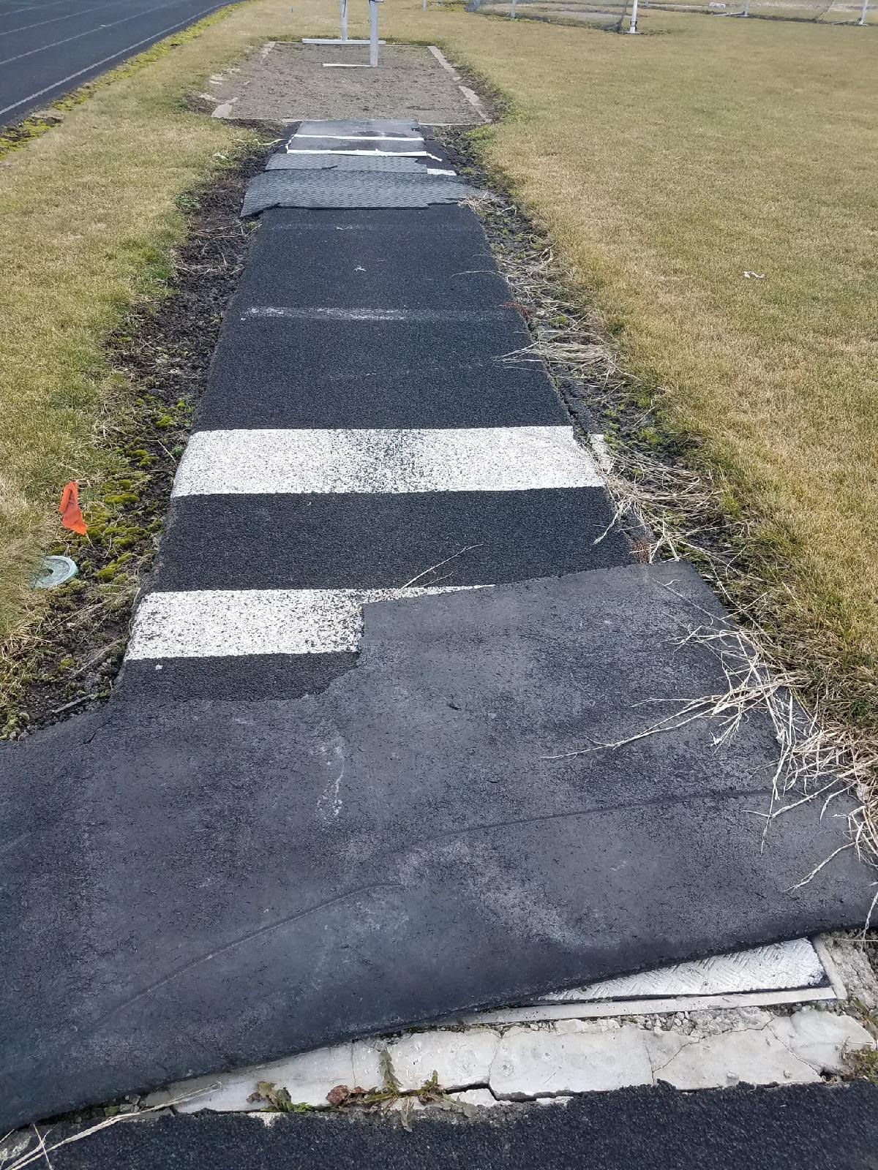
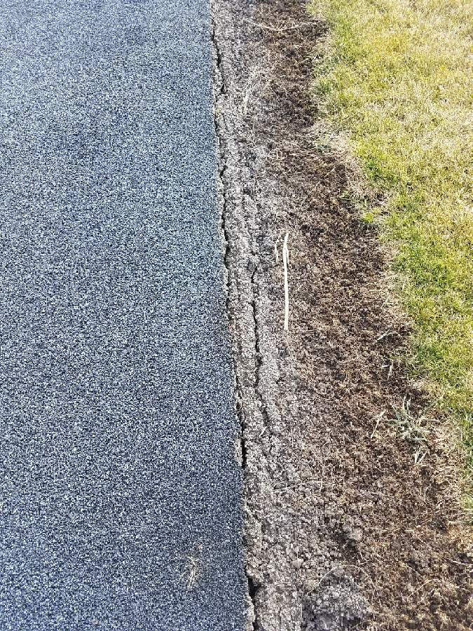
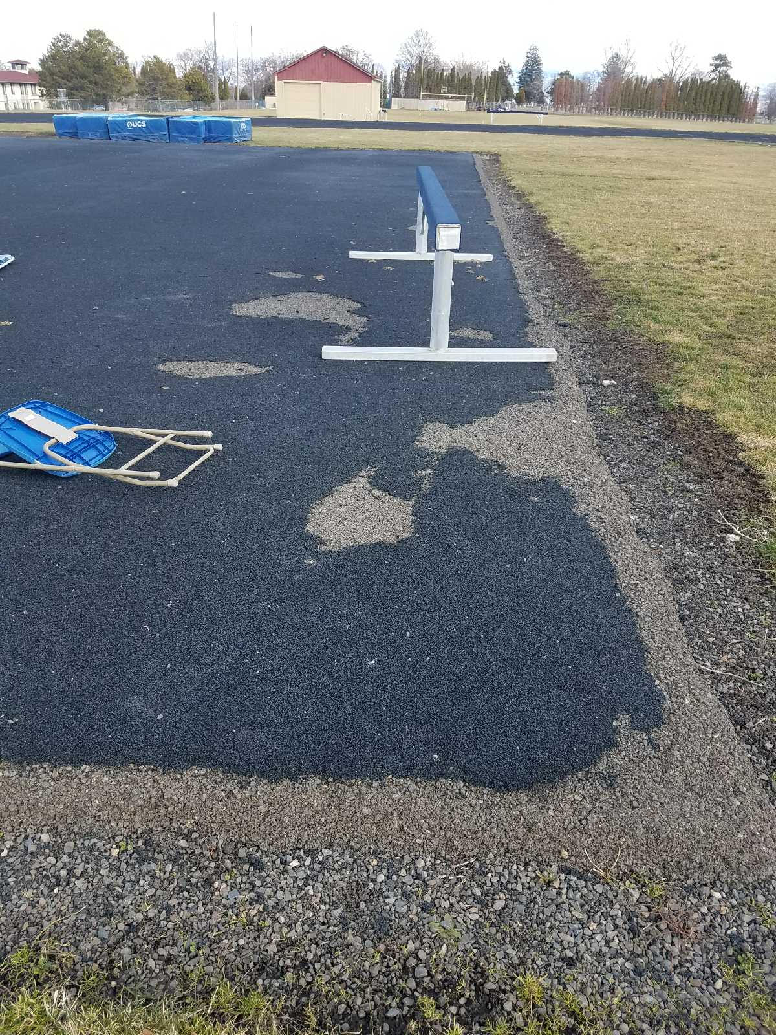
Why is a New Track Needed?
Pole- Vault Runway
High Jump D-Pad
200M Start
Long/Triple Jump Runway
Notes:
Examples of the dilapidated state of the current track at EOU. The competition surface has been worn down to the point of showing the asphalt base layer. The edges the asphalt layer are beginning to deteriorate as well, especially on the jumping runways and the high jump pad. The surfaces shown above are locations on the track that are essential to running a track meet and have the highest need for repair. The long/triple jump runway currently uses a portable roll out runway to reduce chances of injury to jumpers during outdoor season practices. When tested for force reduction the area shown in the 200M photo tested as one of the hardest spots at a rating of 20%. The Pole-Vault runway tested at 31% to 41% making it one of the softer surfaces in the facility as did the High Jump D-Pad. The Long/Triple jump runways tested between 21% and 26%, this makes the runways barely softer than the track itself.

Slide 6
Collegiate Requirements
Current EOU Track
Force Reduction (IAAF Standard)
35% (hard) to 50% (soft)
Thickness (IAAF Standard)
Minimum 13mm
Force Reduction
20% to 28%
Asphalt road- 20%
Concrete Sidewalk- 17%
Thickness
Less than 7mm
Bare asphalt base showing in spots
Notes:
https://www.ncaa.org/sites/default/files/Field%20Diagram%20Track%20and%20Field.pdf
Force reduction reported by Benyon Sports, a company contracted to test the surface and offer a quote to rebuild the track.
http://www.trackandturf.com/wp-content/uploads/2013/05/BSS100CONVERTBSS300.pdf
The IAAF has a comprehensive list of requirements that must be met before a surface is usable for intenational competition. IAAF standard is being used to as a baseline to compare current EOU surface to other surfaces including Division 1 and international athletic facilities. In respect to the IAAF standards, EOU has not conducted tests to show wear in respect to all requirements. There have been tests in regards to force reduction and thickness of the competition surface.

Slide 7
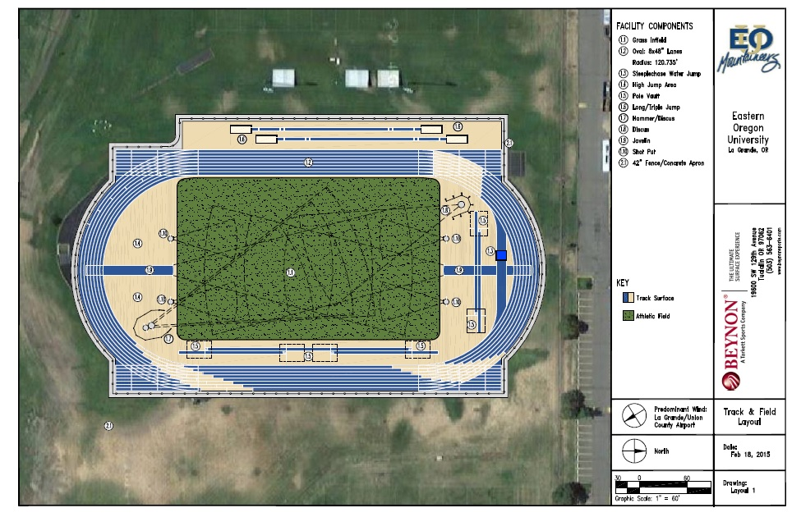
Notes:
Current Expected layout of new track design as provided by Benyon

Slide 8
Budget
Sample
Project Total
$1.5 Million
Beynon Bid
BSS 300 Track Surface
$659,427
BSS 1000 Track Surface
$739,426
Wall 2 Wall (Mondo)
$870,264
Base Bid $663,100
Mobilization 12,000
Erosion Control 6,000
Construction Staking/Survey 13,000
General Excavation (Entire Project) 131,100
Track Surface Product 281,000
New AC below new track AC 142,500
New 4” Base Rock below new track AC 35,000
New ¾” Base Rock below track AC 29,000
New concrete surround at Slot Drain 2,200
New concrete below New Track surfaces 10,400
New Base Rock below track concrete 900
Notes:
Bond Issuance: $750,000 XI-F Bonds
Matching Funds: Private Gifts and Grants $750,000
Base Bid is from Southern Oregon University preliminary construction costs summary. The report includes both football turf and track installation, so we had to change some of the totals. The two bids from Benyon and Wall 2 Wall sports are for the actual competition surface assuming the base layer is properly built to their respective requirements. Benyon and Wall 2 Wall, Mondo, both have a low bid but that is because they are to resurface the track. It doesn’t include both resurfacing and tearing out the track.
Sources:
-Beynon report
-Wall 2 Wall report
-Southern Oregon University Summary

Slide 9
Benefits
University
Community Events
Sense of Community
High School, Collegiate, & Professional Meets
Economic Benefits
Notes:
There are many benefits of building a new track at Eastern Oregon University. Eastern is a school with a very established track and field program, and the addition of a new track that can hold collegiate meets would make EOU attractive to potential track and field athletes. Adding the track would also create a space for the community to hold community events while building a sense of community. A new track would also promote a healthy lifestyle for the community by creating a space for members of the community to exercise. Community fitness classes and events could be held on the track. Surrounding high schools are in need of a place to host their regional meets (Cove, Imbler, La Grande.) The addition of a new track would also provide economic benefits for the community. Hermiston is a model of what a new track could do for a community. They recently put in a new track and field facility where they can hold regional, national, and potentially international, and it has created economic growth in their community as well. Eco Northwest has gathered data that proves this.
A high quality track and field would allow coaches to recruit more athletes which would increase enrollment for the University. Athletic programs tend to have higher retention rates for students as compared to non-athletic students.

Slide 10
University Benefits
Shows Eastern Oregon University is an advocate for community
Attractive addition to the University for potential athletes
Improves overall image
Promotes community involvement in EOU athletics
Notes:
There are many benefits that a new outdoor track and field facility will provide for Eastern Oregon University. By providing a community facility, EOU will show that they are an active part of the community and care for the well being of its members. Adding a new state of the art facility EOU will become a much more attractive option for athletes that are looking to potentially enroll. The fact that we can host events on a collegiate and high school level will expose transfer athletes as well as new graduating senior athletes that are looking for a college to attend. Building a new track will also improve the overall image of the school. The current state that it is in does not create a very positive image for our school, but a new facility will show that Eastern cares for it’s students and the facilities they provide. This new facility will also promote community business involvement. Many new events can be held on this track and that means there are new events that will need to be sponsored. The new facility will push businesses to play a more active role in the community.
[some duplication from earlier slides]

Slide 11




Uses
Events
Youth Events
National Guard / Forest Service
Community Fitness Test / programs
Notes:
The community currently puts on many events that utilize a track facility. They currently use the La Grande High School track for most events. But their track is also being revamped because of surface and structure problems. Like EOU they are also rebuilding their track. The community would benefit greatly from a new track to hold these events. Relay for Life, Drug Free Relay, and Walk-A-Thon are a few community events that could be held on the new facility. Having members take part in events like these adds to the sense of togetherness while promoting fitness. Other community related events that the new track could house are community fitness test, programs, and classes. There is a great need for an outdoor facility that could host these events.
Youth events are another large part of the community. Cove play day, youth sports camps, youth day camps, kids day out (like kids night out held in Quinn Colesium),and youth track meets all could be held on the new facility. This will add greatly to the sense of community in La Grande. Parents and children will gather on this new site to participate in programs that promote physical activity. TrackTown youth league is an organization that “the TrackTown Youth League was created to encourage Oregon youth from all backgrounds and income levels to become healthy and active members of the community, inspire youth to participate in track & field and further Oregon’s position as the spiritual home for the sport in this country (tracktownyouthleague.com).” TrackTown youth league holds a championship meet at Hayward Field at the University of Oregon. Another opportunity that a new track facility offers is a chance to create a youth track team that can compete in the TrackTown Youth League Championship. This new facility could also hold meets that would determine the finalists for the championship.
Other groups that could utilize the facility are the National Guard and Forest service. The National Guard holds routine fitness tests and training that could be held on this facility. Eastern’s ROTC program could also use the new track for their tests and training as well. The Forest Service has a pack test that all their employees that will be fighting fire will have to pass. This test requires employees to walk three miles while carrying 45 pounds in 45 minutes, and this test is held on a track surface.
References
Chad Colewell-TrackTown consultant, Eastern Oregon University Alumni & previous assistant track coach at Eastern Oregon University
Contact info – 805-990-5731, email: chad.colewell@hotmail.com
About. (n.d.). Retrieved February 21, 2017, from https://www.tracktownyouthleague.com/sponsors-1/

Slide 12
Sense of Community
Public facility to promote fitness
Accessible to everyone in the community
Symbol of community (Quinn Coliseum & Community Stadium)
Notes:
Part of our vision is to create a facility that community members can use freely that embodies the community spirit. A new facility would be the space where community members can gather and support each other while living an active lifestyle. Other than events that are booked in advance, the track would be completely accessible for community members to utilize. A new facility that allows this for the community would become a symbol for the community, much like Quinn Coliseum and the Community Stadium. People from all over the community gather to watch EOU sporting events, and this. In turn the stadium and Quinn have become a symbol for the community. When people think of these facilities they think of places where everyone gathers in town for one purpose and to enjoy themselves. A new track would soon become a symbol for the community as well, because it will be a place where the community can gather together for one purpose.

Slide 13
Meets
Youth meets to promote active lifestyle
Community recreational meets
Surrounding high schools in need of facility (Cove, Imbler, etc.)
High school is rebuilding - but still a need for site to host
Cascade Collegiate Conference meets & championships
2021 pre meet training host site for international teams
Notes:
Eastern Oregon University currently cannot host any track meets on a national, regional, or international level. A new track would not only be able to host meets, but it would become a choice facility to host because of the beauty of the surrounding area and the fact that it is a university facility. Teams would not have to travel to other locations that are non-university affiliated. The new facility would also fill the need that surrounding high schools have for a track that can host their meets. La Grande high school’s track will be rebuilt as well, but a higher quality track would be preferred to hold meets on. Schools like Cove, Union, and Imbler would also utilize the new EOU track for their meets. 2021 the IAAF World Track and Field Championships will be held in Eugene. With a new track and being relatively close to Eugene, we would be a choice facility for international teams to practice on for the weeks leading to the meet. This would provide economic benefit as well. International athletes would enjoy participating in our culture while in their downtime. After Michelle Obama’s “Let’s Move” program was brought into the public eye, there has been much emphasis put in promoting a healthy lifestyle especially in youth. With a new community track, Youth sports camps and youth meets would be possible. Youth meets that hold the potential to send children to the TrackTown Youth League Championships would be an opportunity to expose children to track and active living at a young age.
Let’s Move! a lasting legacy for Michelle Obama. (2017, January 12). Retrieved February 23, 2017, from http://thegrio.com/2017/01/08/lets-move-michelle-obama-legacy/
[some duplication on this slide]

Slide 14
Hermiston’s Experience
2013 renovation: Kennison Field
Community funded
Host multi-level events
2,200 seats
Best prep sports stadium in Oregon
Additional school district space
1 million square feet
Gyms, ball fields, auditorium, theater…
Community & district events
Eco Northwest study
Notes:
In 2013 Hermiston School District completed a renovation on their existing athletic facilities as well as several other facilities within the district. Kennison field is a 2,200 seat stadium encompassing the high school’s football and track and field facilities. The project was community funded, along with other improvements throughout the district, and was recently voted the best prep sports stadium in Oregon. The facility is the only one of its caliber in the Eastern Oregon region, and could be a potential attraction for state, national, and even international events. Kennison hosts both school district and community events, and has provided many beneficial services to the area. Eco Northwest, an economic consulting firm with an office in Portland, completed a study to show the economic impact that Kennison Field has had in Hermiston and in Umatilla county.
** All figures pertaining to the Eco Northwest study and the Kennison field renovation were taken directly from the study itself, or from the powerpoint presentation provided by Mike Kay. These resources have been provided to EOU Advancement as well as Professor Zehr.**

Slide 15
Economic Benefit-Hermiston
Eco Northwest Survey
Economic impact analysis
Distinguish between district and community events
Assumes that 50 percent of event attendees are visitors from outside the county
June 2013- June 2014
372 district events
64 non district events
436 events hosted
192,661 total attendee days
96,330 total visitor days
Notes:
Eco Northwest completed an economic impact analysis for the Hermiston School District to see how the improved facilities impacted the community and school district. The study distinguished between community and district events to show how the new facilities drew in visitors from outside of Umatilla county. Eco NW assumed that approximately 50 percent of all attendees at any given district event are from outside of Umatilla county. Looking at a year’s worth of events, from June 2013 to June 2014, Hermiston School District hosted 372 events. 64 non district events were also hosted that year for a total of 436. Based on the Eco NW report, the total attendee days were 192,661 for all events hosted, which breaks down to 96,330 visitor days (upholding the assumption that 50 per cent of event attendees are visitors). With an increased number of visitors coming to the area, local stores, restaurants, hotels and other business will likely see an increase in income.
** All figures pertaining to the Eco Northwest study and the Kennison field renovation were taken directly from the study itself, or from the powerpoint presentation provided by Mike Kay. These resources have been provided to EOU Advancement as well as Professor Zehr.**

Slide 16
Economic Benefit-Hermiston
Table 2: Average Daily Visitor Spending, by Commodity
Commodity | Average | Total, All Visitors
Accommodations | $12.52 | $1,206,054
Food Service | 15.90 | 1,531,429
Food Stores | 5.81 | 559,644
Local Transportation & Gas | 18.11 | 780,899
Arts, Entertainment & Recreation | 10.67 | 1,028,183
Retail Sales | 7.48 | 720,162
Total | $60.48 | $5,826,371
Notes:
This table shows what visitors to Umatilla county spend on average, per day. The 96,330 visitors attending district events throughout the year spent a total of $60.48 per day, or $5,826,371 in the year. As this “new” money circulates throughout the economy, it creates a multiplier effect; when local businesses and households re-spend a portion of the initial income.
** All figures pertaining to the Eco Northwest study and the Kennison field renovation were taken directly from the study itself, or from the powerpoint presentation provided by Mike Kay. These resources have been provided to EOU Advancement as well as Professor Zehr.**

Slide 17
Economic Benefit-Hermiston
Economic Impacts of Visitor Spending in 2013-2014, by Spending Round
Spending Round | Output | Labor Income | Jobs
First | $5,826,371 | $1,470,662 | 64
Subsequent | 1,525,160 | 493,909 | 14
Total | $7,351,531 | $1,964,571 | 79
Notes:
This table shows how the added income from visitors to district events circulates throughout the local economy. Visitors to the county will spend $5.8 million, of which $1.5 million goes to households in the form of labor income. This money supports 64 full time equivalent jobs. As primary beneficiaries of the first round of income spend their extra income, another round of spending occurs, putting another 1.5 million back into the economy, with ½ million in labor income, supporting 17 FTE jobs. Visitors to the Hermiston School District, in one year, spend over 7 million dollars in Umatilla county, almost 2 million of which supports labor income of 78 jobs.
** All figures pertaining to the Eco Northwest study and the Kennison field renovation were taken directly from the study itself, or from the powerpoint presentation provided by Mike Kay. These resources have been provided to EOU Advancement as well as Professor Zehr.**

Slide 18
Economic Benefit-La Grande
Added money to La Grande economy (and surrounding areas)
Larger number of attendees at a collegiate level
Potential to host regional, state, national and international teams
EOU meets
IAAF World Championships
USA Track & Field Masters
Sports Tourism
Travel Oregon
Notes:
The city of La Grande as well as surrounding communities (Summerville, Imbler, Elgin, Cove, Union) have the potential to see great economic impact. Assuming a greater number of attendees at collegiate athletic events, the impacts discussed in the Hermiston study can give an idea of how the proposed EOU track project will benefit La Grande as a community. EOU will have the potential to host events at all levels, including local, regional, state, national and even international. Because the current track is in such poor condition that meets cannot be held on it, EOU and the community are missing out on economic benefits that come from hosting these events. In addition to income gained just from sporting events, sports tourism is a up and coming segment that is gaining popularity, especially in an area like North East Oregon. Travel Oregon could be a potential partner to help advertise the benefits of holding competitions in La Grande and capitalizing on the sports tourism aspect.

Slide 19
Economic Benefit-La Grande/EOU
National Association of Intercollegiate Athletics Cascade Conference
340 athletes
9 schools
$50,000 in hotels alone (400 people, 2 per room at $125/night for 2 nights)
Does not include income from visitors, food, local shopping and activities
Community events held at the track
Local high schools, hosting community events
Savings in travel costs for EOU track & field team
Increased enrollments and interest at EOU
Sponsorships from local businesses and community members
Notes:
Based on projections from the NAIA Cascade Conference, hosting that event in La Grande would bring in $50,000 in hotel fees alone, just for the competing teams. Assuming 400 people affiliated with the competition (not spectators) need a 2 night stay with 2 people per room at $125 per night. This does not include added income from spectators/visitors, money that would be spent in restaurants, local stores, shopping and other activities. As previously mentioned, Northeast Oregon has several opportunities for sports tourism, including several locations for running, hiking, walking, mountain biking, fishing, rock climbing, skiing, etc. Added income from visitors taking part in these activities will give the economy a boost, and as seen in Hermiston will likely contribute to a multiplier effect. In addition to the economic benefits that will be seen in La Grande and the surrounding area’s economies, EOU will directly benefit as well. The track and field team will no longer be forced to travel to a useable track for events, so travel expenses like transportation, housing, and meals. There is also the possibility of attracting more recruits to EOU. The track and field coaches will be able to use the new facilities as a show piece when attracting potential student athletes. EOU will also be perceived as an organization that is committed to making advancements a facility improvements in the interest of its students.

Slide 20
Summary
Re-instate collegiate competitions at EOU
Prevent injury to athletes and community users
Facility for regional, state, national and international meets in the future
Foster a sense of community and active lifestyle
Huge economic benefits to EOU, La Grande and surrounding areas

Slide 21
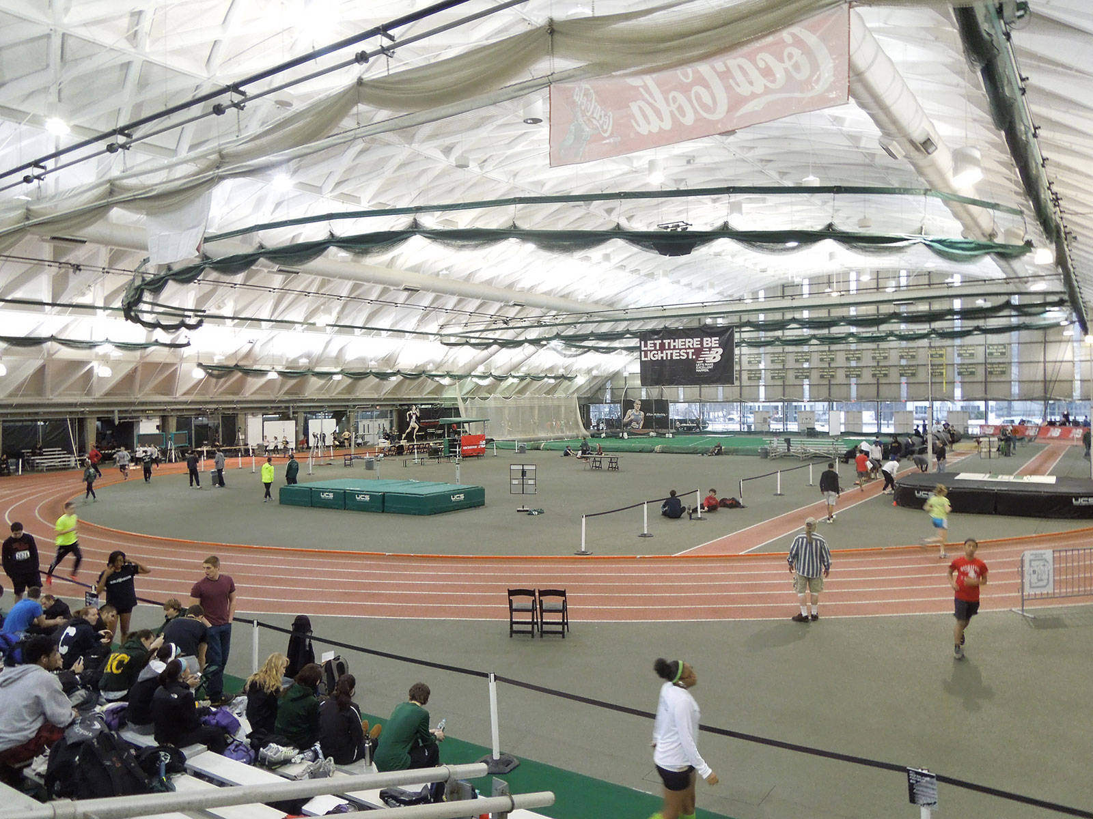
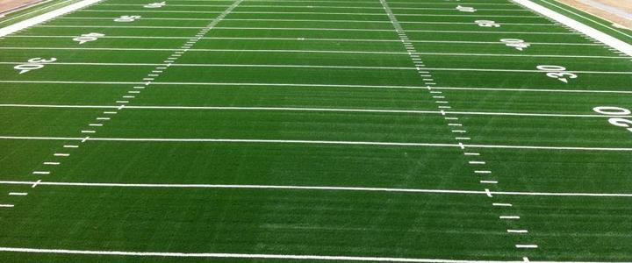
Future Improvements
Field house
Replacing grass football field with turf
Community stadium seating
Notes:
This project originally had multiple parts to it. We decided to focus mainly on the track project. The other parts were to build a field house that would have an indoor track, some classrooms, and more space to hold events. There was also putting in turf on the football field. This would help with less injuries and maintenance costs of the field. Along with those there was talk about improving the community stadium seating.

Slide 22
Thank You

Slide 23
Who to pitch to? State/Private
Les Schawb
Alumni
Boise Cascade
Nike
Adidas
Under Armour
Vendors
Benyon
Fieldturf
Mondo
Notes:
The vendors are companies that have been participating in the project to date in offering bids to do the prep work and construction of the new track and field facility.

Slide 24
PITCH DOCUMENT
Vision: Our vision is to develop a track and field facility that is regionally, nationally, and internationally recognized as the best of its kind to benefit EOU and the surrounding area by embodying a strong community spirit and supporting an active lifestyle.
Need: EOU’s current track was installed in 1980 and resurfaced in 1997. The track in its current state does not meet the minimum standards to hold collegiate level meets, rendering it almost unuseable. While EOU athletes continue to use it for practice, it places team members at an increased risk for shin splints and other injuries.
EOU Impact: A new facility will decrease travel costs for the Track & Field team as EOU will be able to host multi-level events reducing travel time and providing many benefits to EOU. The new track will be a key point in recruiting student athletes and showcasing the University’s commitment to continuous improvement.
Economic Impact: Huge economic benefits were seen when a similar project was implemented in Hermiston, OR. Based on those numbers, EOU and the surrounding communities could expect to see over $5,800,000 in new visitor spending per year. Hosting the NAIA Cascade Conference at EOU would bring in $50,000 in hotel fees alone, plus added revenue for food, shopping and other activities.
Community Benefits: A new track would provide La Grande and the surrounding areas with a place to hold community events as well as promote community partnerships with EOU. The Relay for Life, Drug free Relay, and Walk-A-Thon are just a few examples of events that could be hosted on the track. Promoting a healthy lifestyle while facilitating community events will benefit both EOU and the surrounding areas.
Budget: The current budget for this project is $1.5 million. Half of the funds will be generated through XI-F bonds, and EOU will need to secure matching funds of $750,000 through private gifts and grants.
Notes:
I have copied and pasted the content of our pitch document onto this slide so that the final deliverables can be turned in on one document. This information is meant to be on a 1 page handout that could be easily distributed to potential investors to summarize the track and field project.

