Slide 1

Klamath County School District
Child Care Center

Slide 2
Situational ANALYSIS
KCSD Child Care Center opened its doors in 2006. It was primarily for the teen parents attending high school. It also provided care for the teachers and staff of the Klamath County School District. As the teen parenting numbers started to drop in the Klamath County Schools, it was opened to the public in 2013.
In that time the KCSD Child Care Center decided to make it different than the other child care centers in Klamath Falls, by incorporating student aides to help attain a 1:1 ratio. One child per student or adult.
With this 1:1 ration versus the 4:1 ratio (4 adults to 1 child) it became apparent that parents would rather have their child with someone all day who is devoted their learning needs.

Slide 3
Mission Statement
Our goal is to be supportive of the physical, emotional, social and mental development of each child. We believe that every child deserves to be treated with unconditional love and respect regardless of physical ability. We consider each child to be a unique and worthy individual, deserving of individualized development zone proximity planning and instruction. It is through this kind of assessment that our staff is able to formulate the best curricular activities for your child’s individual learning. With this in mind we highly encourage each family to become actively involved with your child’s early learning and participate in their educational planning with us. This belief is also extended to our parents and staff members.
We are dedicated to the success of the child care center. Our goal is to provide you, as parents, with a high quality center where your child can grow and develop during the hours that they are separated from you. With this in mind, the Klamath County School District has opted to utilize the Creative Curriculum series and tailor activities geared toward each individual child. We are also utilizing the Teaching Strategies Gold program to ensure your child is met with the appropriate level of instruction for their particular point of development.
As a staff we are committed to providing you the best possible child care experience you can have as a parent. In order to do this, KCSD encourages our staff to participate in staff development on a regular basis. You will notice that we have several late starts in order to provide additional staff training as well as two additional closure dates in order to accommodate the need for training.
The KCSD Child Care Center is committed to working with our families in order to promote not only child care services, but connections to community agencies with the intent of ensuring your child is receiving supported services from our program to enhance any other services you may be seeking outside of child care. We will work with community agencies in order to assist you in reducing the number of appointments you must be absent for by offering an area for you to meet with these agencies such as Early Intervention, Cocoon, WIC, Healthy Families, and Early Head Start.

Slide 4
Competitive Analysis
The following is an overview of Klamath County Child Care's competitors.
Direct Competitors The following companies are our direct competitors.
• Direct Competitor #1: Tiny Hopefuls
o Competitor's Overview: Tiny Hopefuls Day Care-Serves children from 2 years old to 5 year olds Pre-School Curriculm Been in business since 1980 Hours of operation Monday – Friday 7:00 am- 6:00 pm Price: $5.00 p/h
• Direct Competitor #2: Our Place To Grow
o Competitor's Overview: Serves children from 6 weeks to 12 years Uses Creative Kaleidoscope Curriculum
Been in business since 2001 Hours of operation Monday-Friday 6:30am- 6:00 pm Prices Vary depending on age and hours. Averages to about $800 for Pre-School and kindergarten and $1400 a month for those in care full time

Slide 5
Competitive Analysis
• Direct Competitor #3: Miss Muffett's Learning Center o Competitor's Overview: Center-Serves children from 6 weeks to 7 years Provides Pre-School and Kindergarten Classes In Business since 1980 Hours of operation 6:30 am to 6:00 pm Price: Varies depending on age and care. Average for preschool and Kindergarten $700 per month and $1000 for daycare services for infants and toddlers
Competitive Advantages:
Klamath County Child Care is positioned to outperform competitors for the following reasons:
Can offer 1 on 1 interaction with children.
Provide the same curriculum of Creative Learning.
Have achieved a commitment to quality certificate from QRIS, and are striving to attain a 4 star rating as a quality program.
Of our five child care center teachers/ director only one falls below a step 10 on the Oregon Registry.

Slide 6
Meet the Staff
•Joanie Rote M.S. ~ Program Coordinator
•Deanna Edwards ~ Substitute Director
•Wendy Crowell B.S. ~ Teacher
•Charity Treasure B.S. ~ Teacher
•Ruby McGinnis ~ Teacher

Slide 7
KCSD Child Care Center
•We have achieved a commitment to quality certificate from QRIS, and are striving to attain a 4 star rating as a quality program.
•Of our five child care center teachers/ director only one falls below a step 10 on the Oregon Registry.

Slide 8
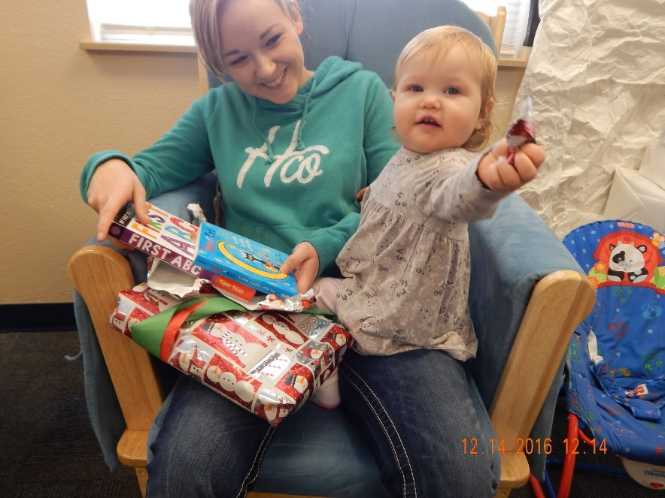
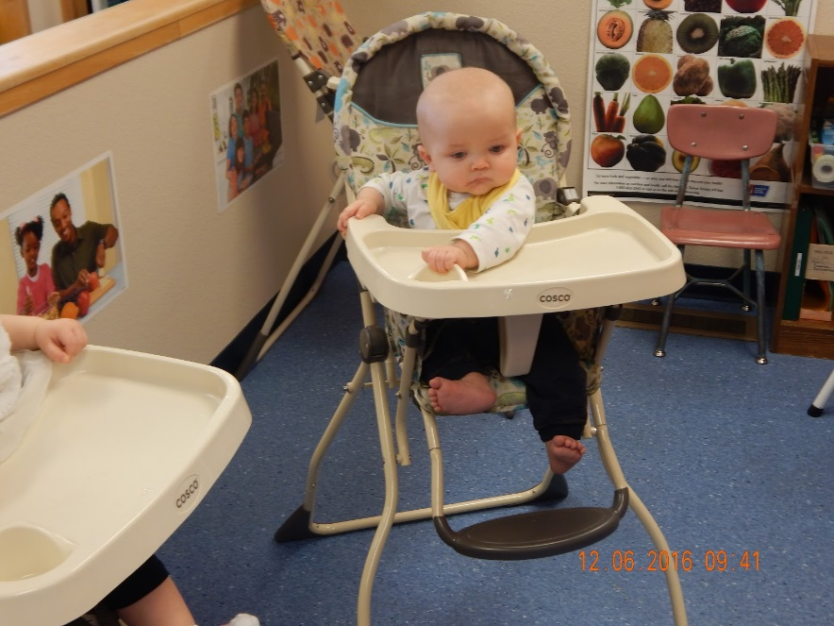
KCSD Child Care Center
We serve children from 6 weeks old through three years old and have a capacity for 20 children.
Teen Parents at all KCSD Schools
Students taking the child care class
Staff and community members

Slide 9
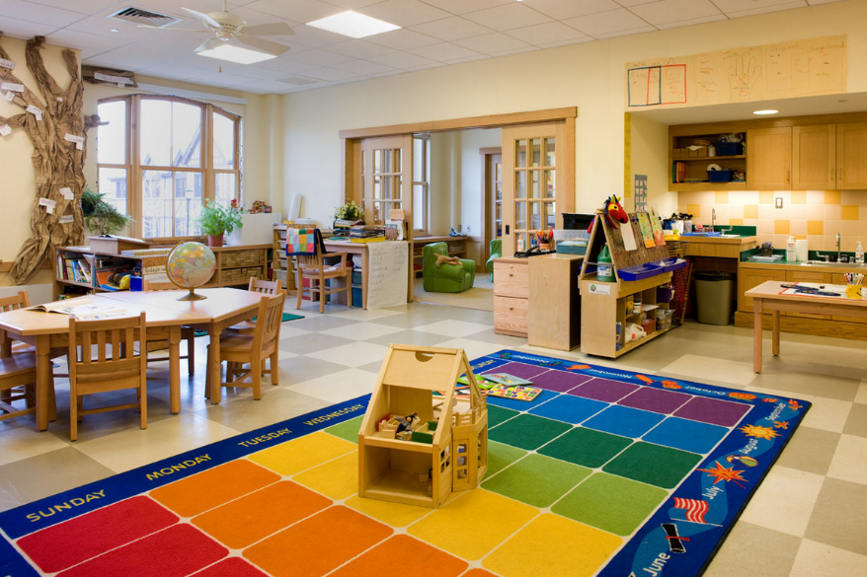
•The KCSD Child Care Center is located at the Mazama High School campus.
•It is available for any teen parent child who attends in our district.
•We are also open to KCSD staff and community members.
KCSD Child Care Center

Slide 10


Fee Schedule
Fees for child care will be assessed using an hourly or monthly rate. If your child is enrolled in the center full time you will be charged the monthly rate. If your child is enrolled in the center part time you will be charged the hourly rate. Each parent is expected to talk with the director to determine the appropriate fees.
Our fees are:
Full time (136-184 hours) – $575.00 per month
Part time (1-135 hours) – $4.50 per hour
Hours of Operation
7:00 am – 6:00 pm

Slide 11
Market Overview
Relevant Market Size
Our relevant market size is the annual revenue that our company could attain if we owned 100% market share.
We are looking to serve up to 20 families
They could expect to spend approximately $7000
Giving our annual income of approximately $140,000
Target Customers
Age: 15-50
Income: 0-$60,000
Location: Klamath Falls, Or
Occupation: Students/Professionals
Language: English
Education: High School/College
Promotion Plan
Online Marketing: Get more organic visits from search engines
Keywords: Child Care, Schools, Klamath County

