Slide 1

Export International, Inc. E-Marketing Plan. By: Michael Aker

Slide 2
Export International, Inc. Analysis
First Incorporated in July of 2008.
On average 3-4 employees.
Produce Exports, and domestic product sales.
12 Million in sales yearly.
Most sales preformed through email or phone.
New business only accounts for 4% of yearly sales.
Well know and respected labels.

Slide 3
Competition
Nakamura & Associates, LLC.
Opened 09/01/2005
Annual Sales 10 Million
4 Employees
S.L. Follen Company
Opened 07/01/1986
Annual Sales estimated 8 Million
Estimated 4 employees

Slide 4
Produce sales.
What does Export Sell?
Onions
Potatoes
Apples
Organic
What makes export different?
Exclusive labels
Exclusive Grower/Packers
Constant direct contact with produce.
Yearly visits with customers.
Claim resolution.
Most of all people

Slide 5
Market Customers
Target Market is importers in..
Taiwan
Japan
Mexico
Panama
Hawaii
China

Slide 6
New Business
Online Communication
Export International’s current web site
Cost: $1200/Year
Leads: 50-100/ Year
New Customers retained, return customers.
Facebook
Cost: $250/year
Leads: 50-75/Year
Customer retention, 1-5 return customers.
Produce Blue Book
Cost: $825-$2,975/ Year
Leads 100-200/ Year
Customer retention, 5-10 return customers.

Slide 7
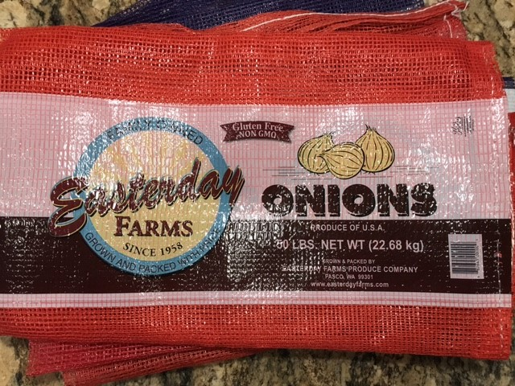
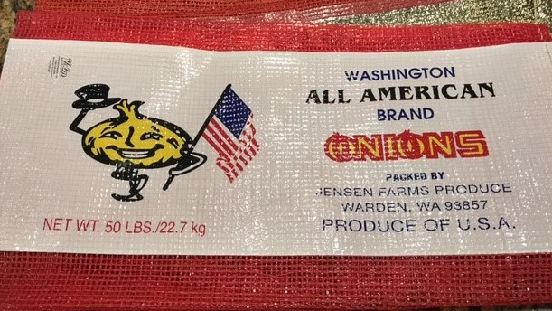
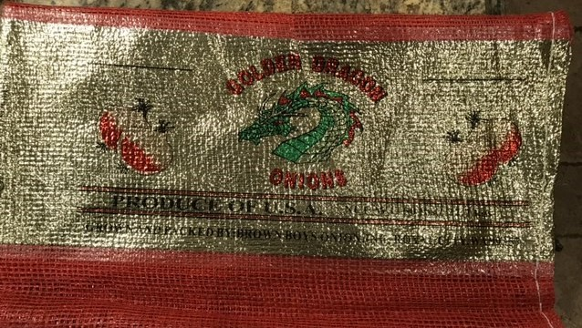
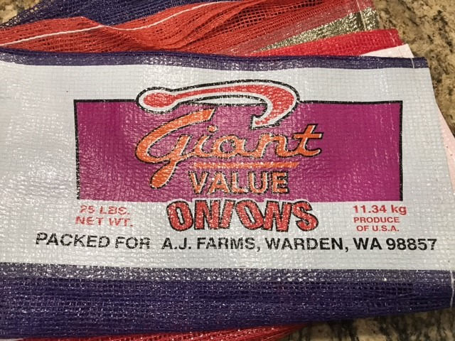
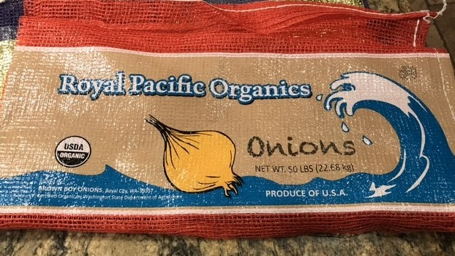
Labels
Good product, packed right, Export Internationals Label

Slide 8
Thank You!

Slide 9
Citations
State Of Oregon, Corporation Division . (2017, August 15). Retrieved August 15, 2017, from http://egov.sos.state.or.us/br/pkg_web_name_srch_inq.show_detl?p_be_rsn=1334484&p_srce=BR_INQ&p_print=FALSE
Net, K. (n.d.). Retrieved August 15, 2017, from http://nakamura-asso.com/about.html
State Of Washington, Corporation Division Retrieved August 15, 2017, from http://dor.wa.gov/content/doingbusiness/registermybusiness/brd/default.aspx

