Slide 1
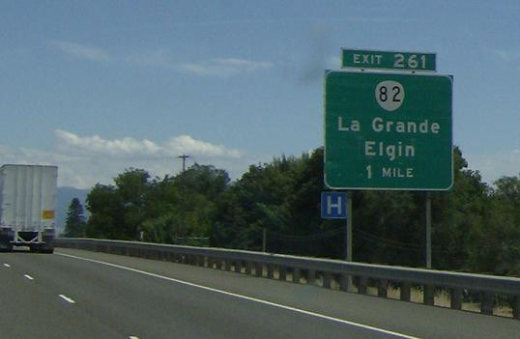
Consumer Catch and Release Zone Project
Notes:
At the beginning of this ten week course our group: Karlyn Graves, Julie Gartner, and Michael Weaver, were presented with a task regarding how to bring even more commerce to La Grande, OR. Our main focal point is the consumer “catch and release zone” which is the intersection located on Island Ave, better known as the Wallowa Exit. This exit sees thousands of vehicles coming and going each day. Our task was to find ways to bring these vehicles from this zone into La Grande, this is where the “catch and release” name comes into play. Each time a vehicle enters the town the chances of generating town revenue increase. Whether vehicles stop at gas stations, restaurants, or other local businesses the money spent increases cash flows for the whole town. This is why it is important for the City of La Grande to look for ways to “catch” consumers and draw them into town, instead of letting them exit to visit other communities.

Slide 2
Beginning Research
Bringing Commerce to La Grande, OR
Conducted a short survey with room for opinions
Established over one week
Variation of participants
Notes:
To kick start our research the group decided to conduct a survey to see what community members and non-community members thought would be beneficial to incorporate into the community. This survey gave us a starting point and a few ideas on what to look into. The survey asked questions about what could be done to enhance the community as a whole as well as ways to bring in people from outside of the local community. Questions were asked about events such as rodeos and concerts as well as feelings toward an outlet mall.
Survey was formatted into short, easy to understand questions. Survey contained 9 questions, in which the most significant results will be presented. All questions had three answers to choose from: very likely, somewhat likely, and not likely. Because the survey was conducted anonymously there is no reportable data on age, sex, location, education, or income level. In order to gain participants we used social media outlets such as Facebook, as well as word of mouth to advertise the survey. An example of the language used to entice more people to participate is as follows, “My group and I are working with the Union County Commissioners looking for ways to bring more travelers to La Grande. By answering questions in this short survey you will be helping us to gain more insight into what community and non community members are looking for in the La Grande community. It is completely anonymous and takes less than two minutes with only 9 questions. Whether or not your are from the community we would love to hear your opinion! We are looking to reach as many as we can so feel free to share. Thank you everyone for helping us to improve our little town of La Grande!” Using this language we were able to gain thirty-four participants in total.

Slide 3
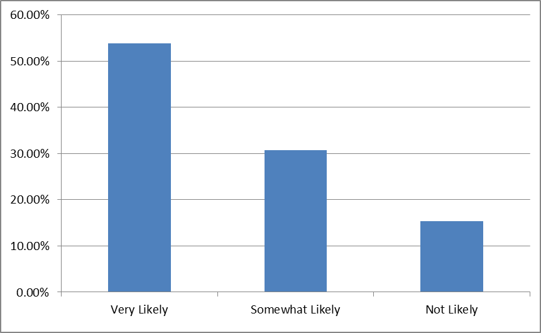
Survey Results
Question: How likely would you be to visit La Grande, OR if the city implemented an outlet/shopping mall?
Results:
Notes:
The first portion of the survey for reporting is how likely individuals would be to visit an outlet or shopping mall in La Grande. Results showed that the majority of participants would be willing to visit. 58.85% of participants showed very high interest, 30.77% showed moderate interest, and only 15.38% showed little or no interest. Upon reviewing these findings the group decided that it would be most beneficial to research the process of implementing a shopping mall. This research gave insight into what it would take for a community to keep an outlet mall up and going, as well as who would be contributing to revenue. We looked into other Oregon malls to see if there were more differences or similarities between our communities and we researched the level of competition that a mall in La Grande would have.

Slide 4
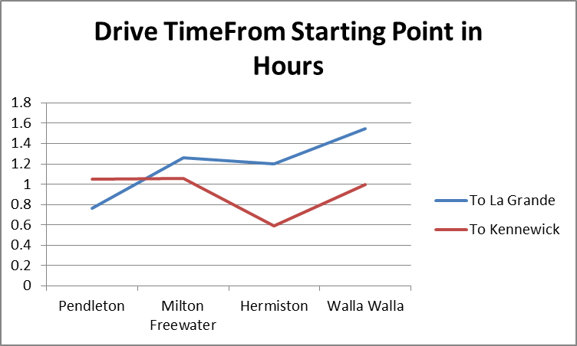
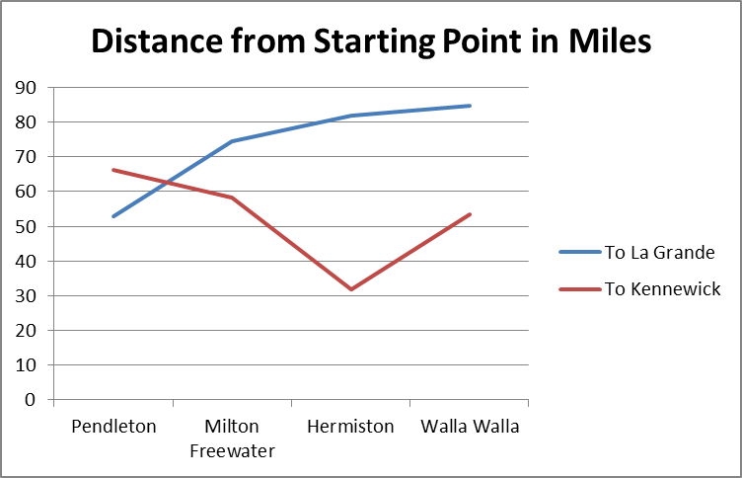
Implementing an Outlet Mall
Left: Amount of time taken in hours to drive from each starting point to the destination
Right: Number of miles in between each starting point to the destination
Notes:
The first question presented when conducting the research was, who will be contributing to this outlet mall and how will a small community like La Grande be able to support it? The answer is simple: adding a shopping center would bring consumers from each of our surrounding communities like Elgin, Union, Wallowa, and Cove. La Grande would never have to worry about supporting the mall on their own. Because the nearest mall is in Kennewick, WA an outlet would also bring people from Pendleton and Milton Freewater. Many other smaller communities fall into this range as well. These communities include: Weston, Athena, Helix, and Mission. A newer and more modern facility could also bring travelers from Walla Walla and Hermiston as well, even though they may have a longer drive time.
The next portion of research was figuring out driving distances and times from each starting point to La Grande as well as Kennewick to make sure that driving to the La Grande outlet would be more logical for the average person in each community. We found that the driving distance and time from Pendleton to La Grande was fifty-two miles and a total of 48 minutes. From Pendleton to Kennewick was sixty-nine miles and one hour and nine minutes of drive time. This means that for the Pendleton community the drive time would support a La Grande outlet over the Kennewick one.
Another community that we looked into is Milton Freewater. The driving distance and time to La Grande is seventy-nine miles and one hour and fifteen minutes. From Milton Freewater to Kennewick is fifty-nine miles at one hour and ten minutes. From only this data it could be assumed that potential customers coming from Milton Freewater could be a toss-up. However there is another hidden variable. In Oregon we do not pay sales tax and Washington residence do. Many stores in the Kennewick mall do not allow for tax exemption for Oregon residence. For this reason the people of Milton Freewater would opt to visit the La Grande outlet. The same could even be true for Walla Walla locals. They may decide to drive further in order to avoid sales tax.

Slide 5
Implementing an Outlet Mall Cont.
Prime location
No competition
  La Grande to Troutdale, OR: 246 miles
  To Woodburn, OR: 291 miles
  To Bend, OR: 294 miles
  To Linclon City, OR: 349 miles
  To Seaside, OR: 340 miles
  To Phoenix, OR: 471 miles
Notes:
The next question presented is who would be La Grande’s competition? The answer: (in Oregon) no one. Looking at locations of other outlets in Oregon we can see that the closest one to La Grande is still 246 miles away in Troutdale, OR. This means that La Grande would have the only shopping center for four hours of drive time in either direction, in Oregon. This is just another reason why the shopping center should not have a problem supporting itself.
La Grande also could not be in a more prim location. Our position on I-84 puts us right between Portland, OR and Boise, ID which are two of the largest communities within hundreds of miles. This location provides access to a huge variety of travelers. From people going on business trips, to family vacations, to fans traveling to watch their favorite sports, La Grande is right in the center of it all. Wallowa Lake also pulls an extra 50,000 travelers per year for holidays like the Fourth of July and Chief Joseph Days as well as families going on summer camping trips.

Slide 6
Implementing an Outlet Mall Cont.
Potential consumers
  50,000 tourists visiting Wallowa Lake each year
  I 84 average daily traffic: reaches a height of 180,000 vehicles per day
  9,200 exit into La Grande
  8,800 exit into the catch and release zone, Wallowa Lake exit
  Thousands more take Union/ Baker exits
Notes:
With such high traffic volume and no competition we should be able to support an outlet. Especially if the outlet pulls in the Union and Baker exiters.

Slide 7
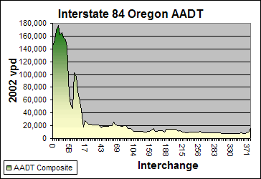
Implementing An Outlet Mall Cont.
Graph shows daily traffic volume from I-84
Graph from 1-84 interstate guide

Slide 8
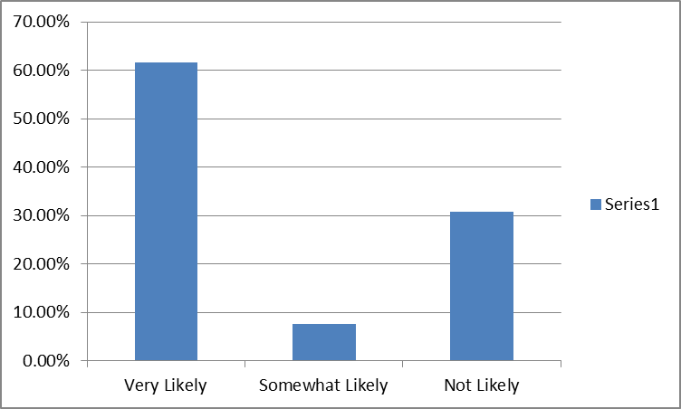
Survey Results Cont.
Question: Would you be likely to attend a concert or rodeo in La Grande?
Results:
Notes:
The next question survey participants were asked was if they would be likely to visit La Grande of a rodeo event. Results showed that 61.54% of participants were very likely, 7.69% were somewhat likely, and 30.77% were not likely. We currently have the fair grounds to host large events, however it goes largely unused. The fair this year was very small compared to others in the area. There were very few children’s rides, almost no activities, and every person that I came into contact with expressed dissatisfaction and disappointment with the entire display. Another idea would be for La Grande to host a horse racing event. Very few rodeos do horse racing anymore, even Walla Walla discontinues the sport years ago. If La Grande hosted horse races it could generate large amounts of revenue for the town.

Slide 9
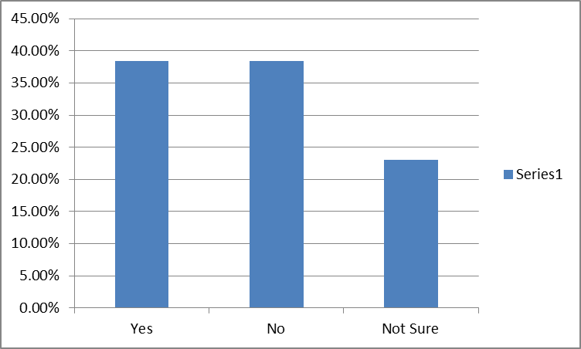
Survey Results Cont.
Question: Would you stay in La Grande’s current hotels?
Results:
Notes:
38.46% yes/no 23.08% not sure
If our hotels are not inviting and customer friendly then travelers will head to the next town for lodging. Which loses revenue for our town.

Slide 10
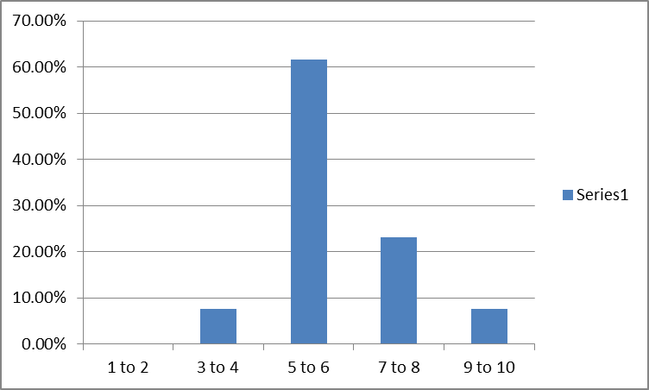
Survey Results Cont.
Question: On a scale of 1-10, 10 being the highest, what is your over all rating of La Grande, OR?
Results:
Notes:
The next question asked was mainly to gather insight. We asked each participant to rank their overall opinion of La Grande on a scale of one to ten, with ten being the highest. We found that nearly every participant rated us in the five to six range. This was especially troubling, but this is where participant opinions come into play.

Slide 11
Survey Results Cont.
Additional comments and suggestions from participants to improve the overall rating:
  “I would like to see more family friendly activities.”
  “More tourist attractions please!”
  “Let new businesses come in. So many are turned away.”
  “I would love to see a large multipurpose community stadium/convention center.”
Notes:
The next question asked was mainly to gather insight. We asked each participant to rank their overall opinion of La Grande on a scale of one to ten, with ten being the highest. We found that nearly every participant rated us in the five to six range. This was especially troubling, but this is where participant opinions come into play. The final question asked participants to provide their own ideas about how to improve their overall rating. There were many great ideas, but listed are some of the most highly repeated and unique.
“I would like to see more family friendly activities.”
“More tourist attractions please!”
“Let new businesses come in. So many are turned away.”
“I would love to see a large multipurpose community stadium/convention center.”
“Outdoor stadium: If it was a turf field it could be used for state playoff football games… Could also be used for rodeos, draw in some monster truck rallies, motocross races, concerts, etc.”
By taking into account the opinions of those living in the community as well as those living outside a Grande will be able to learn new ways to draw in more revenue. Listening to those who care most about the community is the best starting point in looking for ways to improve.

Slide 12
References
Retrieved August 20, 2016, from Interstate 84 Oregon Annual Average Daily Traffic (AADT), http://www.interstate-guide.com/i-084_aadt.html
Google maps. Retrieved August 20, 2016, from Google Maps, https://www.google.com/maps
Interstate 84, US-30 to OR 82 « Washington highways. (2016). Retrieved August 14, 2016, from Washington Highways, http://corcohighways.org/highways/blog/?p=588

