Slide 1
Commercial Catch & Release Zone
La Grande, Oregon

Slide 2
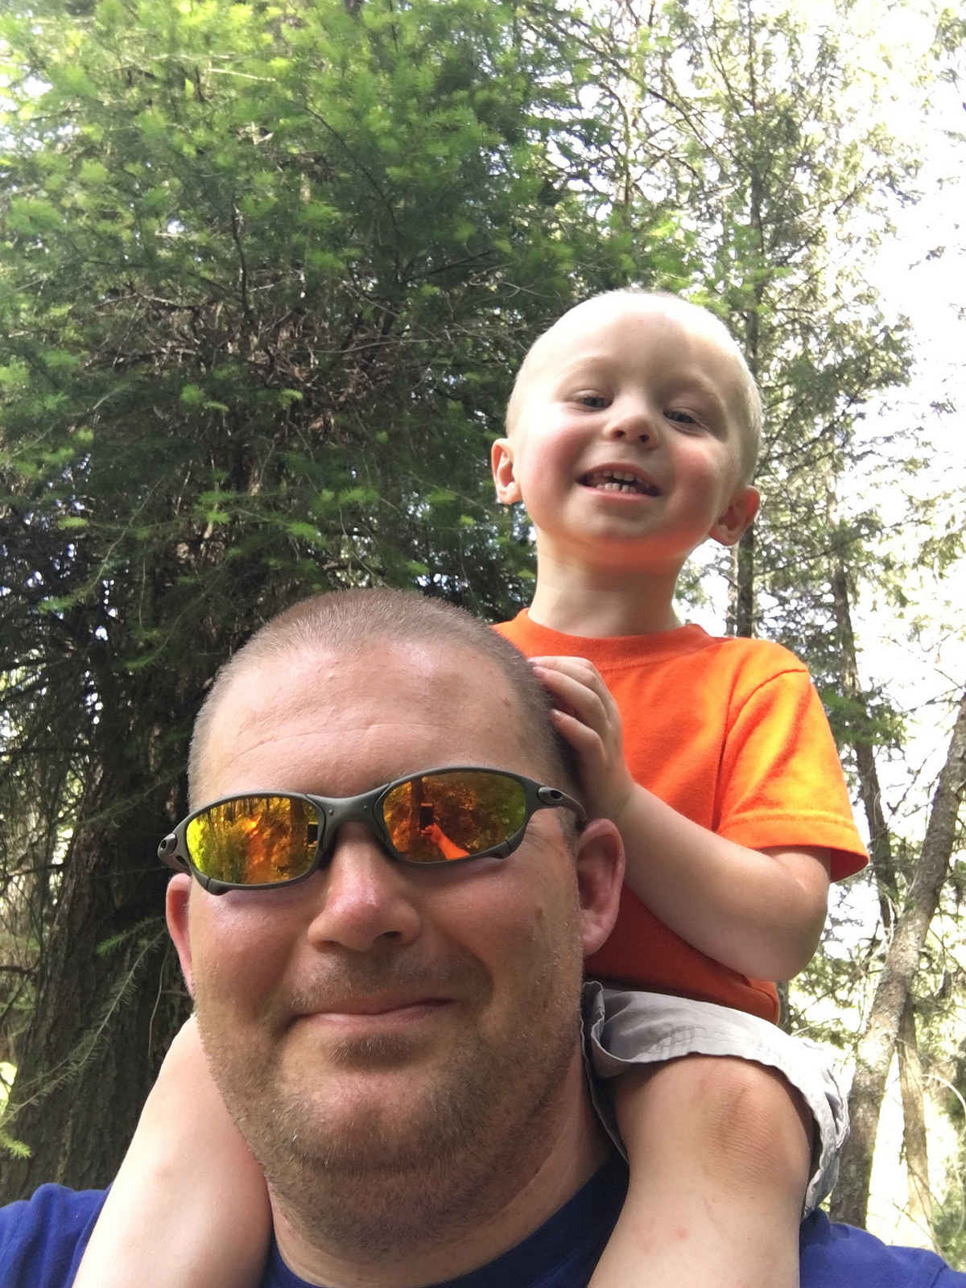


The Team
Travis Adair
Kyle Keith
Rayanne Hoopes

Slide 3
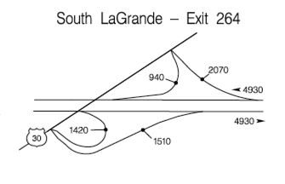
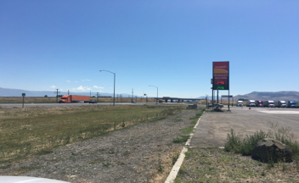
Current Economic Impact
Exit 265 deposits vehicles from Interstate 84 onto US30, close to a Flying J travel center and Eagle Freightliner, a truck repair business.
Annual Average Daily Traffic (AADT): 9900 vehicles
Daily vehicles leaving I84 at this exit: 3490 vehicles
Portion of AADT that is commercial: About 22%
Notes:
The Annual Average Daily Traffic measure is defined as the total volume of traffic on a highway or road for a year divided by 365 days. Oregon Department Of Transportation’s 2014 transportation volume tables list the AADT for Interstate 84 at this exit to be approximately 9900 vehicles. This figure includes average directional traffic volumes for both northbound and southbound traffic. The interchange traffic volume diagram for this exit breaks down the average daily traffic both leaving the interstate at this exit and merging onto the interstate at this exit. The Annual Average Daily Traffic for all traffic exiting the interstate at this exit is approximately 3490 vehicles.
The Economic Development Research Group prepared a report for the Oregon Business Council and the Portland Business Alliance titled “The Cost of Highway Limitations and Traffic Delay to Oregon’s Economy.” In this report, they suggest that in parts of Interstate 84, commercial truck traffic composes up to 22% of all traffic. ODOT’s data in the 2014 Transportation Volume Tables suggests this estimate may be conservative. The nearest automatic traffic recorder station is located at the north La Grande exit, and ODOT’s data indicates that commercial traffic comprises approximately 48% of all traffic exiting the freeway at that exit. Commercial traffic identified in that data as buses and single unit trucks with two or more axles, excluding light trucks, cars, and motorcycles.
Note: The Oregon Department Of Transportation interchange traffic volume diagram for this intersection labels it as exit 264, yet the signage on the interstate and the transportation volume tables describe this as exit 265.

Slide 4
Current Economic Impact
Companies currently attracting commercial trucking traffic into La Grande and Union County include:
Flying J Travel Plaza (A&B Enterprises)
Eagle Freightliner
Boise Cascade
Baretto Manufacturing
Northwood Manufacturing
B&K Auto & Recycling
Les Schwab
FedEx
UPS
Notes:
The La Grande Flying J, owned by A&B Enterprises, and Eagle Freightliner, recently acquired by Valley Freightliner, currently cater to and attract commercial traffic off Interstate 84 into the La Grande area. In addition to these commercial trucking oriented businesses, other businesses that contribute to both incoming and outgoing commercial traffic in La Grande, including Boise Cascade, Baretto Manufacturing, Northwood Industries, B&K Auto Salvage & Recycling, FedEx, UPS, as well as regular freight deliveries for many of the retail businesses in Union County. Boise Cascade and Northwood Manufacturing both occupy spots on the Union County Economic Development Corporation’s list of the largest employers in Union County.

Slide 5
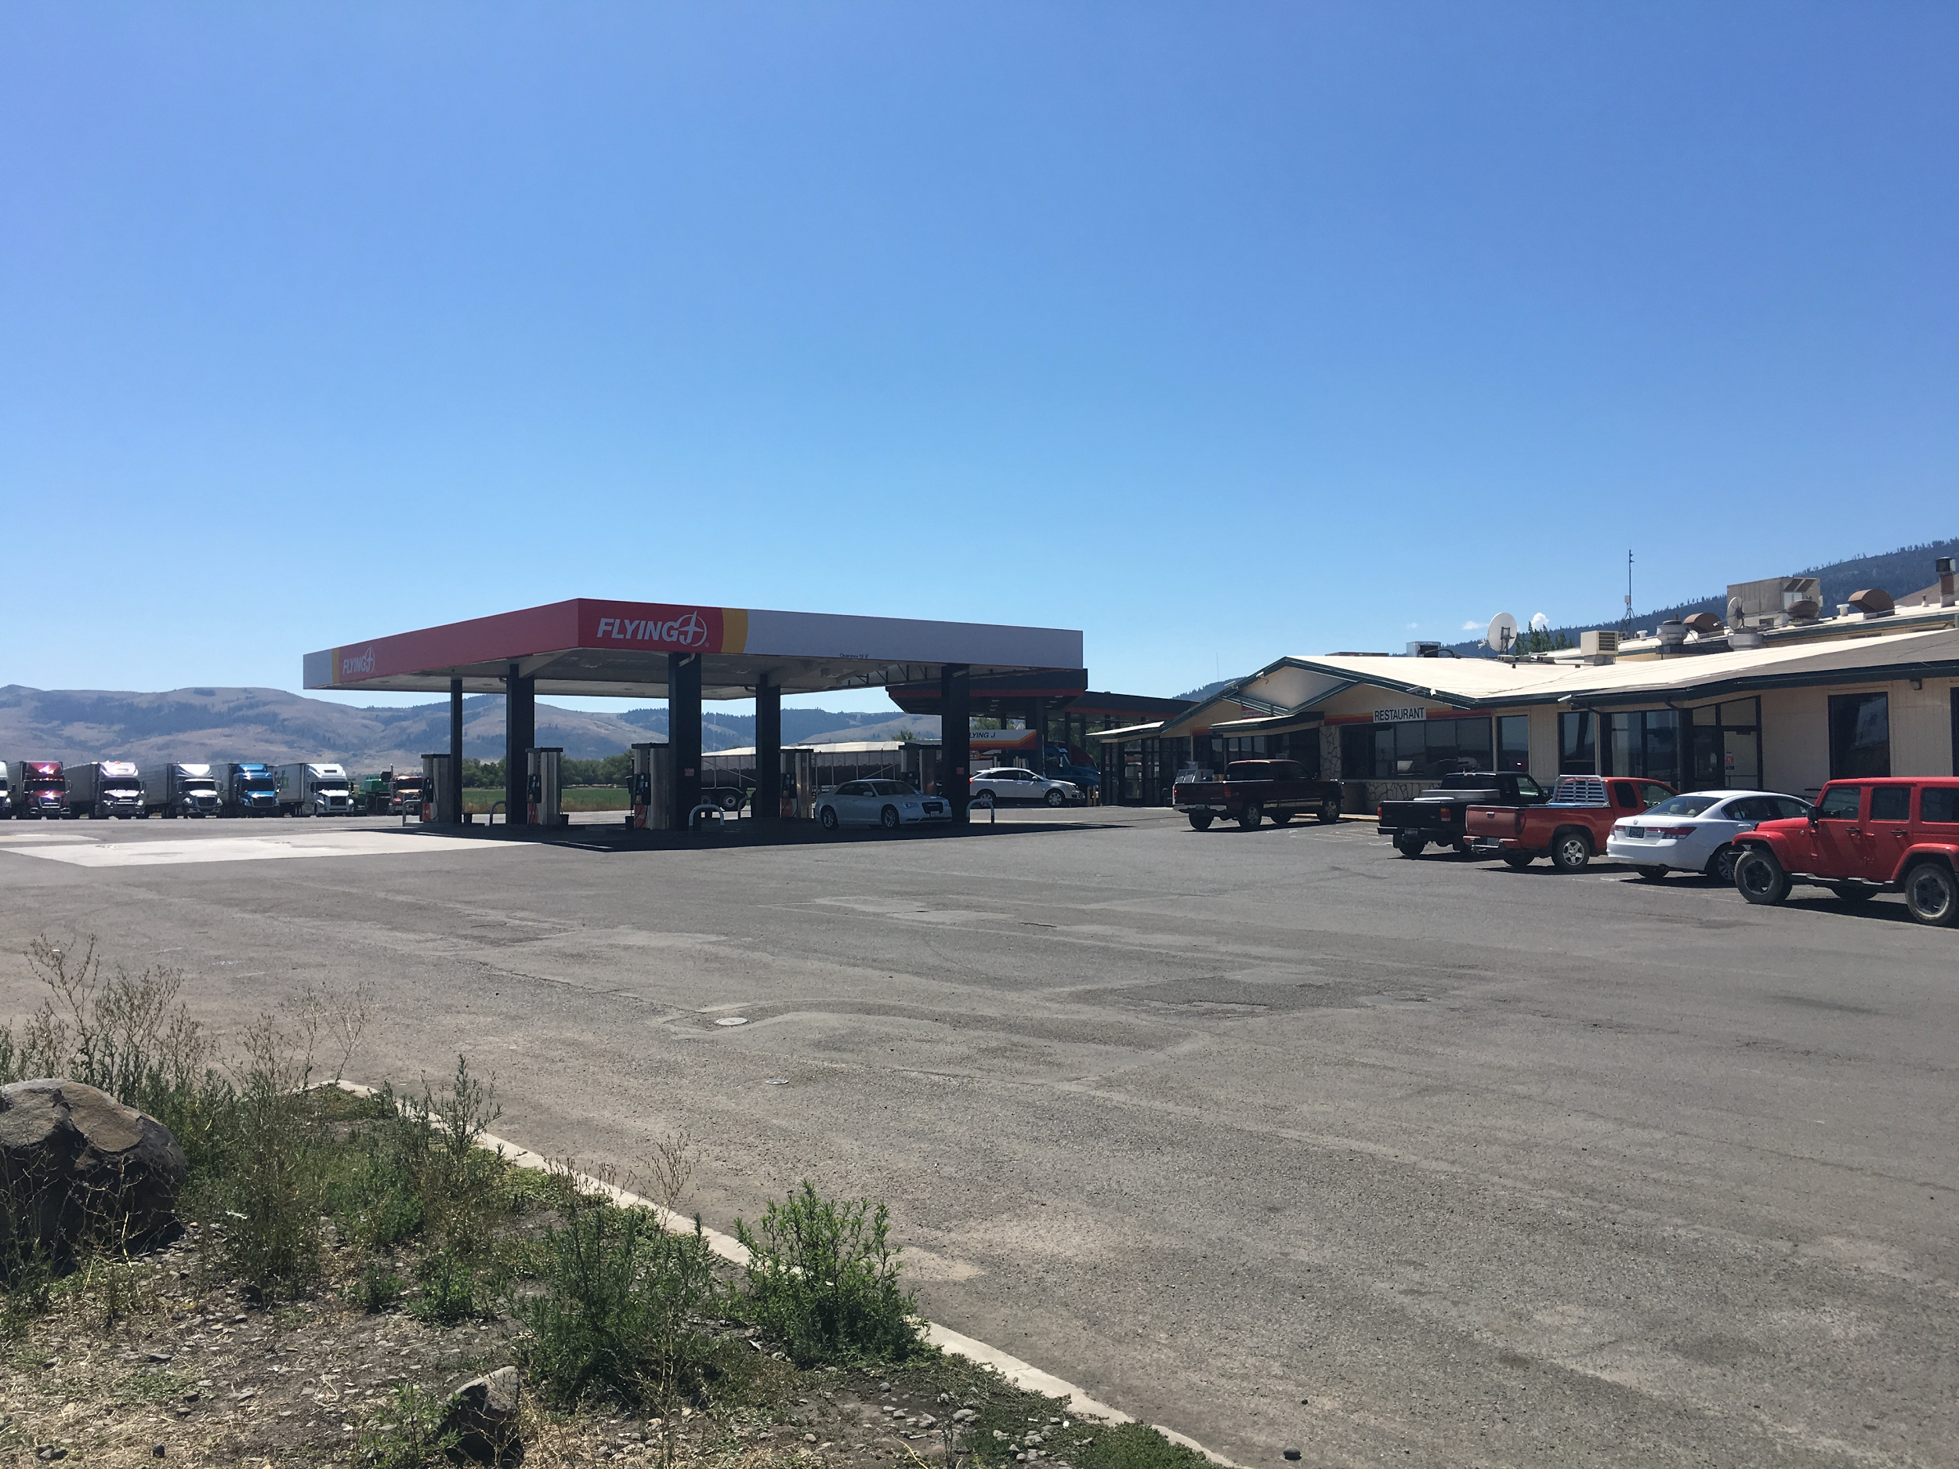
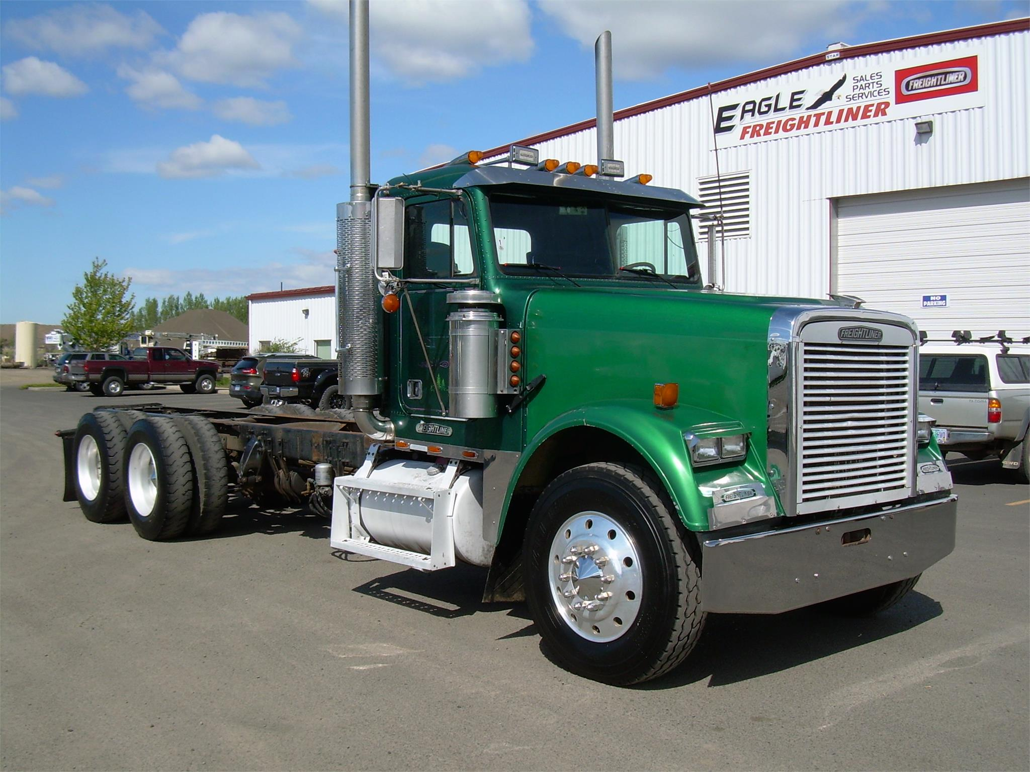
Flying J Travel Plaza & Eagle Freightliner
Flying J Travel Plaza
50 parking spots
4 showers (recently remodeled)
7 diesel fueling lanes + gasoline
Restaurant and convenience store
Eagle Freightliner
Offers commercial truck sales, parts, service and repairs
80% of their repair business are commercial trucks from I84
Notes:
Data from Eagle Freightliner was obtained by the branch manager for the La Grande office, Bob Kautz. Bob indicated that 80% of the repair business that the La Grande Eagle Freightliner office sees are trucks coming in from Interstate 84, as opposed to local trucks getting repair service. Eagle Freightliner was recently purchased by Valley Freightliner, and Mr. Kautz informed me that they will soon be advertising motorhome repairs, which should also attract traffic from the highway and contribute to La Grande’s economy. When speaking with Mr. Kautz on ways to attract local commercial traffic to La Grande, he brought up the issue of the lack of parking and amenities available to long haul trucks coming through the valley. When Ladd Canyon and/or Cabbage hill close down in the winter for weather or for wrecks, his lot fills up quick, as does the lot next to him, since Flying J is limited in their parking spaces. Trucks end up having to park down Hwy 30, at the rest stops, and along I84 when the passes are closed due to insufficient parking. He also added that a second truck stop would only increase the business that Eagle Freightliner would potentially see, as they currently work with the competing truck stops for their Hermiston office. In Hermiston, there is a third large truck stop under construction, and if they are allowed to advertise there as they are in the other two truck stops in the area, he thinks that Eagle Freightliner should be able to see a sizeable increase in their business.

Slide 6
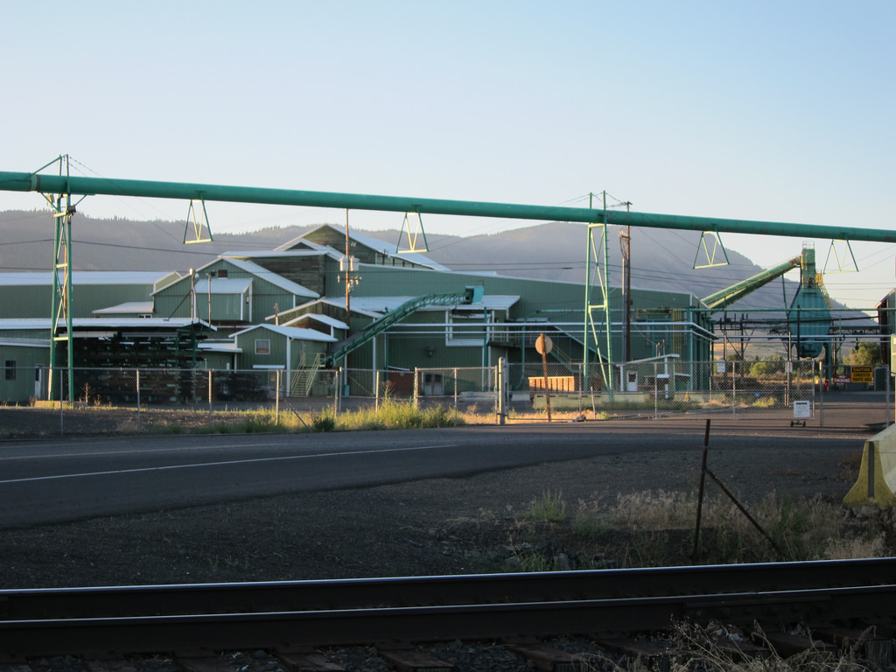
Boise Cascade
Boise Cascade employs 568 people among 4 facilities in Union County, each receiving raw materials by commercial truck and shipping finished products to their customers by truck. Total truck volume for outgoing shipments in 2015: 5,017
Breakdown
La Grande Particleboard: 3348
Mt. Emily Lumber (La Grande): 343
Elgin Studs: 512
Elgin Plywood: 814
Notes:
Data on Boise Cascade shipping was obtained from Brett Kennedy, Transportation Analyst for Boise Cascade Wood Products division. Brett included a breakdown of the volume that his group handled in 2015. The volume represents the amount of trucks they delivered to their customers who purchased product with delivered pricing. There is additional volume where customers arrange their own freight but that is a small fraction compared to the volume below. Brett included the 5 facilities we have in the La Grande area.
La Grande Particleboard - 3348
Mt. Emily Lumber (La Grande) - 343
Elgin Studs - 512
Elgin Plywood - 814
Pilot Rock Lumber 790
Total 2015 volume: 5807
Employment data for Boise cascade was obtained from Tracy Hayes, Senior Human Resource Specialist for Boise Cascade, Northeast Oregon region. The figure of 568 employees was calculated by totaling the number of employees between Boise Cascade’s two La Grande locations, the region office and the Mt. Emily Mill, (82 employees) the Island City particleboard plant (124 employees), and the two Elgin locations, the studmill and the plywood facility (143 and 219 employees, respectively).

Slide 7
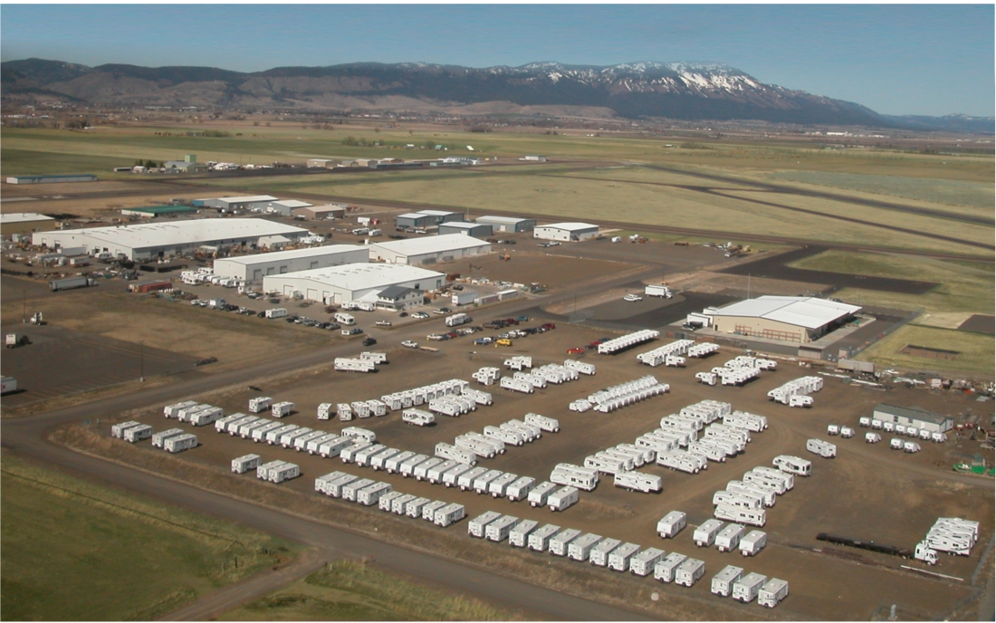
Northwood Manufacturing
Northwood Manufacturing is one of the largest employers in Union County, currently employing approximately 450 people. Northwood was able to secure a competitive advantage in the RV industry by being manufacturing the undercarriage all in house, offering an aluminum superstructure, and curved rooftops for more internal space.
Averages 5 commercial loads of raw material a day
Ships 5,000 units a year
Primarily sold in western United States, Alaska, and Canada
Shipped by commercial carriers using passenger trucks
Shortage of employees is impacting ability to meet demand
Notes:
Data for Northwood Manufacturing, who also now owns Outdoor RV, was obtained from an in-person interview with Jim Jones, President and CEO of Northwood Manufacturing. Northwood currently receives approximately 5 commercial truck loads of raw material a day, ranging from appliances for their units to lumber, as well as many other raw materials. Mr. Jones indicated that the trucks are ready to unload first thing in the morning, and will typically arrive in the night and park the truck outside the Northwood campus rather than use the local truck stop facilities, due to ease of parking and a timely offload. Northwood and Outdoor RV together produce approximately 5,000 units a year, ranging from campers, 5th wheels, toy haulers, and travel trailers. These campers and trailers are shipped out using commercial transport, utilizing passenger pickups rather than a large commercial truck. These drivers typically operate under a CDL, and will tow the trailers and 5th wheels one at a time to their destination. Campers are either towed one at a time, or in doubles, with one on the bed of a pickup and another on a specialized trailer. For shipments of campers that are going long distances to the eastern united states, Northwood utilizes a specialized triple transport trailer, but is only used in a small percentage of the shipments. Products destined for Alaska are towed by pickup to Seattle, where they are transported by barge the rest of the way.
When talking with Mr. Jones about their commercial deliveries and shipments, he brought up his biggest concern, which is Northwood’s inability to keep up with demand for their product. The products they make are already paid for when they are built, but they are experiencing a serious labor shortage between Northwood and Outdoor RV which is keeping them from filling their orders in a timely manner. Jim said that he had 100 positions to fill, and if he could fill them today, they could increase their outputs immediately. This would in turn increase their need for raw materials, which would require more commercial delivers to both facilities. Northwood will train new hires with zero experience in the trades; as a welder, electrician, or a plumber. They have openings for all of those positions, and offer good wages, as well as generous bonuses based on efficiency. For every unit produced over the quota for a particular weekly run, the employees will get up to a 50% bonus for that that week. Mr. Jones suggested that if Northwood were able to find enough people to fill those positions, who could pass the mandatory drug test, they could not only make a contribution to the Union County economy due to the added jobs, but also to the commercial traffic coming into and going out of La Grande in the form of raw input deliveries and outbound deliveries of their finished product.

Slide 8
B&K Auto Salvage & Recycling and Les Schwab
B&K Auto Salvage & Recycling
•Currently ships out on average 600 tons of material a month in recycling and scrap
•Receives on average approximately 900 tons of freight a month over the last year
•Majority of business (65%) is commercial
La Grande Les Schwab
•Services on average 5 commercial trucks a day for tire repairs in the Grand Ronde Valley
Notes:
Data for B&K Auto Salvage & Recycling was obtained from a phone interview with Jake Hanson, owner of B&K auto. Jake indicated that approximately 65% of his total business was commercial, and that he ships out approximately 600 tons a month in freight over the last year, and receives approximately 900 tons a month in freight at his La Grande location.
Data from Les Schwab was obtained from the local store manager, Arnie Peasley, who provided the estimates. He estimated that they service on average 5 commercial trucks a day for tire repairs and replacements, half of which are taken care of onsite and the other half at the La Grande Les Schwab tire center.

Slide 9
Competition: Truck Stops in Other Cities
La Grande is being impacted by competing cities’ truck stops for many reasons:
More/better foods and amenities (Olszewski).
More convenient locations
Better customer service
Better parking
Better gas station
Better entertainment (Omnitracs).
Notes:
Businesses are being impacted by truck stops everywhere. There are several reasons why commercial traffic has “steered clear” of La Grande. There are places with more/better foods and amenities, such as the casino buffet in Pendleton. Poor food options and lousy customer service in La Grande is becoming common knowledge, as more and more review sites mention it. And like better food, and better customer service, there is also nearby competition that also has better parking. Competing cities offer more and are in more convenient locations.
In addition, some truck stops also increasing their competitiveness by offering dentist offices, dog washes, barbershops, truck showrooms/museums, lounges, gambling, adult-entertainment, chapels, arcades, swimming pools, bakeries, wireless internet, golf courses, reptile museums (Olszewski), and laundry facilities (Omnitracs).

Slide 10
Competition: Truck Stops in Other Cities
Here are some cities that compete with La Grande.
Pendleton
Baker City
Troutdale
Hermiston
Ontario
Truckers have expressed a lack of interest or need for stopping in La Grande.
Notes:
Nearby neighboring cities, and other not-so-nearby cities are taking commercial business from La Grande. Just about every city along a trucker’s path could be seen as a competing city for La Grande, however; some truck stops seem more central to the routines and tendencies of truckers. Pendleton probably is the greatest competition because it is a nearby city that seems to have a lot more to offer. Baker City, Hermiston, and Ontario all have truck stops that the cities are proud of. The Baker City Truck Corral brings in trucks from other nearby truck stops, Hermiston has a brand new truck stop, Ontario’s Pilot Travel Center is said to have excellent, amazing showers, and legendary “Pilot Coffee,” compared to the coffee of other truck stops (Brown, R. (2016). Personal communication). Since truckers fill up their gas tanks to travel extremely long distances, even Troutdale is competition for La Grande because truckers could fill up in Troutdale and bypass La Grande with no reason to even stop (Stevens, S. (2016). Personal communication).

Slide 11
Reviews and Opinions of Truckers
When asked about La Grande, truckers were:
Often not wanting their name mentioned
Reluctant to answer
Suspicious
Wondered why being asked
As for how to improve the commercial exit, truckers
Didn’t have any ideas
Seemed happy with other truck stops (Stevens, personal communication, 2016).
Notes:
Truckers were often reluctant to answer questions about La Grande. They seemed suspicious as to why they were being asked about the city. Several commercial drivers made it clear that La Grande’s Flying J truckstop already has everything they could need, however; they usually already have everything they need before even passing by La Grande (Stevens).
When asked how it could be made better, no truckers offered suggestions, or even expressed an interest in wanting it to be better. Many seemed fine with the parking lot how it is. Most truckers wouldn’t mention their own names.

Slide 12
Reviews and Opinions of Truckers (Cont.)
Truckers said that there was little need to stop in La Grande for fuel because of filling up in Portland, or as Steve, an interviewed trucker said, “I fill up in Troutdale, with enough fuel to get to Wyoming” (Stevens, personal communication, 2016).
Gas prices seem comparable, however; there have been several negative reviews of people’s experiences there, from multiple websites:
Google Reviews (2.8/5.0) (Google).
Allstays (2.0/5.0) (Allstays).
Notes:
Truckers said that there was little need to stop in La Grande for fuel because of filling up in Portland, or as Steve, an interviewed trucker said, “I fill up in Troutdale, with enough fuel to get to Wyoming” (Stevens).
Gas prices seem comparable, however; there have been several negative reviews of people’s experiences there, from multiple websites, out of five stars, Google Reviews gave La Grande’s Flying J a 2.8 rating (Google), while Allstays, another truck stop review site, only gave it 2 stars (Allstays).
In addition, reviewer Daniel Reattoir said, “This isn't a full Flying J truck stop is just a dealer for the diesel fuel” (Reattoir, (2016), Personal communication).

Slide 13
Google Reviews Flying J Travel Plaza
There were several negative reviews, some being:
jameswade1977 said, “worst flying J within 300 miles” (Jameswade1977, personal communication, 2016).
Sam Rodriguez said, “The worst customer service ever! Rude ass lady behind counter. I will never bring my truck to a stop here again!” (Rodriguez, personal communication, 2015).
Ren23G said, “Worst food. Salty Alfredo pasta and $18 dollars for the plate. Way too much for a salty (feels like they pour the whole container of salt)” (Ren 23 G, personal communication, 2015).
Notes:
There were a few positive reviews, however; the most recent negative reviews are the ones that demonstrated ways La Grande’s truckstop could improve its reputation. Jameswade1977 said, “worst flying J within 300 miles.” Sam Rodriguez said, “The worst customer service ever! Rude ass lady behind counter. I will never bring my truck to a stop here again!” Ren23G said, “Worst food. Salty Alfredo pasta and $18 dollars for the plate. Way too much for a salty (feels like they pour the whole container of salt).”

Slide 14
Bad experience at the La Grande Flying J
In June 2016 Jerry Eastman said, “Only two diesel pumps. Cashier was extremely rude. Should have got her name. She kept announcing over intercom for me to move my truck, while I was standing in line trying to get my fuel reciept. The driver behind me hadn't even started pumping his fuel yet! There were three people in line in front of me at the cash register. Should I just shove them aside and beg for my reciept first? Never stopping here again. I spent almost $500 here in fuel, they won't get another dime” (Eastman, personal communication, June 2016).
Notes:
In July 2016 Jerry Eastman said, “Only two diesel pumps. Cashier was extremely rude. Should have got her name. She kept announcing over intercom for me to move my truck, while I was standing in line trying to get my fuel receipt. The driver behind me hadn't even started pumping his fuel yet! There were three people in line in front of me at the cash register. Should I just shove them aside and beg for my receipt first? Never stopping here again. I spent almost $500 here in fuel, they won't get another dime.”

Slide 15
Allstays Reviews Flying J Travel Plaza
Allstays truck stop review site, also had negative reviews:
Splash from CO said, “2 urinals, non-brand drinks and cups, Didn't provide reward points, dirty, Won't allow RVs on the truck pumps” (Splash, personal communication, 2016).
Mswarped from Arkansas said, “Does not serve pilot coffee. Coffee is horrible” (Mswarped, personal communication, 2016).
Notes:
Another truck stop site, called Allstays, also had negative reviews for the La Grande Flying J Travel Plaza (Allstays).
Splash from CO said, “2 urinals, non-brand drinks and cups, Didn't provide reward points, dirty, Won't allow RVs on the truck pumps” (Splash).
Mswarped from Arkansas said, “Does not serve pilot coffee. Coffee is horrible” (Mswarped).

Slide 16
Competing Truck Stops
Flying J Travel Plaza | La Grande | -- | 2.8 stars (Google).
Jackson’s Baker Truck Corral | Baker City | 44 miles | 3.8 (Google).
Arrowhead Travel Plaza | Pendleton | 52 | 4.4 (Google).
Pilot Travel Center | Ontario | 115 | 3.3 (Google).
Space Age Travel Center | Hermiston | 81 | 4.3 (Google).
Crossroads Truck Stop | Umatilla | 94 | 3.3 (Google).
Notes:
The following is a list of the closest I-84 truck stops, and their distances from La Grande, and their Google ratings (if provided) to compare with the La Grande Flying J Travel Center’s 2.8 out of 5 stars. Jackson’s/Baker City Truck Corral, 44 miles away, earned 3.7 stars. Arrowhead Travel Plaza, in Pendleton (52 miles away) earned a score of 4.4! Pilot Travel Center, in Ontario earned a 3.3. The new Space Age Travel Center, in Hermiston scored 4.2 stars, and the Crossroads Truck Stop in Umatilla scored a 3.3. Every nearby city major city seems to have a truck stop that outperforms the Flying J Travel Plaza in La Grande.

Slide 17
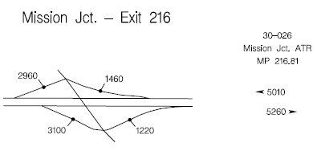
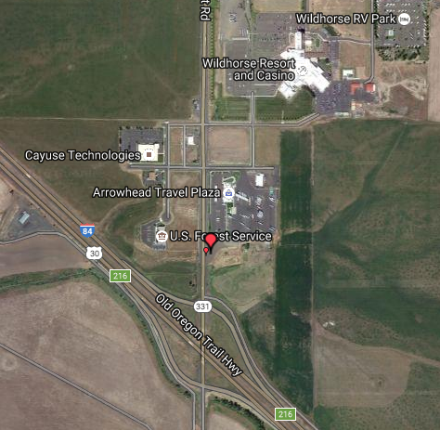
Pendleton, OR
52 miles Northwest
of La Grande
Arrowhead Travel Plaza
(arrowheadtravelplaza.com)
Truck-friendly Casino
Golf Course
Movie Theatre
Fast-food Restaurants (Google).
“It's like the holy grail of truck stops”
(Clifford, personal communication, August 2016).
(State of Oregon).
Notes:
Pendleton is located 52 miles Northwest of La Grande. For those heading West, it is only an extra hour passed La Grande, and the truck stop seems to have several features lacking at La Grande’s Flying J. Now only does Pendleton have fast-food restaurants, Pendleton has a Arrowhead Travel Plaza next to a trucker-friendly casino. There is also even a movie theatre and golf course! Several dining options are available nearby (Google).
According to ODOT, most of the traffic that stops in Pendleton never makes it to La Grande -- they seem to turn around and drive back toward Portland (State of Oregon).
Clifford F, said “It's like the holy grail of truck stops.” (Clifford, personal communication, August 2016).

Slide 18
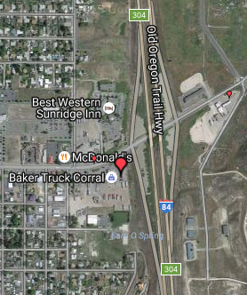
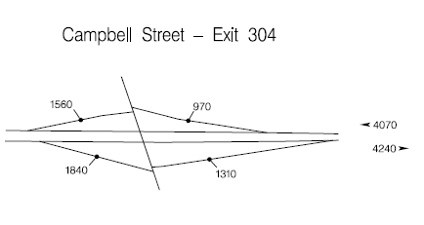
Baker City, OR
44 miles South of La Grande
Baker Truck Corral (bakertruckcorral.com)
Truck Wash
200 parking spaces
24 hour repair shop
Lounge (FindFuelStop).
Barber (Google).
“Great stop for commercial
drivers” (Beeson, personal
communication, 2016).
(State of Oregon).
Notes:
Baker City is located 44 miles South of La Grande, also about an hour away. This exit also has a truck stop that seems superior to La Grande’s Flying J. Now only does Baker City feature it’s truck wash, and barber shop, they also have a 24-hour repair shop. There also seems to be better parking.
According to ODOT, this exit in Baker City has comparable traffic to the commercial exit in La Grande (State of Oregon).
Veronica Beeson said, “Great food for your dollar and the staff treats you as family. They are also upgrading the showers, with wall jets. This location offers a Jacuzzi room. Great stop for commercial drivers.”

Slide 19
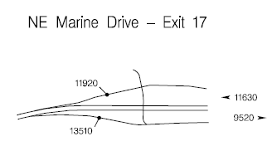
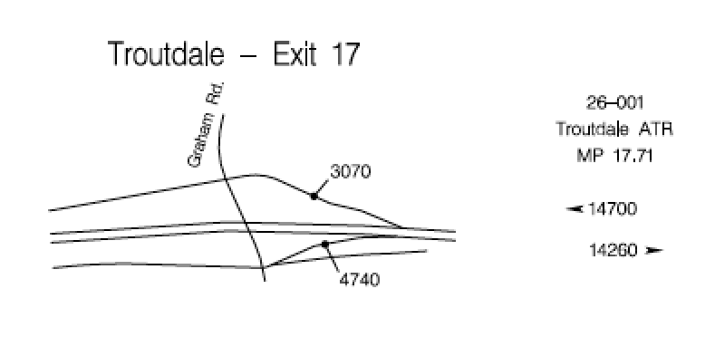
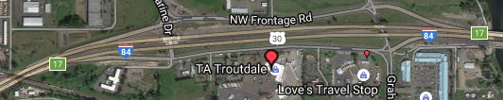
Troutdale, OR
245 miles West of
La Grande
Two truck stops
400 parking spots
Countless stores nearby
Full Amenities (Google).
Cheap Gas (TA).
Convenient Location
(State of Oregon).
Notes:
Troutdale, Oregon’s slogan is “Gateway to the Gorge.” That is literally true, because truckers often try to take care of refueling and other things as they are leaving town (TA), probably so they don’t have to stop in every town along the way, across the United States. Truckers passing through Troutdale, such as Steve mentioned earlier, directly talked about how they didn’t need to stop in La Grande (Stevens), because Troutdale has everything they need (Google), therefore; La Grande is being outcompeted by more functional and bigger freeway exists over 200 miles away! Why go to La Grande when you can plan around La Grande and go to Troutdale, or Portland?
Even with this much traffic (State of Oregon), Troutdale still only has two truck stops, therefore; adding another La Grande truckstop really doesn’t seem as practical as making the current one more competitive with the other nearby stops, perhaps by improving food quality and expanding to offer more features.

Slide 20
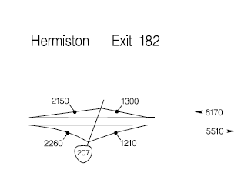
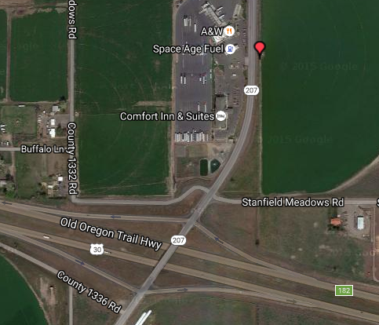
Hermiston, OR
81 miles Northwest of
La Grande
Cheap fuel (FindFuelStops).
New Space Age
truck stop
1 shower (Google).
(State of Oregon).
Notes:
Hermiston is somewhat nearby and could potentially take commercial traffic from La Grande. Hermiston is 81 miles Northwest of La Grande. There is a new truckstop there, and even though it supposedly only has one shower, the fuel is a good price, and customers seem very satisfied with the quality of the stop, and have left positive online reviews.

Slide 21
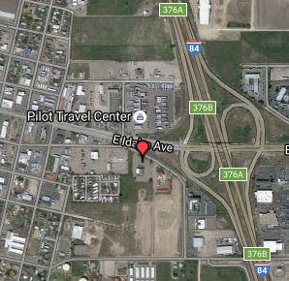
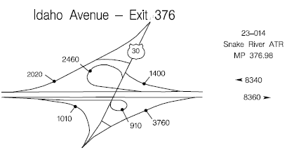
Ontario, OR
115 miles south of La Grande
Pilot Travel Center (FindFuelStops).
100 parking spots
7 nice showers (Google).
(State of Oregon).
Notes:
Ontario, almost two hours away from La Grande, has the Pilot Travel Center, which is famous for great coffee and having awesome showers (Google). The freeway is busier here, having almost twice the catch-and-release traffic of La Grande (State of Oregon).

Slide 22
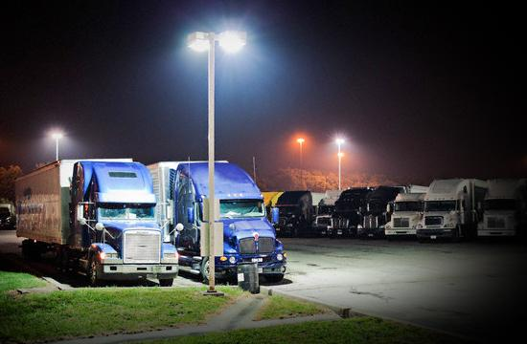
Better Facilities for Truckers
•78% of truckers say that for overnight stops they prefer truck stops with the following amenities (Transportation, 2004):
–Food
–Fuel
–Restrooms
–Phones
–Showers
–Well lit parking lots with large spaces
–Convenience to the highway
Notes:
Truck drivers prefer to stop at rest stops for overnight stays where the following amenities are available: food, fuel, restrooms, phones, showers, convenience to the highway and well- lighted parking lots with big, maneuverable spaces(Transportation, 2004 p.6) . In order for La Grande to bring in more commercial traffic the 265 exit should provide more of these amenities to bring in truckers. According to Transportation (2004 p 10) the most popular improvements for truck stops in relation to their parking lots included:
• Build more truck stop parking spaces (79%)
• Build more rest area parking spaces (66%)
• Stop enforcement officers from waking drivers (57%)
• Eliminate time limits (49%)
• Improve parking layout/configuration (e.g. more pull through) (46%)
• Separate truck, car and RV parking (42%).

Slide 23
Better Parking
•More and better access to parking can increase the number of trucks that stop in La Grande
•Towns like Weed, California have increased truck traffic in the town by leasing lots and providing truck parking free (Kahaner, 2016).
Notes:
Studies show that the demand for trucking services has increased greatly over the last 20 years and is still continuing to grow (Associates, 2008 p. 10). Commercial truck drivers are feeling this extra demand and parking for truckers is a constant problem that cities can address to increase the amount of trucks that stop in their cities. The northwest is known for its lack of commercial parking that accommodates trucks (Associates, 2008 p.10). Oregon is ranked in the lowest third for states with the most parking for truckers (Federal Highway Administration, 2015). La Grande can help fill this void by creating parking lots off of the commercial exit for trucks to park in and stay overnight. Weed, California has created free truck parking in its town and is advertising being a trucker friendly town to boost its economy (Kahaner, 2016). Associates (2008) lays out the federal program that states can use to construct new parking for truckers:
Under the last federal highway reauthorization act: Safe, Accountable, Flexible, Efficient
Transportation Equity Act: A Legacy for Users (SAFETEA-LU), funding was made available for
states to construct new parking facilities, modify existing ones, develop ITS systems to improve
the efficiency of systems (section 1305), designate and sign for facilities (Interstate Oasis) that
provide specific services and free parking for automobiles and trucks (section 1310), and permit
electrification or other idling reduction facilities and equipment for use by commercial motor
vehicles in rights-of-way on the Interstate System, and allow charging of fees for use (section
1412) (p. 4).
Associates (2008) also explains that 98% of the trucking companies that they surveyed have no policies for parking and leave the responibilities for finding parking up the their drivers.(p.8)

Slide 24
Real Time Information for Truckers
•Truckers knowing about a truck stop and stopping there are two different things
•Having electronic signs to signal drivers about available parking makes it easy for drivers to decide to stop
•Broadcasting on the traveler information radio about La Grande’s truck stops will also bring attention and help pull in more truckers
Notes:
Having this information posted along highways before truck stops invites truckers in since they will know that there is parking available for their rigs. Broadcasting on radio stations that truckers use to get information from will put La Grande out there as an option and keep it in the minds of drivers as they are traveling. The Intelligent transportation System (ITS) and Federal Motor Carrier Safety Administration's “SmartPark” program have both started using technology to show drivers where parking is available and therefore know where a good stopping point is (Associates, 2008 p.4). La Grande could look into becoming part of these programs in order to be put on the map as a place that is available for truckers. Williams (2009) also shows from their study that:
Ninety-three percent of Americans aged 18 or older listen to an AM or FM radio station for five minutes or more during an average week and
more than eight in 10 (81%) billboard viewers agree they will continue to listen to AM/FM radio as much as they do now despite increasing
advancements in technology. (p.2)
This means that not only will radio advertising reach truck drivers but it will also reach other travelers looking for a place to stay or passing through including tourists and locals.

Slide 25
Restaurants
•The availability of food can be a big draw for commercial drivers.
•Providing fast food and convenience food for drivers just passing through is important
•Many drivers who stay overnight also prefer options and home cooked food to be available as well.
Notes:
Flagstaff, AZ has a truck stop that is rated one of the top ten in America due to its hotel like appearance and its reputation for good food which draws a lot of traffic (Magoci, 2016). Food options is one of the top reasons why drivers stop a truck stops. Exit 265 has an Annual Average Daily Traffic of about 9900 vehicles (Oregon Department of Transportation, 2014). Compare that to Stanfield, where their pilot station has more parking and more food options, which is Exit 188 - they have an AADT of 14,400 (Oregon Department of Transportation, 2014). The travel center at Wildhorse casino is a bit more than La Grande as well, and is at 10,300 (exit 216) (Oregon Department of Transportation, 2014). Getting more and better food options to be available off of exit 265 is sure to increase traffic.

Slide 26
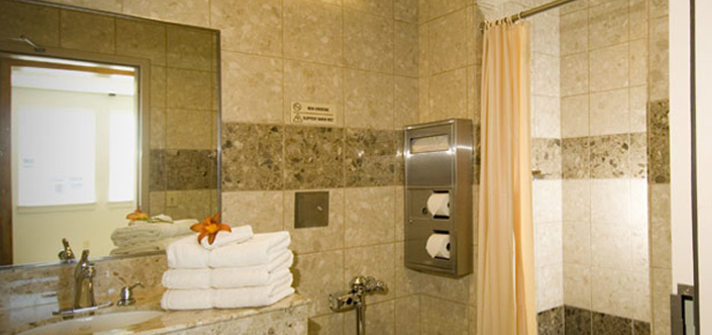
Truck Stops with more Amenities
Laundry
Showers
Lodging
Food/Coffee
Wi-Fi
Phones
Barbers
Notes:
Truckers are more likely to spend more time and therefore more money at truck stops that provide amenities that they can not get elsewhere on the road. Portland, OR provides a truck stop off I5 complete with a movie theater, video poker, a convenience store and much more to cater to people who live life on the road (Magoci, 2016). This is a perfect place for truckers to stop and spend money that contributes to the local economy while they rest. The state of Oregon only has between 2,000 and 4,000 parking spaces provided by private truck stops whereas just passing through the La Grande area every day are an estimated 5,000 commercial trucks (Federal Highway Administration, 2015). This means that if there were more options for truck stops that provided more amenities that attracted truckers, La Grande could become a hub for truckers and boost its economy.

Slide 27
Truck Washes
•Having truck washes for commercial vehicles is an added convenience for drivers since their rigs cannot be accommodated at regular car washes.
Notes:
Truck washes are one of the many new amenities that truck stops all over the country are offering to drivers to give them a one stop shopping experience that caters to all of their needs at once. This is one of the amenities provided by some of the busiest and most famous truck stops in America. Other amenities that have drawn truckers as tourists alike are movie theaters, convenience stores, restaurants, barbers, chiropractors, 24 roadside service for trucks, and swimming pools (Magoci, 2016).

Slide 28
Truck Mechanics
•The availability of mechanics who specialize in big rig repair to deal with truck problems could bring more truck business into La Grande
•Tire shops that cater to 18 wheelers can also increase truck traffic
Notes:
When drivers need maintenance while on the road having mechanics that specialize in 18 wheelers and tire shops that cater to the needs of big rigs close to truck stops where drivers can stay while repairs are done is a draw for truckers around the country. Exit 265 is already home to Eagle Freightliner who caters to long haul truckers and their mechanical needs but they do not provide tire services and their hours of operation are limited. They are closed by 6pm every day and closed on Sundays. This can cause problems for truckers who need emergency services. Increasing traffic to this exit could cause Eagle Freightliner to increase its hours in order to deal with more business and increasing the services provided could increase traffic so both situations would be beneficial to La Grande.

Slide 29
Better Signage to Increase Truck Traffic
•La Grande could increase its signage on the highway to help draw truckers in by advertising for its truck stops and food and gas options
•Studies show that billboards do reach consumers and cause them to stop at destinations that they saw on billboards
Notes:
Having increased signage that allows truckers to know before they get to La Grande that Exit 265 it trucker friendly and that it provides the things that they are looking for could convince more truckers to make La Grande one of their stops. Studies have shown that billboards and roadside ads do reach a lot of travelers that drive by them. “Seventy-one percent of travelers often look at the messages on roadside billboards and more than one-third (37%) report looking at an outdoor ad
each or most of the time they pass one. (Williams, 2009)” Williams (2009) also states that:
Viewers learn a lot from billboard ads. Billboard viewers recall seeing a wide range of
actionable information, including stores and restaurants they later visited, radio and TV programs
they were interested in, events they wanted to attend or something funny they shared with friends
later that day.

Slide 30
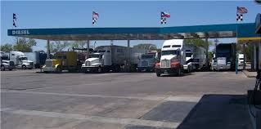
Gas Stations
•Ease of access to gas stations setup to handle large commercial trucks can increase trucks stopping in La Grande
Notes:
Truck drivers need to be able to refuel efficiently especially if they are only stopping to fuel. This means that gas stations need to be located directly off exits and be able to accommodate commercial vehicles. Almost as many drivers stop to refuel as they do to eat and rest (Associates, 2008 p.9). The availability of gas stations that cater to big rigs with ease will help to convince more truckers to stop in La Grande for refueling. The hope is that they will also decide to purchase other services while they are there or combine their refueling time with rest and food.

Slide 31
Suggestions from Analysis
•Put better signage on the highway
•Attract more businesses to La Grande off of exit 265 that cater to long haul truck drivers
•Look into radio advertising for truck drivers
•Consider city owned lots for truck parking if businesses do not provide enough
•Encourage the Flying J already located there to expand and include some of the amenities that they do at other locations throughout the U.S.
Notes:
The cheapest options for La Grande to improve its commercial catch and release zone are broadcasting on truck driver frequencies, increasing their signage, and providing lots with parking. However the options that are going to have the most impact for La Grande will be getting new businesses to open up and either getting Flying J to expand or getting another truck stop with more amenities that cater to truckers to move in and open up.

Slide 32
Attracting more Business to La Grande
•Many cities have begun to provide incentives for businesses to open there in order to boost the local economy
–These incentive include tax breaks for new businesses which is a good option for filling the space off of exit 265 with businesses that cater to commercial traffic
Notes:
Incentives that cities offer to get businesses to open stores there are tax incentives that make it cheap or easy for new stores to open. If these openings are successful it is good for the local economy because it provides more jobs and the business draws in more money from traffic that comes through the area. Filling the empty space off of exit 265 with more businesses that long haul truck drivers are known to enjoy and stop for will increase the traffic to exit 265 and allow it to build a reputation as a perfect place to stop for commercial truckers. Many cities have policies already drawn up to provide tax incentives for businesses that are willing to open there (Roberts, 2015). If La Grande already has a policy it should begin looking for businesses to fill the space off of exit 265 and if not the economic development team in La Grande could be enlisted to come up with a tax incentive policy for the city to use.

Slide 33
Local Employment - Northwood Manufacturing
Northwood Manufacturing currently is having trouble hiring enough employees to meet demand. They currently have 100 vacant positions between the main Northwood Campus and Outdoor RV, located on Pierce Rd. Filling these positions would allow northwood to fulfill the demand for their products, increasing commercial traffic for deliveries of raw materials and deliveries of finished product
Possible solution - working with Union County Economic Development Corporation’s Union County Business Retention and Expansion Program to promote the training opportunities and benefits of working at Northwood Manufacturing.
Notes:
In the interview with Jim Jones, President and CEO of Northwood Manufacturing and Outdoor RV, he suggested that the one of the biggest issues that Northwod faces curently is their shortage of employees. They have had trouble filling the 100 open positions with candidates that are able to pass a mandatory drug test. Northwood will train their new employees in the trades, whether it be welding, plumbing, as an electrician, or as a carpenter to contribute to manufacturing their products. This shortage of employees has contributed to their inability to meet the demand for their product in a timely manner. Filling these positions would help the Union County economy by adding 100 jobs, but also increase the commercial traffic in and out of La Grande in the form of increased deliveries of raw materials and increased outgoing deliveries of product to Northwood’s customers.
The goal of the Union County Business Retention and Expansion Program is to “The BR&E Program seeks to provide immediate response to issues and concerns facing local companies that may seriously impact on their competitiveness, issues such as local permitting, access to affordable utility services, workforce quality, and regulation of business activities.”

Slide 34
References
Allstays. (2016). Flying j travel plaza | near la grande oregon. Retrieved from http://www.allstays.com/truckstops-details/90254.php
Associates, W. S. (2008). The Minnesota Interstate Truck Parking Study. Retrieved from http://www.dot.state.mn.us/ofrw/PDF/MN_TrkParkFnlRpt.pdf
Beeson, V.. (2016, August). Personal interview, Personal interview with Google Reviews. Retrieved from http://goo.gl/Ozals8
Brown, R. (2016). Personal interview, Personal interview with Google Reviews. Retrieved from http://goo.gl/78vK8P
Clifford, F. (2016, August). Personal interview, Personal interview with Google Reviews. Retrieved from http://goo.gl/WBYS5A
The Cost of Highway Limitations and Traffic Delay to Oregon’s Economy [Scholarly project]. (2007, March 20). In Port of Portland. Retrieved August 2, 2016, from
https://www.portofportland.com/PDFPOP/Trade_Trans_Studies_CostHwy_Lmtns.pdf
Eastman, J. (2016, June). Personal Interview, Personal interview with Google Reviews. Retreived from http://goo.gl/DZchVE
Federal Highway Administration. (2015). Jason's Law Truck Parking Survey Results and Comparative Analysis. Retrieved from
http://www.ops.fhwa.dot.gov/freight/infrastructure/truck_parking/jasons_law/truckparkingsurvey/ch2.htm
Notes:
HERE ARE ALL THE REFERENCES ALPHABETIZED
Allstays. (2016). Flying j travel plaza | near la grande oregon. Retrieved from http://www.allstays.com/truckstops-details/90254.php
Associates, W. S. (2008). The Minnesota Interstate Truck Parking Study. Retrieved from http://www.dot.state.mn.us/ofrw/PDF/MN_TrkParkFnlRpt.pdf
Beeson, V.. (2016, August). Personal interview, Personal interview with Google Reviews. Retrieved from http://goo.gl/Ozals8
Brown, R. (2016). Personal interview, Personal interview with Google Reviews. Retrieved from http://goo.gl/78vK8P
Clifford, F. (2016, August). Personal interview, Personal interview with Google Reviews. Retrieved from http://goo.gl/WBYS5A
The Cost of Highway Limitations and Traffic Delay to Oregon’s Economy [Scholarly project]. (2007, March 20). In Port of Portland. Retrieved August 2, 2016, from https://www.portofportland.com/PDFPOP/Trade_Trans_Studies_CostHwy_Lmtns.pdf
Eastman, J. (2016, June). Personal Interview, Personal interview with Google Reviews. Retreived from http://goo.gl/DZchVE
Federal Highway Administration. (2015). Jason's Law Truck Parking Survey Results and Comparative Analysis. Retrieved from http://www.ops.fhwa.dot.gov/freight/infrastructure/truck_parking/jasons_law/truckparkingsurvey/ch2.htm
FindFuelStops. (2016). Arrowhead Travel Plaza. Retrieved from http://www.findfuelstops.com/truck-stop-001493
FindFuelStops. (2016). Love’s travel stop. Retrieved from http://www.findfuelstops.com/truck-stop-000185
FindFuelStops. (2016). Pilot travel center. Retrieved from http://www.findfuelstops.com/truck-stop-000422
FindFuelStops. (2016). Space age travel center. Retrieved from http://www.findfuelstops.com/truck-stop-001495
FindFuelStops. (2016). Troutdale travel center. Retrieved from http://www.findfuelstops.com/truck-stop-000758
Google Reviews. (2016, August 23). Arrowhead Travel Plaza. Retrieved from http://goo.gl/WBYS5A
Google Reviews. (2016, August 23). Baker Truck Corral. Retrieved from http://goo.gl/Ozals8
Google Reviews. (2016, August 23). Crossroads truck stop. Retrieved from http://goo.gl/a5Nv0A
Google Reviews. (2016, August 23). Flying j travel plaza. Retrieved from http://goo.gl/DZchVE
Google Reviews. (2016, August 23). Love’s travel stop troutdale. Retrieved from http://goo.gl/JcR4Op
Google Reviews. (2016, August 23). Pilot travel center ontario. Retrieved from http://goo.gl/SM8dJR
Google Reviews. (2016, August 23). Space age travel center hermiston. Retrieved from http://goo.gl/Ce4v8r
Google Reviews. (2016, August 23). TA troutdale. Retrieved from http://goo.gl/93CP7F
Hanson, J. (2016, August 1). Jake Hanson, owner of B&K Auto Salvage & Recycling [Telephone interview].
Hayes, T. Sr. Human Resource Specialist, Boise Cascade Northeast Oregon Region [E-mail interview]. (2016, August 3).
Jameswade1977. (2016). Personal Interview, Personal interview with Google Reviews. Retreived from http://goo.gl/DZchVE
Jones, J. (2015, August 4). Jim Jones, President & CEO of Northwood Manufacturing & Outdoor RV [Personal interview].
Kahaner, L. (2016, June 17). Truckers love Weed; Weed loves truckers. FleetOwner. Retrieved from http://fleetowner.com/driver-management-resource-center/truckers-love-weed-weed-loves-truckers
Kautz, B. (2016, August 4). Bob Kautz, La Grande Branch Manager for Eagle Freightliner [Personal interview].
Kennedy, B. (2016, August 3). Brett Kennedy, Transportation Analyst for Boise Cascade Wood Products Division [E-mail interview].
Magoci, J. (2016, March 2). Best Truck Stops in USA – Top 10 Locations for Truckers. Fueloyal. Retrieved from https://www.fueloyal.com/best-truck-stops-in-usa-top-10-locations-for-truckers/
Mswarped. (2016, June). Personal Interview, Personal interview with Allstays. Retreived from http://www.allstays.com/truckstops-details/90254.php
Olszewski, M., Barbod, S. (2015, October 19). 10 best truck stops in america. Retrieved from http://www.teletracnavman.com/fleet-management/topics/best-truck-stops-in-america
Omnitracs. (2011). 10 best truck stops. Retrieved from http://www.omnitracs.com/blog/best-truck-stops
Oregon Department of Transportation. (2014). Oregon Traffic Studies. Retrieved from http://www.oregon.gov/ODOT/TD/TDATA/tsm/docs/TVT_2014.pdf
Peasley, A. (2016, August 2). Arnie Peasley, Manager of La Grande Les Schwab Tire Center [Telephone interview].
Roberts, M. (2015, July 3). Why Do Cities Offer Tax Incentives to Businesses? About. Retrieved from http://govcareers.about.com/od/GovCulture/f/Why-Do-Cities-Offer-Tax-Incentives-To-Businesses.htm
Rodriguez, S. (2015). Personal Interview, Personal interview with Google Reviews. Retreived from http://goo.gl/DZchVE
Reattoir, D. (2016). Personal Interview, Personal interview with Google Reviews. Retreived from http://goo.gl/DZchVE
Ren 23 G. (2015). Personal Interview, Personal interview with Google Reviews. Retreived from http://goo.gl/DZchVE
Splash. (2016, June). Personal Interview, Personal interview with Allstays. Retreived from http://www.allstays.com/truckstops-details/90254.php
State of Oregon. Oregon Department of Transportation, Transportation Data Section. (2015, September). 2014 Transportation Volume Tables. Retrieved August 3, 2016, from https://www.oregon.gov/ODOT/TD/TDATA/tsm/docs/2014_TVT_Complete_Publication.pdf
Stevens, S. (2016, August). Personal interview.
TA. (2016, August 23). TA troutdale. Retrieved from http://www.ta-petro.com/location/or/ta-troutdale
Union County Business Retention and Expansion Program. (n.d.). Retrieved August 5, 2016, from http://ucedc.org/services/business-retention-expansion/
Williams, D. (2009). The Arbitron National In-Car Study. Abitron. Retrieved from http://www.arbitron.com/downloads/InCarStudy2009.pdf

Slide 35
References (Continued)
FindFuelStops. (2016). Arrowhead Travel Plaza. Retrieved from http://www.findfuelstops.com/truck-stop-001493
FindFuelStops. (2016). Love’s travel stop. Retrieved from http://www.findfuelstops.com/truck-stop-000185
FindFuelStops. (2016). Pilot travel center. Retrieved from http://www.findfuelstops.com/truck-stop-000422
FindFuelStops. (2016). Space age travel center. Retrieved from http://www.findfuelstops.com/truck-stop-001495
FindFuelStops. (2016). Troutdale travel center. Retrieved from http://www.findfuelstops.com/truck-stop-000758
Google Reviews. (2016, August 23). Arrowhead Travel Plaza. Retrieved from http://goo.gl/WBYS5A
Google Reviews. (2016, August 23). Baker Truck Corral. Retrieved from http://goo.gl/Ozals8
Google Reviews. (2016, August 23). Crossroads truck stop. Retrieved from http://goo.gl/a5Nv0A
Google Reviews. (2016, August 23). Flying j travel plaza. Retrieved from http://goo.gl/DZchVE

Slide 36
References (Continued)
Google Reviews. (2016, August 23). Love’s travel stop troutdale. Retrieved from http://goo.gl/JcR4Op
Google Reviews. (2016, August 23). Pilot travel center ontario. Retrieved from http://goo.gl/SM8dJR
Google Reviews. (2016, August 23). Space age travel center hermiston. Retrieved from http://goo.gl/Ce4v8r
Google Reviews. (2016, August 23). TA troutdale. Retrieved from http://goo.gl/93CP7F
Hanson, J. (2016, August 1). Jake Hanson, owner of B&K Auto Salvage & Recycling [Telephone interview].
Hayes, T. Sr. Human Resource Specialist, Boise Cascade Northeast Oregon Region [E-mail interview]. (2016, August 3).
Jameswade1977. (2016). Personal Interview, Personal interview with Google Reviews. Retreived from http://goo.gl/DZchVE
Jones, J. (2015, August 4). Jim Jones, President & CEO of Northwood Manufacturing & Outdoor RV [Personal interview].
Kahaner, L. (2016, June 17). Truckers love Weed; Weed loves truckers. FleetOwner. Retrieved from
http://fleetowner.com/driver-management-resource-center/truckers-love-weed-weed-loves-truckers

Slide 37
References (Continued)
Kautz, B. (2016, August 4). Bob Kautz, La Grande Branch Manager for Eagle Freightliner [Personal interview].
Kennedy, B. (2016, August 3). Brett Kennedy, Transportation Analyst for Boise Cascade Wood Products Division [E-mail interview].
Magoci, J. (2016, March 2). Best Truck Stops in USA – Top 10 Locations for Truckers. Fueloyal. Retrieved from
https://www.fueloyal.com/best-truck-stops-in-usa-top-10-locations-for-truckers/
Mswarped. (2016, June). Personal Interview, Personal interview with Allstays. Retreived from http://www.allstays.com/truckstops-details/90254.php
Olszewski, M., Barbod, S. (2015, October 19). 10 best truck stops in america. Retrieved from
http://www.teletracnavman.com/fleet-management/topics/best-truck-stops-in-america
Omnitracs. (2011). 10 best truck stops. Retrieved from http://www.omnitracs.com/blog/best-truck-stops
Oregon Department of Transportation. (2014). Oregon Traffic Studies. Retrieved from http://www.oregon.gov/ODOT/TD/TDATA/tsm/docs/TVT_2014.pdf
Peasley, A. (2016, August 2). Arnie Peasley, Manager of La Grande Les Schwab Tire Center [Telephone interview].

Slide 38
References (Continued)
Roberts, M. (2015, July 3). Why Do Cities Offer Tax Incentives to Businesses? About. Retrieved from http://govcareers.about.com/od/GovCulture/f/Why-Do-Cities-Offer-Tax-Incentives-To-Businesses.htm
Rodriguez, S. (2015). Personal Interview, Personal interview with Google Reviews. Retreived from http://goo.gl/DZchVE
Reattoir, D. (2016). Personal Interview, Personal interview with Google Reviews. Retreived from http://goo.gl/DZchVE
Ren 23 G. (2015). Personal Interview, Personal interview with Google Reviews. Retreived from http://goo.gl/DZchVE
Splash. (2016, June). Personal Interview, Personal interview with Allstays. Retreived from http://www.allstays.com/truckstops-details/90254.php
State of Oregon. Oregon Department of Transportation, Transportation Data Section. (2015, September). 2014 Transportation Volume Tables. Retrieved August 3, 2016, from https://www.oregon.gov/ODOT/TD/TDATA/tsm/docs/2014_TVT_Complete_Publication.pdf
Stevens, S. (2016, August). Personal interview.
TA. (2016, August 23). TA troutdale. Retrieved from http://www.ta-petro.com/location/or/ta-troutdale

Slide 39
References (Continued)
Transportation, U. D. (2004). Intelligent Transportation Systems and Parking. Retrieved from http://safety.transportation.org/htmlguides/DDD/Appendices/Appendix_6.pdf
Union County Business Retention and Expansion Program. (n.d.). Retrieved August 5, 2016, from http://ucedc.org/services/business-retention-expansion/
Williams, D. (2009). The Arbitron National In-Car Study. Abitron. Retrieved from http://www.arbitron.com/downloads/InCarStudy2009.pdf

