Slide 1
Union, Oregon:
City of Victorian Heritage
“Union is the town time forgot!” ~Nancy O’Conner, Union resident.
“Union is like Brigadoon, a wonderful place where average people are
leaders and children are heroes.”
~Dr. Willard Bertrand, Union resident
Population: 2100
Amenities:
Buffalo Peak Golf Course, Eastern Oregon Live Stockshow, Union County Museum, Union Historic Cemetery, Union Historic Hotel, Historic Carnegie Library, Health clinic, Gift shops, Pharmacy, Post Office, City Park with gazebo, Proximity to camping, hiking and hunting, Historic Hotel, Catherine Creek, Community/school athletic facility Several fields geared to tournament size activities, and an amazing school district, plus much more.
Climate: moderate
Local Chamber of Commerce.
Notes:
“Union has maintained its rural charm and friendly atmosphere. With a population of just over 2100 this town has clean air and fabulous water and is a highly desirable place to live, play, retire and visit. Open space, appealing Victorian style homes, buildings and tree-lined streets preserves its historic authenticity. Union offers a unique character and quality of life. Strategically placed between La Grande and North Powder on Highway 203 and 237, Union has much to offer. With the Federal Highway (Interstate 84) 11 miles northwest of Union, access to and from the community is efficient and diverse. Union has infrastructure to allow growth without disturbing the beauty of the landscape. “ (http://www.cityofunion.com/).

Slide 2
The Buffalo Peak Golf Course
“Gem of the Grande Ronde Valley”
----Bill Rosholt
One of Oregon’s Finest Golf Courses
Notes:
Challenging 18-hole links style course with fantastic views of creatively sculpted land forms.

Slide 3
The Buffalo Peak Golf Course owned and managed by Union
County is seeking to expand and renovate their golf course clubhouse. The land that they are currently occupying is located right at the edge of the city of Union, OR, 15 miles from La Grande. It is an 18-hole golf course for recreational-consumer activities, but was also originally constructed as an extension to the Union City water processing system.
History of: Buffalo Peak Golf Course
Notes:
Set in the beautiful Grande Ronde Valley of northeast Oregon, Buffalo Peak Golf Course looks out on the panorama of the Blue and Wallowa Mountain Ranges. Course architect William Phillips took advantage of the setting and natural changes in elevation to create an 18-hole links style course which offers challenges for players of all levels.

Slide 4
Mission: “Our goal is to provide an opportunity for all skill levels of golfers to play affordable golf on a quality golf course and create activities that will spur economic development for both Union County and the City of Union.
Program Description: To operate Buffalo Peak Golf course in a manner that will increase play to the extent that will generate the revenue necessary to pay the expenses in an effort to make the facility self-supporting.
Major Objectives for FY 2016-2017: The long term goal is to generate the revenue that matches or exceeds the expenses. Facilitate programs that promote new player development and work toward player retention with an emphasis on more dollars per player.
Buffalo Peak Golf Course
Objectives:
Notes:
Personnel Costs: One course Superintendent; one maintenance/mechanic Tech; one PGA Professional; three seasonal clubhouse employees; and, nine seasonal maintenance employees.

Slide 5
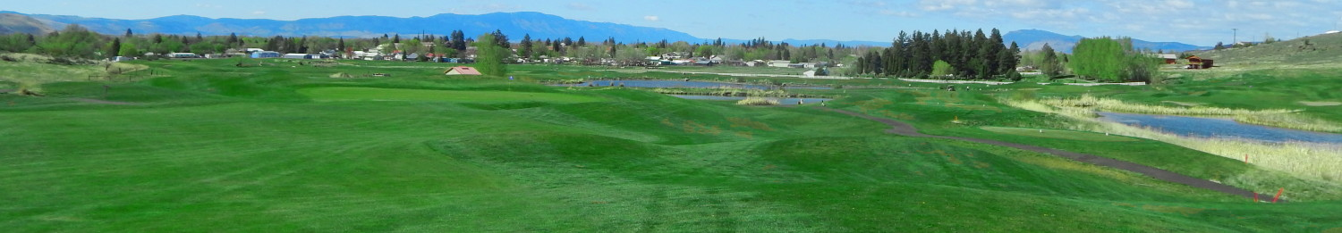
Strengths: Location, Location, Location
  Union County—Diverse, Business Oriented, Industrial, Eventful.
  Union, OR -- Peaceful, relaxing, and calm.
Notes:
Peaceful, relaxing, and calm is ideal for golfing.

Slide 6
Strengths: Viable 18-Hole Golf Course
  Flexibility & Variability
  Singles Dates
  Family Events
Groups/Clinics/Camps:
Forest Service Hackers
American Legion
Jr Golf Camp
Boys District Golf
couples
High School Invitational
Activities/Tournaments:
April Fools Scramble
Season FUNally Par 3
United Way Scramble
Eastside Srs.
Revenue Streams:
Advertising
Memberships
Gift Certificates
Pro Shop Sales
Misc.
Green Fees
Annual Passes
Carts
Food & Beverage
Beer & Wine
Range Balls

Slide 7
Strengths: Buffalo Creek Golf Course is All Age Appropriate.
  The course offers different prices for different age groups, allowing everyone to have some fun.

Slide 8
Strengths: Online Website Media
Website to indicate-
  Hours
  Pricing
  Weather diagnostics
  Connections with social media
  Golf Course hours of operations
  Golf Course Contact Info
Notes:
Features like these will have customers engaging and willing to try out the course if new to the course or area. Some courses don’t have a website just a phone registered, so customers have to call and ask. The website is an advantage and strength that other competitors don’t have.

Slide 9

Strengths: Lessons
Golf instruction by Scott Marcum, PGA Head Professional.
Contact Scott today to schedule your lesson 541-562-5527.
Notes:
Some courses don’t offer lessons. Those individuals who want to learn, but aren’t sure how to play are encouraged to go golfing.

Slide 10
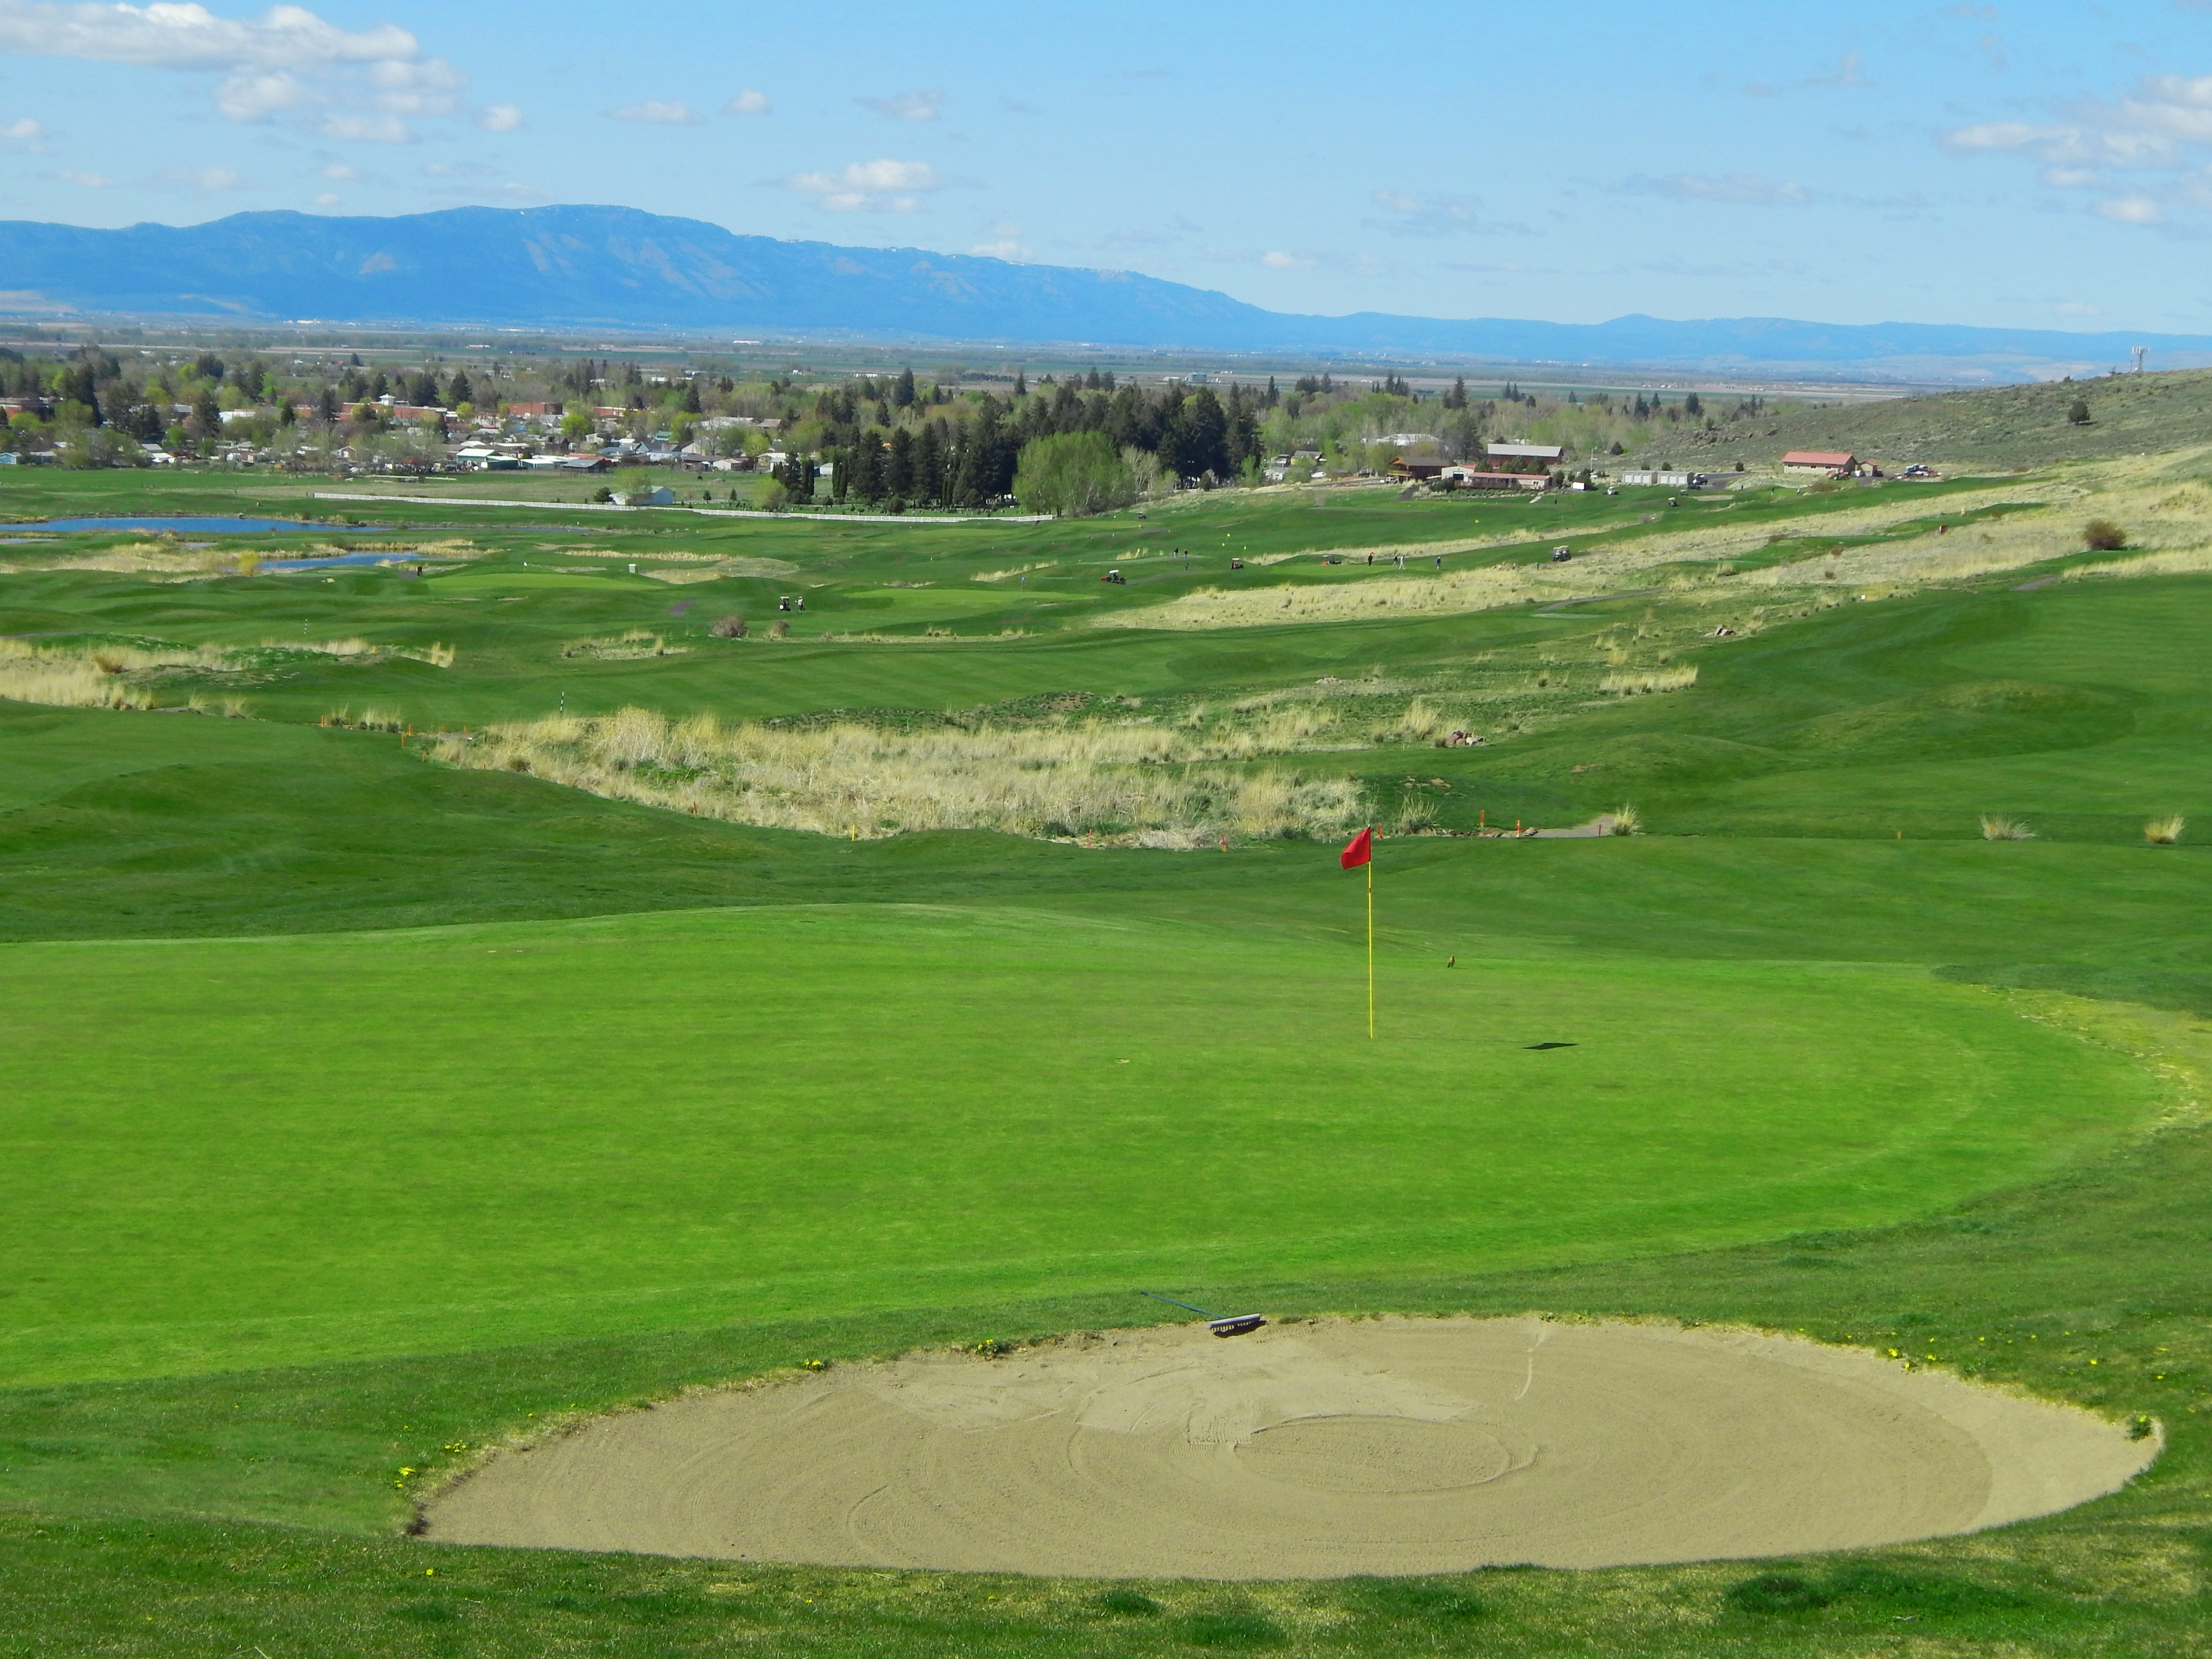
Buffalo Creek Financials: Revenues
Strengths: Revenue Stream Steady Growth
2012-2013: in excess of $516,000 ($516,547).
2013-2014: in excess of $539,000 ($539,571).
2014-2015: in excess of $480,000 ($480,839).
2015-2016: Equal to $554,000.

Slide 11
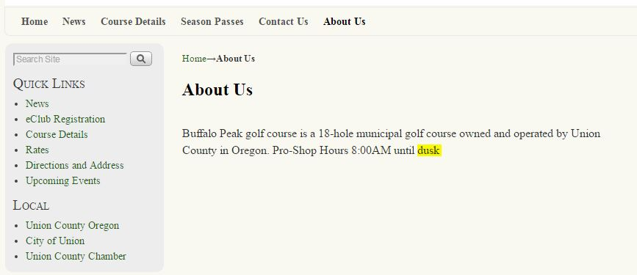
Weaknesses: Online Presence
Section could use more detail about your services.
Replace this with a time to make it easier to understand.
Notes:
Not just including the “About” section, but the website as a whole is lacking in information that could be provided before people visit the establishment. What’s above is just an example.

Slide 12
Weaknesses: Online Presence
Consider adding online store opportunities for merchandise.
  Getting more engaged with customers outside of the clubhouse.
  Online store could increase your sales.
    Could result in more sales to pay off any current debts.

Slide 13
Weaknesses: Monthly Event Planner
Having at least one event on a monthly basis. Keeping your customer’s engaged with more fun and interesting opportunities.
Ideas to Consider:
Kids events:
Get younger generations more involved in golfing experience.
Fundraisers
Party Reservations

Slide 14
Weaknesses: Club Interior
Create menu design (Within the clubhouse interior as well as the website).
Consider adding more seating within your clubhouse. This would allow more party reservation opportunities.
Better and more improved dining experience.
To keep things low budget, you might want to consider more outdoor seating for larger event plans.

Slide 15




Weaknesses: Menu Designs
Menu |  | August 23,2016 Ghostly Buffalo Creature Cafe
Sand, Surf, & Turf At:
Buffalo Creek Golf Course Clubhouse Cafe

Slide 16
Weaknesses: Buffalo Creek Financials: Expenditures/Revenue Allocation
Please See Attached Spreadsheet Financial Model

Slide 17
Opportunities--Market Buffalo Creek as Golf Travel Getaway:
Historic Union Hotel
Opportunities--Market Union County As Travel Golf Destination Getaway:
La Grande Country Club and 9-Hole Course: LA Grande, Oregon--Population 13,085
Excursion Train in Elgin, Oregon—Population 1,700
Geiser Grand Hotel & Quail Ridge Golf Course in Baker City, Oregon—population 9,828
Buffalo Creek Golf Course: Union, Oregon--Population 2,100
Alpine Meadows Golf Course: Baker City, Oregon--—Population 9,828
Joseph, Oregon—Population 1,081
White Water Rafting
Pan for Gold on the Oregon Trail
See the Paleontology Museum

Slide 18
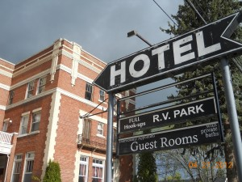
Notes:
“The Union Hotel was built in 1921, this imposing three story brick building is the largest commercial structure on Union’s main street. restoration began in the 1990’s and continues even today. The Union Hotel is renowned for it’s beautiful theme rooms and excellent food.”

Slide 19
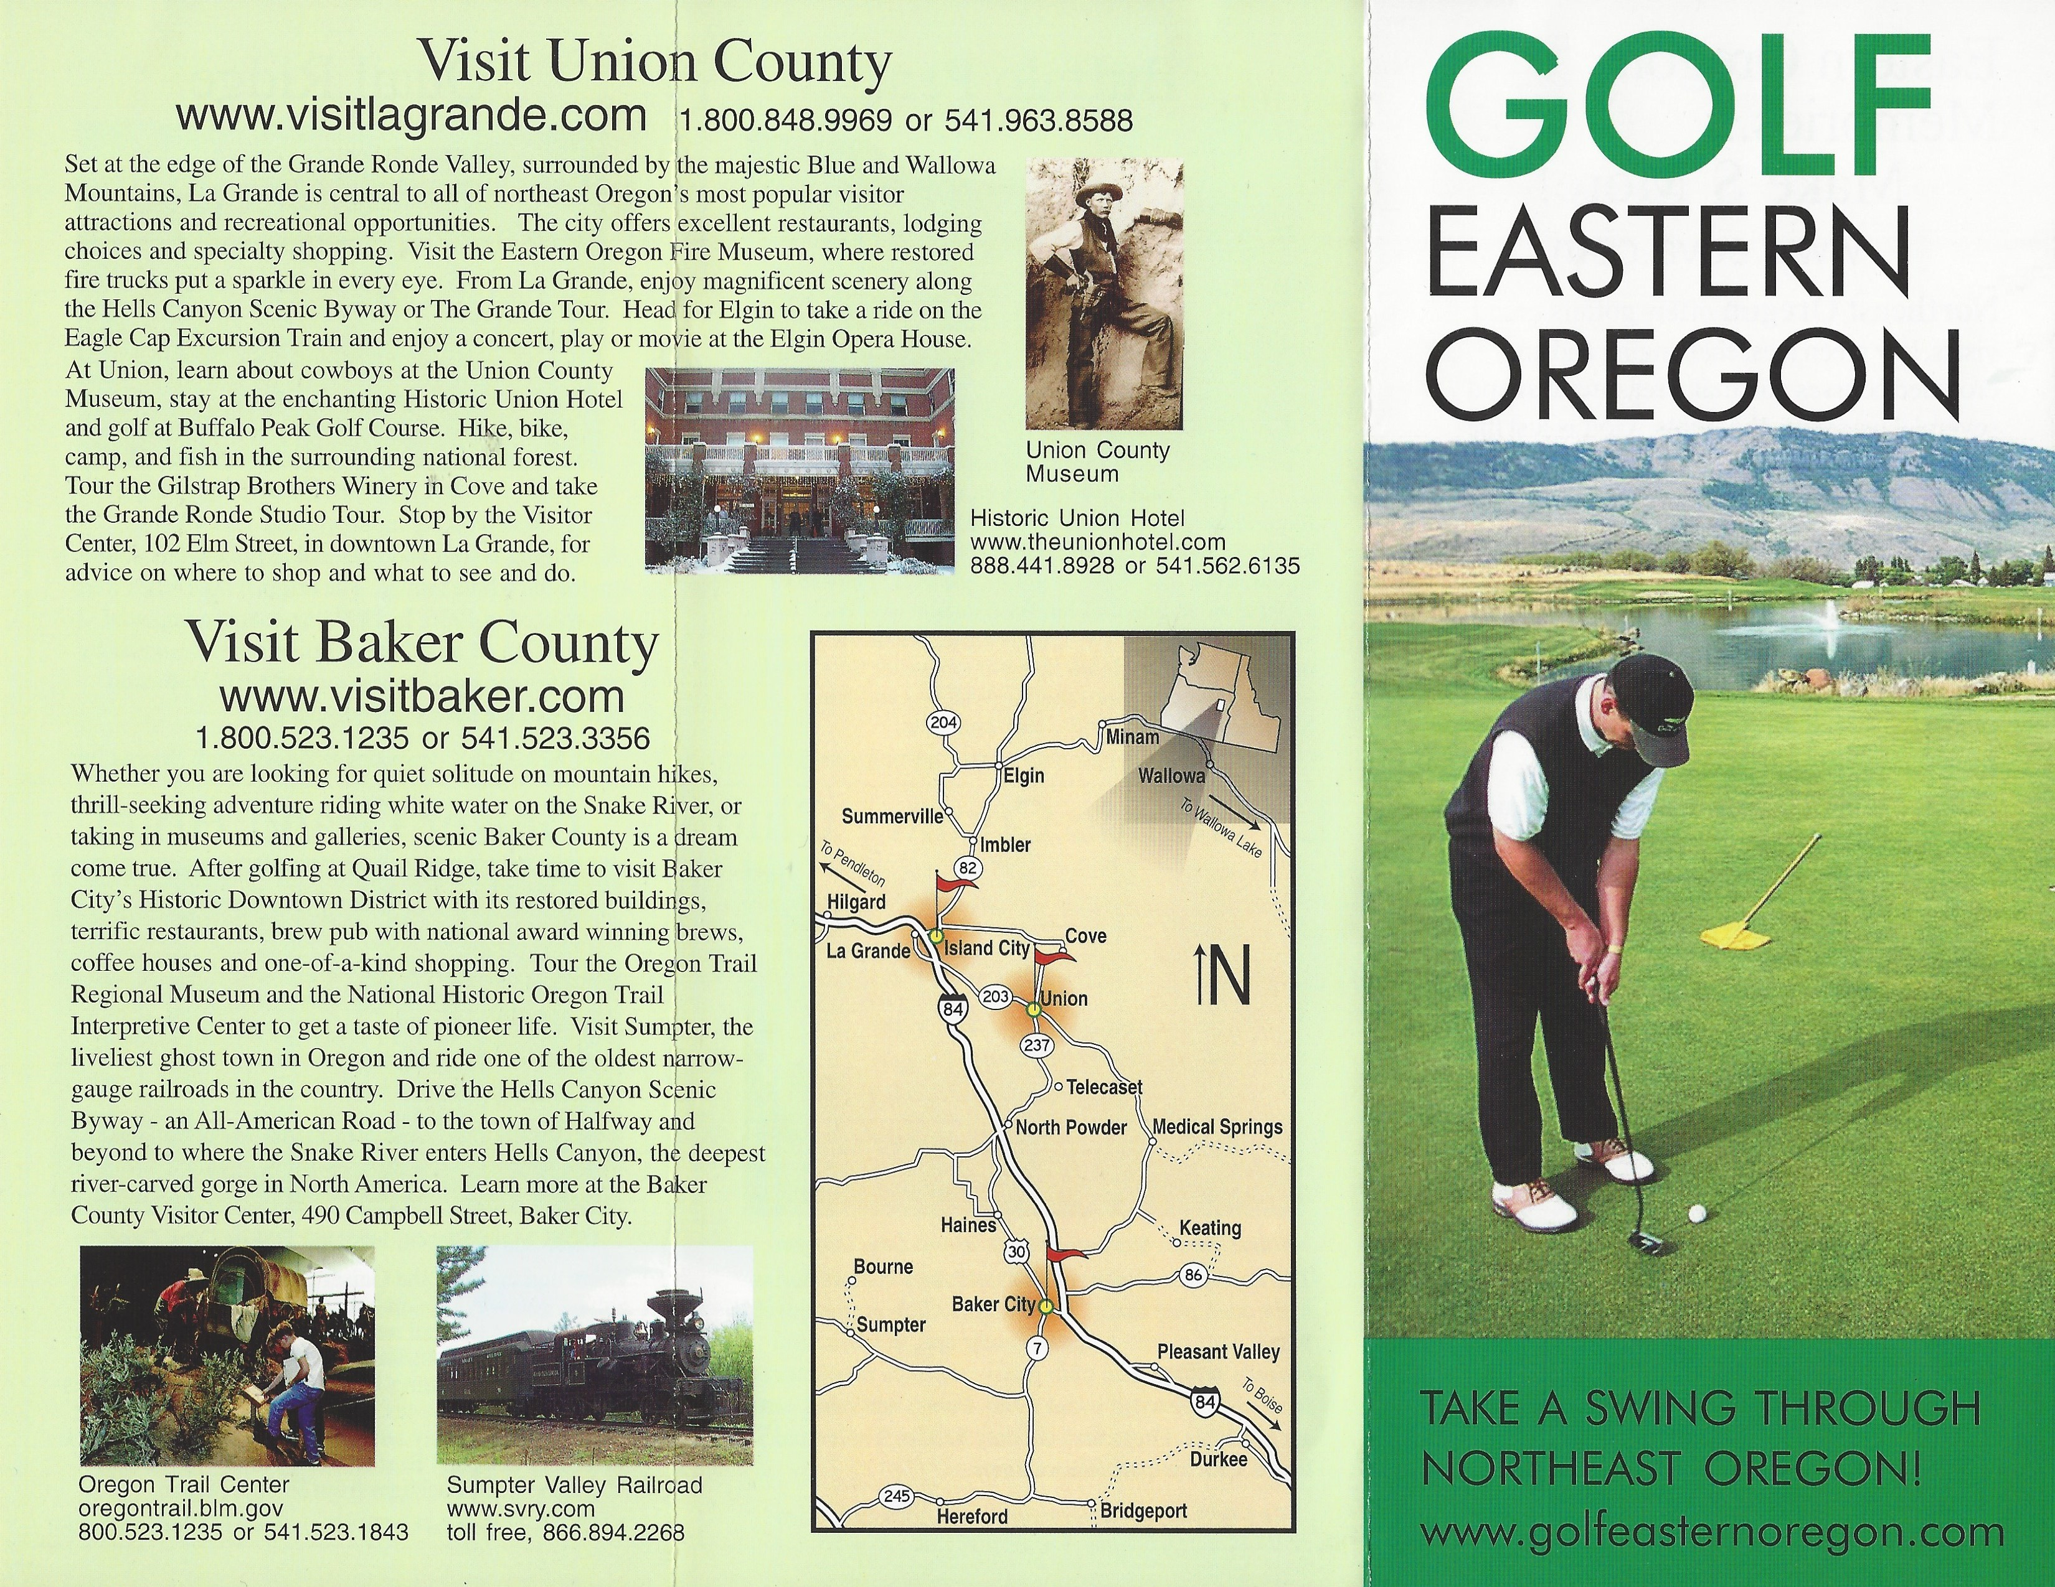

Slide 20
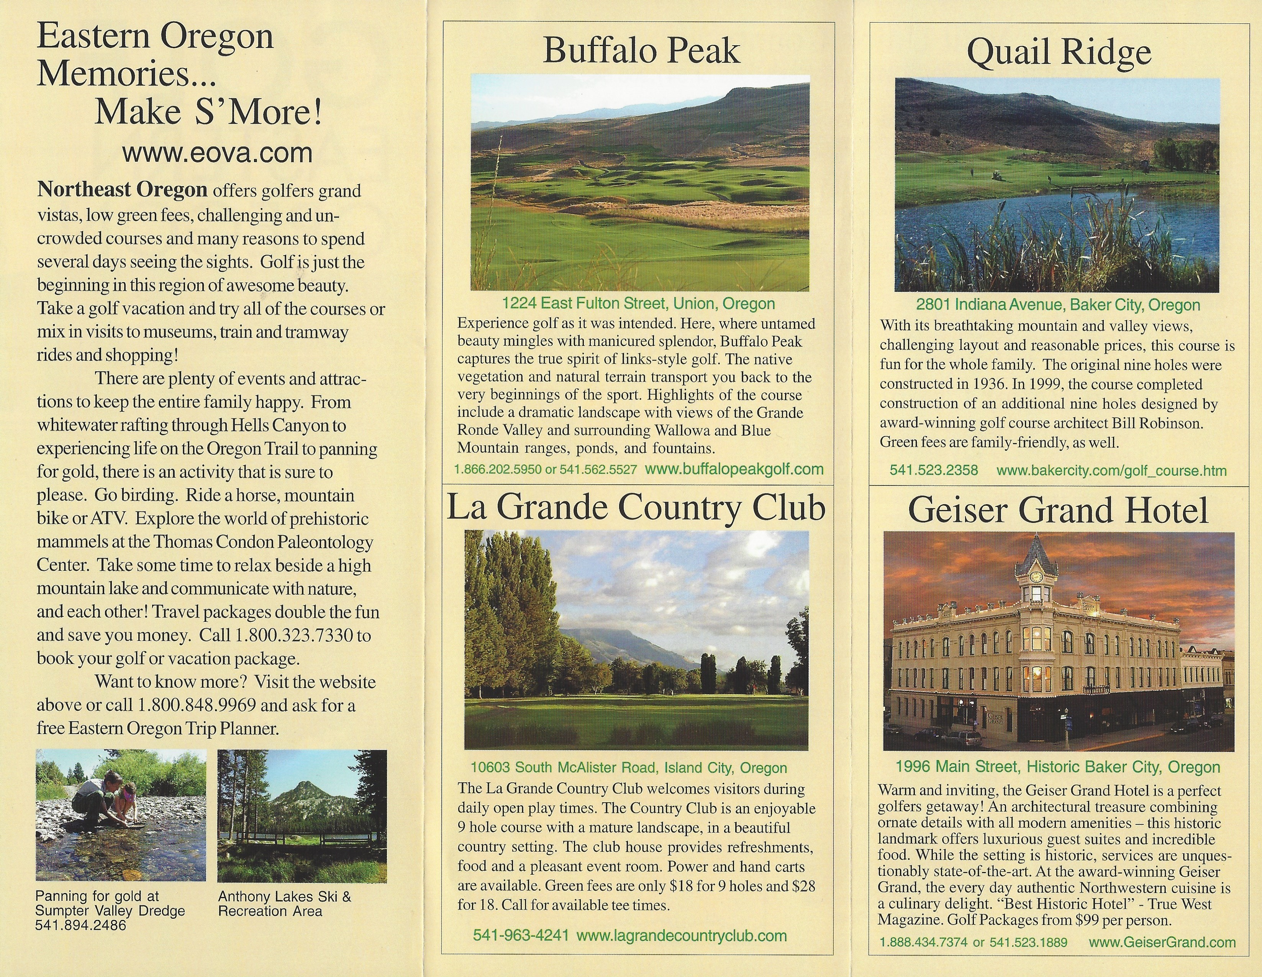

Slide 21
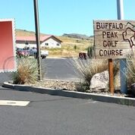
Union County has population of 25, 652; this is opportunity for new business and greater revenue streams:
Corporate Events
Weddings & Receptions
Fundraisers Parties and Celebrations
Opportunities: Buffalo Creek As Venue:

Slide 22
We will examine three clubhouse scenarios: (1); (2); and, (3).
What it will cost:
Any where from: $86,000; $339,000; $500,000; to $1,700,000.
How we will fund it:
Capital Assistance Program (CAP)
Credit Enhancement Fund (CEF)
Credit Enhancement Fund (CEF) Application Form
Entrepreneurial Development Loan Fund (EDLF)
Oregon Business Development Fund (OBDF)
S SBA - Loans and Grants
Venture Capital
SBIC Program
SBA Lenders
Notes:
Union County owns Buffalo Creek Golf course; therefore, appropriate measures would be to seek state and federal business loans. If there is no money to appropriate, then Union County could seek an addition to their existing loans through debt or investor financing.

Slide 23
What will be the impact on visitors and the local economy:
Revenue for Union County.
Revenue for City of Union, Oregon.
Revenue for Golf Course and Improved Golf Facilities.
Expanded Golf Membership
Tourist Destination.
Vacation Packages.
Expanded Recreation Department Programs.
County and Town Meeting Space
Rehearsal Space For Theater or Community Band Groups
School Department Space
Extra Meeting Space for Town Functions
Conference Venue
Specialty Groups
Entertainment Venue
Restaurant and Catering
Weddings and Banquets
Town Swimming Pool
Town Spa
Poker Tournaments

Slide 24
Update the existing clubhouse
Paint:
Home Interior Painting Cost
Average Cost $1,804-$2,406; $4,000 Max Cost
Home Exterior Painting Cost
134 sq. ft. $38.32-$52.69
Home Exterior Painting Labor – Basic
134sq. Ft. 3.2 hrs. $99.36-$281.07
Home Exterior Painting Materials and Supplies
125 sq. ft. $25-$40
Total Costs:
125 sq. ft. $162.38-$373.70
Cost for Exterior Paint: $2,437- $5,000 Max.
Average Cost: $2,943-$3971
Notes:
On average, homeowners spend between $1,804 and $2,406 for professional painting projects in the interior of their home. Taking into account average paint materials and supplies, the average price to paint a home’s exterior is $2,394. Average reported cost based on 18609 cost profiles $4,000 Maximum cost.

Slide 25
Update the existing clubhouse
Carpet:
Carpet Cost:
268 sq. ft. $528.88-$696.45
Carpet Labor – Basic:
4.8 hr. $285.17-$496.87
Carpet Materials and Supplies:
250 sq. ft. $127.57-$145.13
Carpet Equipment Allowance:
$28.50-$40.50 Total cost 250 sq. ft. $970.12-$1,378.94
Average per sq. ft. $3.88-$5.52
Average Total Costs: $746--$2,311; $4,000. Max.
Cost of carpeting: $1-$11 per square foot; Cost of padding (if not included in the carpet or labor cost): $0.30-$0.60 per square foot; Cost of labor: $0.50-$1 per square foot; Cost of labor add-ons (furniture removal, Berber carpet, special cuts, hauling away, etc.): $0.50-$2 per square foot
Notes:
The average cost of an entire carpet installation project is $1,490, with most homeowners paying between $746 and $2,311 but with some paying as little as $200 or as much as $4,000.
Therefore, a standard 12-foot by 12-foot room without any odd angles or cutouts should cost between $300-$750 for carpet installation using a low- to middle-grade carpet material. That equals approximately $2-$5 per square foot.

Slide 26
Update the existing clubhouse
Updates:
Home Staging Process:
Cost of Lighting Changes: $329 for the labor, the materials and the fixture itself.
Upgrades:
Interior Design:
$4,465 Average reported cost based on 1473 cost profiles $14,000 Max-cost
Patio Renovation:
$14,183 Average reported cost based on 1047 cost profiles $35,000
While that price tag is anything but small, it’s important to realize that this enclosure actually increases the total square footage of capacity.
Landscaping:
$10,000-$20,000
Notes:
There are countless reasons that you might be interested in hiring an interior designer or decorator. These skilled and creative professionals can upgrade a newly-purchased home to give it a fresh look, help you to decorate. However, a fair estimate is to pay somewhere between the range of $3,407 and $5,143, which is the average price range for interior design services.
An easy way to make the most of your patio is to build an enclosure and cover up the patio entirely. Patio enclosures protect you and your patio from inclement weather, bugs, debris and much more. Screens, while not as strong, can do much of the same.

Slide 27
Update the existing clubhouse:
Interior Painting Cost- ; $4,000 Max.
Exterior Painting Cost-5,000 Max.
Carpet Cost-$4,000. Max.
Cost of Staging: $4,465 Max.
Cost of Lighting Changes: $329
Interior Design: $14,000 Max.
Patio Renovation: $35,000 Max.
Landscaping: $20,000 Max.
Total Proposed Costs For Updates: $86,794 to $100,000
Notes:
“The clubhouse is the golfer’s first and last impression when playing a round. Certainly the golf course is generally why people come, but a poorly designed clubhouse can adversely affect their overall experience. Care must be taken to ensure that a clubhouse complements the course and is an enjoyable place to be - and this in turn should drive increased revenue. . . Based on our research, the cost of building a very basic clubhouse of 200-250m2, starts at EUR 300,000. $339,000—USD. Nevertheless, some high-end clubhouses, which are also much larger in size (often well above 2,000m2)and offer extensive sport, leisure, and recreational facilities, can cost several millions to build.” (kpmg.com)

Slide 28
Pros:
The town can continue (and possibly expand) the functions by the Recreation Department and others.
Cons: Rehabilitation might take time putting the building out of service due to replacement.
All code upgrades including complete rewiring should be made to extend the life of the building.
Costs: $339,000; $500,000;$1,200,000. Life expectancy -/+ 35 years.
(2) Replace the existing clubhouse with one that has a commercially viable restaurant and pro shop:
Notes:
We can theorize that like a Jamestown, Rhode Island Clubhouse, the useful area doubled in the replacement building option while the cost to maintain the usefulness of the existing structure might be as much as 70% of the cost of a new, larger building. In order to continue using the current building year round , immediate and extensive structural repairs must be conducted (jamestownri.gov). Please see attached spreadsheets on above projections.

Slide 29
(3) Everything in (2) but it can also serve as a venue for private events (e.g. wedding receptions, parties, …) and a site for community events:
Pros: A new restaurant and catering facility, with possibly a spa, a pool, a racket ball court, locker rooms and showers, and a gift shop.
Existing Building could be relocated away from golf course—used as the new golf pro shop renovation, a maintenance grounds office, and, or a live on site management living quarters, or used as a second level, or the banquet facility.
This replacement could start a new municipal building life span and the new building could be built specifically to address town needs and potential revenue.
Cons: Permitting for zone change of use.
Parking conflicts will arise due to the expanded use of facility vs. golf course needs
Parking would have to be expanded, in addition to handicap accessibility.
Projected Costs: $1,700,000. Life expectancy –75 +/-years

Slide 30
Replacement Building Space Requirements:
Dining –150 persons at 15 square feet per person(sub dividable) 2,250 SF
Stage area –band and dancing as well as rehearsal space 500 SF
Catering Kitchen for 150 meals served with storage and wash up 800 SF
Public restrooms, coats, entry hall 500 SF
Break out rooms, storage 1,700 SF
Golf Club, café, lockers, rest rooms, storage (carts, maintenance equipment elsewhere) 2,500 SF
Offices 150 SF
Mechanical 300 SF
Equipment storage and workshop for golf course 3,400 SF
General circulation (corridors, hall ways, stairways) +/ - 35% 3,500 SF
Total Building Space Proposal: 15,600 SF (Let's hypothesis that the current building is approximately 8,000 SF).
Proposals A through E
Notes:
Assumed 150 person capacity catered dining for weddings, special functions or golf course events, with suitable break out space for conferences: Please see attached spreadsheets on above projections.

Slide 31
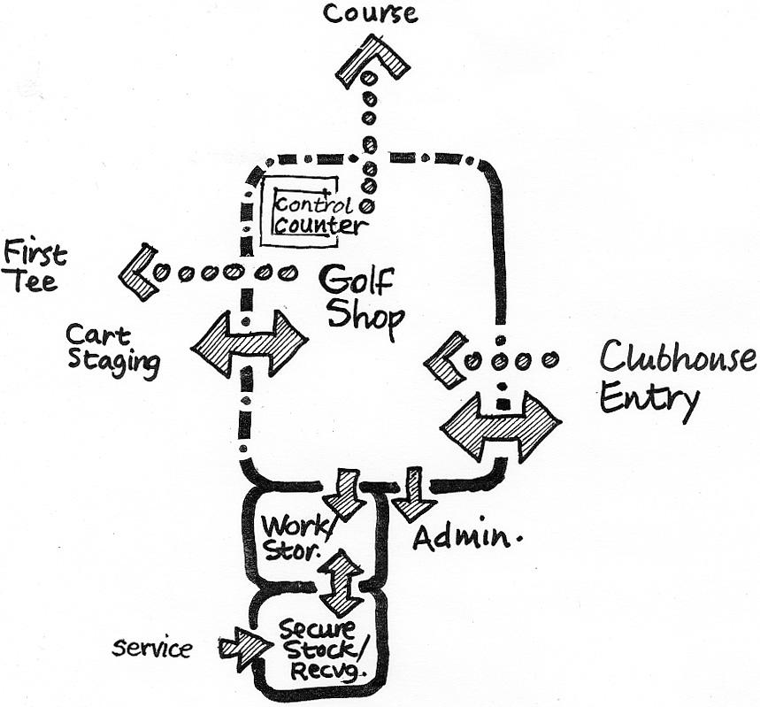
Proposal A

Slide 32
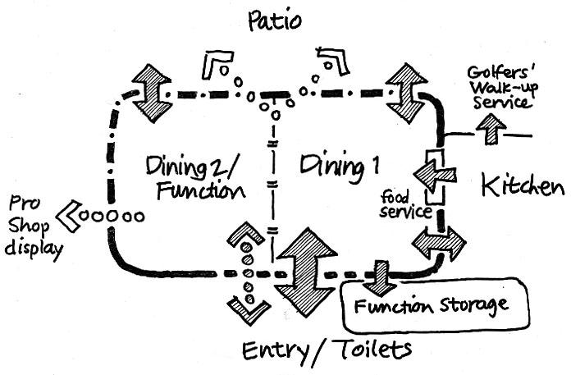
Proposal B

Slide 33
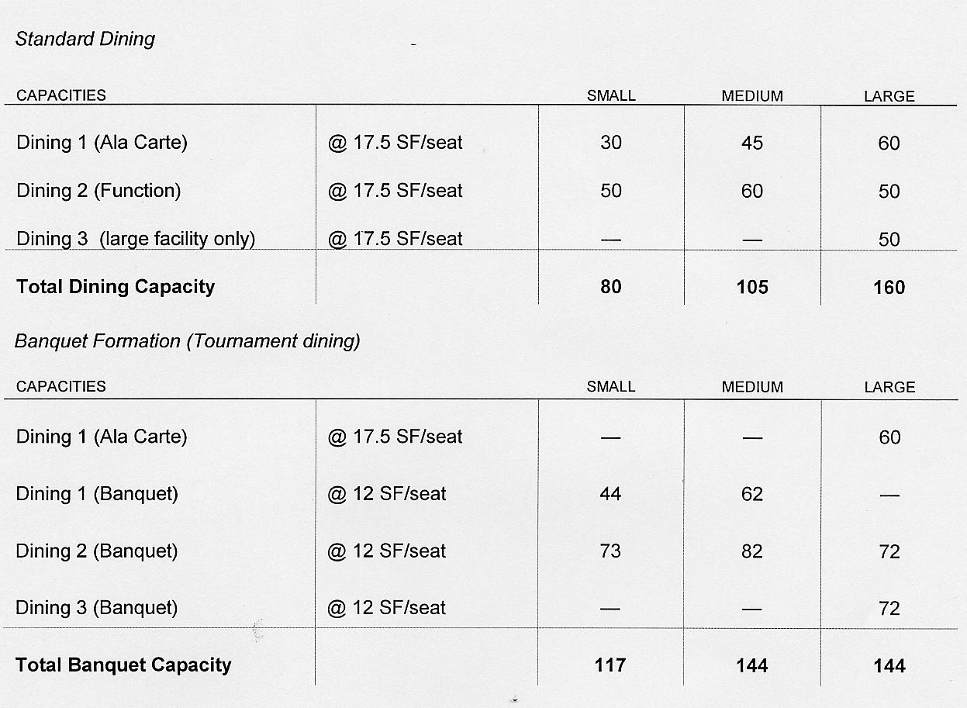
Proposal C

Slide 34
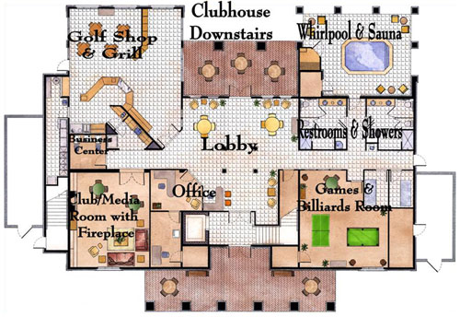
Proposal D

Slide 35
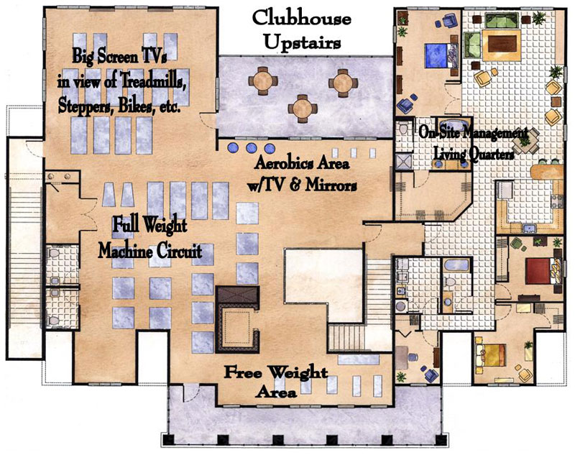
Proposal E

Slide 36
Threats: Un-Sustainable Revenues
Expenditures Exceed Revenues—Please See Attached Spreadsheet Financial Model
Buffalo Creek Financials:
Expenditures

Slide 37
La Grande Golf Course: population 13,085.
“La Grande Country Club was established in 1924 and opened at its present location in 1928. For 80 years this highly regarded nine-hole layout has been a true test for the best of the best and enjoyable for the beginner. The tree lined fairways, elevated postage stamp greens, and a total yardage of 6500 yards provide a wonderful place for any caliber of player to pursue their passion. Nestled in the Grande Ronde valley of Northeast Oregon with views of the Blue and Eagle Cap mountains La Grande Country Club is truly a golfing value.”
Threats: Competitors
Notes:
“The City of La Grande (population 13,085) is nestled against the eastern base of the Blue Mountains, one of Oregon's oldest and largest mountain ranges. At the edge of one of the largest, enclosed circular valleys in the United States, with over a million acres of fertile soil surrounded by snow-capped mountain peaks. Native Americans once roamed the Grande Ronde Valley during the summer months, gathering food for the winter, and called it ‘The Valley of Peace.’” (cityoflagrande).

Slide 38
Quail Ridge Golf Course: population 9,828.
“Quail Ridge opened in 1999, and has matured nicely, offering some of the best playing conditions in Western Michigan. There is a nice flow to the layout, with the tougher handicapped holes interspersed amongst the more playable ones.” – Two Guys Who Golf
“The course which is now known as the Quail Ridge Golf Course provides a relaxing, picturesque backdrop to enjoy while you play your round. The course is owned by the City and operated by a private contractor. The course provides a bar and grill, pro shop, cart rentals, and event facilities. The course is open every day between April and November. For tee times, please call 541-523-2358. The course is located at 2801 Indiana Avenue.”
Threats: Competitors
Notes:
“The Baker City golf course was constructed in 1936. In 1999 award-winning course architect Bill Robinson designed a second nine holes and the citizens of Baker City funded the expansion. The course provides pristine views of the Elkhorn mountains to the west and the Wallowa mountain range to the east.” (bakercity.com).

Slide 39
Enterprise Alpine Golf Course:
“Alpine Meadows Golf Course, is owned by the City and operated by a private contractor. The course provides a bar and grill, pro shop, cart rentals, and event facilities.”
“Surrounded by wide-open prairies with mixed conifer forests to the north and the Eagle Cap Wilderness to the south Enterprise is nestled in the historic and scenic Wallowa Valley, ancient home of the Nez Perce.”
Threats: Competitors
Notes:
“Founded in 1889, Enterprise Oregon is located in the northeast corner of Oregon. Enterprise is the County Seat and the largest town in Wallowa County with 1,940 residents.”

Slide 40
Conclusions:
Based on a Spreadsheet Financial Model, operating
profits will be attained if--
(2) Replace the existing clubhouse with one that has a commercially
viable restaurant and pro shop: Projected Costs: $500,000.
Life expectancy -/+ 35 years.
OR
(3) Everything in (2) but it can also serve as a venue for
private events (e.g. wedding receptions, parties, …) and
a site for community events: Projected Costs: $1,700,000.
Life expectancy –75 +/-years.
Notes:
According to preliminary findings, Scenario 2-2 and Scenario 3-2, provide a consistent capacity for future operating profits; where, as if we only spent $100,000 for Scenario 1 on upgrades--continuing at the approximate rate of revenue streams, we would continue to be at an operating loss.

Slide 41
References
Buffalo Creek Golf Course Financials.
Design. Pdf. info@cedengineering.com.
Guyer, J. Paul. P.E., R.A. (2009). Introduction to Golf Clubhouse
http://24timezones.com/mapa/usa/or_union/union.htm.
http://cityoflagrande.org/muraProjects/muraLAG/lagcity/index.cfm/about-us/#vision
http://cityoflagrande.org/muraProjects/muraLAG/lagcity/index.cfm/about-us/#vision
http://media.photobucket.com/user/sarge0946/media/Oregon/NorthofMcKinleyville2.jpg.
http://thedallescountryclub.com/contact-us/
http://union-county.org/county-history/.
http://union-county.org/mera-maps/
http: //union-county.org/planning/
http://union-county.org/surveyor/
http://www.buffalopeakgolf.com
http://www.buffalopeakgolf.com/course-details/
http://www.buffalopeakgolf.com/lessons/
http://www.bakercity.com/2177/Golf-Course
http://www.cityofunion.com/.
http://www.cityofunion.com/city-of-victorian-heritage/
http://www.cityofunion.com/wp-content/uploads/2014/11/A180519.jpg.
http://www.countymapsoregon.com/union.shtml

Slide 42
Reference
http://www.emeraldgreensal.com/pages/clubhouse.html
http://www.enterpriseoregon.org/
http://www.jamestownri.gov.
http://www.lagrandecountryclub.com/fairway-grill-menu
http://www.quailridgegc.com/homepage/start_page.php.
http://www.pga.com/golf-courses/details/or/union/buffalo-peak-golf-course.
http://www.homewyse.com/services/cost_to_paint_house_exterior.html
http://www.improvenet.com/r/costs-and-prices/interior-house-painting-cost-estimator
http://www.improvenet.com/a/how-much-does-it-cost-to-paint-a-house
http://www.improvenet.com/r/costs-and-prices/exterior-painting-cost-estimator
http://www.improvenet.com/a/how-much-does-it-cost-to-paint-a-house
http://www.homewyse.com/services/cost_to_install_carpet.html
http://www.homeadvisor.com/cost/flooring/install-carpeting/
http://www.improvenet.com/r/costs-and-prices/home-staging-cost-estimator
http://www.improvenet.com/r/costs-and-prices/interior-designer-cost
http://www.improvenet.com/r/costs-and-prices/patio-enclosures-cost
http://www.oregon.gov/business/Pages/financing.aspx

Slide 43
Reference
https://www.sba.gov/sbic
https://suburbanstats.org/population/oregon/how-many-people-live-in-elgin).
https://suburbanstats.org/population/oregon/how-many-people-live-in-joseph.)
https://suburbanstats.org/population/oregon/how-many-people-live-in-baker-city
http://thedallescountryclub.com/clubhouseswimming-pool/
http://www.wideopenspaces.com/wild-game-restaurants-across-country-pics/
http://www.worldgolf.com/features/oregon-golf-courses-wildhorse-resort-la-grande-country-club-buffalo-peak-quail-ridge-9221.htm.
https://www.cedengineering.com/userfiles/An%20Introduction%20to%20Golf%20Clubhouse%20Design.pdf.
https://www.mapquest.com/us/or/union-282036518
https://www.youtube.com/watch?v=lChoc_bbNTE.
La Grande Observer. (Jun 3, 2015). Buffalo Peak's future not quite so bleak?www.lagrandeobserver.com/2015060382089/News/Local-News/Buffa...
Kpmg. (2014). Golf Course Development Cost Survey 2014. PDF. Retrieved From: www.kpmg.com/ID/en/IssuesAndInsights/ArticlesPublica. 08/22/2016.
Maden, S. & Allphin. J (August 2, 2001). The Jamestown Golf and Country Club: 1901-2001. The Jamestown Press. Jamestown Historical Society. Retrieved From:
http://www.jamestownri.gov/Home/ShowDocument?id=229. 8/22/2016.
www.lagrandeonline.com
www.buffalopeakgolf.com Jpeg.
www.golfingoregon.com. Jpeg.

Slide 44
