Slide 1
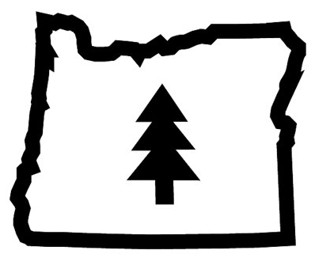
Producing Torrefied Biomass In Eastern Oregon
By: Emma Bergin, Gil Alexander, Taylor Smith, Tyrin Wedlow

Slide 2
Our Objective
Can we develop and establish an efficient supply chain that not only harvest and manipulates torrefied biomass from local state forest and implement a solid transportation line at/ or under the cost of coal ($450) a ton?
Execution: Our team will look into existing and developing markets for Biomass that allows us to develop a plan that meets the expectations PGE has set to convert to a renewable source of energy by 2020. Our team will provide in depth research, collect data, and apply strategic methods that allow us to look at both external and internal factors when using professional judgement to analyze the cost of producing torrefied biomass (onsite) in three major National Forests(Ochoco NF, Umatilla NF, and Wallowa-Whitman NF) along with the transportation costs of shipping the torrefied biomass to the Boardman Plant.

Slide 3
Overview
PGE- Boardman Plant
Advantages & Disadvantages of Switching to Torrefied Biomass
Biomass Resources in United States/ Oregon/ 3 National Forests
Supply Chain Costs
Labor
Mobile Units
Transportation
Total Costs
Conclusion
Recommendations

Slide 4

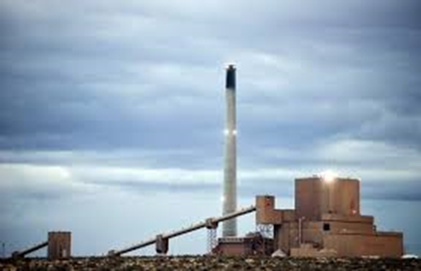
PGE Plant- Boardman Oregon
Coal- Fired Power Station
Single largest source of greenhouse gas emissions in the state
Signed Voluntary Decree to stop using coal by 2020
Wants to switch to torrefied biomass
600 Mega Watt (MW) capacity
Currently burns 8,000 tons of coal daily
8,000 tons of Torrefied Biomass* 3 (ratio from raw to torrefied)*365 days= 8,760,000 tons torrefied biomass per year.
Spends approximately $3,600,000 on coal daily

Slide 5
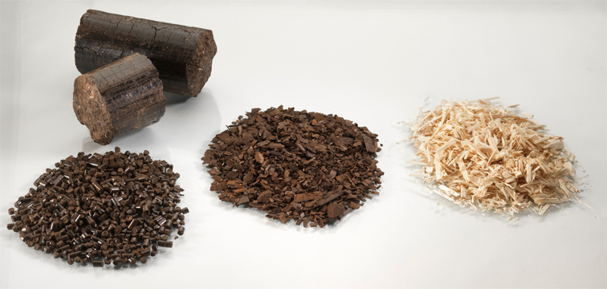
PGE Demands
Need approximately 8,000 tons of Torrefied Biomass per day
2,920,000 tons Torriefied Biomass per year
https://www.google.com/search?q=torrefied+biomass&espv=2&source=lnms&tbm=isch&sa=X&ved=0ahUKEwiksY_v-MrSAhUY0WMKHXTpB00Q_AUIBigB&biw=1440&bih=770#imgrc=u_DgTCfHI41e9M:

Slide 6
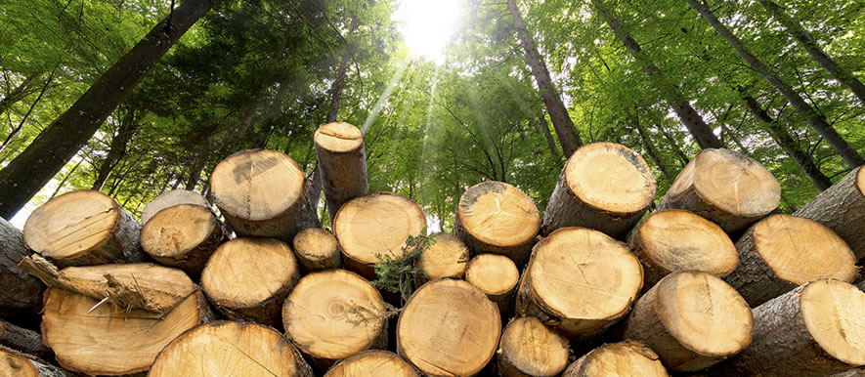
Background Information and Definitions
Biomass: “Energy. Organic matter, especially plant matter, that can be converted to fuel and is therefore regarded as a potential energy source” (Biomass, 2017).
Notes:
1. Densified Biomass: Raw biomass materials are usually irregular in shape, contain low energy density, are greatly affected by temperature/ moisture, and can be problematic to transport. As a result to classify and treat biomass as a common fuel it needs to have the characteristics of a common fuel, which can be achieved through the densification process. Densification creates a regular and usable shape, as well as increasing its energy density, reduces the effects of temperature and moisture, and making it easier to transport.
Densification increases the amount of energy stored per unit volume (typically defined as BTU/lb). Wood in its raw form has an energy density of about 7,600-9,600 BTU/lb, wood pellets are about 8,200 BTU/lb. Torrefied pellets have an energy density range of 9,000 -10,800 BTU/lb.
3. Biomass Feedstock:
Biomass fuel pellets can be manufactured from various types of biomass feedstocks. These inputs range from corn stover and straw like hays to hardwoods and plant materials. Usually inputs used to make wood pellets are derived from an established and well planned biomass waste stream such as sawdust from a mill, trees killed by pine beetles, clean waste wood from construction or furniture making, or etc. In Oregon, joint agency projects such as the Blue Mountains Forest Resiliency Project, and logging and mill residues will help to generate the required feedstocks as well as establish a solid and well planned biomass waste stream. Since the type of raw material determines the amount of grinding and drying needed before the conditioning process. Wood feedstock not in a raw state would require minimal grinding and drying.
Torrefication 1. Process is a closely related to that of charcoal production, but the torrefaction process is handled in a much more controlled environment
2. Torrefied biomass has favorable combustion properties which in most cases include better mechanical properties and higher energy density.
BTU: The British thermal unit is a traditional unit of heat; it is defined as the amount of heat required to raise the temperature of one pound of water by one degree Fahrenheit. ... Heat is now known to be equivalent to energy, for which the metric unit is the joule; one BTU is about 1055 joules.

Slide 7
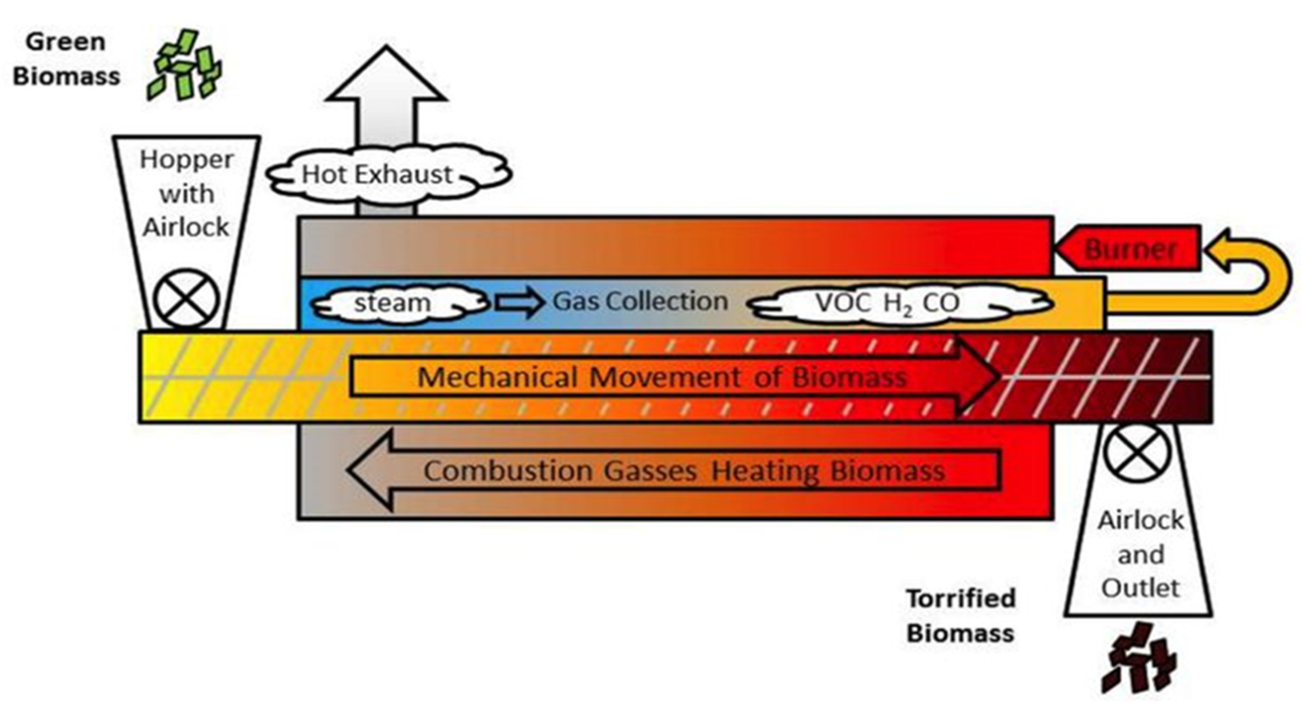
Torrefication Process
Torrefication:
“Thermal conversion method of biomass in the low temperature range of 200–300 °C. Biomass is pre-treated to produce a high quality solid biofuel that can be used for combustion and gasification.” (Biomass upgrading by torrefaction for the production of biofuels: A review, 2017)
Notes:
Raw biomass is densified to increase the energy content of the per unit weight so it can be comparable to oil, propane, and other fuels.
Biomass Densification Includes:
Feeding the feedstock into a dryer.
Grinding it to the required size.
Conditioning the mixture, which involves reducing moisture of the feedstock for efficient use with pellet equipment.
Pelletizing, cooling and screening the pellets.
Packaging the product for storage, shipping and sales.

Slide 8
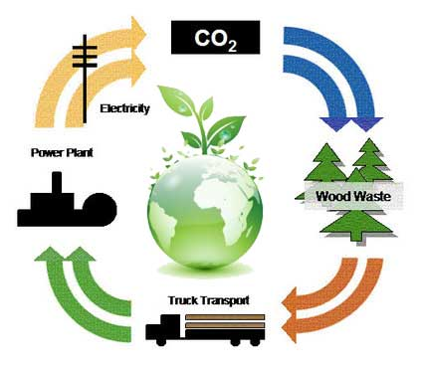
Advantages- Switching to Biomass Fuel
Biomass is widely available
Technology for production and conversion is well understood
Suitable for small or large applications
Production and utilization requires only low light intensity and low temperature (535C)
Flexible storage and transportation options
Low or negligible pollution
No Harmful Emissions
Abundant and Renewable
Notes:
No Harmful Emissions: Biomass energy, for the most part, creates no harmful carbon dioxide emissions. Many energy sources used today struggle to control their carbon dioxide emissions, as these can cause harm to the ozone layer and increase the effects of greenhouse gases, potentially warming the planet. It is completely natural, has no such carbon dioxide side effects in its use.
Abundant and Renewable: Biomass products are abundant and renewable, since they come from living sources. These products potentially never run out. In the United States and Russia, there are plentiful forests for lumber to be used in the production of biomass energy.

Slide 9
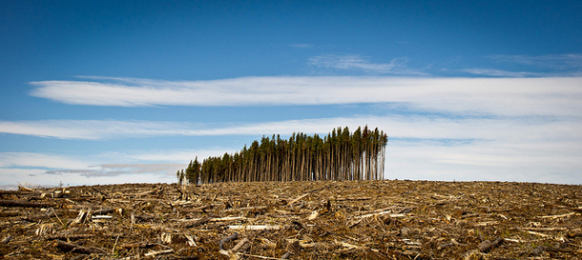
Disadvantages- Switching to Biomass Fuel
Consume More Fuel: Some researchers believe using trees and tree products to power machines is inefficient
Additional work is needed in areas to develop efficient harvesting methods
Land used for energy crops might be in demand for other purposes, such as farming, conservation, housing, resort or agricultural use
Notes:
1. To amass enough lumber to power a power plant, companies would have to clear considerable forest area. This results in major topological changes and could possibly destroys the ecosystems.

Slide 10
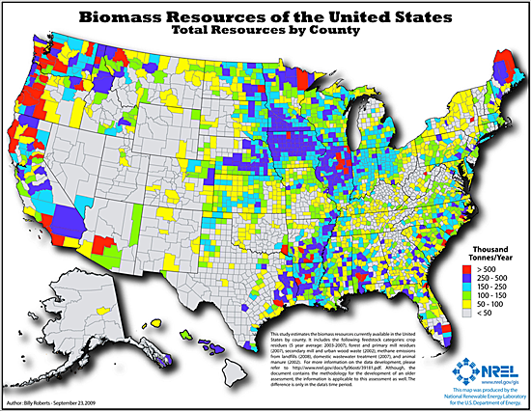
https://www.wbdg.org/resources/biomass-electricity-generation

Slide 11
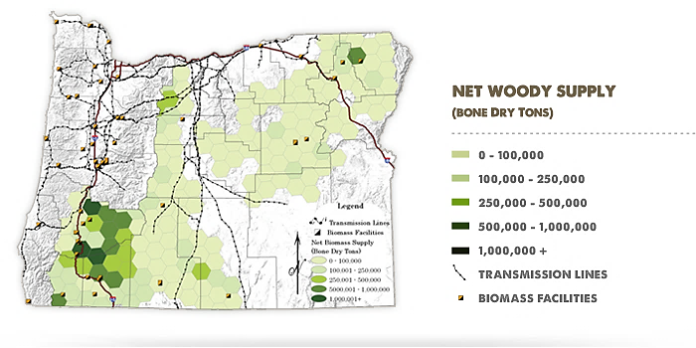

2.7 Billion tons of live and dead trees in the whole state of Oregon
https://www.google.com/search?q=biomass+in+oregon&espv=2&source=lnms&tbm=isch&sa=X&ved=0ahUKEwiHoIvo4afSAhVJ3mMKHT0nAqgQ_AUICSgC&biw=1440&bih=745#imgrc=rTD95pPBWG-aeM:

Slide 12
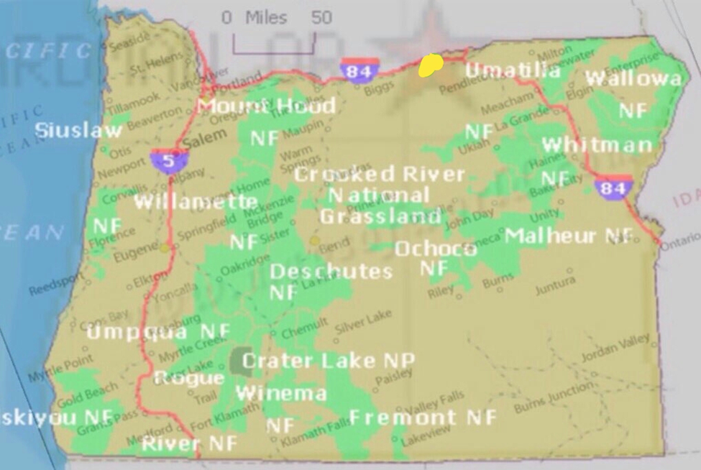
Boardman PGE Plant
Notes:
This image is very helpful because not only does it show The location of the Boardman PGE plant, but it also shows the major highways (red line) that go through out the entire state of Oregon, as well as Eastern Oregon's Rail ways (Dotted line) and The 3 national forest we intended to pull from (green areas/ circled)

Slide 13
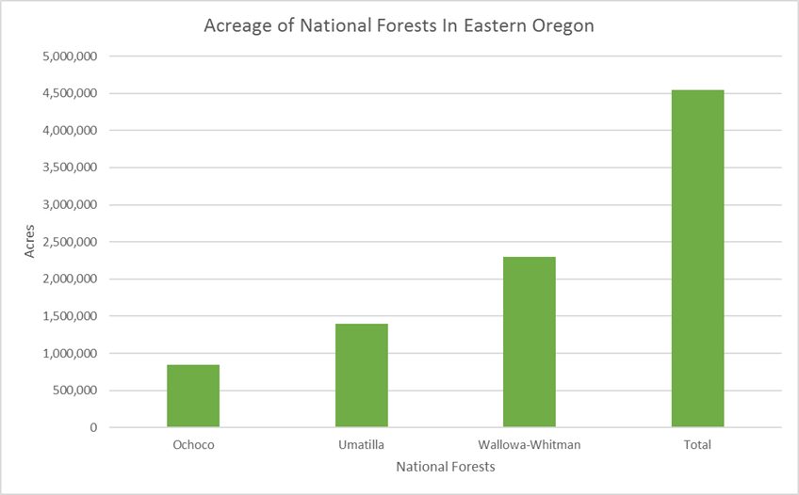
Ochoco: 845,498 acres
Umatilla: 1.4 million acres
Wallowa: 2.3 million acres
Total Acres: 4,545,498 acres

Slide 14
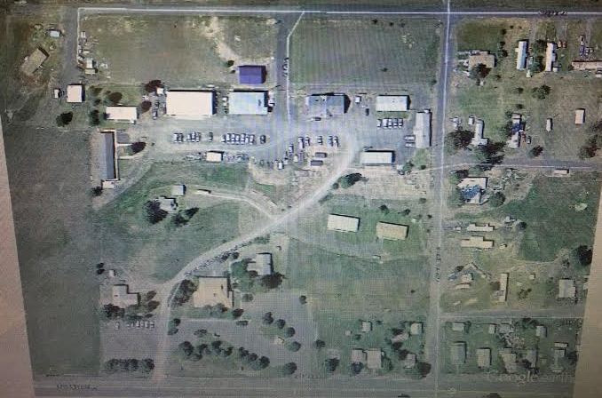
Compound Map
This image shows the government compound where, we would station and operate our mobile units, or accumulate and store the harvested biomass on site.
This could be a very good opportunity because it helps provide PGE with a place to operate their machines, and gives the agency a place to dispose the harvest timber toward a good cause.

Slide 15
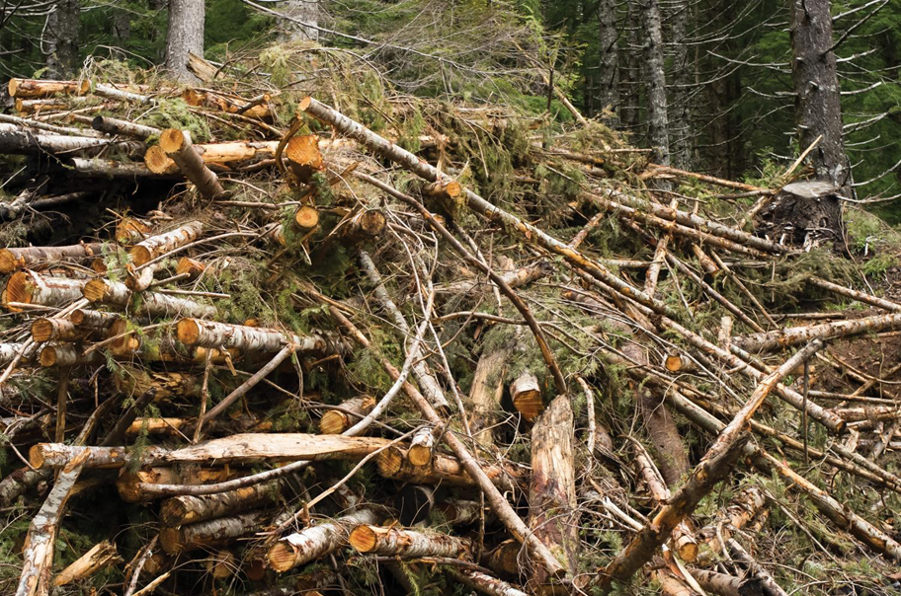
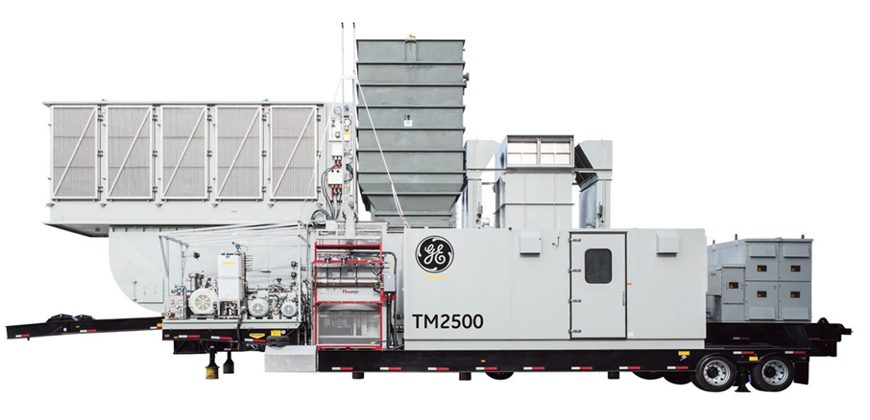
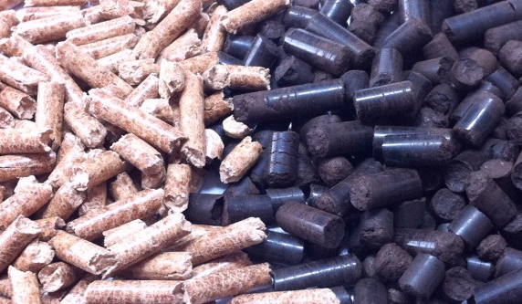
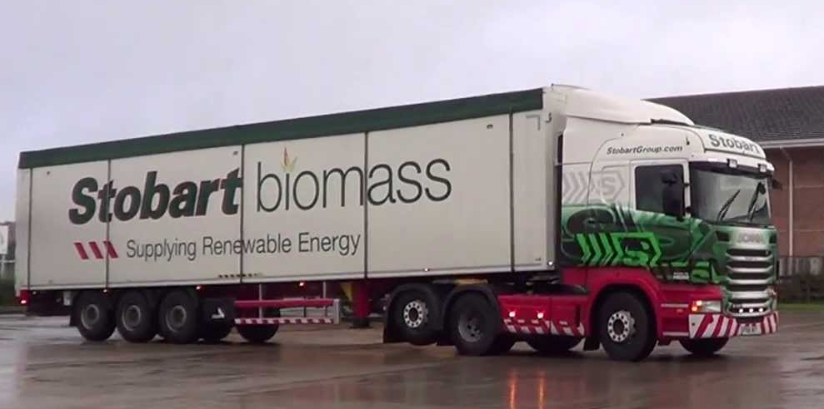
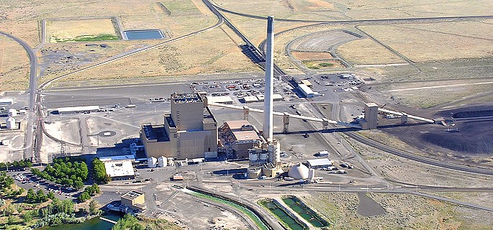
Supply Chain
Raw Material
Mobile Torrefication Processor On-Site
Transport Torrefied Biomass By Truck to Boardman Plant

Slide 16

Harvest Raw Biomass:
Partner with Blue Mountain Resiliency Project
Treatments are recommended for 610,000 acres within the three forests
Oregon Locations:
Ochoco National Forest
Umatilla National Forest
Wallowa-Whitman National Forest
https://www.google.com/search?q=biomass+in+oregon&espv=2&source=lnms&tbm=isch&sa=X&ved=0ahUKEwiHoIvo4afSAhVJ3mMKHT0nAqgQ_AUICSgC&biw=1440&bih=745#imgrc=A40UW3Cm682NvM:
Notes:
Blue Mountain Forest Resiliency Project is an effort that the EPA and other agencies have developed in order to protect our national forests from dry, overcrowded and vulnerable to unusual outbreaks of insects, diseases, and wildfires.

Slide 17
Best to Use Mobile Units Closest to Harvest of Raw Material
Torrefaction substantially reduces the moisture content of the wood chips used and increases the BTU value per ton.
If Torrefied Wood is pelletized, the density is doubled and transport costs reduce by 1/3 of the cost/ton mile associated with transporting green wood chips.
Notes:
Torrefied Biomass: 10,000- 11,200 BTU/ Ton
Fossil Coal: 6,400- 12,500 BTU/ Ton
(Torrefication 2017)

Slide 18
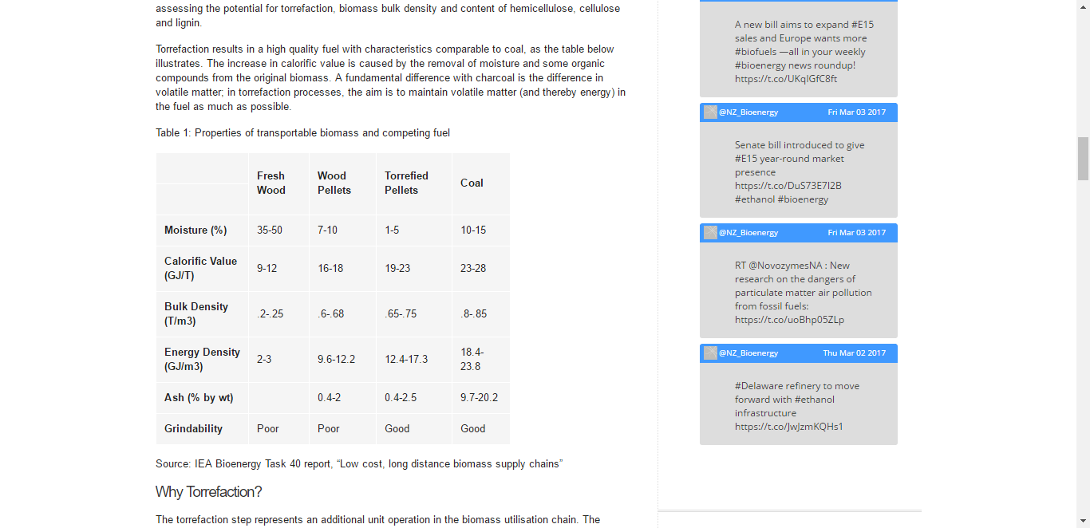
Raw Wood Torrefied Biomass Ratio
3:1 ratio for Fresh wood versus torrefied Biomass
.75/.25= 3
8,000 tons of torrified Biomass* 3= 24,000 tons of raw material needed daily
https://mail.google.com/mail/u/0/#inbox/15a9c52e99dfc35b?projector=1
Notes:
This slide shows the raw wood to terrified biomass ratio, which is important because it helps us furcate the amount of raw materials we’d need to supply and power the plant. This was important because we found that there's a 3:1 ratio from raw wood to terrified biomass which just further goes with our findings that we need a really large amount of raw materials to make our project viable.
Green wood 45-50% of water

Slide 19
Fire Crew Production Rates
Production Rates Vary Seasonally
1 Forest Service Crew produces appx. 2,000-3,000 tons/raw material per day
Approximate Number of Fire Crews in 3 Forests: 11 Crews
11 Crews*2,500 tons= 27,500 tons
Crews that produce the material would need to have means of transportation and qualified personnel to do so
Material could come from old burns i.e. Tower Burn on Umatilla District (50,000+Acres)
Thinning or Road Clearing

Slide 20
Cost of Labor to Extract Enough Raw Biomass to Fuel Boardman Plant Daily
Forest Service Rates:
GS-03 / GS-04 employees (seasonal May-October) make $12.65 - $13.45 per hour.
GS-05 + (permanents) make $14.00 + an hour but would only supervise project work during seasonal hours.
Gas Costs for Labor Varies
1 Crew
Approximately 8 gallons of gas for saws
12 gallons of gas for vehicles
Gas $2.75*20*11= $605
Oil, fuel, maintenance costs for Saws.
11 crews*10 people*13.00/hr= $15,730
Total: $16,335

Slide 21
Approximate Amount of Raw Biomass Harvested for Fire Reduction in Eastern Oregon National Forests
Ochoco 3 crews* 2,500
Umatilla
Wallowa-Whitman 5 crews*2,500
27,500 tons
Based on consistent “project work” FS style with 3-10 Saws running
Possibility of already burned material to be harvested

Slide 22
Clear Cut Acres
1 year
Running 15% of PGE plant would require 500,000 tons of biomass pellets
100% switchover would require 3.3 million tons of biomass pellets.
55 million tons of wood= 650,000 clear-cut acres assuming average forest biomass per acre in the US (http://www.pfpi.net/biomass-basics-2)
55 million tons of wood/ 3 (ratio from raw to torrefied biomass)= 18.3 million tons of torrefied biomass
18.3 million tons of torrefied biomass/3.3 million tons of torrefied biomass (100% switchover) = 5.5
650,000 clear cut acres/ 5.5= 118,181 clear cut acres needed to fire plant for 1 year
Notes:
This slide shows our calculations for how many clear cut acers we would need to fire the plant

Slide 23
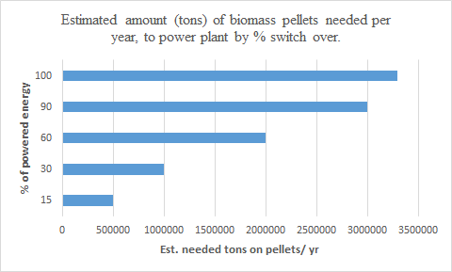
Notes:
This slide talks shows the amount of terrified pellets needed to run the plant at various levels of energy.
If PGE was to follow its original plan of switching to a renewable source and burn less coal its going to need a significantly large amount of pellets to be efficient.
This slid is very important because it helps provide PGE with a solid graphic that shows them their energy output burning torriefied pellets at various levels.

Slide 24
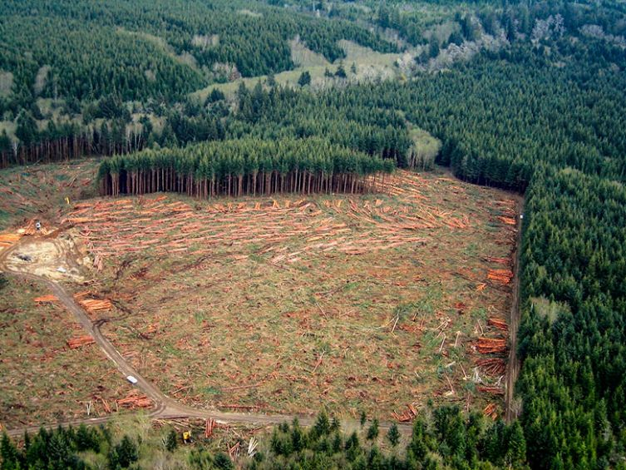
Clear Cut Forest

Slide 25
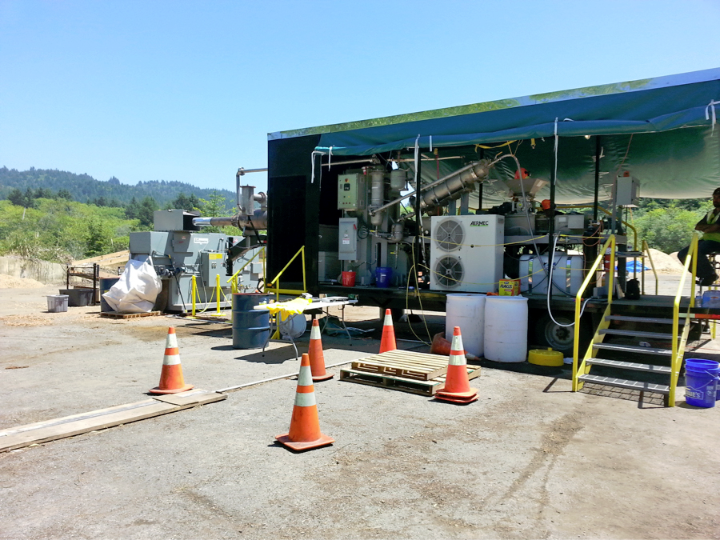
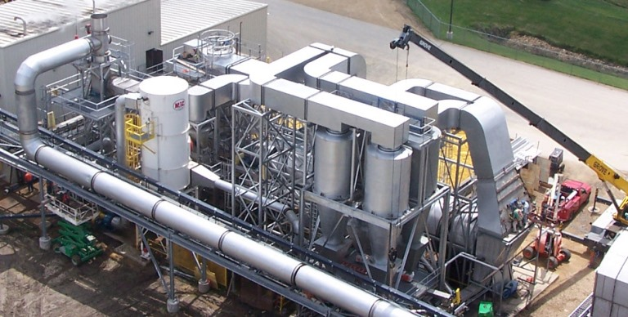
Torrefication Machines
Mobile Unit Cost: $850,000
Moveable
Torrefied Biomass Production
4 Tons Hourly
96 Tons Daily
Stationary Plant Cost: $9,000,000
Torrefied Biomass Production
15,000- 20,000 Tons Hourly
360,000- 480,000 Tons Daily
Our team recommends starting out with mobile units positioned closest to the harvest site and then investing in a Stationary Torrefication Plant after gaining insight on the supply chain process.

Slide 26
Mobile Units
8,000 Tons/ 96 Tons (How much a mobile unit is able to produce per day)= Would Need 84 Mobile Units Operating At Full Capacity.
In order to Produce enough Torrefied Biomass to Fuel the Boardman Plant 100% it would be necessary to build a Stationary Torrefication Processing Plant.
Hard to meet the biomass fuel expectation- would take more than just thinning forests.

Slide 27
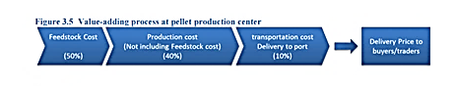
Mobile Unit Operation Cost

Slide 28
Mobile Plant Production Costs
Fixed Cost
Variable Cost
Fixed Cost (Annual Depreciation+ Fixed Operational and Maintenance Costs)
$22.41 /ton pellet: $5.00/ ton pellet= $27.41
6,808 tons* $27.41= $186,607.28
1 ton of pellets we need 400-600 Kilowatts hours of energy
(1kilowat= 9.8 cents in Oregon)
9.8 cents*600KW= $58.80
$58.80*6,808 tons= $400,310.40
Total Operation Cost: $586,917.68

Slide 29
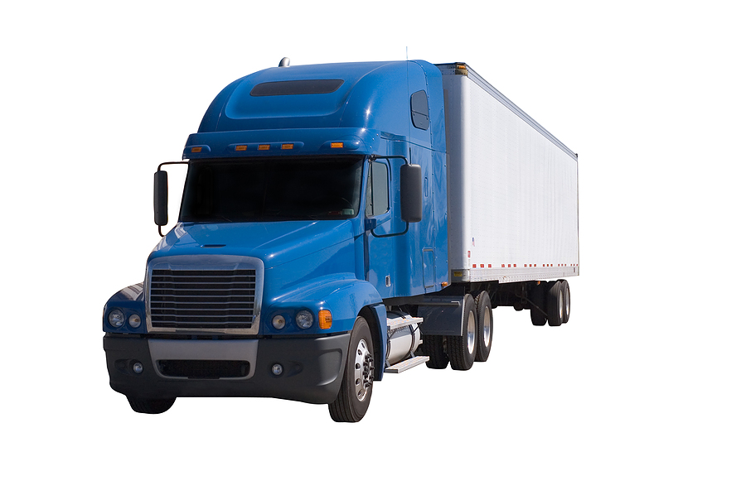
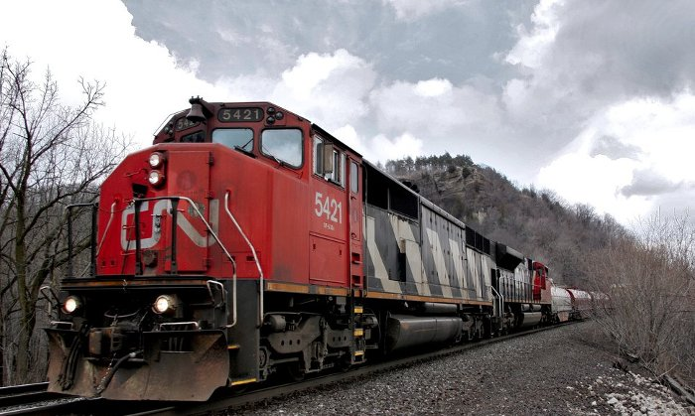
Transportation

Slide 30
Semi Truck Versus Railroad Containers
Semi-Trucks
Railroad
Ideal for Shorter distances
Faster Mean of Transportation
Longer Distances
Economies of Scale

Slide 31
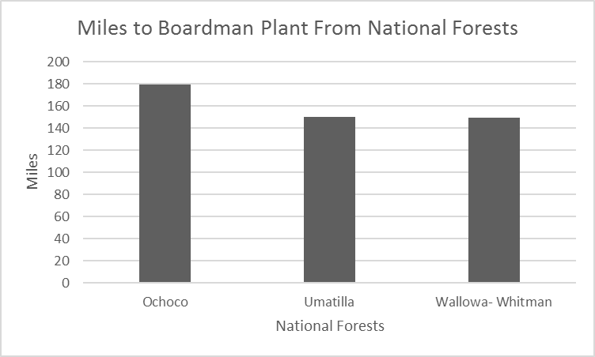
National Forests & Distances to PGE
Ochoco National Forest: 179 Miles
Umatilla National Forest: 150 miles
Wallowa-Whitman National Forest: 149 miles

Slide 32
Tons Per Truck Load
1 Semi Truck- Legal payload 42,000 to 52,000 lbs.
(http://www.forestbioenergy.net/training-materials/fact-sheets/module-4-fact-sheets/fact-sheet-4-5-biomass-transportation-and-delivery/)
1 Ton= 2,000 Lbs.
42,000/2,000= 21 tons 52,000lbs/2,000=26 tons
1 Truck Load Could Carry 21-26 tons of Torrefied Biomass.
If a Mobile Unit Produced 96 Tons a Day it would take between 4-6 Truckloads to Transport that material.
PGE Needs 8,000 Tons to run completely on torrefied Biomass/ 21 tons= 381 Truckloads Daily

Slide 33
Cost of Transportation- Semi-Truck
Cost of purchasing a semi truck $164,000 http://www.lonemountaintruck.com/inventory/
Purchase 192 trucks
Initial Cost: $31,488,000
Those Trucks will be delivering 296 Loads a Day.
296 Loads*23 tons=6,808 tons a day
Does not meet our need of 8,000 tons a day
This is the maximum capacity!

Slide 34
Cost of Transportation by Semi-Truck
http://gasprices.aaa.com/

Slide 35
Total Cost
Labor Costs/ Day: $16,335
Production
Mobile Plant Purchase: 850,000*84 Mobile Plants= $71,400,000
Cost of Operating/ Day=$586,917.68
Transportation
Semi Truck Purchase= $31,488,000
Fuel Cost/ Day=$36,697.80
Initial Purchasing Costs: $102,976,000
Per Day Costs: $639,950.48
Total Cost: $103,615,950.48

Slide 36
Coal vs. Torrefied Biomass
Coal
Torrefied Biomass
$3,600,000 per day
$639,950.48 per day

Slide 37
Conclusion
Not enough raw material from the 3 National Forests we focused on
Recommend- Looking into pulling more raw material from other forest in Oregon. Continual Harvest
Transportation- At full capacity from 84 mobile units it is still not possible to move enough material based off of speed of production and the distances to the Boardman Plant
Need more labor help than just fire crews
Recommend- PGE hiring more crews

Slide 38
Works Cited
Biomass. (n.d.). Retrieved February 23, 2017, from http://www.dictionary.com/browse/biomass
Biomass upgrading by torrefaction for the production of biofuels: A review. (n.d.). Retrieved February 23, 2017, from http://www.sciencedirect.com/science/article/pii/S0961953411003473
Torrefaction. (n.d.). Retrieved February 23, 2017, from http://www.aeonnrg.com/torref.aspx
O., O., & O. (2006). Oregon Biofuels and Biomass . Woody Biomass in Oregon - Current Uses, Barriers and Opportunities for Increased Utilization, and Research Needs . Retrieved February 23, 2017, from http://owic.oregonstate.edu/sites/default/files/pubs/biomass.pdf
http://www.forestbioenergy.net/training-materials/fact-sheets/module-4-fact-sheets/fact-sheet-4-5-biomass-transportation-and-delivery/
https://snrecmitigation.wordpress.com/2009/04/24/pipes-trains-and-trucks-how-to-move-biomass-cost-effectively/
https://www.fs.fed.us/rm/pubs_other/rmrs_2014_keefe_r001.pdf
http://oregonforests.org/content/woody-biomass
(http://www.forestbioenergy.net/training-materials/fact-sheets/module-4-fact-sheets/fact-sheet-4-5-biomass-transportation-and-delivery/)

Slide 39
Manning, R. (n.d.). PGE Considering Fate Of Boardman Coal-Fired Plant. Retrieved March, 2017, from http://www.opb.org/news/article/pge-considering-fate-boardman-coal-fired-plant/
News. (2015, July 05). Retrieved March, from http://biomassa.de/news-development-of-torrefied-pellets-market-in-germany-14.html
Oregon. (n.d.). Retrieved March, 2017, from https://www.fs.fed.us/pnw/rma/fia-topics/state-stats/Oregon/index.php
Oregonian, M. P. (2010, January 31). Boardman coal-burning power plant may have a future after all: biomass. Retrieved March, 2017, from http://www.oregonlive.com/news/index.ssf/2010/01/coal-burning_power_plant_in_bo.html
Oregonian, S. L. (2010, December 09). PGE's coal-fired Boardman plant gets approval to close in 2020, with fewer pollution controls. Retrieved March, 2017, from http://www.oregonlive.com/business/index.ssf/2010/12/pges_coal-fired_boardman_plant.html
Oregonian/OregonLive, T. S. (2017, January 03). PGE delays biomass test burn at Boardman coal plant. Retrieved March, 2017, from http://www.oregonlive.com/business/index.ssf/2017/01/pge_delays_biomass_test_burn_a.html
SINOVO MACHINERY ENGINEERING. (n.d.). Biomass Pellet Equipment. Retrieved from http://www.simecpellet.com/product/biomass_pellet_equipment/Containerized_Pellet_Mill_Plant.html
Sjoding, D., Kanoa, E., & Jensen, P. (n.d.). Developing a Wood Pellet/Densified Biomass Industry in Washington State: Opportunities and Challenges. Retrieved from https://www.msuextension.org/forestry/WB2E/Pellets/Densified%20Biomass%20Report.pdf
Stelte, W. (n.d.). Fuel Pellets from Torrefied Biomass – The SECTOR Project. Retrieved from https://sector-project.eu/fileadmin/downloads/presentations/DTI_Presentation_Energy_Europe__SECTOR_24May_wst.pdf
Wild, M., & Deutmeyer, M. (n.d.). Possible effects of torrefaction on biomass trade . Retrieved from http://task40.ieabioenergy.com/wp-content/uploads/2013/09/t40-torrefaction-2016.pdf
Wilén, C., Sipilä, K., & Tuomi, S. (n.d.). Wood torrefaction – market prospects and integration with the forest and energy industry. Retrieved from http://www.vtt.fi/inf/pdf/technology/2014/T163.pdf

