Slide 1
Rural Housing Development
By: Joshua Hermans, Corbin Hammond, Olivia Sharp, and Eddy Ramos

Slide 2
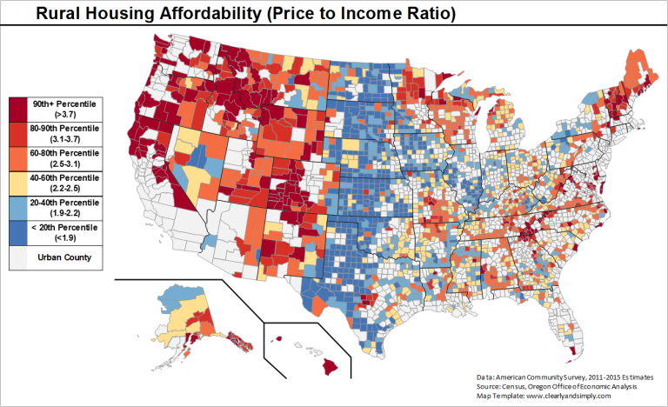
Summary
Shortage of housing
Impairing economy
Difficulty attracting talent
Suffocating expansion
Reduced taxes
60% of median income
Workers middle-class
Notes:
State, community, and business leaders are concerned that a shortage of housing across Eastern Oregon is impairing regional economic opportunity. Low vacancy rates make it difficult
to attract workforce needed for existing businesses to expand and new businesses to locate. This impacts businesses ability to successfully operate in the region, restricts
the number of people who can support local businesses and community projects, and reduces taxes and fees collected by local and state government to fund public services. There are several reasons for this jobs-housing imbalance. Wages for available jobs exceed limits for public housing assistance programs but are not high enough to attract developers and
capital from higher wage areas; projects in rural areas are smaller which combined with lower wages makes them less profitable for developers and builders; and a general lack of recent
development in the region makes it challenging to attract financing. Housing development in rural areas is generally less profitable and more risky than in larger, faster growing urban areas. In order to address these issues local and state policy makers need to be able to understand and share information on local/regional housing demand and leverage resources and assistance across all sectors to help attract builders and developers to increase regional housing availability.

Slide 3
Rural Risk
Changing economy
Single-purpose towns
EOU in La Grande
PSU in Portland
EOU strategic review
Enduring and durable niche

Slide 4
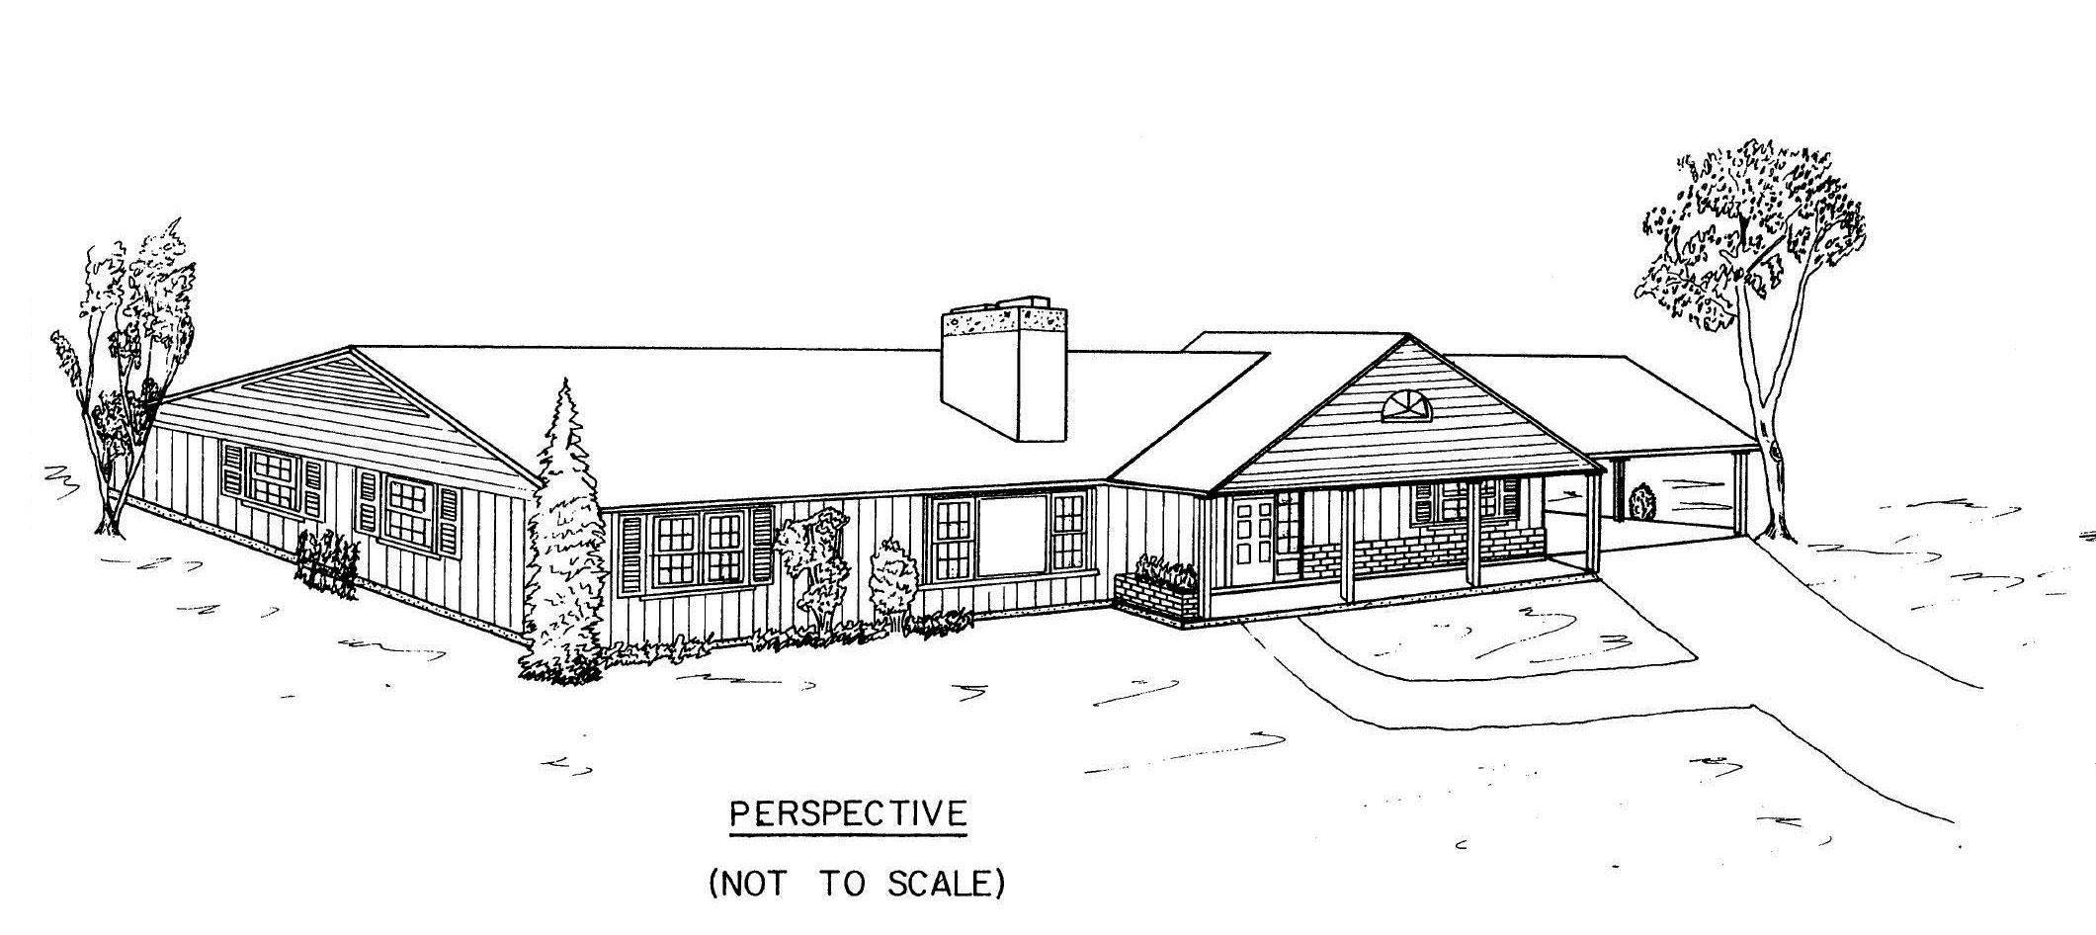
Multi-Family Housing
Single-family vs. Multi-family
Renters vs. Homebuyers
Most cities lose money from residential development
Gain from industrial/commercial
Notes:
When there is talk about a housing crisis in rural areas, the shortage is not normally in single-family dwellings. The problem shows itself more when it comes to multi-family dwellings. This is because it brings up the bias towards homeowners and away from renters. This leads to local politics sometimes obstructing real estate development, in spite of there being a crisis. If the county decides that it wants the development, there are ways that the county and state can work together on making real estate development a reality. The county can petition the state for development up to 10 miles outside of an incorporated settlement with a population of 25,000 or less. There is no settlement in the 10 Eastern Counties that has more than 25,000 citizens. This makes Eastern Oregon the perfect place for the state and the county to work together on development. The question is, what’s in it for the counties?

Slide 5
City Revenue
Employers petition on job opening
List of posts needing to be filled
If housing is an issue:
Community can see housing needs visually
Example: Data center between Port of Morrow-Umatilla (5, 50-70, $70,000)
From their primary source of revenue
Employers may promise expansion if more workers

Slide 6
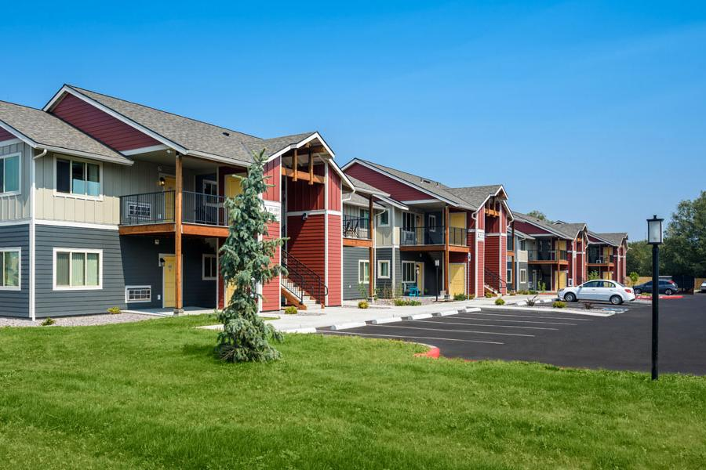
Tax Credits
Motivation for county
Affordable housing
Blue Springs Crossing
Island City
Guardian Real Estate Services
$70,000/year for 10 years
Workforce housing
Notes:
Current policies for affordable housing have worked exceptionally well at motivating local officials, now all that remains is to build that same enthusiasm for workforce housing. Blue Spring Crossings in Island City received $70,000 a year for 10 years for building affordable housing.

Slide 7

Incentives
Current budget
Incentives pay themselves off
Short term incentives
State gets property tax until paid back
County gets paid up front; increases long-term income
State gets steady stream of income
Notes:
Being cognizant of the current budgetary realities in Salem, we are not going to propose massively increasing spending. However, there may be a way for incentives to pay themselves off. If the state provides incentives to the county and developer up front, and then the property tax goes to the state instead of the county until the incentive is paid off, then the county gets paid up front and increases long-term income at the same time. Meanwhile, the state gets a steady stream of income and a return on their investment. The county can start spending their money tomorrow, and more property taxes will be paid on a real estate development than on a field, creating a win-win situation for both parties.

Slide 8

House Bill 4079 Version 2.0
2016 Session
Pilot project communities
Local governments expand Urban Growth Boundary (affordable housing)
Do the same for workforce
Communities not yet chosen
Notes:
In the 2016 Legislative Session, House Bill 4079 passed, allowing local governments to expand their Urban Growth Boundaries for the purpose of siting and developing affordable housing. A pilot project was run in two communities, and Salem is pending their progress report. If things went well, there is no reason this could not be expanded to include workforce housing.

Slide 9

Proper Planning
Communities need to maintain a 20 year supply of land
Budgetary difficulties
Land use planning gets cut
Communities completely unprepared to accommodate rural housing development
Rural communities hit harder
Pool resources at state level?
Notes:
Communities need to maintain a 20 year supply of land. When communities face budgetary difficulties, land use planning is one of the first areas to get cut, leaving communities completely unable to accommodate rural housing development. Communities generally need a 20 year plan/supply for housing. Legal framework can help maintain this balance

Slide 10

Website
One central website
Bidding, contracts
Better organization
Bridge the gap between Urban and Rural developers. Oregon developers not just regional developers.
Site host? OHCS? State Department of Housing?
Notes:
To increase communication and efficiency, it would be best if all bidding and contracts across the state were conducted on one government-run website. This would bridge the gap between urban and rural developers, instead creating just Oregon developers.

Slide 11

Marketing
Increased awareness
Industry & government involvement
Consistent communication
Notes:
These steps, if instituted, would be a major reform of current housing policies. For maximum efficiency, awareness should be widespread throughout the state. This can be accomplished through a successful marketing campaign to industry leaders and relevant government officials. Once established, lines of communication will have to be maintained going into the long-term to prevent this from breaking down years from now.

Slide 12

OHCS
46% of local officials and real estate developers
Had no contact with OHCS in past 3 years
Source: Association of Oregon Counties
Broaden mission
State Housing Department
OHCS
Notes:
The Association of Oregon Counties commissioned a survey, which was passed onto us, that revealed that 46% of local officials and real estate developers had no contact with Oregon Housing and Community Services for three years or more. The extent of the overhaul needed in this agency is not for us to decide. However, we will be discussing later in the presentation ways Oregon’s real estate support services can be reformed.

Slide 13
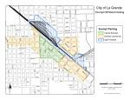
Zoning Dilemma
OR Regional Housing Study:
Local zoning is cited as being in the top five reasons there is a housing crisis
State land use laws are cited as being equally responsible as Local Zoning
Many city zoning and ordinances concerning housing development are outdated
The demand for housing has increased and the available space hasn’t been updated to accommodate this growth (urban growth boundary).
Planning is outdated due to lack of funding
Can be addressed through state funding
Rural Oregon is unique in the way that it has the space to develop (unlike Portland, etc) if it is zoned correctly
Notes:
Land use dilemma: One of the reasons behind the lack of housing development is the lack of buildable land. Between urban growth boundaries, and hindering requirements for parcel size and density, limited land use, along with other guidelines, there is much red tape the developers must go through.
Awaiting an email from LG Planning concerning the outdated zoning.

Slide 14
Inclusionary Zoning
Definition: municipal and county planning ordinances that require a given share of new construction to be affordable by people with low to moderate incomes
Used to create more affordable housing by mandating a % of development to be affordable
Debate as to whether it is the solution
Side A: The supply of affordable houses increases
Side B: The requirements will deter developers from developing
Alternative Solution
Reduce overall developing requirements instead of increasing to increase total supply, economic supply and demand will then balance out driving housing prices down
Notes:
PDX inclusionary zoning has some house developers worried. The zoning decreases the margin of the projects which reduces financing for them. This in turn reduces the amount of developing being done. A lot of builders are suggesting that the goal should be to increase the overall supply of housing development which will create a more buyer friendly environment in the economy, instead of limiting the developers freedoms and forcing them to go elsewhere for more desireable zoning.
Rogers, J. (2017, January 15). DEVELOPERS SPEAK OUT ON HOUSING. Retrieved February 19, 2017, from http://pamplinmedia.com/but/239-news/340162-220159-developers-speak-o

Slide 15

Enterprise Zones
Definition: an area in which policies to encourage economic growth and development are implemented
Traditionally used for industrial, use the model for housing
Types of Incentives include:
Tax concession (a reduction in the amount of tax that has to be paid)
Infrastructure incentives (roads, water, sewer, etc.)
Need to fully align with overall objective (A., 2015)
Notes:
Urban Enterprise Zone policies generally offer tax concession, infrastructure incentives, and reduced regulations to attract investments and private companies into the zones.
Tax Concession: Governments receive interest free federal loans and don’t pay income taxes. Because the USA is becoming privatized, there need to be tax breaks given to them as well to encourage investment and create a level playing field in cases where private companies are competing against government agencies.
Chris Edwards July 24, 2013. (2013, July 24). Encouraging Private Infrastructure Investment. Retrieved February 19, 2017, from https://www.cato.org/publications/testimony/encouraging-private-infrastructure-investment
Infrastructure Incentives: The incentives and penalties in the contract needs to be in line with the overall goal. This will keep the developer honest and you won’t have cases where developers only start developing for the incentive with no true intention of completing the overall goal.
A. (2015, March 21). The Incentives Infrastructure . Retrieved February 19, 2017, from http://calleam.com/WTPF/?p=2965
Reduced Regulation: states receiving federal aid for their facilities have been required to repay the aid if the facilities are privatized, which means state buildings or land couldn’t be converted to housing/apartments. Private companies also need a break from the local level of state to induce development. This could be in property easements, housing density, etc.

Slide 16

Utility Service Coverage (Cost Comparison)
 | La Grande | Portland
Electricity | $92.08 | $99.99
Water | $63.54 | $56.00
Sewer | $38.05 | $59.85
Solid Waste | $21.25 | $27.00
Notes:
***Annotations are to be changed***
This is used to illustrate the significant difference in the utility service coverage. Given of population of Portland (609,456) compared of La Grande (13,074), we are a much smaller community in comparison but pay a significantly higher rate in utility costs. Electricity coverage is 32% higher in La Grande. Water costs are 56% higher in La Grande. Sewer costs are 68% higher in comparison. Solid Waste is 32% higher in La Grande. On average utility service coverage in La Grande is 47% higher than in Hermiston that has a higher population. Because La Grande is a smaller community with a smaller economy, there is a lack of economy as a scale. La Grande’s residential rate for electricity is currently at $9.28, which is that less than the Oregon average rate of $9.80. We aslo are 21.89% lower than the national average rate of $11.88 (Electricity Local, 2017). With La Grande ranking lower than the national average and below our state’s average it shows that we are significantly lower as a whole for Oregon, although Hermiston is more affordable in comparison in Eastern Oregon.
https://www.portlandoregon.gov/cbo/article/392681
https://www.tvwd.org/customer-services/residential-water-rates.aspx#TVWD
$10.72 for average residental electricity rate

Slide 17

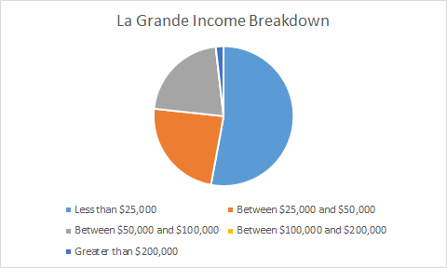
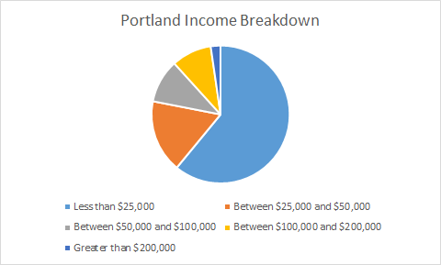
Differences in Income
Notes:
We want to used this to illustrate the income levels in La Grande and how it makes up the working class. According to the US Census, 17% of La Grande households are making incomes that place them at poverty level.
Income Summary for Hermiston, OR
· Household income: The city of Hermiston has a median household income of $54,443, versus $58,522 for the U.S.[4]
· Compared to the U.S.: Median household income in Hermiston is approximately 7 percent less than the median income for the entire United States.[4]
· Poverty level: Approximately 16 percent of Hermiston households have incomes below poverty level.[4]
· Electric bills: The average residential electricity bill in Oregon is about $94/month, ranking 36th in the U.S. and 12.15% less than the national average of $107.[5]
Income Summary for La Grande, OR
· Household income: The city of La Grande has a median household income of $18,602, versus $58,522 for the U.S.[4]
· Compared to the U.S.: Median household income in La Grande is approximately 68 percent less than the median income for the entire United States.[4]
· Poverty level: Approximately 17 percent of La Grande households have incomes below poverty level.[4]
· Electric bills: The average residential electricity bill in Oregon is about $94/month, ranking 36th in the U.S. and 12.15% less than the national average of $107.[5]
(Olivia)
https://www.electricitylocal.com/states/oregon/portland/
Less than$25,000 = 60.9
Between$25,000and$50,000 = 17.1
Between$50,000and $100…= 10.2
Between$100,000and $200…=9.4
Greaterthan$200,00 = 2.3

Slide 18
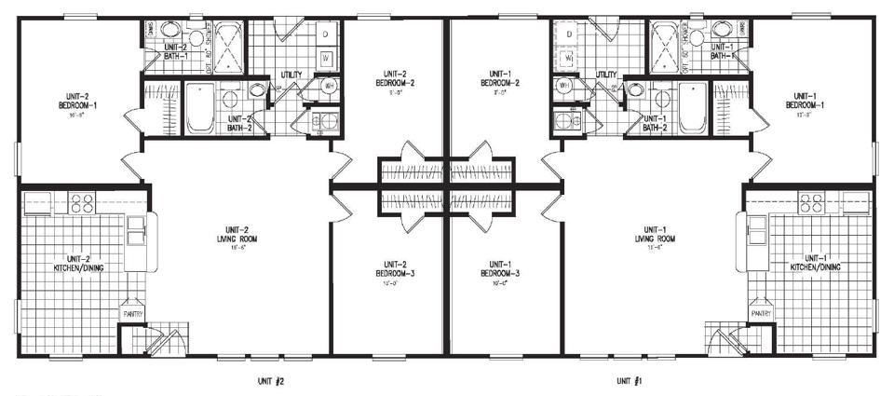
A solution for NIMBY
The opposing of new development
On average an apartment is 861 sq ft vs. average duplex is 900 sq ft.
Cost per sq ft is between $85 to $125 nationally
Potential for development in Island City and Union
Results are seen sooner with duplexes
Notes:
I predict that there will a need for more stable transportation needs for those that use public transportation.
I think that the Not In My Backyard movement is something that could occur in our community and also can be prevented. We have suggested the building of duplexes on properties that are not big enough for apartments but also just too much land for working force to afford. I believe that it would be possible to build at least two duplexes on one property and be able to have their own driveway and backyard space. To the left is an example of how we could build duplexes to still provide space for seperate driveways and also room for a backyard for each duplex. I think that this would be extemely benefical because of the fact that duplexes would be able to house a family more comfortably than in an apartment. I think that with the properties that have not been built on yet there should be restrictions that are made to who the houses are rented to for a 5 year period. A lot of the housing that is rentals in our community are rented to college students and continued to be passed on to college students as seniors graduate. This is a conflict that has restricted housing for the working force.
If developers have the opportunity to build duplexes they could use the the model to the right that would create space between houses and allow each duplex to have its own driveway.
5 to 7 houses (at 3000 sq ft each) can be built on an acre of land in a subdivision (Union and Island City)
http://www.pewtrusts.org/~/media/legacy/uploadedfiles/wwwpewtrustsorg/reports/partnership_for_americas_economic_success/paeshousingreportfinal1pdf.pdf

Slide 19
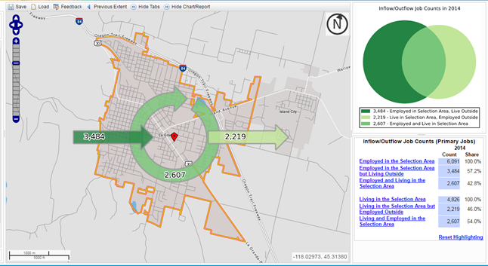
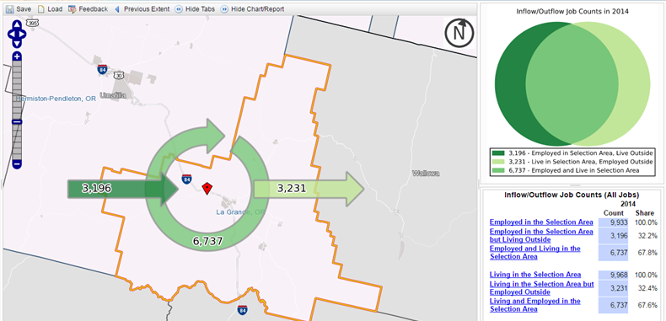
Right: Full-time jobs
Below: All jobs
Flow of Workers
Notes:
2014
The top chart shows the full time jobs of people (in and out of town) who have all benefits.
Below- Includes part -time jobs as well, but they are workers who may also be looking for other jobs.

Slide 20
Isolated
Infrastructures- limited access
ex) Railroad, Trucks, Airports
Services vs. Production
Internet Service
Rural areas 55% vs 94% Urban broadband service
(National Broadband Map)
￼
Notes:
Isolation plays a huge role in the lack of workforce housing in rural oregon. Living in rural oregon is like living on an island in the middle of the ocean. There are not many attractions in the area and people need to travel away from the rural areas into urban cities for services and other goods. Rural areas are practically cut off from important services like railroads, freight truck transportation, and airports that all play a huge part in delivering a goods or services and attracting the best possible workers. Services are beginning to play a major role in business as well. Those jobs that allow people to work from home can be difficult in rural areas. The reason being is that internet access is not the best compared to the access urban areas are used to. This can cause huge issues with communication and processing other important information.

Slide 21
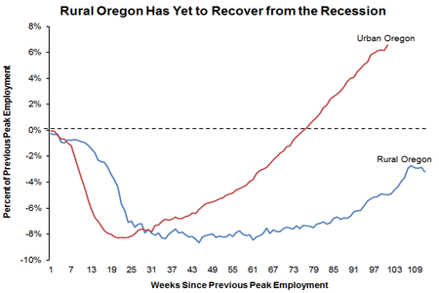
Growth
Notes:
Due to the greater dependence on business and other industries, rural oregon is experiencing much slower growth than urban oregon. This chart shows just how much of a difference that statement of fact is true. While rural areas are experiencing growth, it is still well below levels of pre-recession.

Slide 22
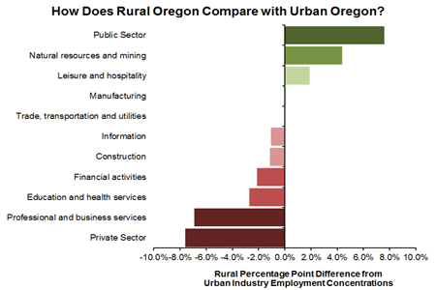
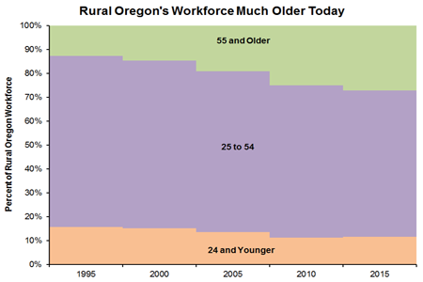
Vulnerable
Dependent
Aging Workers
Notes:
Rural communities are very dependent on large but limited numbers of businesses or industries. The recession caused huge problems for rural businesses and because of that, they have not been able to recover quickly. On the other hand, because urban areas have a wide variety and multiple businesses that offer similar services and products they were able to recover more quickly. Businesses that failed could be replaced by one that got through the recession or were not affected to much. Urban areas offer more options and ease of substitutes for services. The other problem that is affecting the entire state, but mainly rural oregon is that the workforce is getting older. The number of workers age 55 and older has more than doubled (13%-27%) from 1995 to 2015. Millenials are not just looking for a career these days, they are also looking to be active and have a recreational lifestyle. Something that is offered in many urban areas, but it can be something that rural areas can look into developing due to how much open space rural communities offer.

Slide 23
Solutions
Expose Natural features of area
ex) Bend- Deschutes River and Cascades
Diversity
Ease land use planning laws
Notes:
It is hard to try and make quick changes to a rural area in order to attract more workers. However, using the natural features of a particular city can play a helpful role. This can be done by exposing/marketing features of the land/area and offering recreational sites to attract tourism in the hopes of the tourists staying and making a living in the area. Easing the land use laws can also help by allowing contractors to build in what is now restricted land to offer a variety of living spaces and bring in new businesses for a more diverse and less dependent industry.

Slide 24
Conclusion
Workforce housing falls through the cracks
Solutions to close the gap
Pooling resources, community resources, expanding services
Zoning
Needs to be updated
Enterprise Zoning shows promise and merits further exploration
Cost of living in rural communities needs to be considered
Encouraging and inviting new and different business can help attract new workers to live in rural areas.

Slide 25

Special Thanks
Becky Steckler, Oregon Chapter of the American Planning Association
Gordon Howard, Principal Urban Planner
Phillip Scheuers

Slide 26
References
Oregon Office of Economic Analysis Website (price to income ratio map)
Electricity Local (http://www.electricitylocal.com/states/oregon/la-grande/#ref)
US Census (onthemap.ces.census.gov) (flow of worker graphs)
Pinnacle Architecture for the image of Blue Springs Crossing

