Slide 1

Eastern Oregon University
eCommerce
eCommerce
101

Slide 2
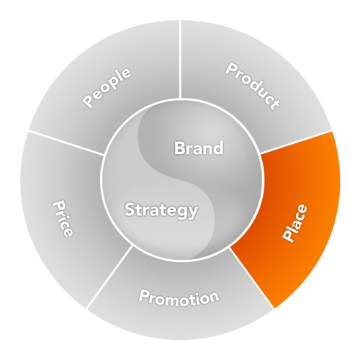
Promotion
Compliment the Channel
2017 MOST firms
need a presence
online
Marketing
Mix
growing
% of businesses
operate ONLY online
video
:30

Slide 3
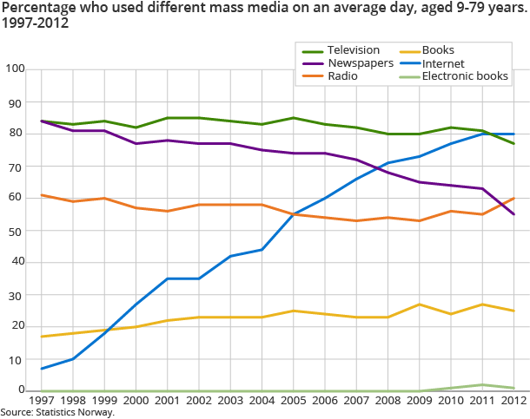
Popular Media
Consumption Trends

Slide 4
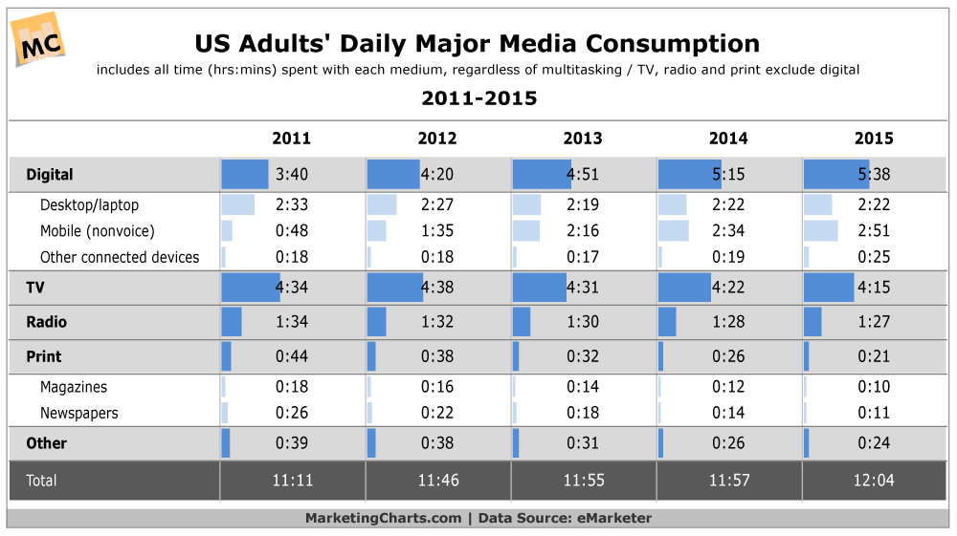
Popular Media
Consumption Trends

Slide 5
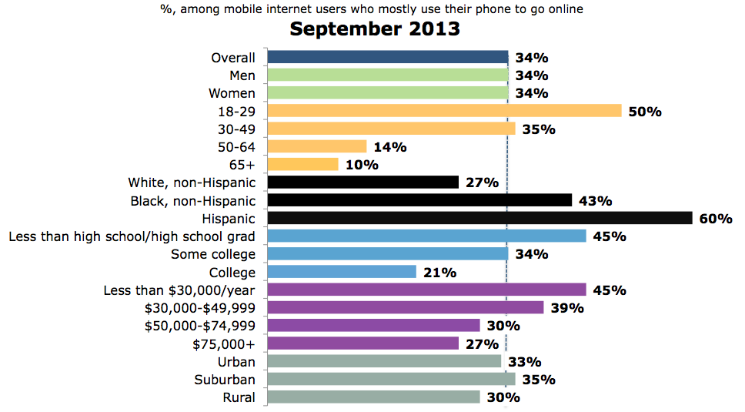

Internet Audience
“Cell-Mostly” Internet Users
Source: Pew Research Center Internet Project Survey

Slide 6
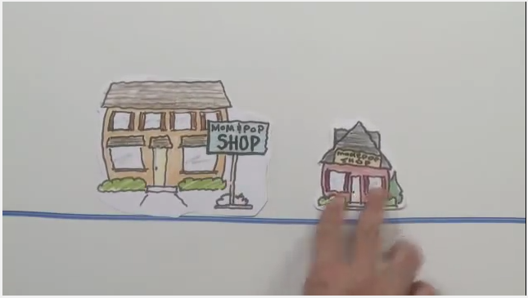
Step One: Get Online
Overview
video
3:41
https://www.youtube.com/watch?v=-msld_7j7T0

Slide 7
Step One: Get Online
Select a Strategy
build
credibility
lead
generation
eBusiness
Goal(s)
eCommerce
Internet + Intranet
service
directories
website builder
directories
website builder
Amazon
eBay…
shared
hosting
Wix, Squarespace
Hosted CMS
Hosted CMS
Shopify …
dedicated
hosting
CMS
custom cart
CMS
custom cart
career:
Information
Technology
custom cart
enterprise app
custom cart
enterprise app
co-location
picture
on premise
accounting
ERP, workflow…
Goal(s) & Budget Should Drive Selection

Slide 8
Step One: Get Online
Select a Strategy
build
credibility
lead
generation
eBusiness
Goal(s)
eCommerce
Internet + Intranet
directories
website builder
directories
website builder
Amazon
eBay…
service
Free/small $
shared
hosting
Wix, Squarespace
Hosted CMS
Hosted CMS
Shopify …
dedicated
hosting
CMS
custom cart
CMS
custom cart
career:
Information
Technology
custom cart
enterprise app
custom cart
enterprise app
co-location
Big $$$
on premise
accounting
ERP, workflow…
Goal(s) & Budget Should Drive Selection
Data Center
Build-out
video
4:31

Slide 9
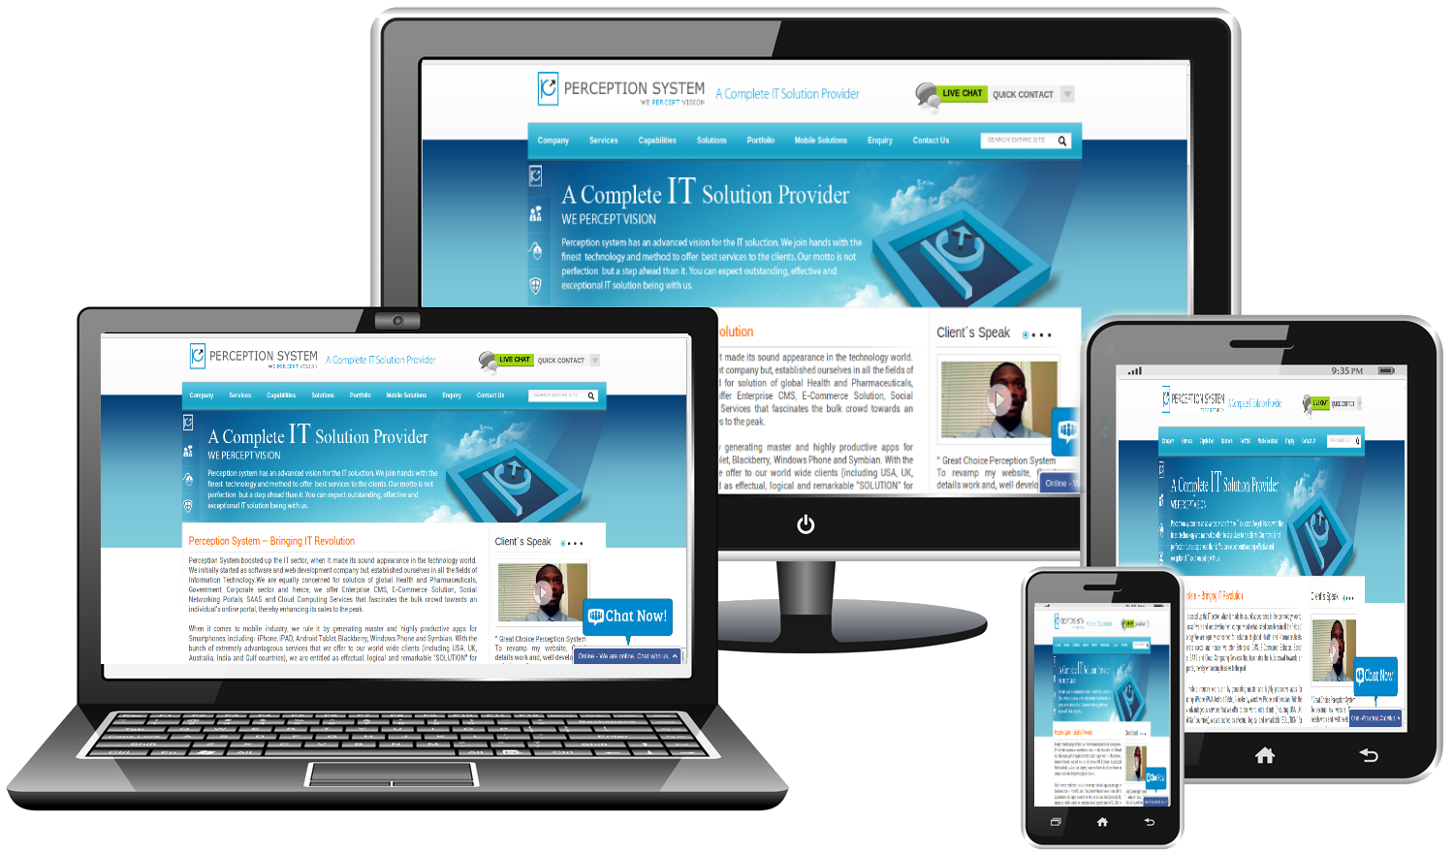
Step One: Get Online
Responsive Design

Slide 10







Step One: Get Online
Marketplace
career:
Entrepreneur
video
3:35
lot’s more audience specific markets…
marketplaces help drive traffic…
marketplaces have a price…

Slide 11





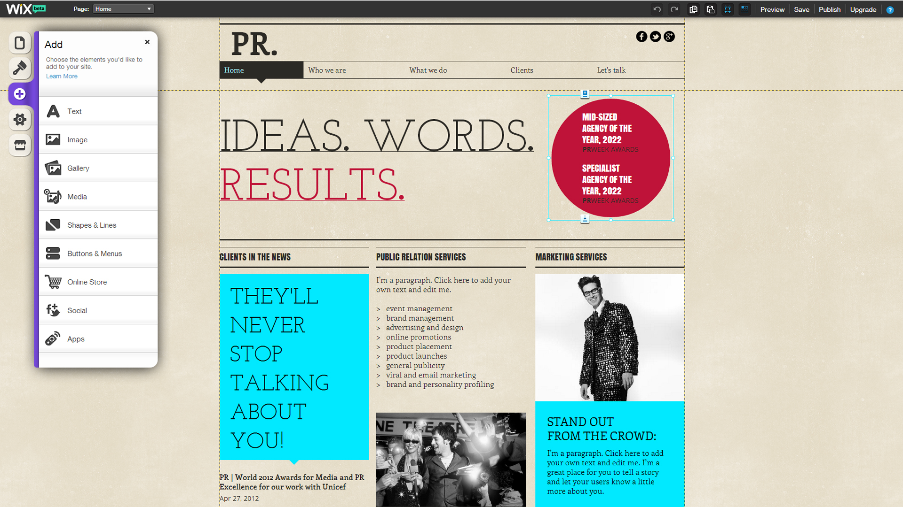

Step One: Get Online
Website Builder
career:
Entrepreneur
Many others to choose from…
video
4:25

Slide 12
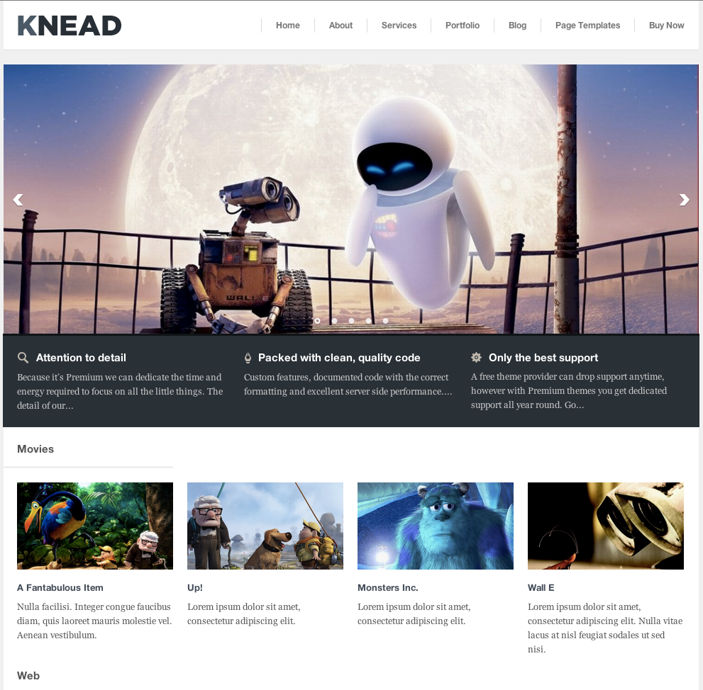

Step One: Get Online
Configuration Management System (CMS)
career:
Web Designer
Themes
Widgets
Plug-ins
eCommerce
SEO
…
WordPress
Joomla
Drupal
video
9:30

Slide 13
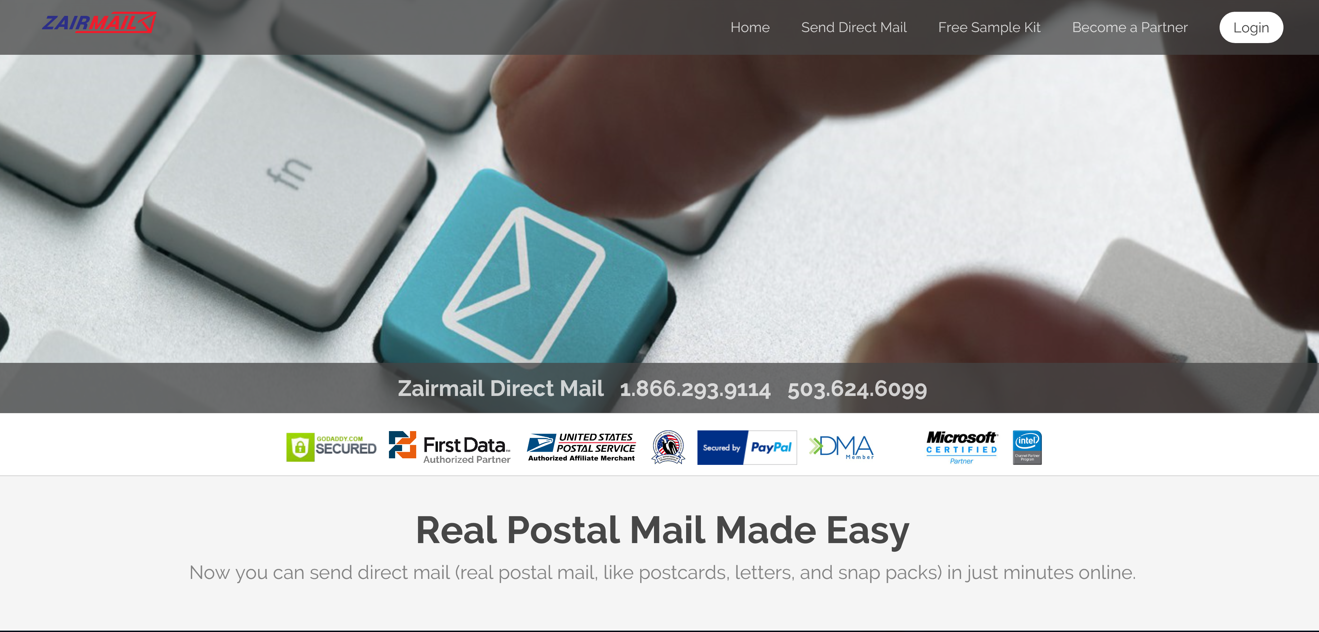
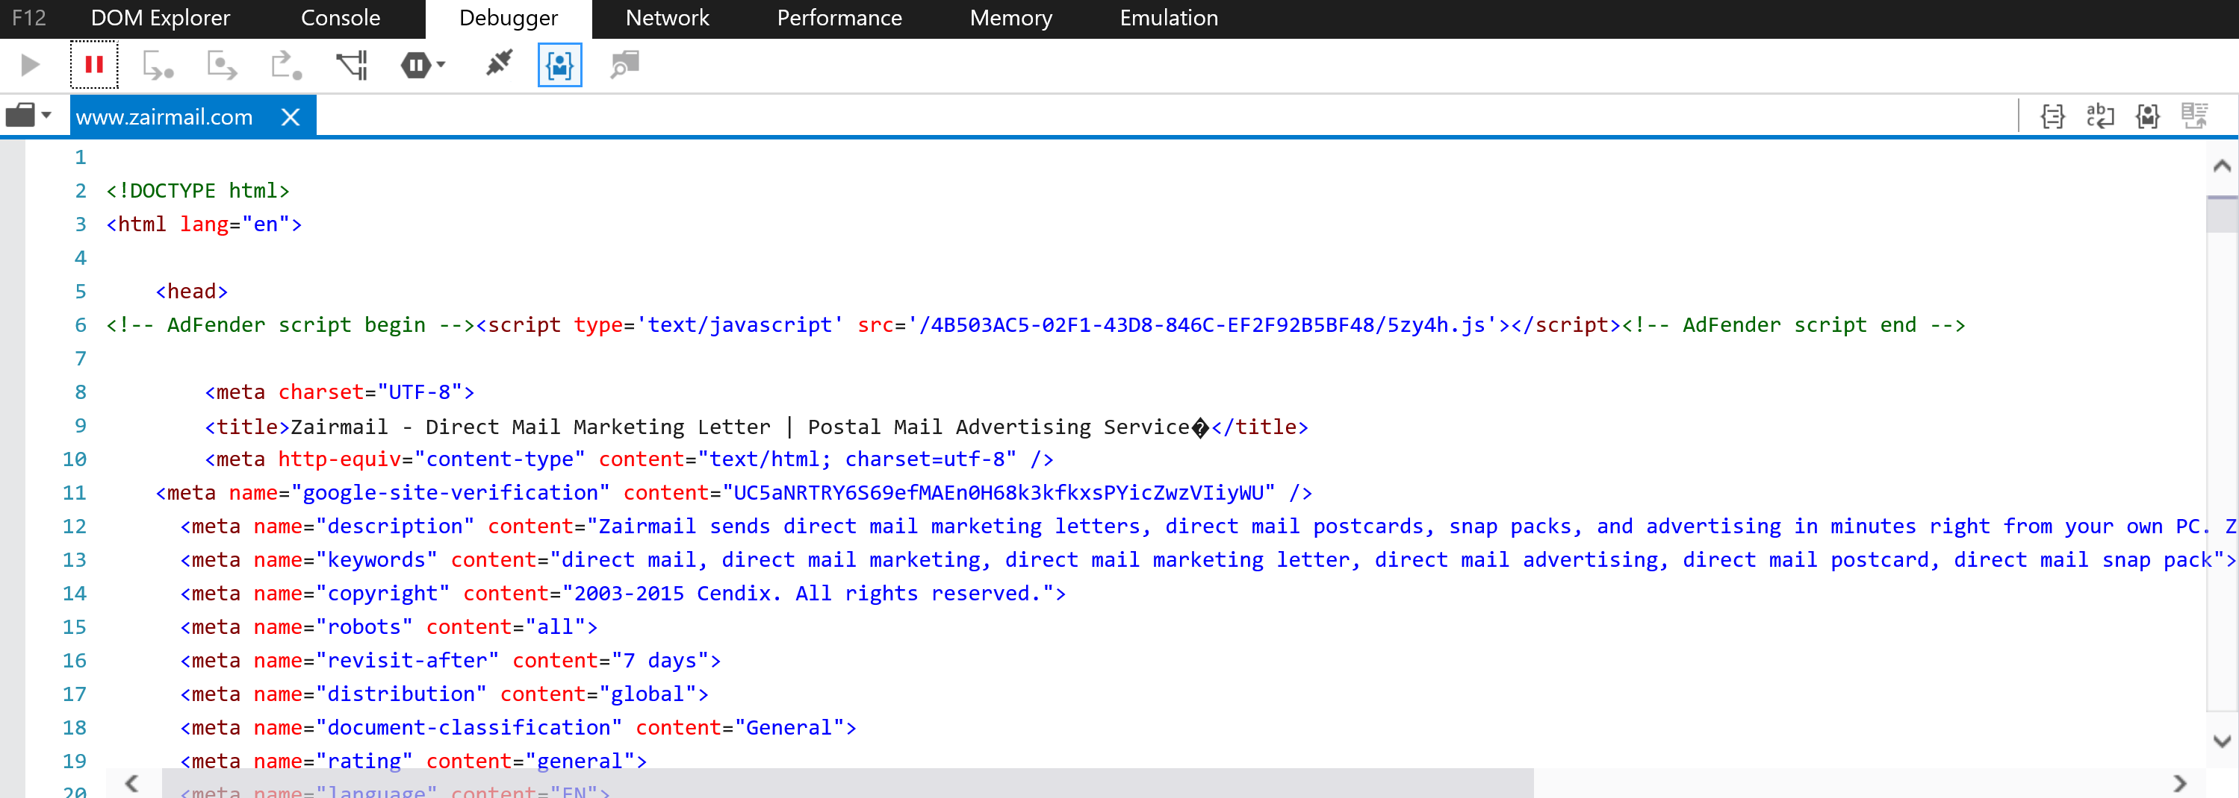

Step One: Get Online
Custom Code (Hand Coded)
Sample
Technologies
HTML/CSS
ASP/PHP
Frameworks
XML/JSON
Ajax
….
career:
Software Engineer

Slide 14
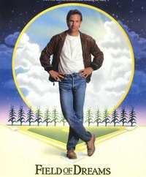
Step One: Get Online
“Build it and They Will Come”
Well,
Not Really…

Slide 15
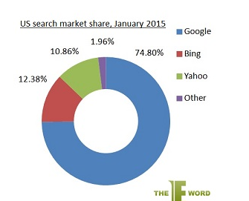
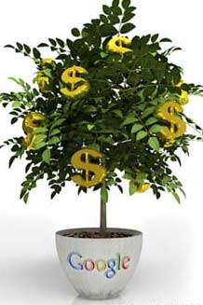
Step Two: Get Found
Search Engine Factoids
US Search Market Share
January 2015
Search is used by over
90% of Internet users
Search Engine Marketer

Slide 16
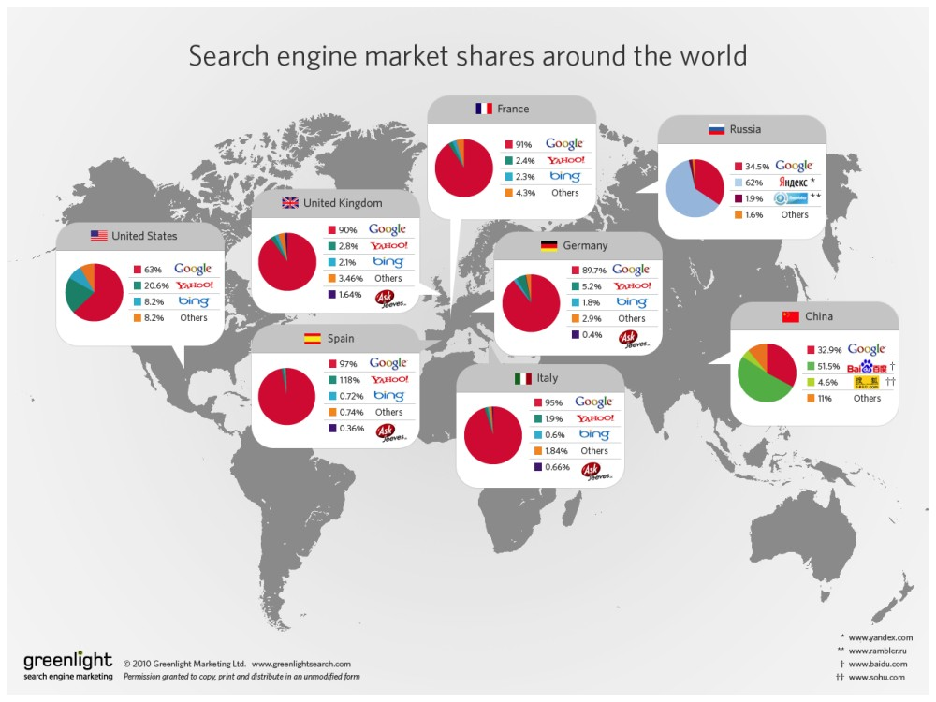



Slide 17

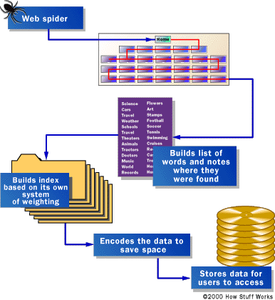

Step Two: Get Found
How Search Engines Work
Internet
search
query

Slide 18
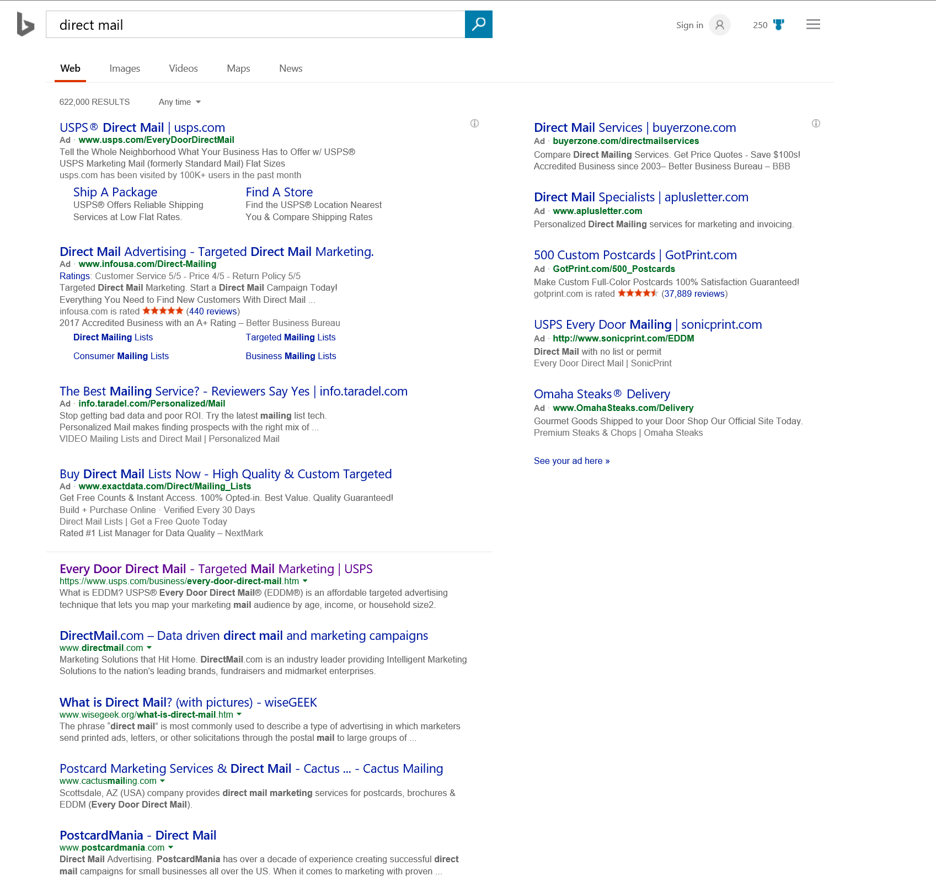
Step Two: Get Found
Search Engine Marketing (SEM)
Paid
Listings
Organic
Listings

Slide 19

Step Two: Get Found
SEO: White Hat vs. Black Hat
Meta Tags
Keyword Analysis
Keyword Selection
Content Publishing
Relevant Content
Link Building
Affiliates
Link Farms
Invisible Text
Blog Spamming
Keyword Stuffing
Paid Directories
Paid Links
Redirects

Slide 20
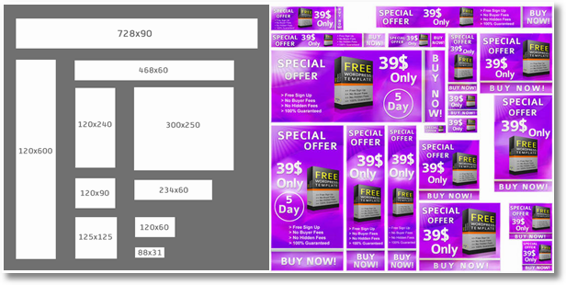
Step Two: Get Found
Banner (Display) Ads
careers:
Account Executive
Web Designer
Creative

Slide 21
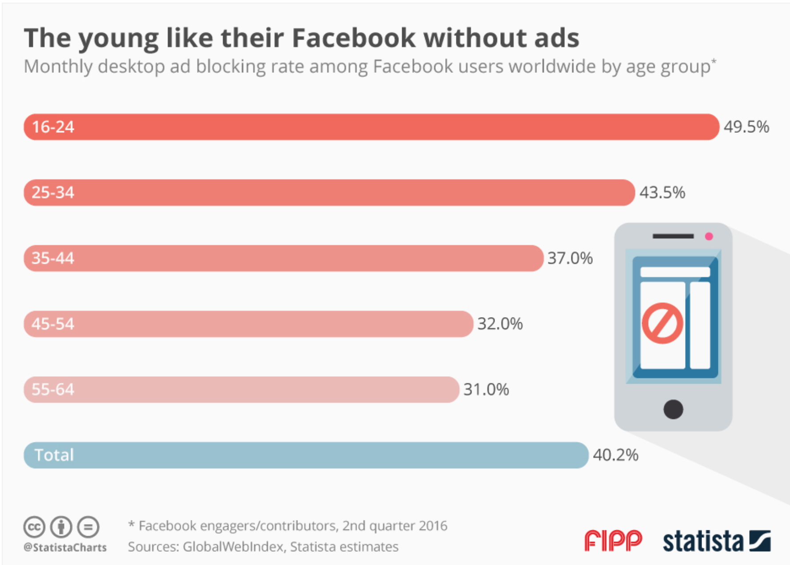
Step Two: Get Found
Banner (Display) Ads
https://www.statista.com/chart/6124/young-facebook-users-snub-ads/

Slide 22
Step Three: Create a Buzz
eMail Marketing
134 billion messages per day (2009ª)
First “killer” online application (1971^{b})
Single most popular online tool (96% users ^{c})
Communication fabric for social media
Well understood and accepted
Active when used online
The Original “Online” Social Media
ª McAfee, Threat Report, Q1 2009
^{b} Hobbes' Internet Timeline (http://www.zakon.org/robert/internet/timeline/)
^{c} University Southern California, 2008 Digital Future Report (http://www.digitalcenter.org)

Slide 23
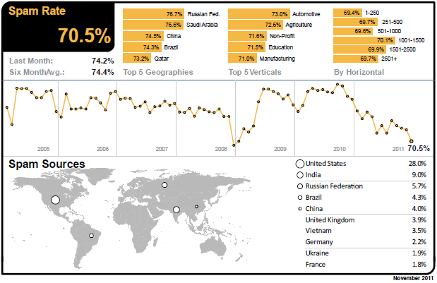
Step Three: Create a Buzz
Obstacle: SPAM Volume
Step Three: Create a Buzz
Unsolicited Email (SPAM) Regulated by CAN-SPAM
source: http://emailmarketingweb.com

Slide 24
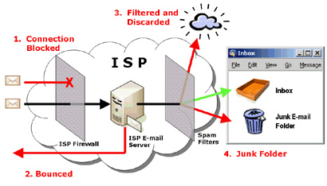
Step Three: Create a Buzz
Spam Filters Reduce Deliverability
26.7% of legitimate commercial email is not delivered
Return Path (2009)

Slide 25
Step Three: Create a Buzz
eMail: Why Should You Care?
Effective When Used Correctly
  ROI of $43.62 for every $1.00 ª
  Ranks 2nd in conversions behind SEO ^{b}
  80.4% say email performs strongly ^{c}
Ingredients for Success
  Do Not use for (cold) prospecting
  Build rapport with existing customers
  Assure recipients “opt-in”
  Use reputable service
ª Direct Marketing Association, 2009
^{b} Forbes Media, Feb-Mar 2009
^{c} Datran Media, Annual Marketing & Media Survey, 2009

Slide 26
Step Three: Create a Buzz
Viral Marketing
Word-of-mouth on Steroids
Coined by Tim Draper (www.dfj.com)
  Technique used to launch Hotmail
  12 million users; 1.5 years; $500K investment
  Simple link allowing others to subscribe
Content spreads virally on the Internet
Content continues to circulate
Drive traffic and conversions

Slide 27
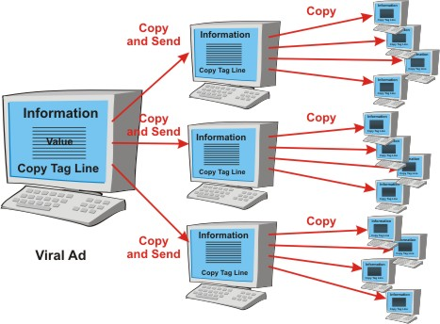

Step Three: Create a Buzz
Viral Marketing
Content Spreads Virally…

Slide 28
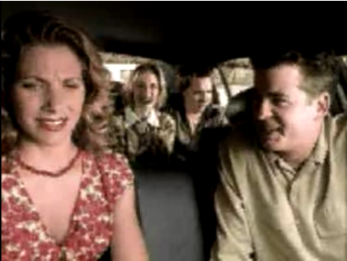
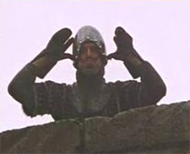
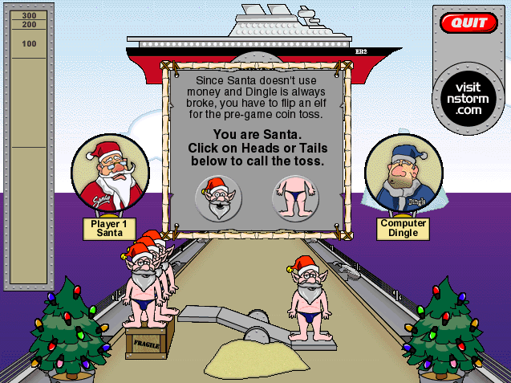
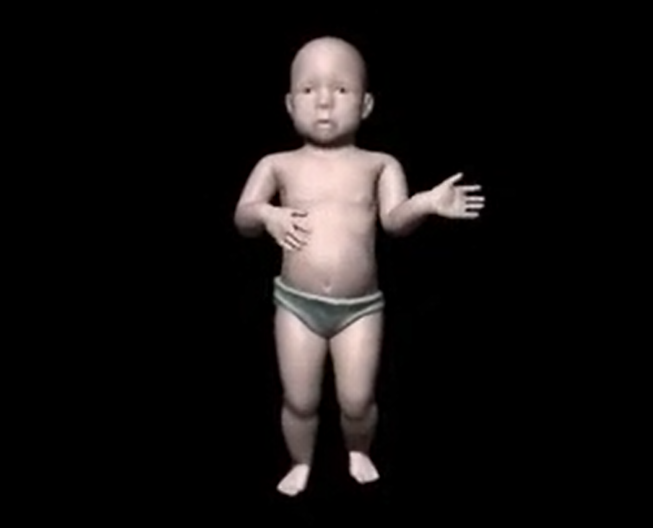
Step Three: Create a Buzz
What is Viral Content?
Video
Audio
Games
Curios
“Anything” That is Valuable & Unique to Recipient

Slide 29

Step Three: Create a Buzz
Fast Forward to Social Media

Slide 30
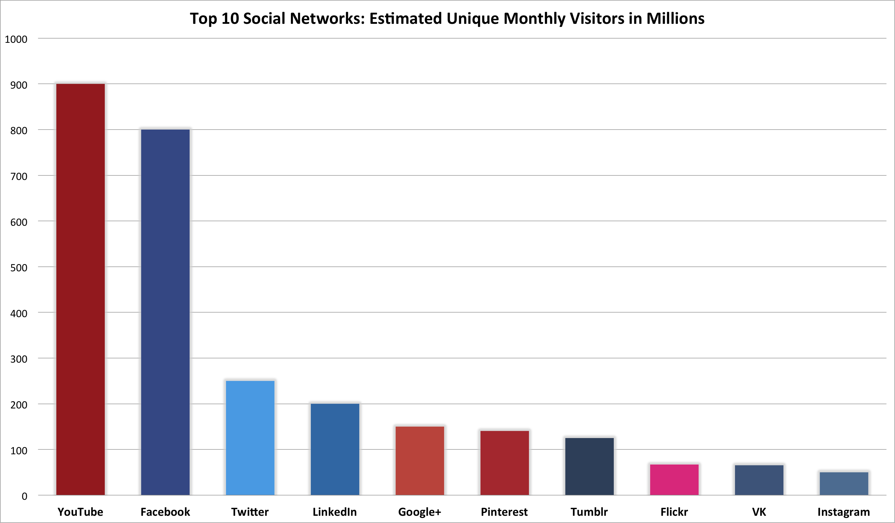
Step Three: Create a Buzz
Social Networking Demographics
large drop
B to B
Source:http://blogs.globalteckz.com/wp-content/uploads/2014/04/Top_10_Social_Networks_Unique_Monthly_Visitors.png
April 2014

Slide 31
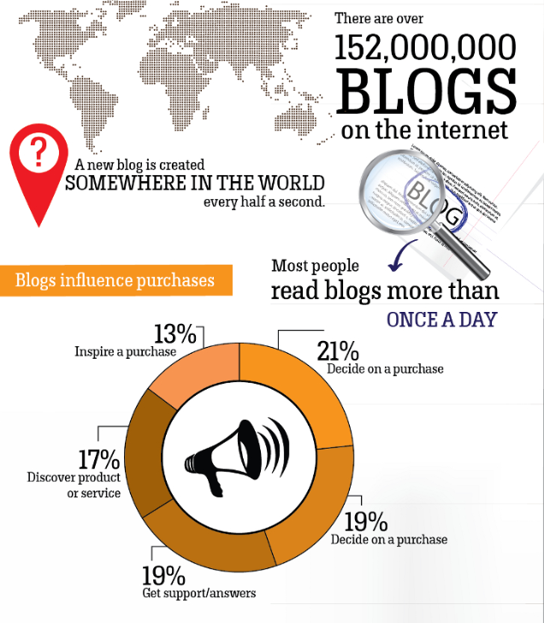
Step Three: Create a Buzz
Social Media Blogs
Source: http://www.wpvirtuoso.com/how-many-blogs-are-on-the-internet/
http://www.blogtopsites.com/

Slide 32
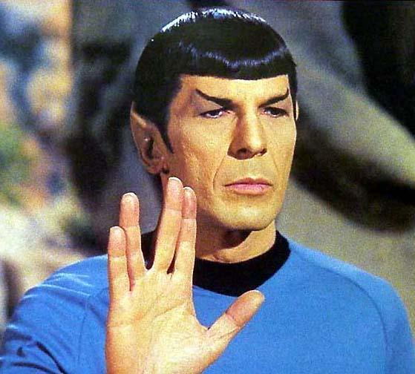
eCommerce 101
Summary
Get Online
Get Found
Create a Buzz
Live Long & Prosper
ONLINE

