Slide 1
Student Engagement
Traditional View
Faculty & Student
faculty
student
Is it enough?

Slide 2
Student Engagement
Another View
Faculty & Student
student
faculty
student
+ course
student
Student to Student
Entire Class
Experiential Learning

Slide 3
Student Engagement
Another View
student
faculty
student
course
student
+ university
[Student] Lifecycle Stage

Slide 4
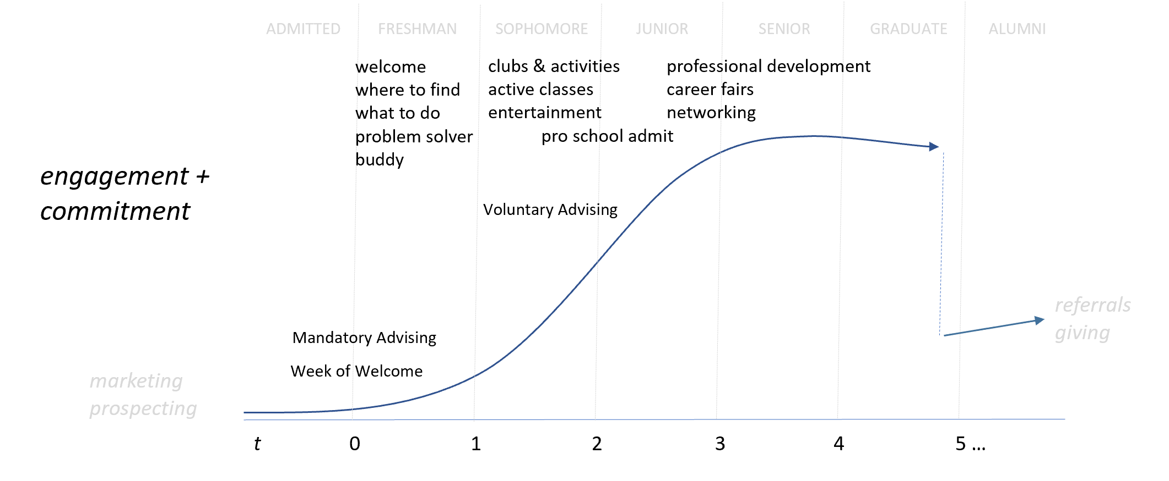
Student Engagement
[Student] Lifecycle Stage

Slide 5
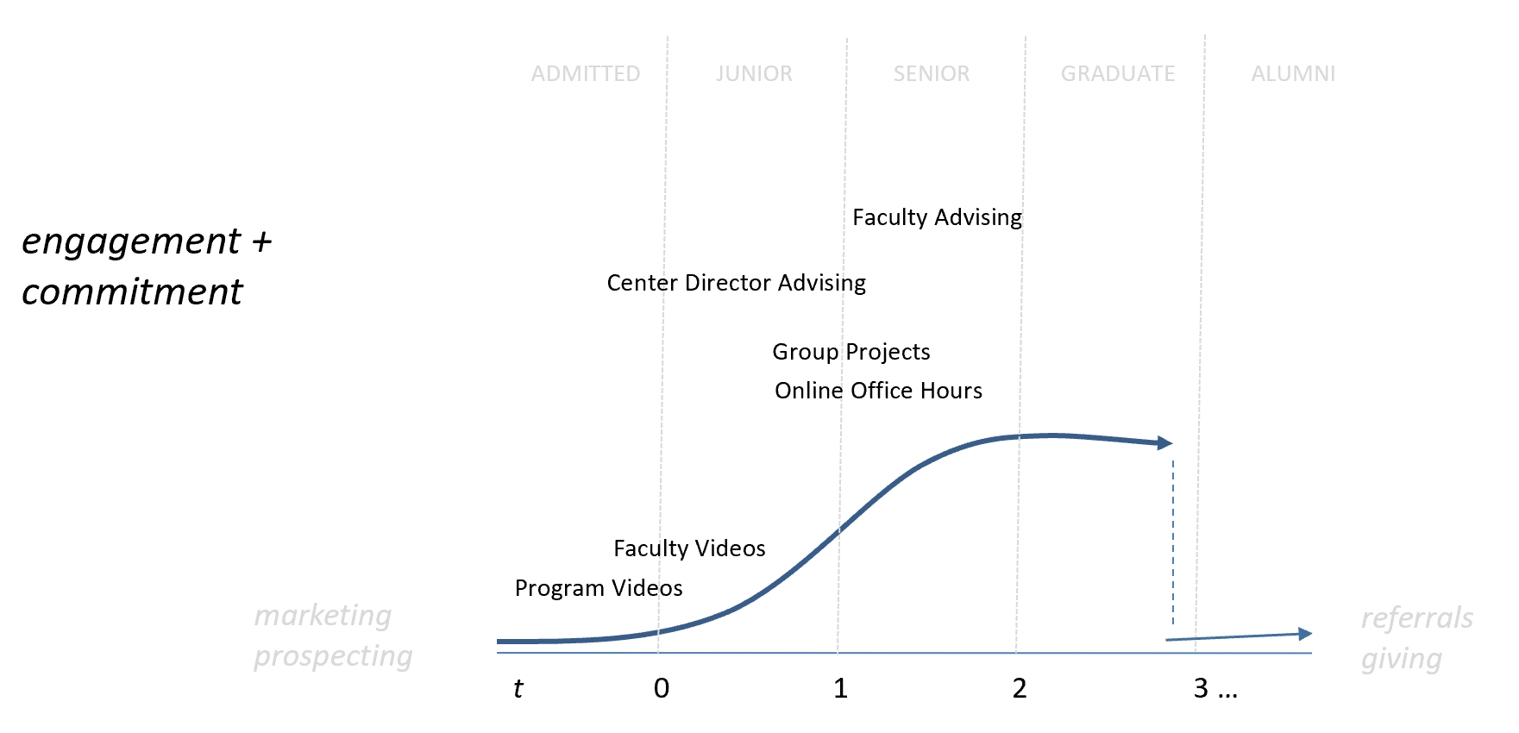
Student Engagement
[Student] Lifecycle Stage

Slide 6
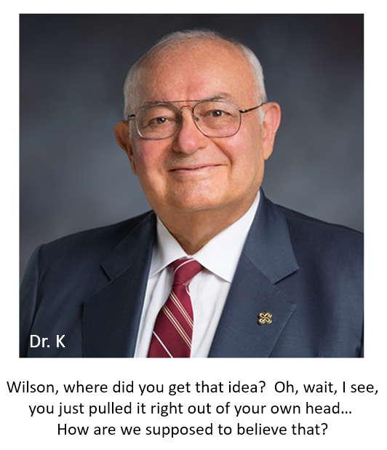

Student Engagement
Another View
student
faculty
student
course
student
university
+ community
add value in all the communities we serve

Slide 7
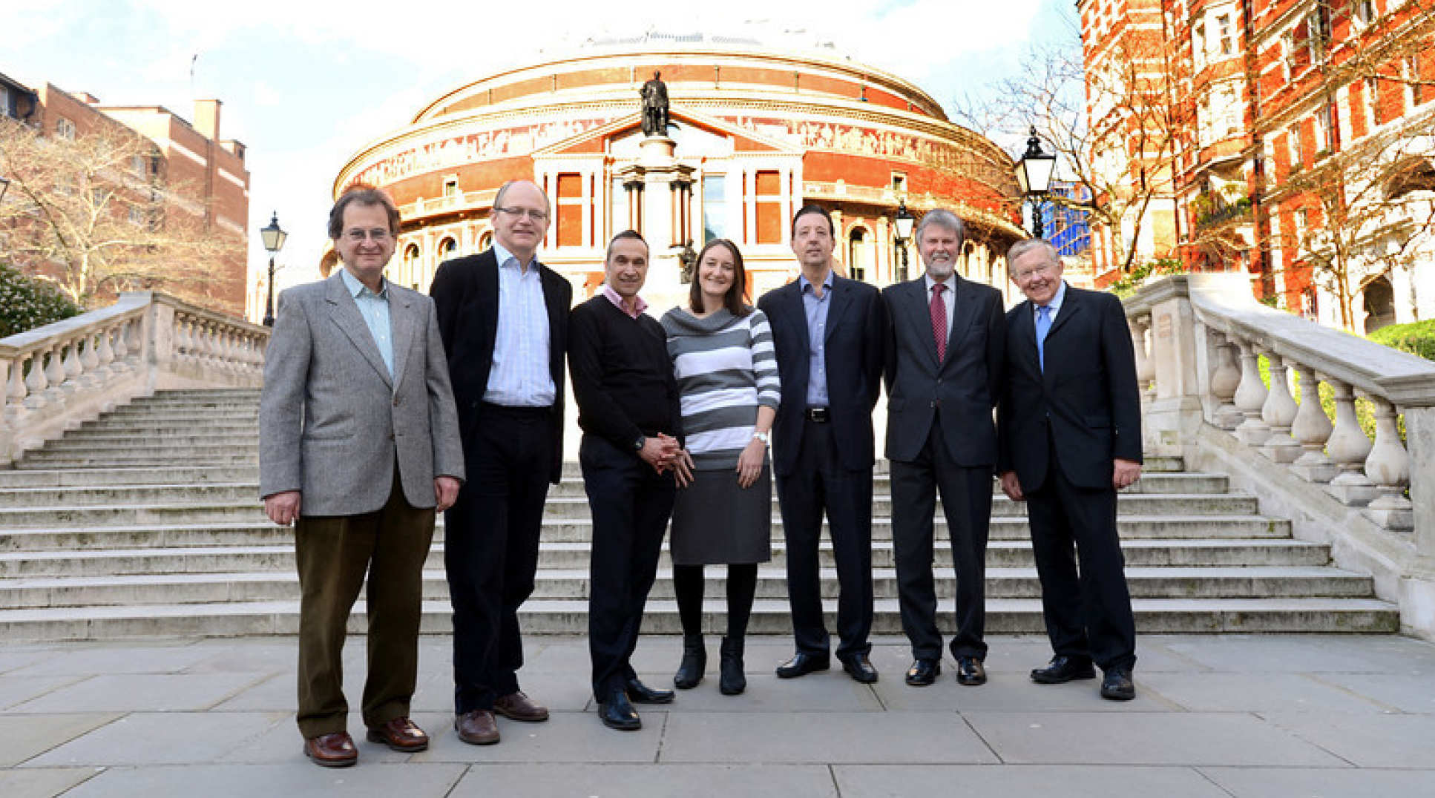


Student Engagement
Expectations Evolving
80% of public 4-year colleges make course management tools available to their faculties, professors only use them in 20% of their courses (Lynch, 2002).
…faculty members are hesitant to embrace technology because it is perceived as a source of stress. (Baltaci-Goktalay, 2006).
multiple modalities: on campus, online, hybrid…
engagement, curriculum (topic), + technology
tech-savvy student population
References:
Baltaci-Goktalay, S., & Ocak, M. A. (2006). Faculty Adoption of Online Technology in Higher Education. Turkish Online Journal of Educational Technology-TOJET, 5(4), 37-43.
Lynch, D., Altschuler, G. C., & McClure, P. (2002). Professors should embrace technology in courses... and colleges must create technology plans. Chronicle of Higher Education, 48(19), B15-B15.

Slide 8

Student Engagement
Principles in Action
Welcome
Weekly announcement
  Week in the term (encouragement)
  Connect with the university/community
  What needs to be done
Weekly module
  Readings, articles, videos
  Presentation slides
  Assignments
  Discussion – content + classmates + community
Group project(s)
class observation
common
core
on
campus
online

Slide 9
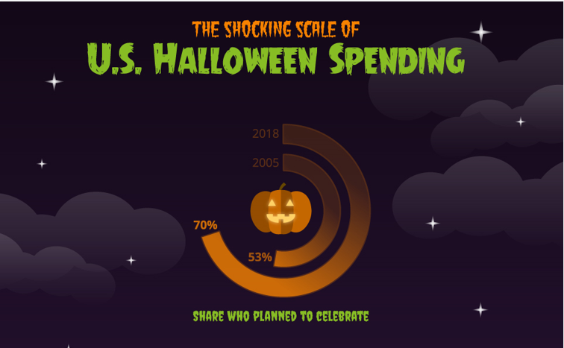
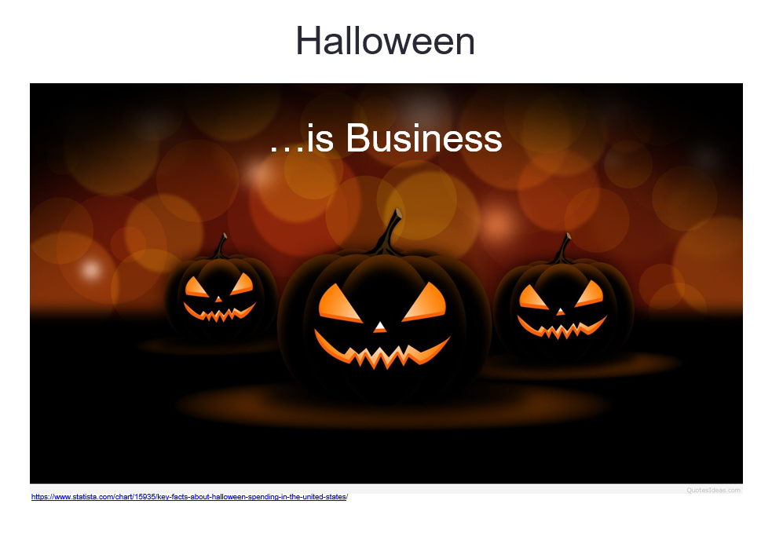
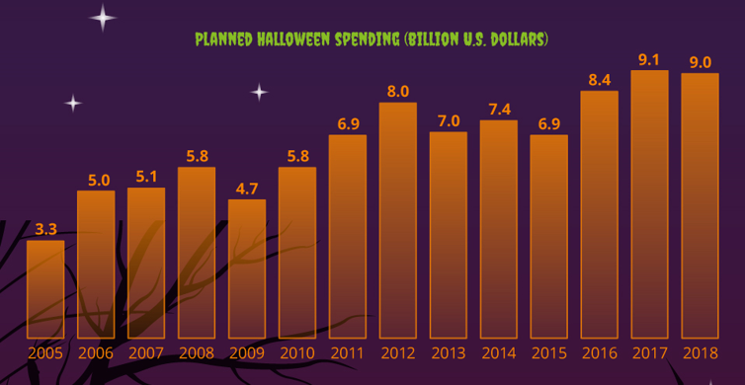
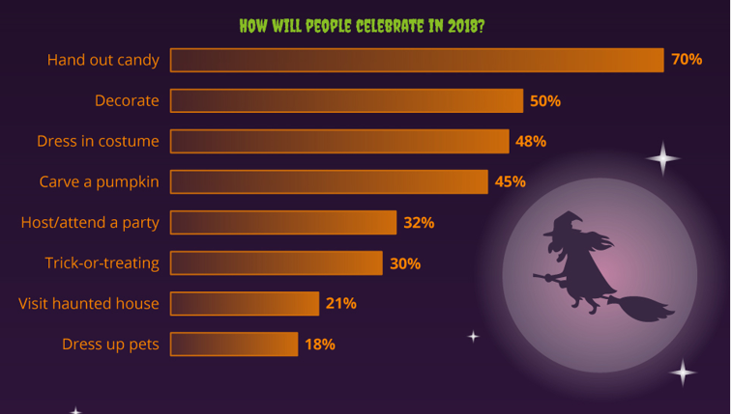
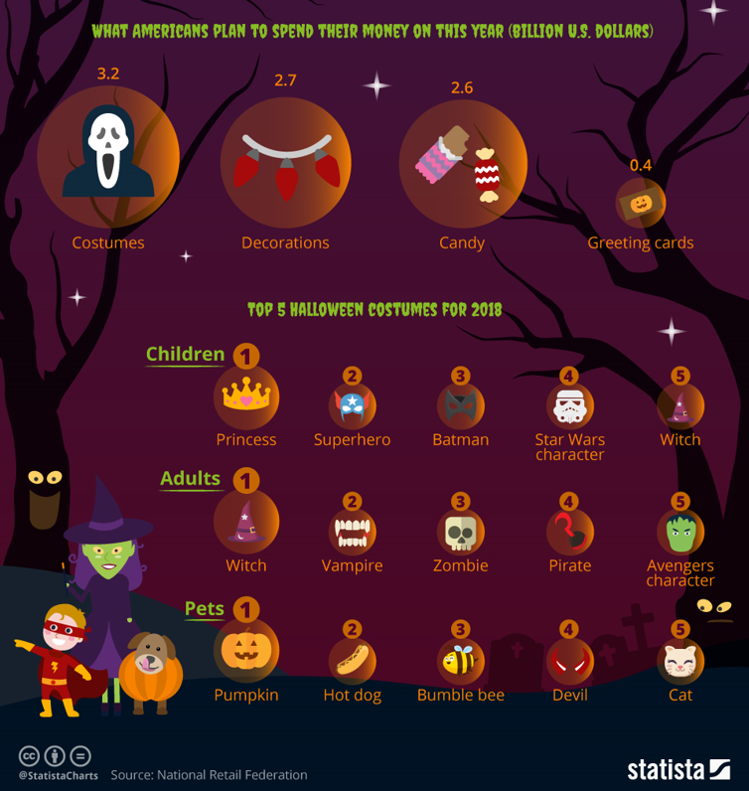
Student Engagement
Principles in Action
connect with current events…

Slide 10

BA 313
Learning Outcomes 1 to x
week n
n = 1 to 10
n credit hours
Read
before class
Discuss
in class
Assess
after class
examples
quiz
exam
exercise
reflection
…
study
relevance + practical skills
stock game (economy + markets + value)
business publication(s)
student topics
Fun
engagement: - student(s) + school + community

Slide 11
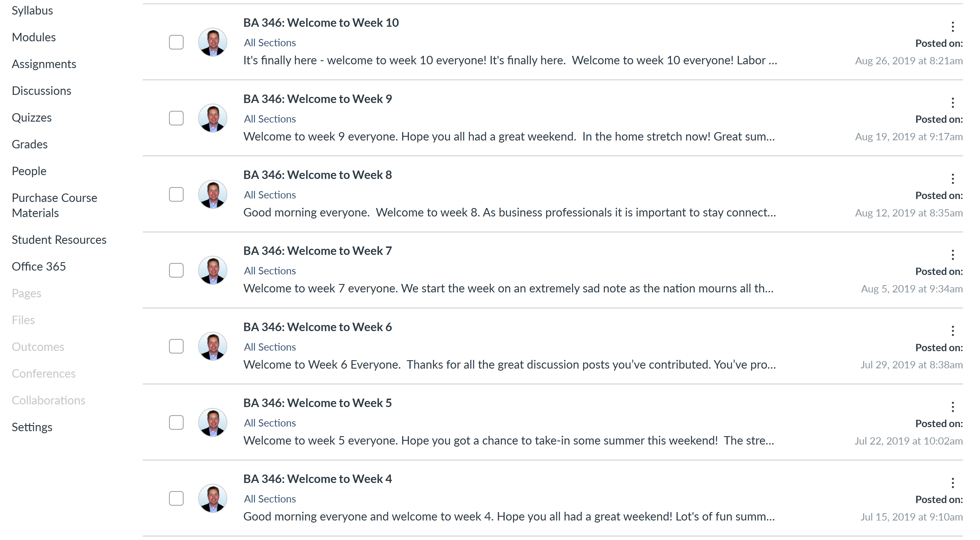
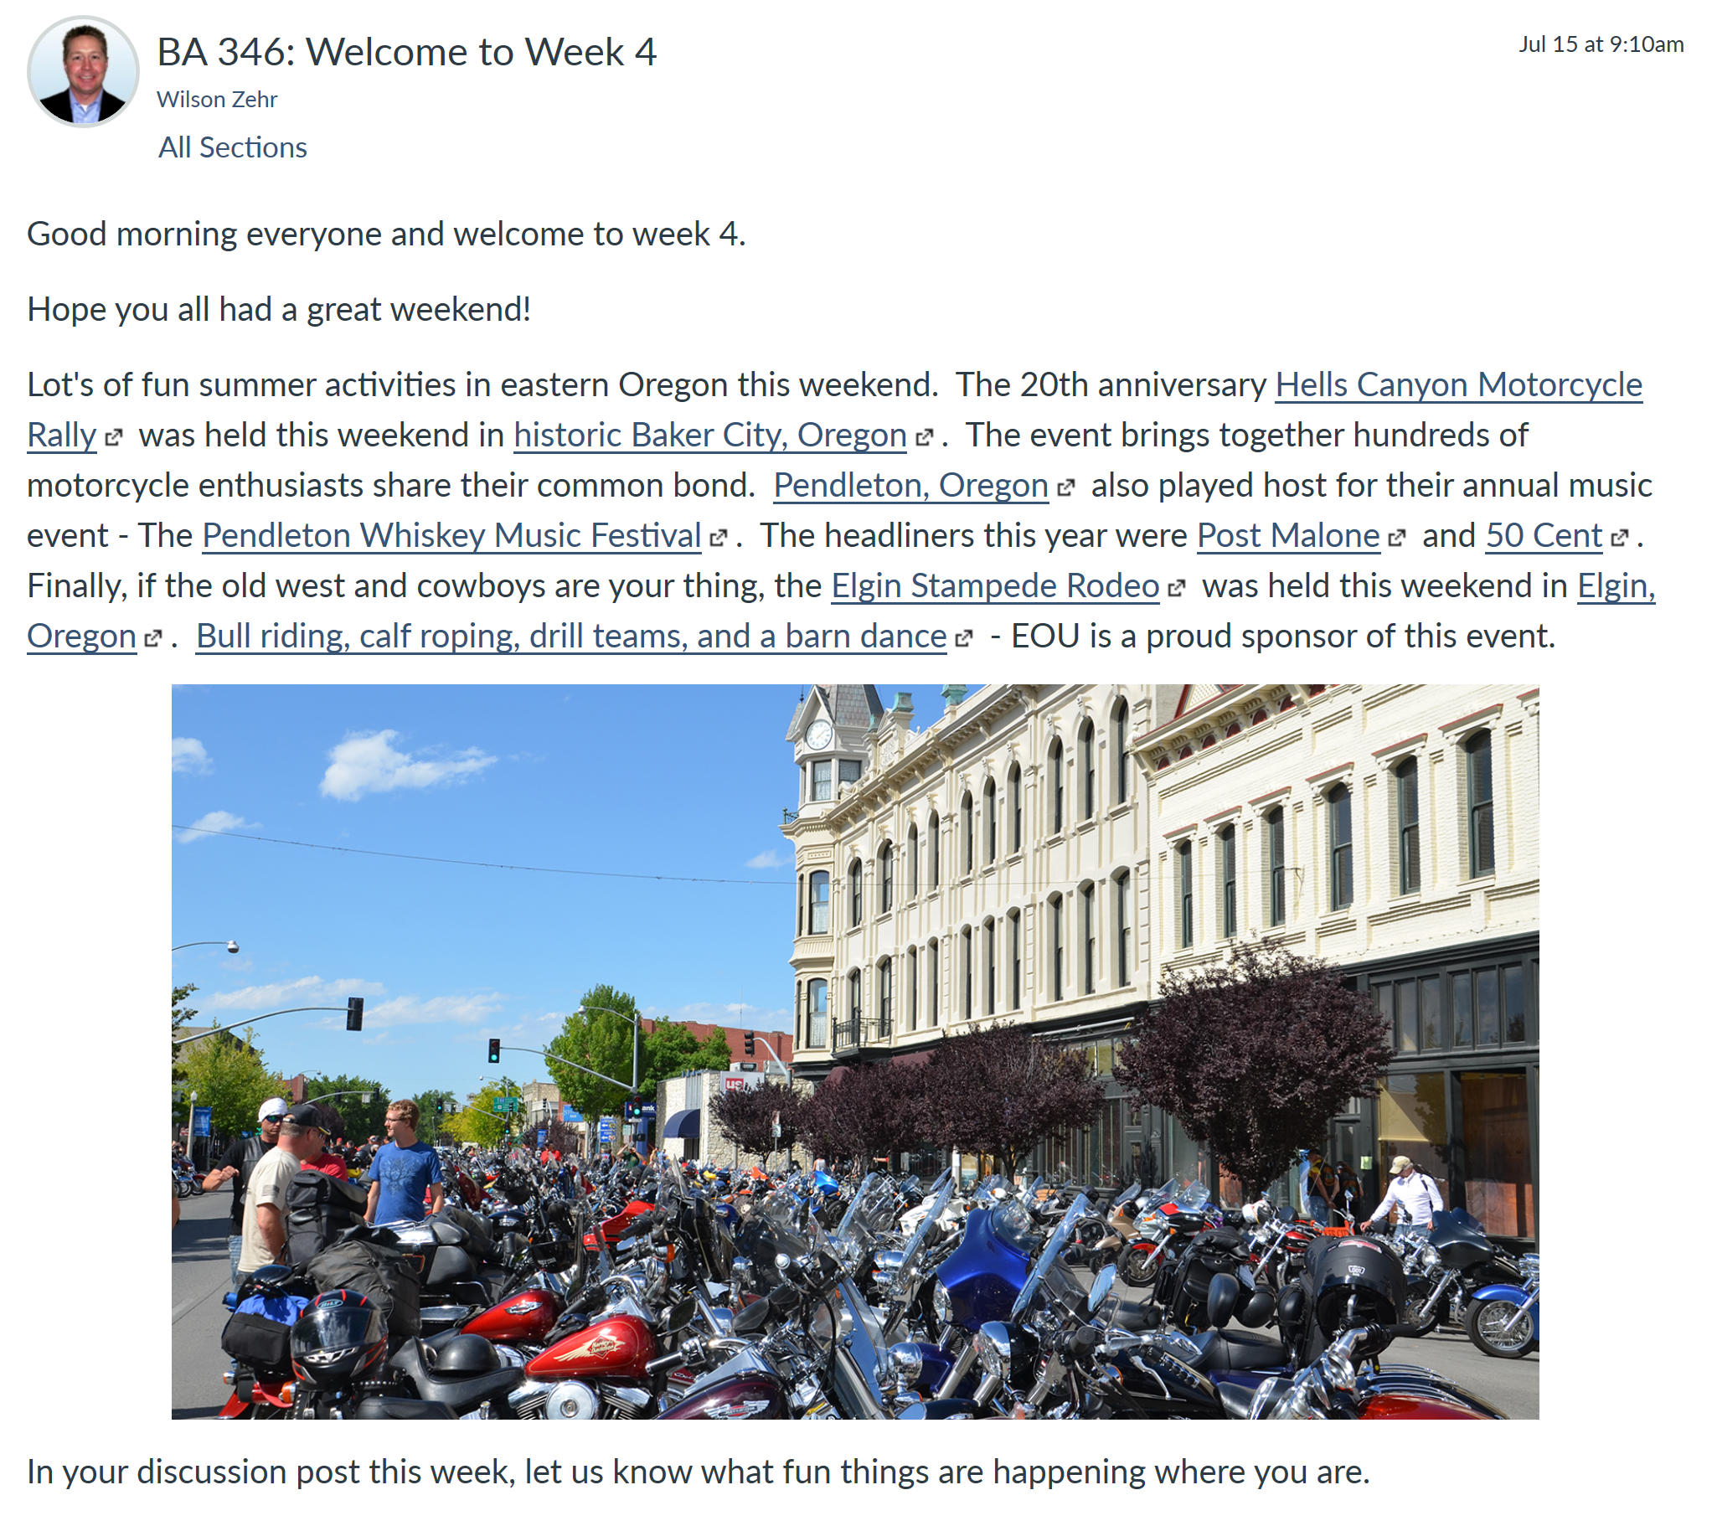
profile photo required
connect with community
& current events….

Slide 12
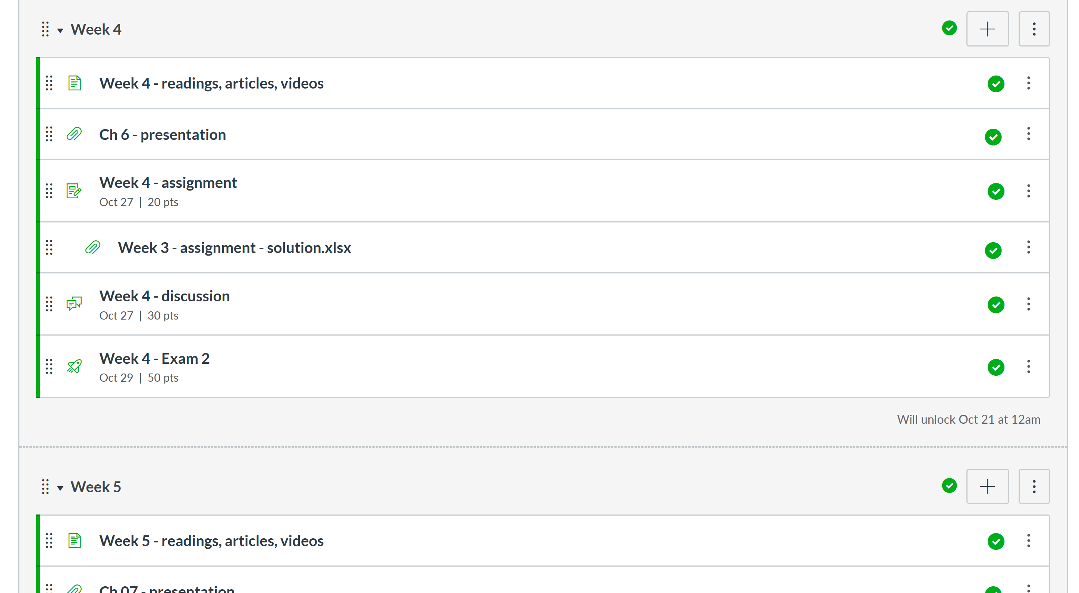

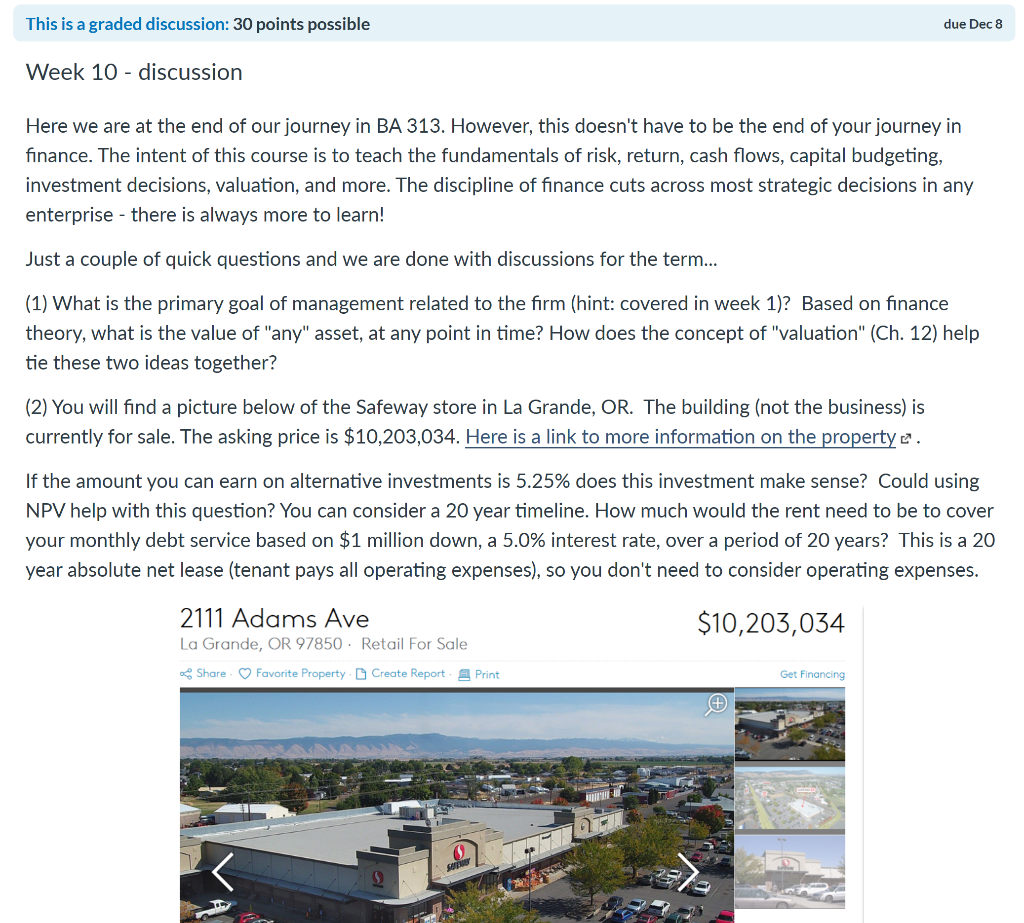
connect with community…

Slide 13
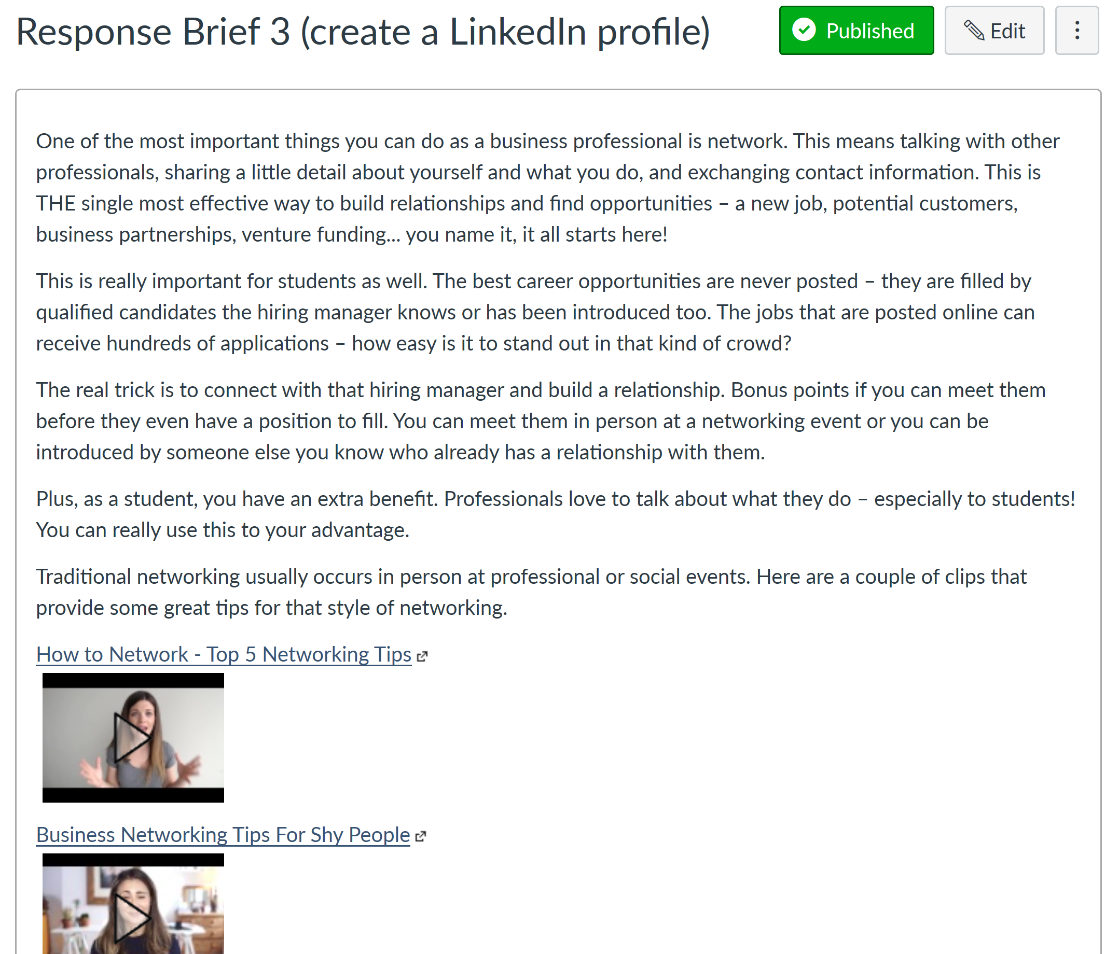
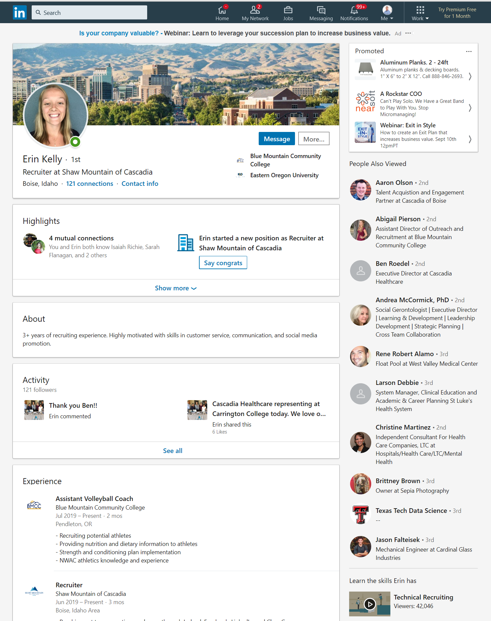
create
connect
recommendations
classmate feedback
instructor feedback

Slide 14

Student Engagement
Principles in Action
Group Project(s)
  BA 313 BA 450 BA 465
  BA 346 BA 460 BA 498
Student Organizations
  Entrepreneurship Club
  Millennial Community
  TheAgency@EOU

Slide 15
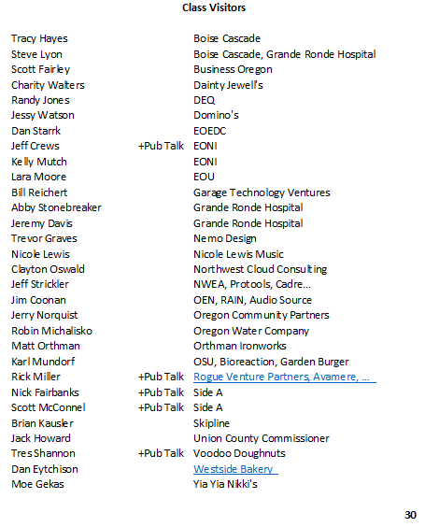
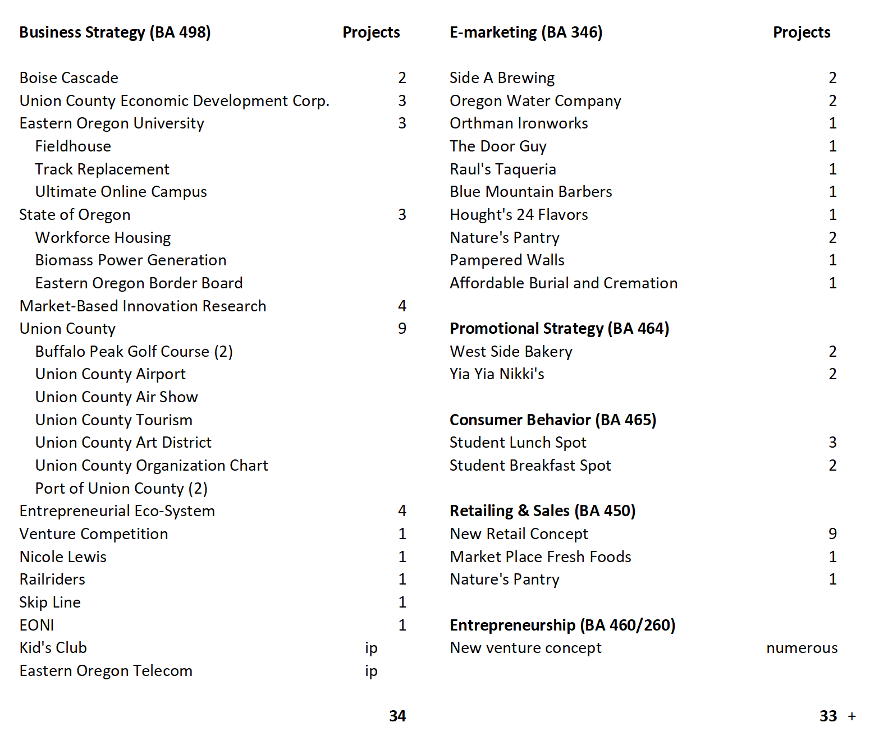
Student Engagement
Principles in Action

Slide 16
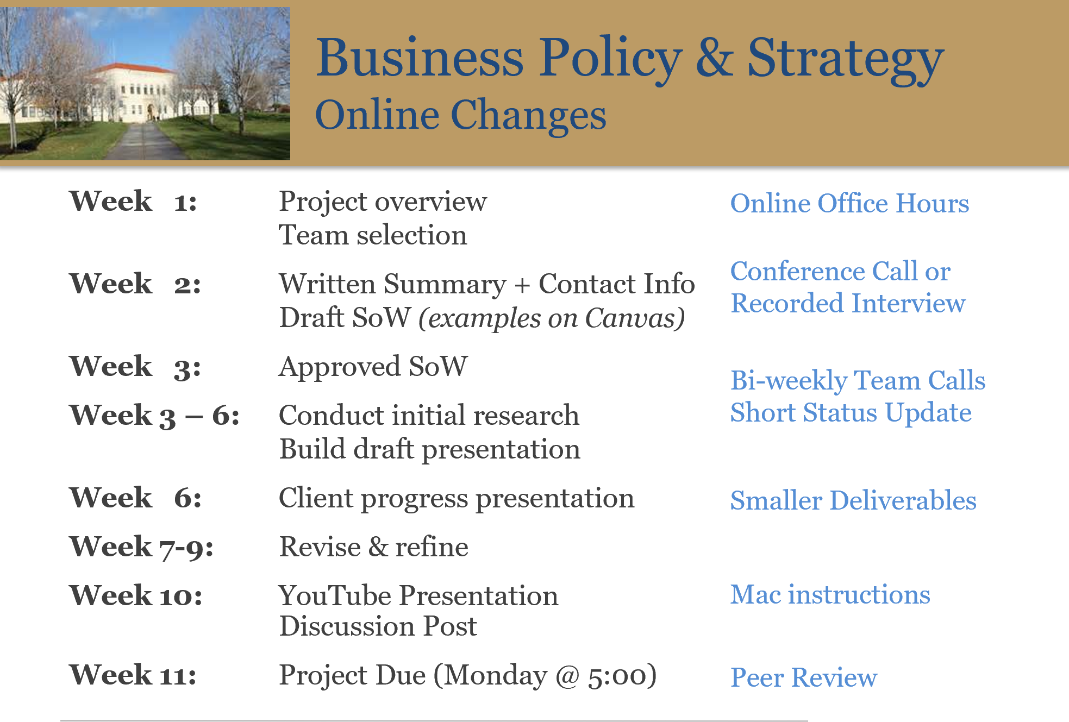
STI Changes
From 2018

Slide 17
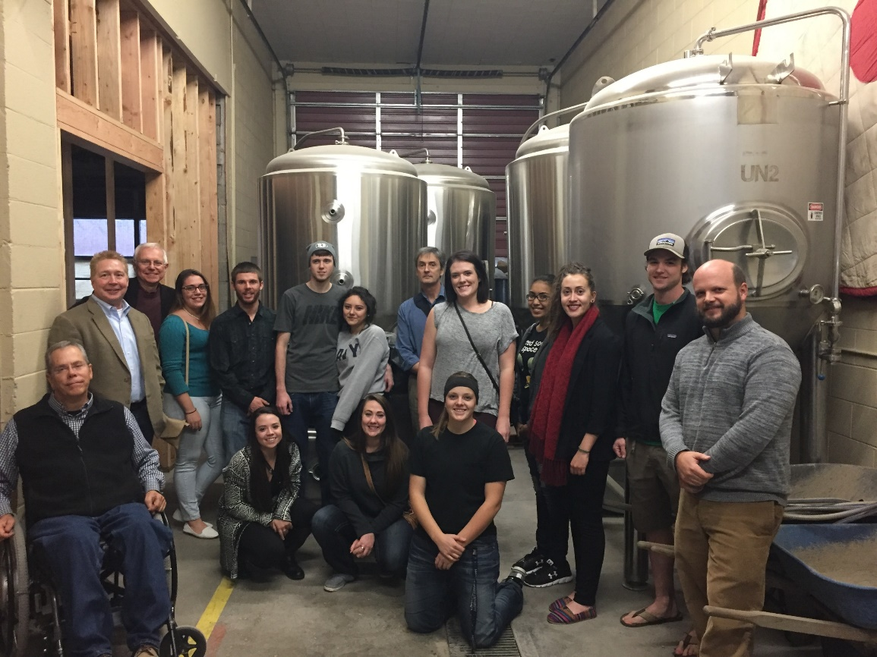






Student Engagement
Entrepreneurship Club
Side A
Brewing
Social Activities Competition
Networking Pub Talks
Speaker Series:
…
Entrepreneurs, Service Providers, Investors…
…role models and hero’s
maggie & cocoa

Slide 18
Student Engagement
Entrepreneurship Club
EOU
high growth enterprise
EOV
E Club
InventOR
classes/speakers
consulting projects
internships
research
Pub Talks
business visits
eCommerce
(t-shirt/art)
eco-system+
resource directory
venture summit
SBDC
small business

Slide 19


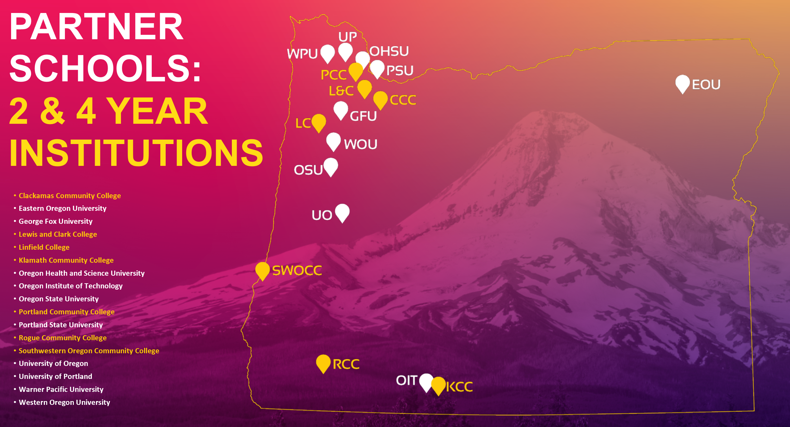
Student Engagement
InventOR
$2,500 to prototype
Compete $25,000 prizes
Invitation to Bend Venture Conference
www.inventoregon.org
Invent Oregon
Venture Competition
Portland, OR

Slide 20


Borrowing from Others is Good
The Dr. K way…
Discovering Creative New Solutions is Essential
Engagement Should Extend Well Beyond
Technology is Your Friend
Well, mostly…

