Slide 1
PEOPLE HELPING PEOPLE
THRIFT STORE
La Grande, OR Pendleton, OR …

Slide 2
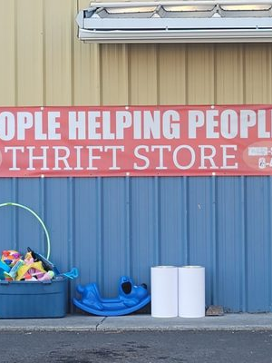
People Helping People
Owner(s): Jeremiah (Jeremy) Sprague
Leadership Team:
Randi Stauffer and Debra Ralston (Store Managers)
Years in Business:
2004 - started
2016 - Jeremy acquired
Organization Goals:
Grow current location
Pendleton expansion
Current Tools/Campaigns:
Facebook (primary)
Building (visibility)
Billboards
Website
word-of-mouth…
Promotional Budget:
$12,500 yearly

Slide 3

People Helping People
Back Story
Original founder of People Helping People was George Martin who simply wanted to help those in need. People that struggled with addictions and had financial problems were the people he wanted to help. The ultimate goal was to strengthen the people around him and build the community.
Started by gathering used clothing and selling it for very cheap. He started the 50-cent rack, the dollar rack, and did whatever he could to cut the prices as low as possible. He helped maintain people's clothes by washing them and replenish clothes that were old or falling apart.
Jeremy took over in 2016 and started with vouchers that helped pay half of people's expenses on houses, clothing, and furniture. Established a partnership with the Union Country Sheriff’s Department to help inmates.

Slide 4

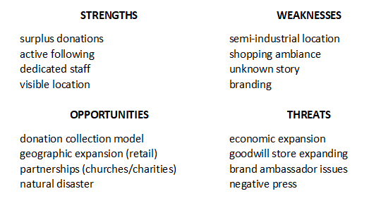

SWOT

Slide 5
Thrift Store Industry
Market Potential
United States
$10.3 billion
25,225 businesses
122,335 employees
7% CAGR
33% Goodwill
3,000 locations
Oregon
$131 million
1.3% of U.S. (4.2 million)
La Grande
5,984 households
Pendleton
6,869 households
20% consumers will visit annually
~equal department stores, 2x outlet stores
IBISWorld - https://www.ibisworld.com/united-states/market-research-reports/thrift-stores-industry/
Brandon Gaille - https://brandongaille.com/32-thrift-store-industry-statistics-and-trends/
NARTS - https://www.narts.org/i4a/pages/index.cfm?pageid=3285
Households - www.directmail.com/mailinglists/ (10-mile radius, households $40K+ income)

Slide 6
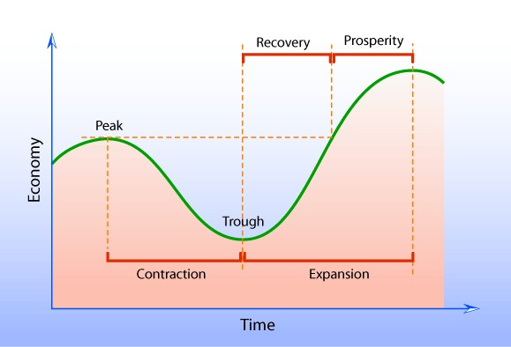
Thrift Store Industry
Market Dynamics (expected)
Counter-Cyclical
+demand premium goods
+demand bargain goods
Could Social Good Sustain Demand (?)

Slide 7
People Helping People
Market Model
social good (help others)
avoid waste
GIVERS
SHOPPERS
affordable goods
community benefit

Slide 8
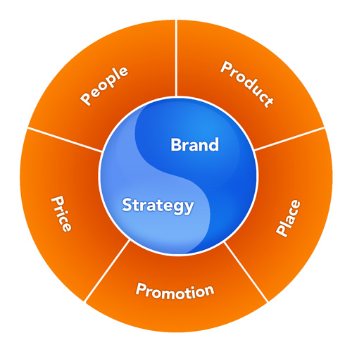
GIVERS
28 – 60
$40K+ year
10-mile radius
own vehicle
own home
validate?
competitors:
store/gather dust
garage sale
Waste-Pro
ReStore
safe, convenient,
Judgement-free donation place
no waste
social good
tax deduction*
gently used
charitable gifts
donation center
(La Grande, Pendleton)
online vs. offline
* Underscores the good (charitable nature) of the contribution - +experience

Slide 9
GIVERS
28 – 60
$40K+ year
10-mile radius
own vehicle
own home
validate?
competitors:
store/gather dust
garage sale
Waste-Pro
ReStore
safe, convenient,
Judgement-free donation place
no waste
social good
tax deduction*
2 + 1 questions
(1) What is your zip code?
(2) Have you ever donated here before?
if no, then…
How do you learn about us?
Conduct for two week minimum. Ideally, we would do this for all time so we can see progress over time.
gently used
charitable gifts
donation center
(La Grande, Pendleton)
online vs. offline
* Underscores the good (charitable nature) of the contribution - +experience

Slide 10
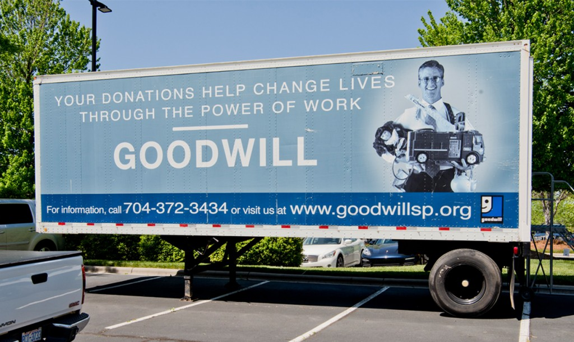
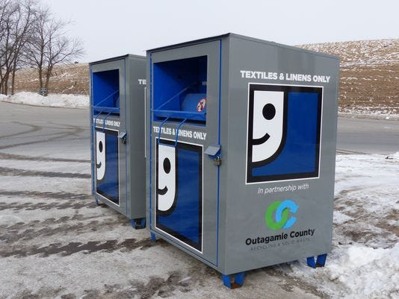
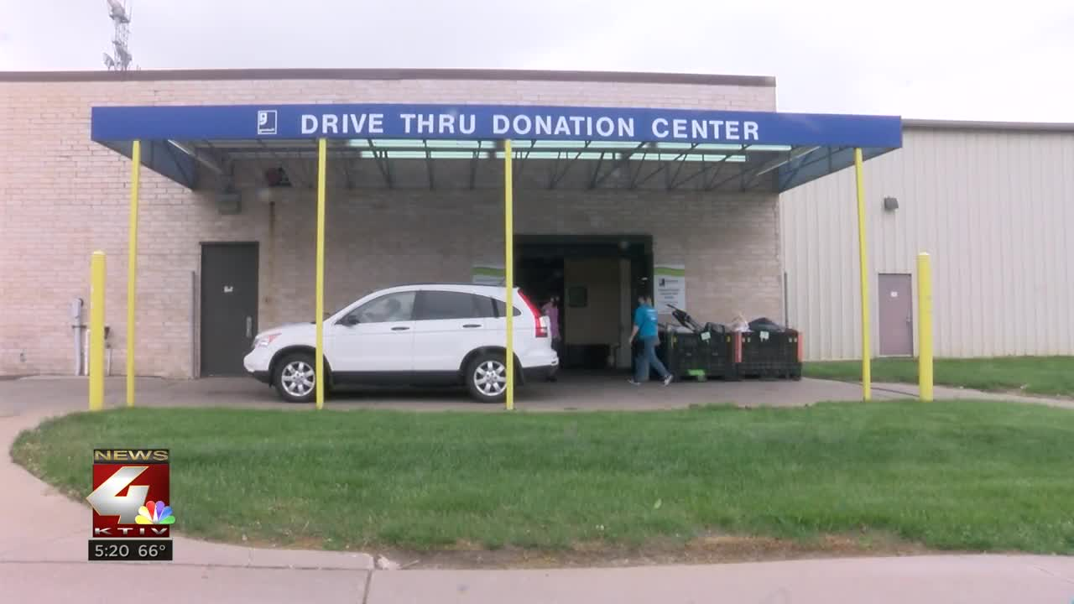
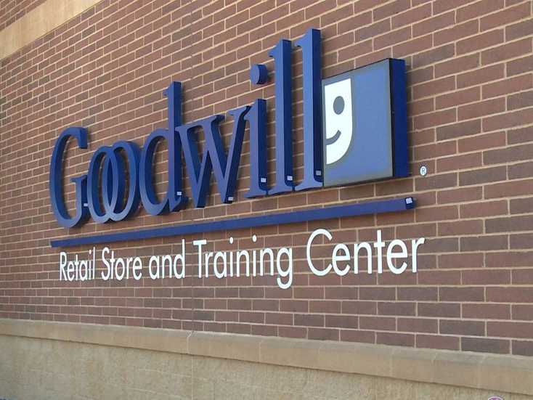
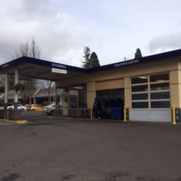
Convenience & Visibility
should increase donation volume
could increase donation quality
increase community awareness

Slide 11
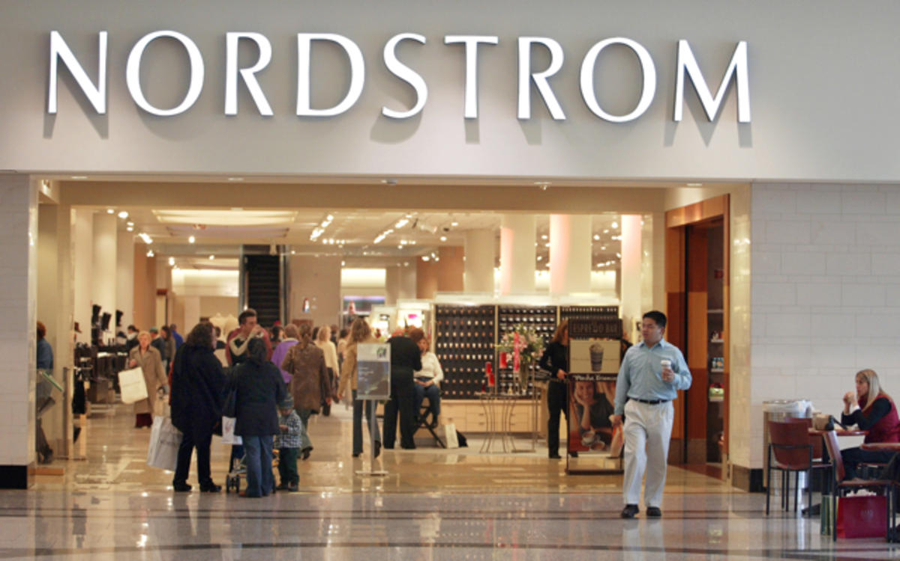
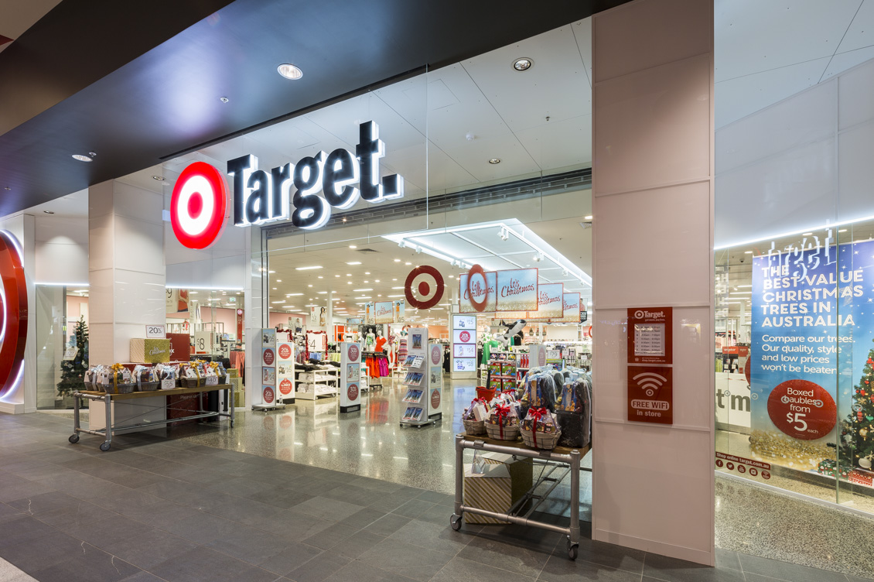
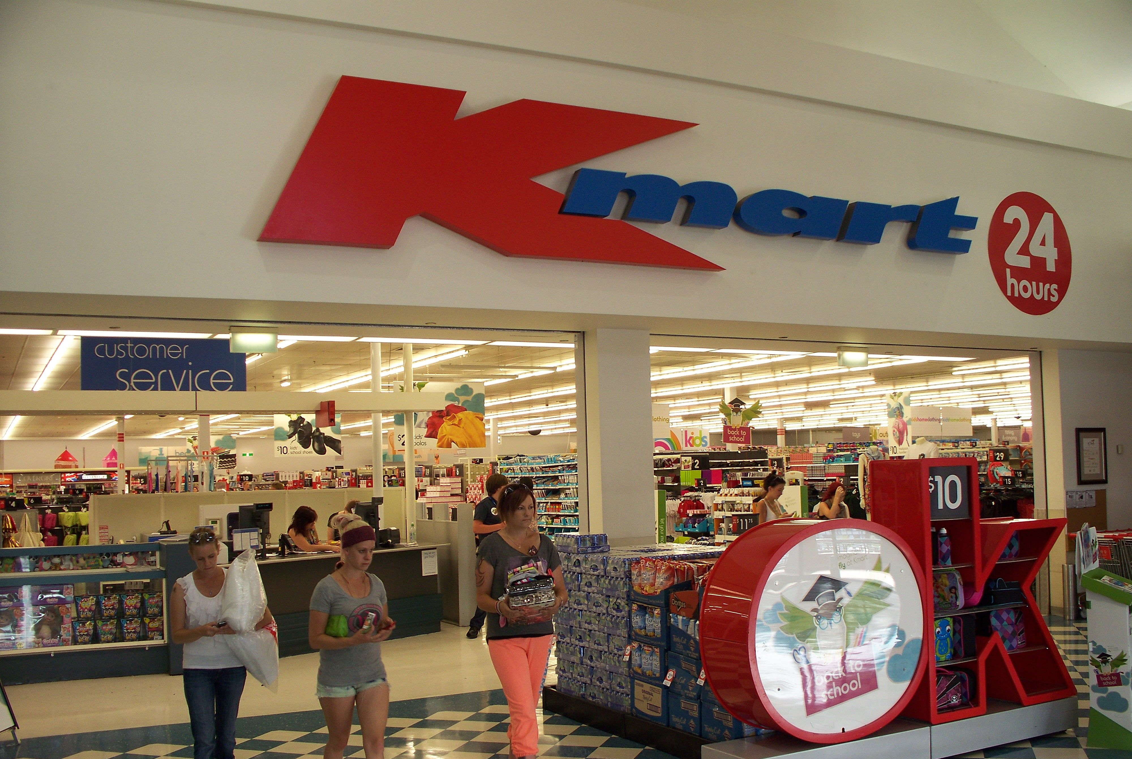
SHOPPERS
22 – 60
10-mile radius
< $30K year*
students
validate?
experience?
competitors:
Community Kindness
Bugs & Butterflies
Royal Clothiers
Walmart
ReStore
clothes & essentials
budget-friendly
not charity (dignity)
clean, bright, pleasant,
shopping experience
match experience with target segment
this will expand/contract the size of the target market depending on location
richer experience requires investing more in the business (higher costs)
higher costs require higher prices/margins
retail keystone 2x cost
depends on magnitude of price, frequency of turn-over, and business model
$1 - $100
< Walmart
scholarship (pay it forward)
retail shop
(La Grande, Pendleton)
online vs. offline
* dial up/down based on merchandise/audience/experience

Slide 12
SHOPPERS
22 – 60
10-mile radius
< $30K year*
students
validate?
experience?
competitors:
Community Kindness
Bugs & Butterflies
Royal Clothiers
Walmart
ReStore
clothes & essentials
budget-friendly
not charity (dignity)
clean, bright, pleasant,
shopping experience
$1 - $100
< Walmart
10% student discount
10% veteran discount
scholarship (pay it forward)
retail shop
(La Grande, Pendleton)
online vs. offline
* dial up/down based on merchandise/audience/experience

Slide 13
Competition: Market Map
La Grande, OR
collectible
antique
stores
Royal
Clothiers
Community
Kindness
Bugs &
Butterflies
$
Walmart
$$$
Grocery
Outlet
PHP
ReStore
demographic
distressed

Slide 14
PRICE
General Model
Value-Based Pricing
Perceived Value
$$$
Competitive Solutions
Market-Based Pricing
Price Range
$
Cost of Goods Sold (COGS)
Cost-Based Pricing
(mark-up)

Slide 15
PRICE
Price/Product Relationship
Price
Product
Perceived Value
Augmented Product
(market offering)
brand
selection guidance fitting alterations
financing terms insurance**
timing environment*
newness novelty
scarcity
$$$
supply & demand
Functional Value
Price Range
Core Product
core features
incremental features
$
Cost of Goods Sold (COGS)
Raw Materials
*took took story and weather in Bangkok, popsicle in summer vs. popsicle in winter
** auto dealership business model
(scarcity) ride during rush-hour (Uber)
Craig’s List vs. used car lot vs. car dealership

Slide 16
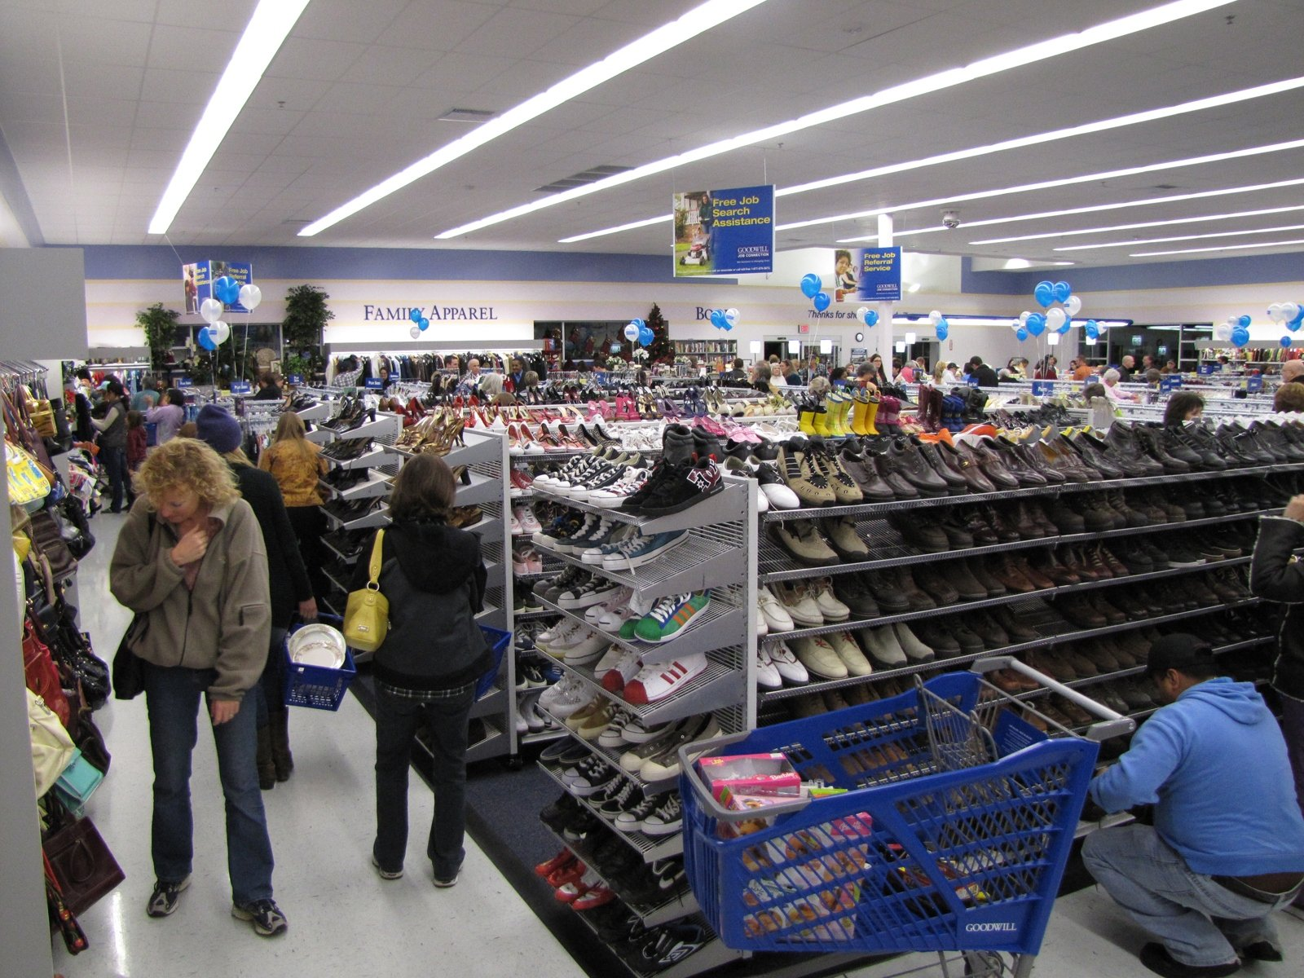
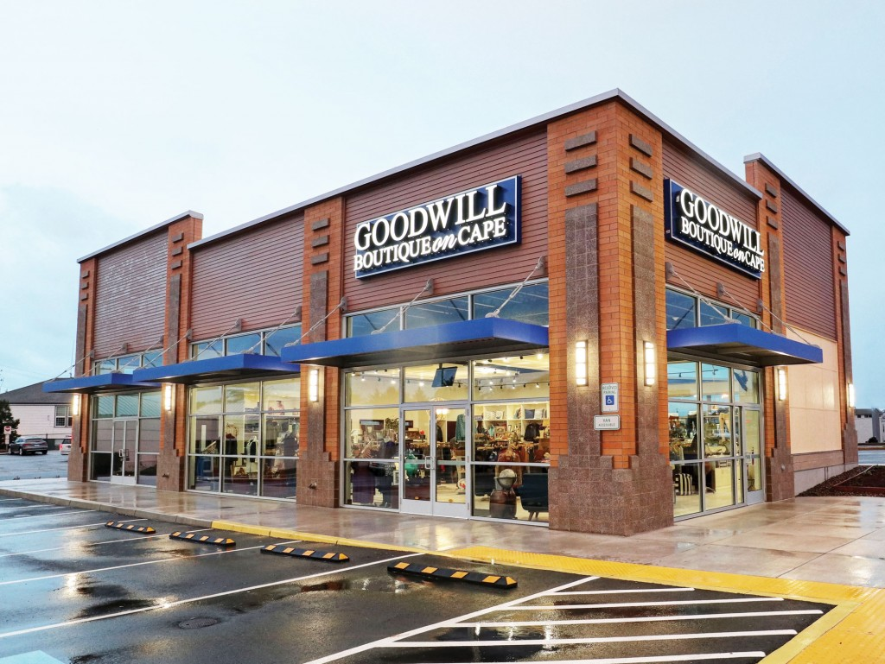
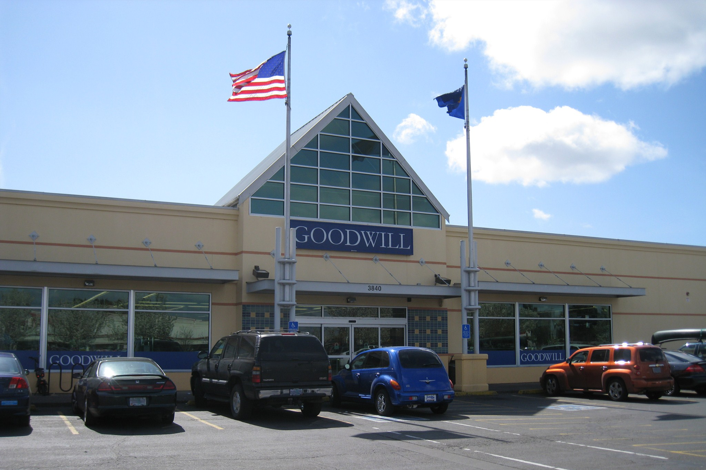
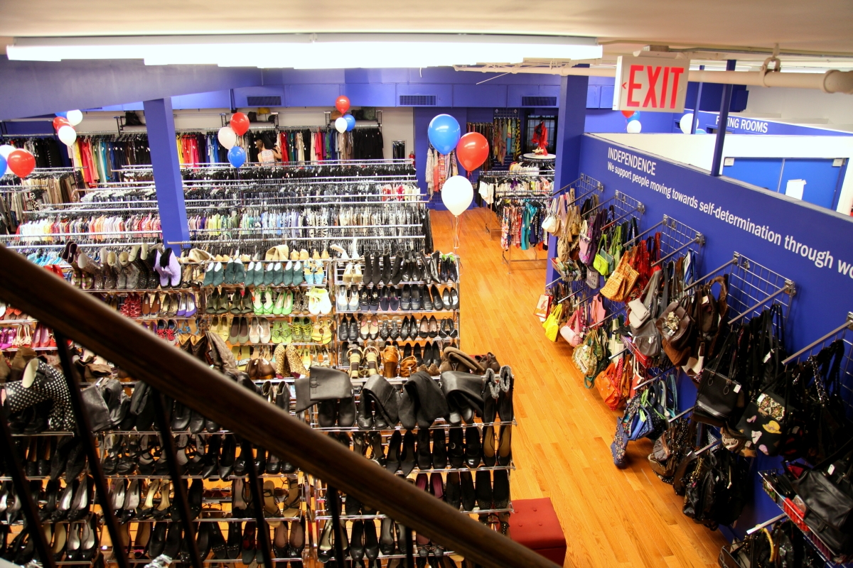

Slide 17
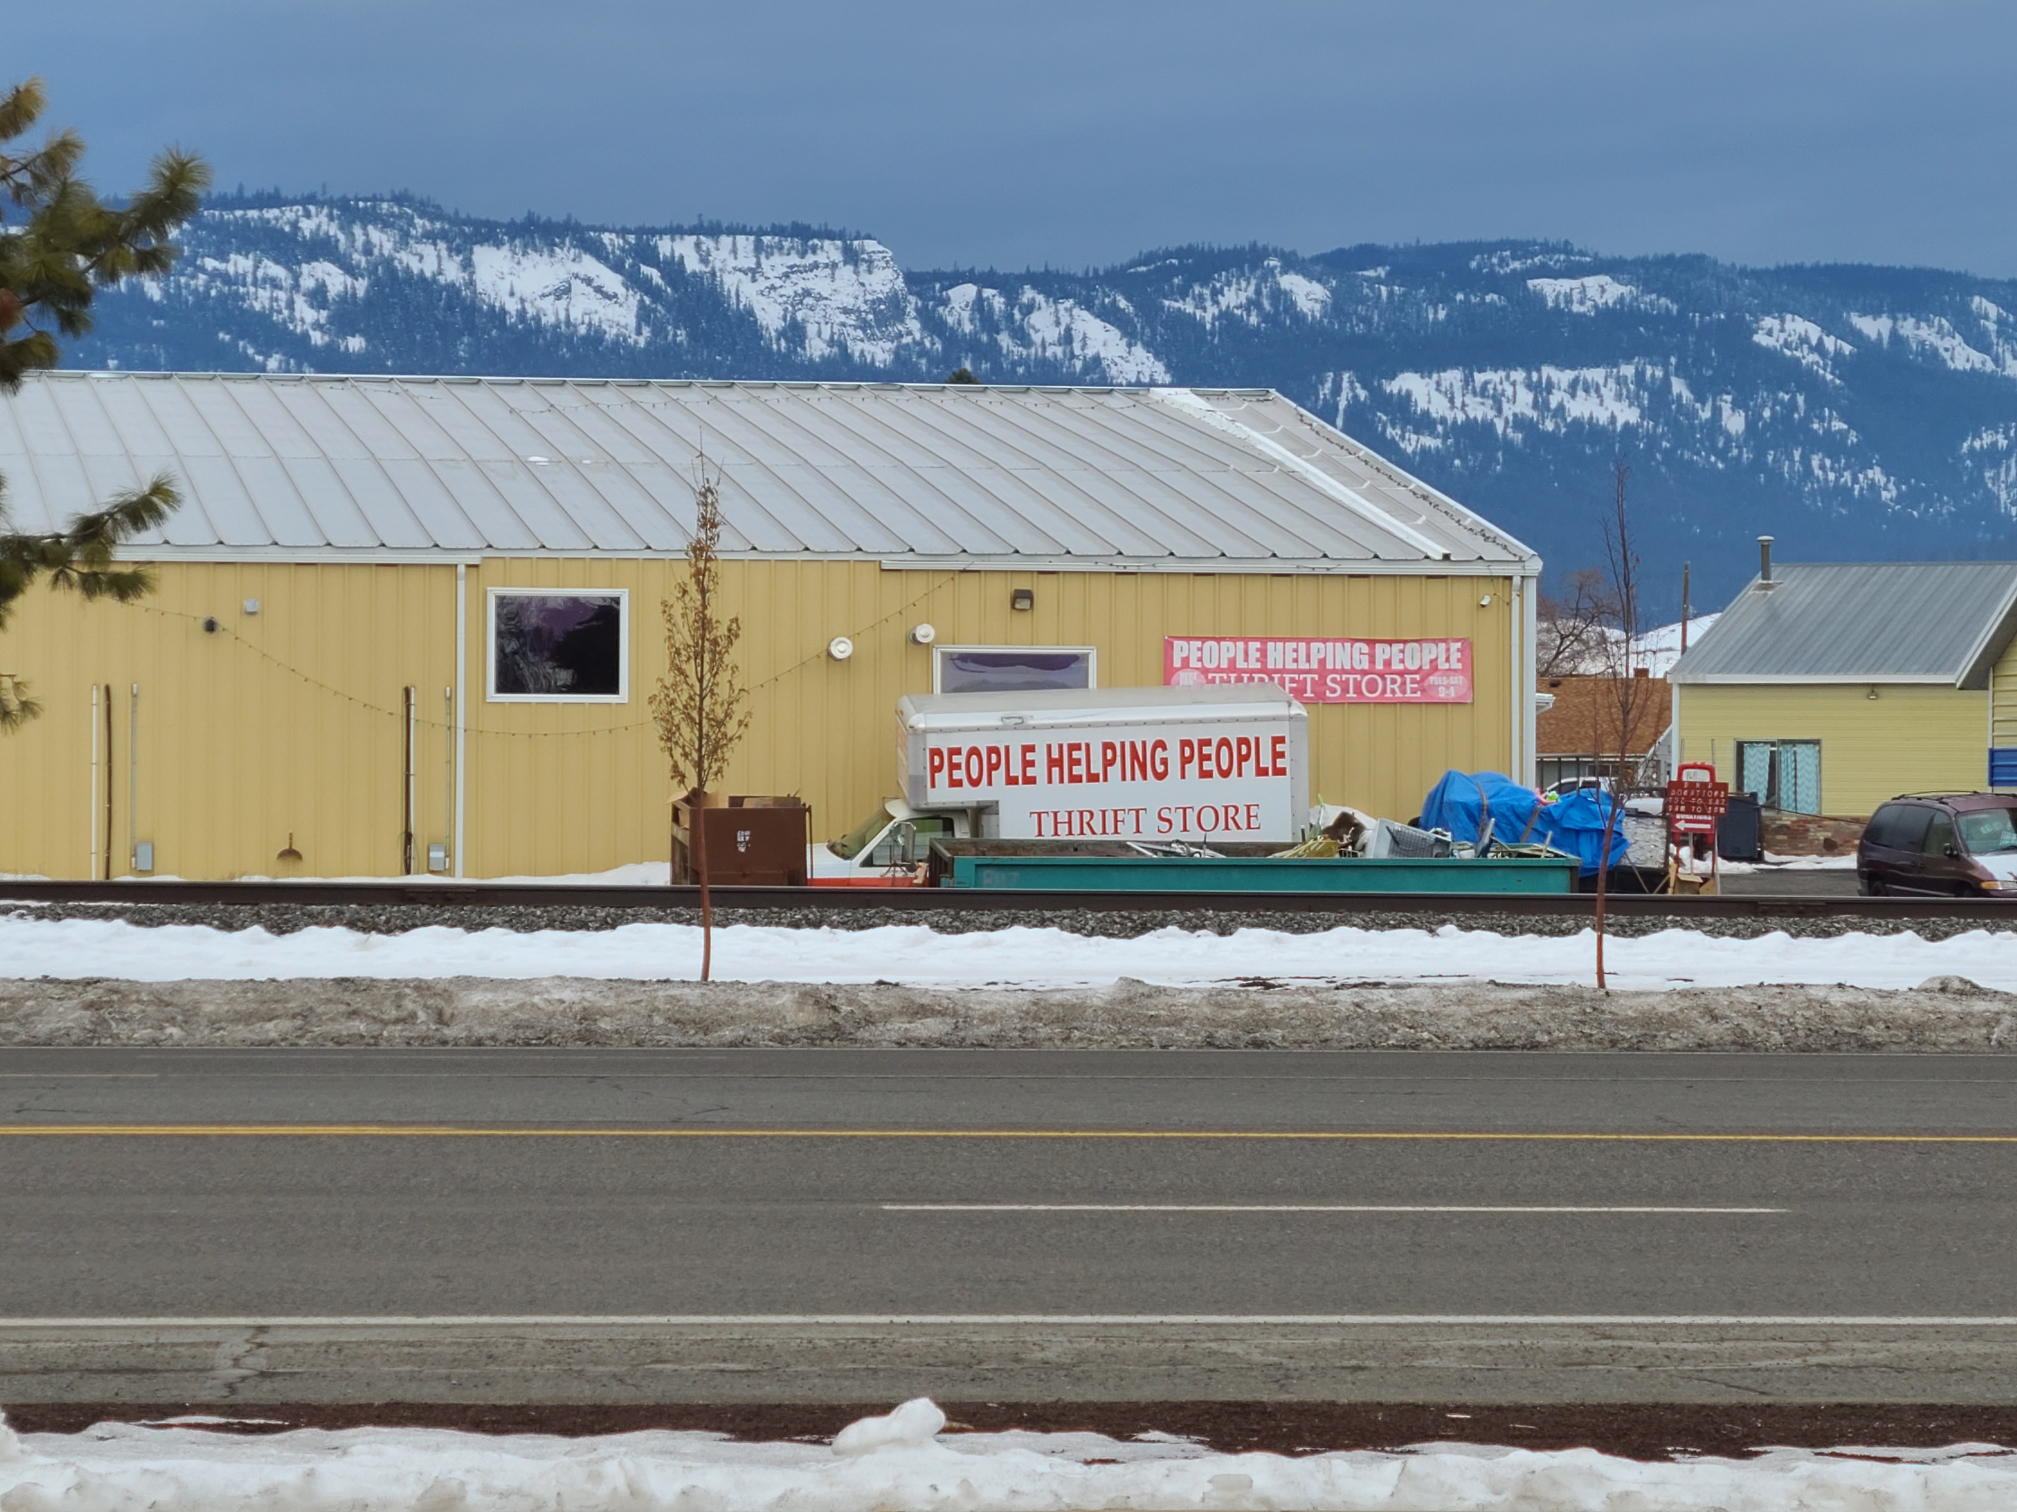
Island Avenue
La Grande, OR

Slide 18
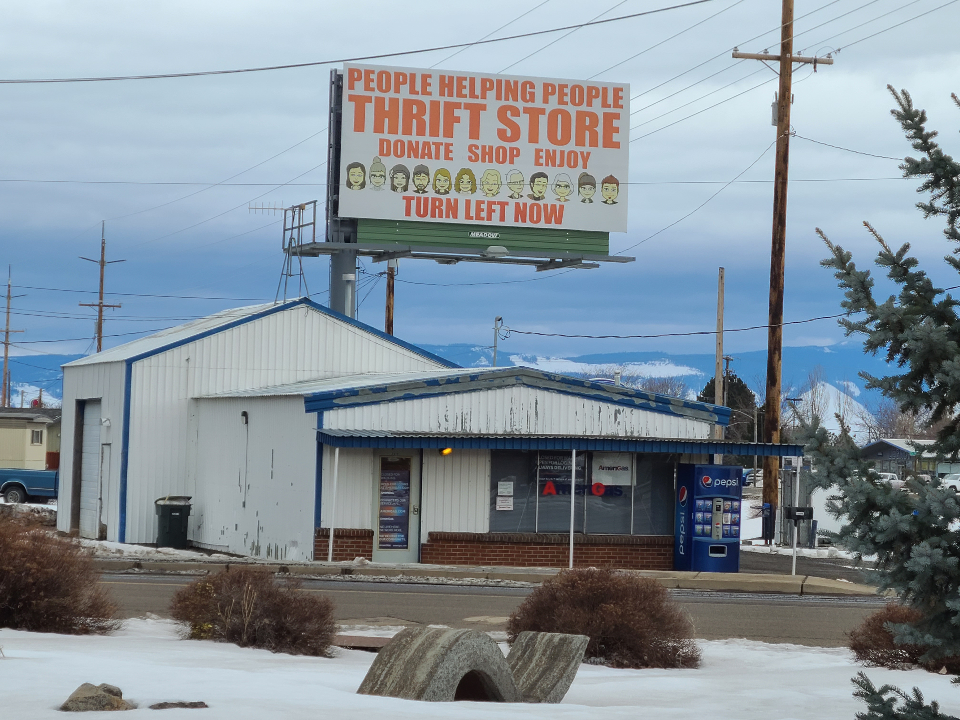
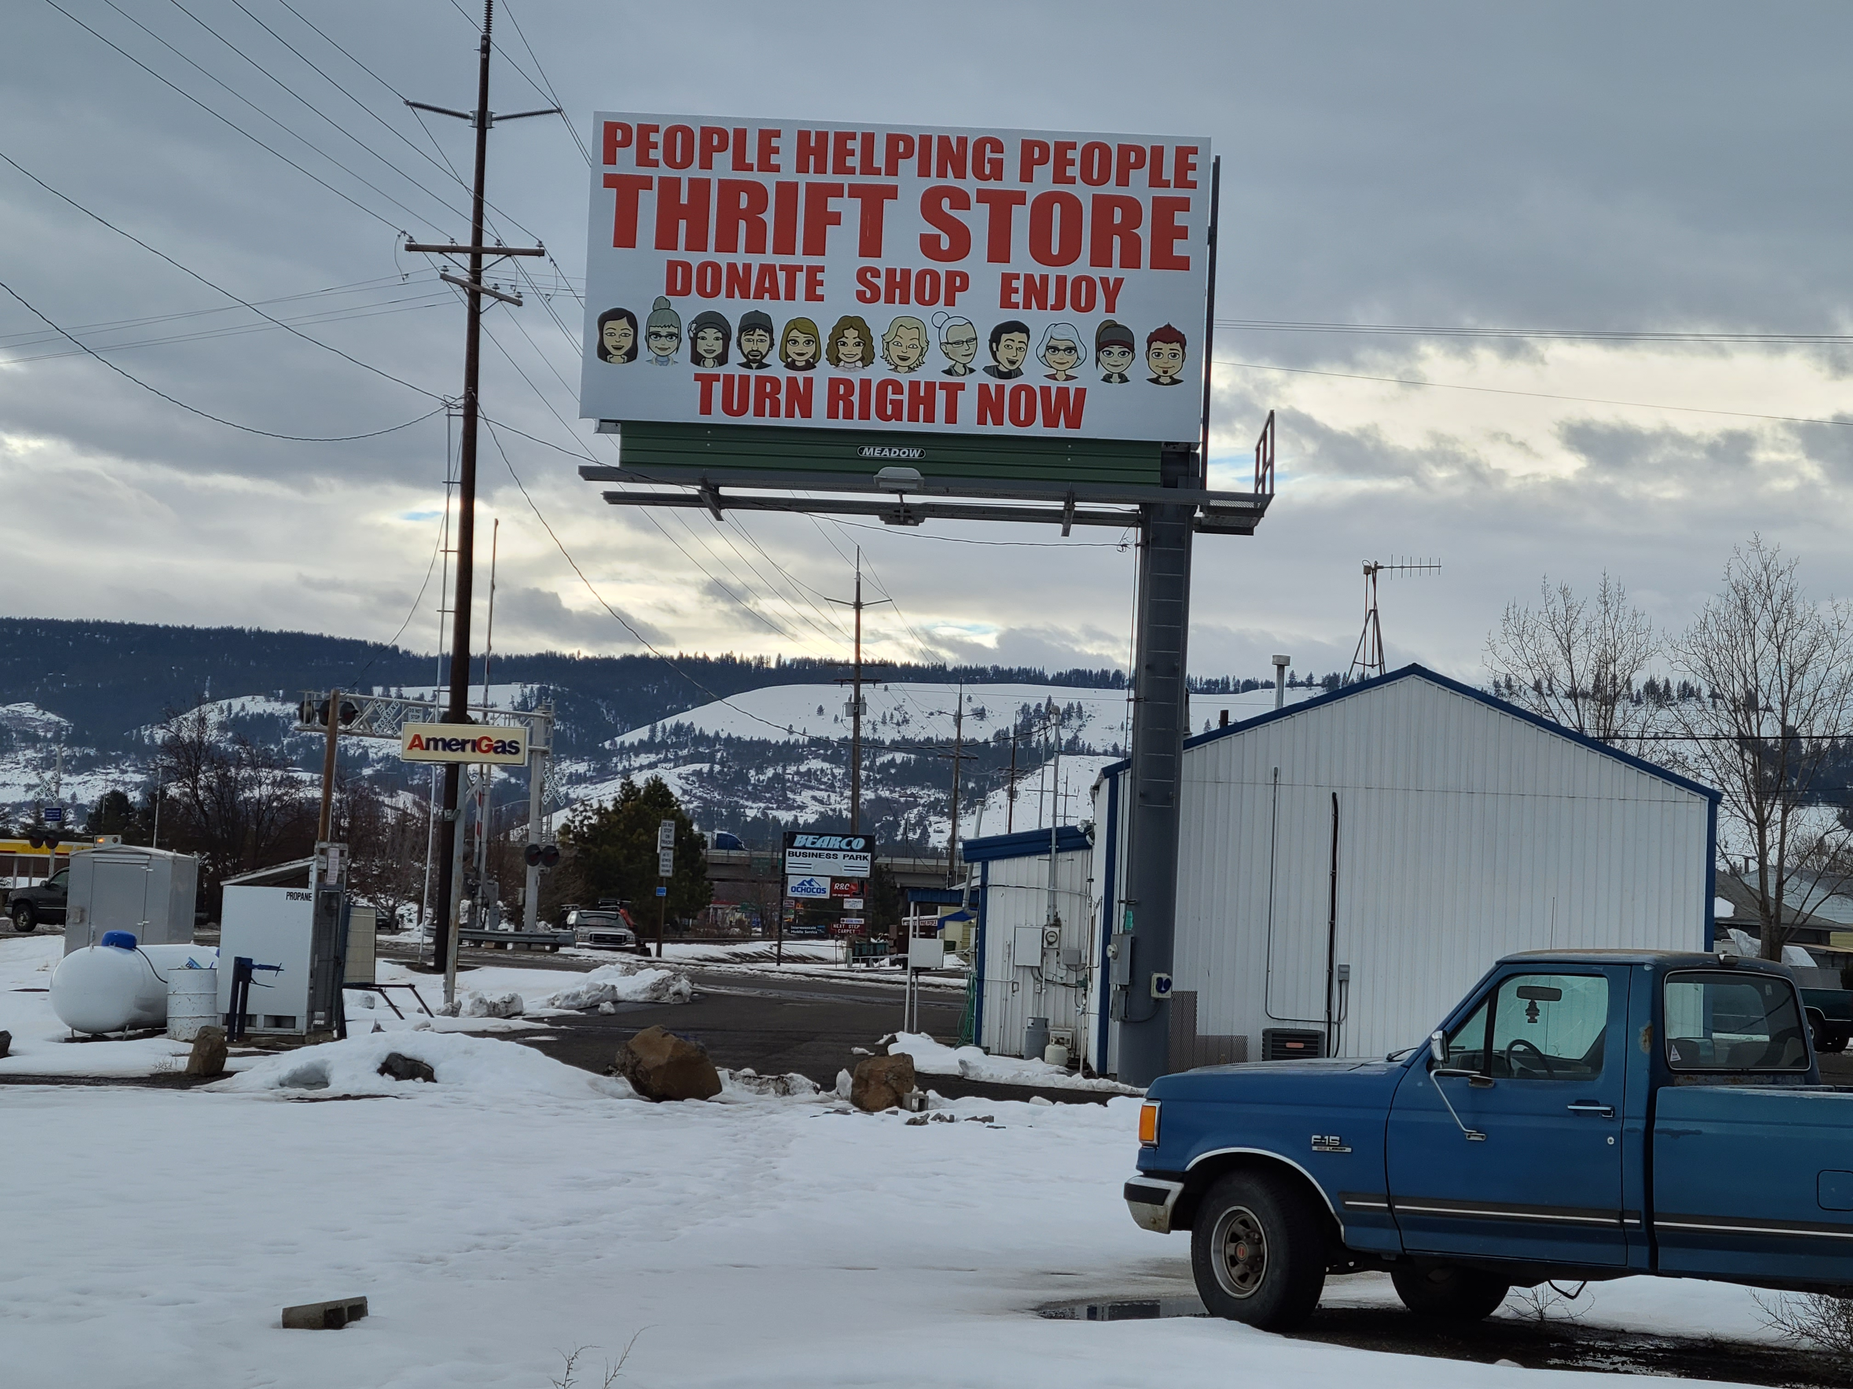
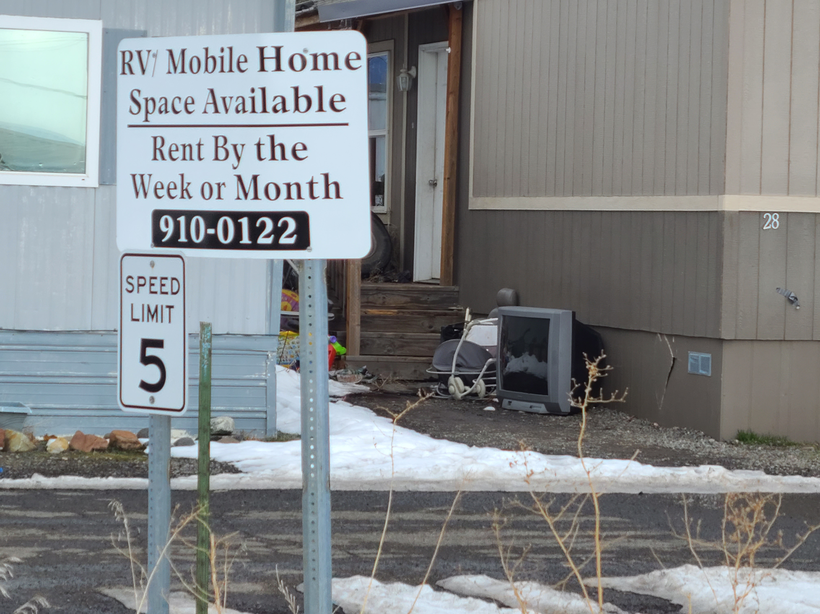
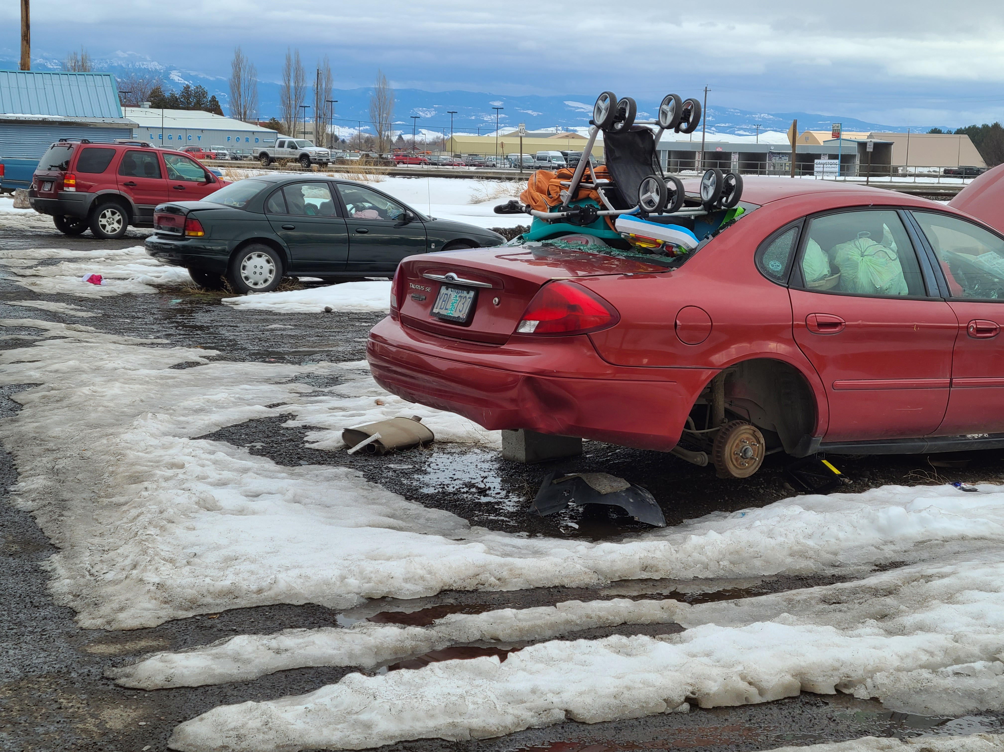
Outlet Mall Riff (?)
Neighbors (?)

Slide 19



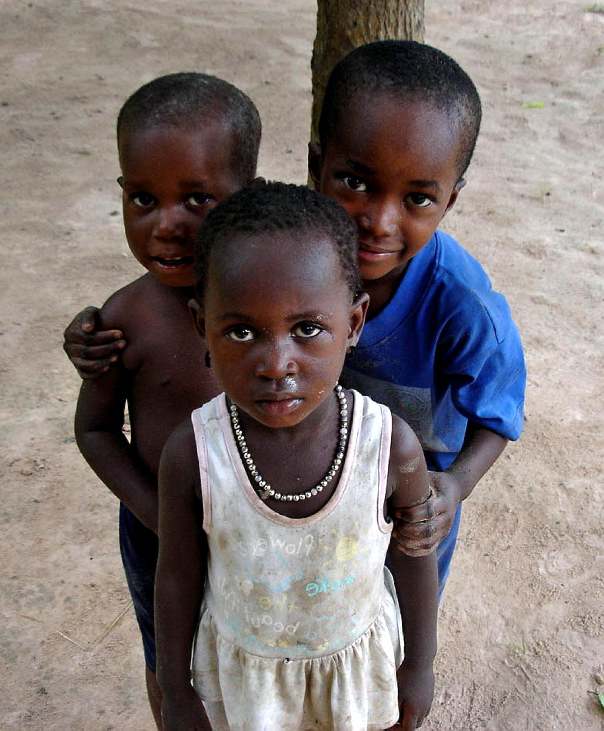
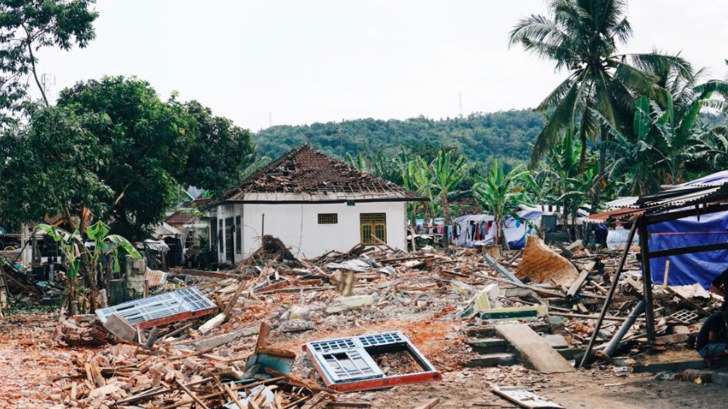
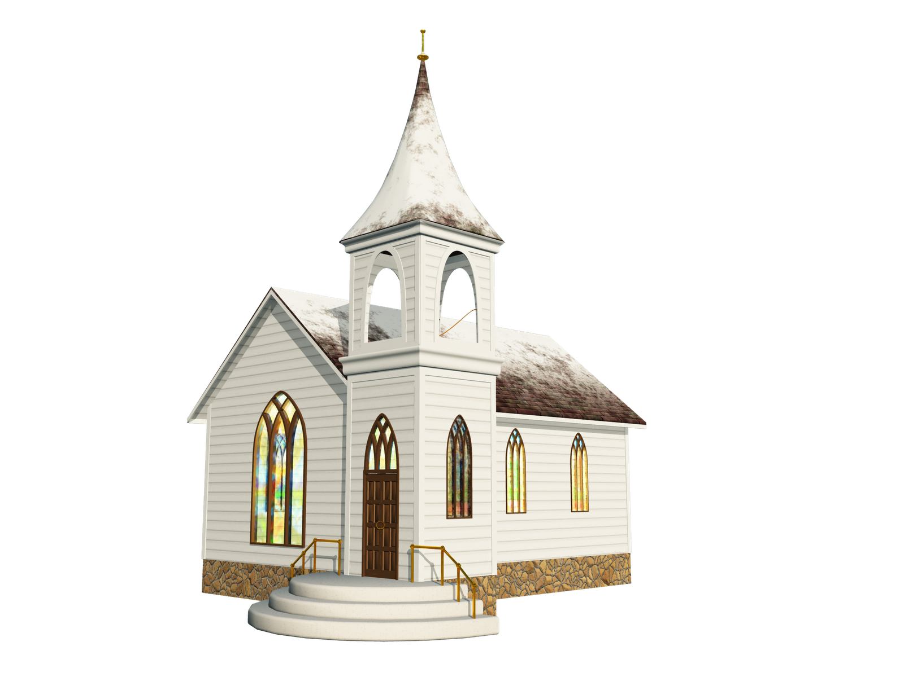

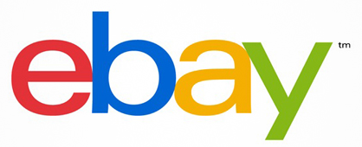
BE CLEAR. BE AUTHENTIC. BE CONSISTENT.
givers
shoppers
balance
Helping. Telling the Story…
overflow
local
national
international

Slide 20
givers
shoppers
balance
Promotion (?)
Promotion (?)

Slide 21
PROMOTION (starting point…)
partnerships
community organizations
university
churches
community outreach
Farmer’s Market
home make-over
interview day
job search
billboard
customer research
market model (?)
periodic events
national xxx day
make-over Monday
eBay/Craig’s List
EARNED
MEDIA
PAID
MEDIA
website
complete (brand consistent)
no eCommerce (for now)
tell the story (pictures)
social media
build on existing
Instagram, TikTok (??)
community hero’s
OWNED
MEDIA
logo (brand image)/story
brand building/store
donation location (?)
drop-off
pick-up (?)

Slide 22
IT ALL STARTS HERE…
Mission
Who are we?
What do we do?
Vision
What will we accomplish?
How will we change the world?
Values
Rules of engagement
What matters most to us?
HP Way
EOU
The SEED

Slide 23

givers
shoppers
balance
social venture(?)
non-profit(?)

Slide 24
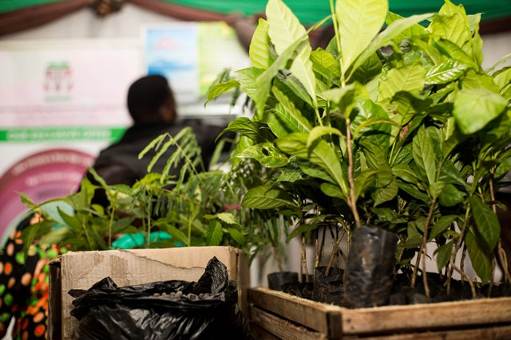





NUCAFE

Slide 25
THE BRAND
People
Helping
People

Slide 26
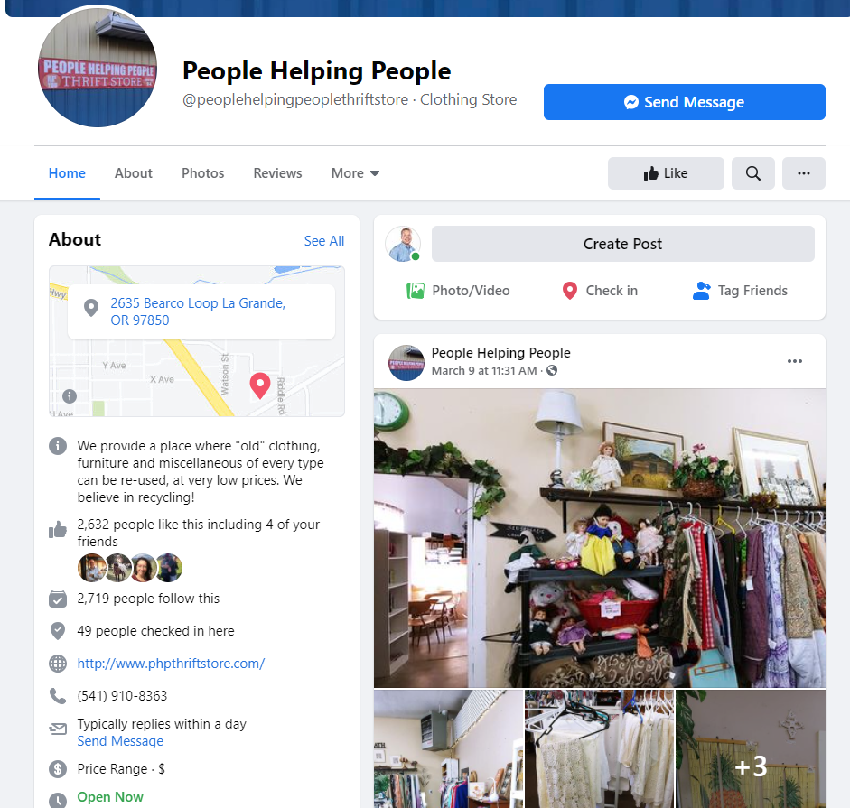
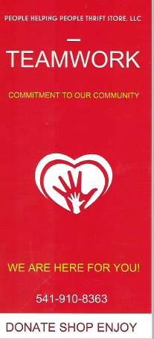
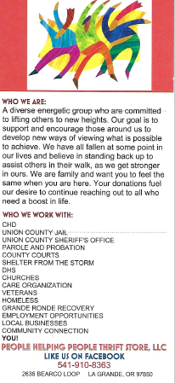
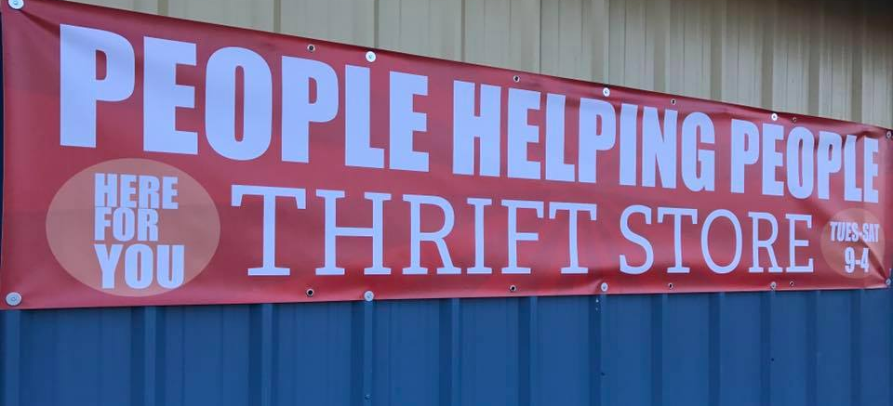
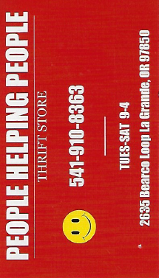
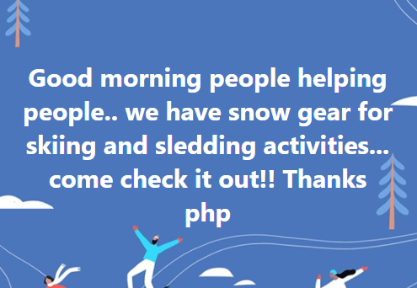
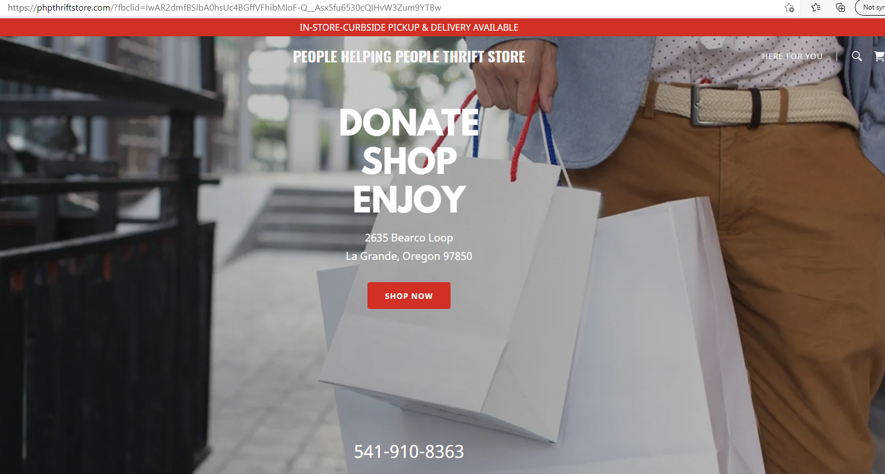
THE BRAND
People
Helping
People

Slide 27
THE BRAND (match the mission…)
Community Trust
Treasure Chest
Helping Hand
The Shed
Fashion Forward

