Slide 1
BA 498 – Business Policy & Strategy
Term Project
Consulting Engagement
Community Partner
Government Agency, Commercial Business, Non-Profit

Slide 2
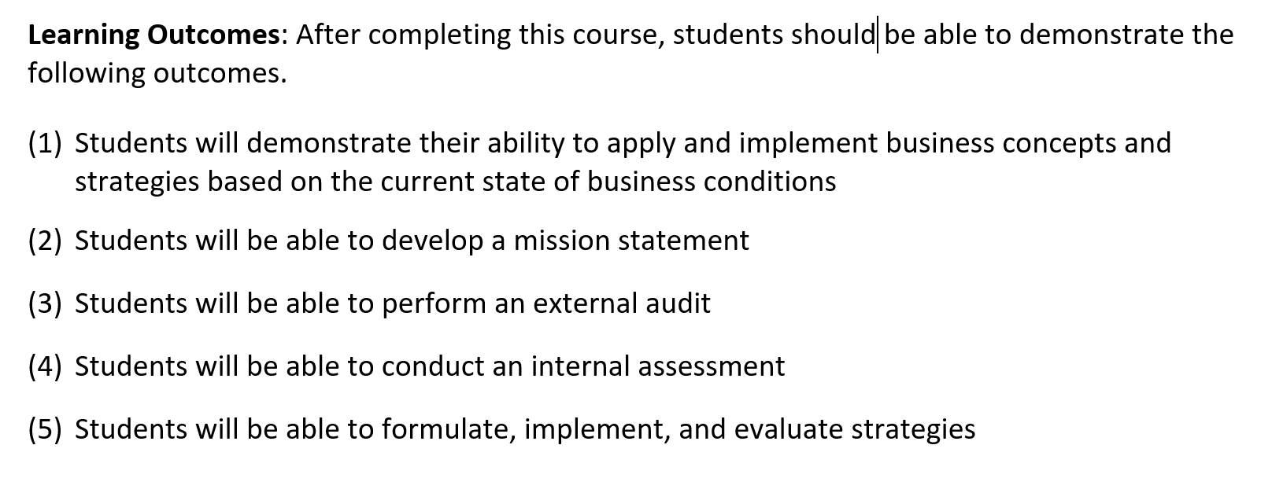
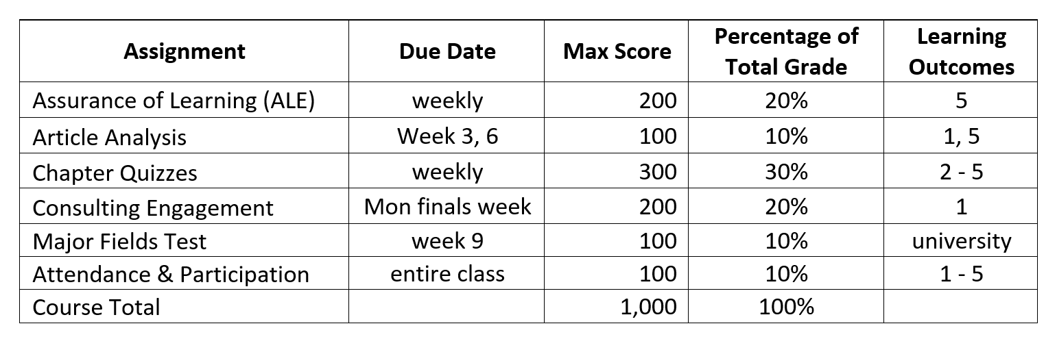
Business Policy & Strategy
Setting the Stage

Slide 3
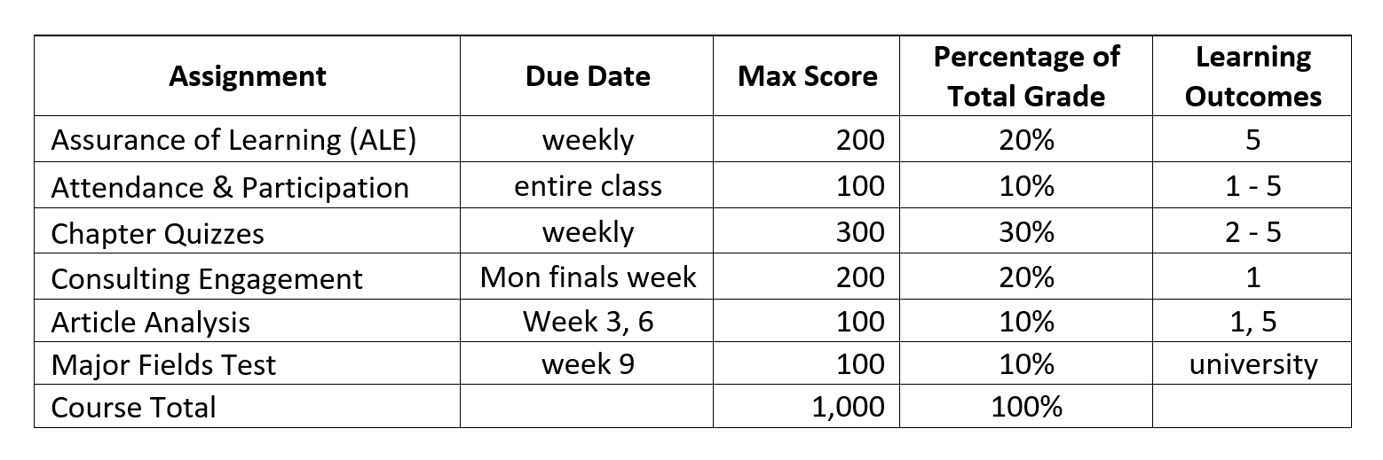
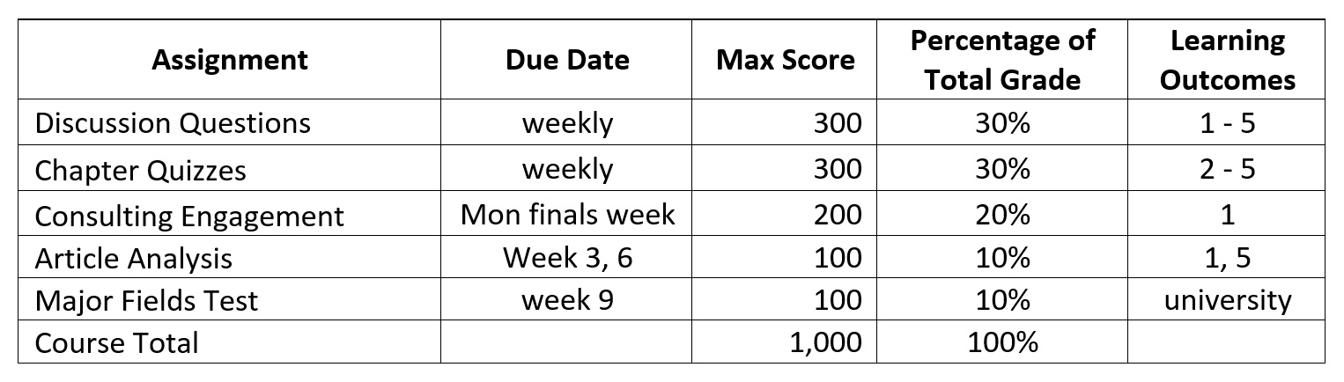
Business Policy & Strategy
Comparison
On Campus
Online

Slide 4

BA 498
Life-Long Learning
Politics
Networking
Career
Communication
Education
Policy & Strategy

Slide 5

Business Policy & Strategy
Sample Research Projects
State of Oregon
Charter Ranger District/DEQ
Biomass Fuel

Slide 6
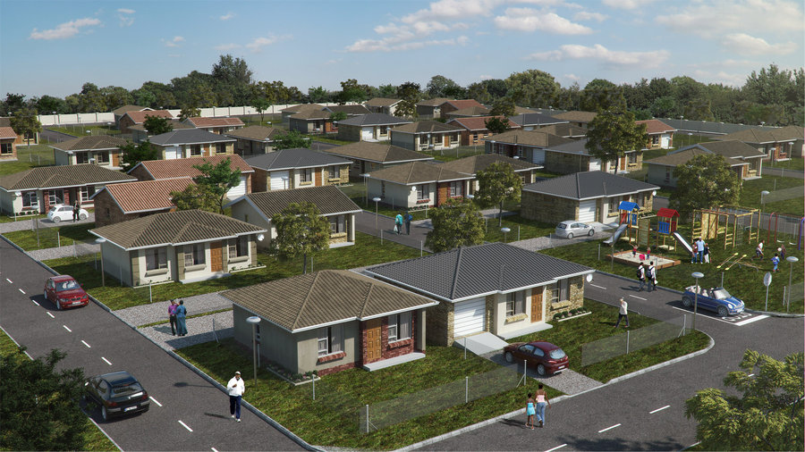
Business Policy & Strategy
Sample Research Projects
State of Oregon
Regional Task Force
Workforce ($15/hr+) Housing

Slide 7
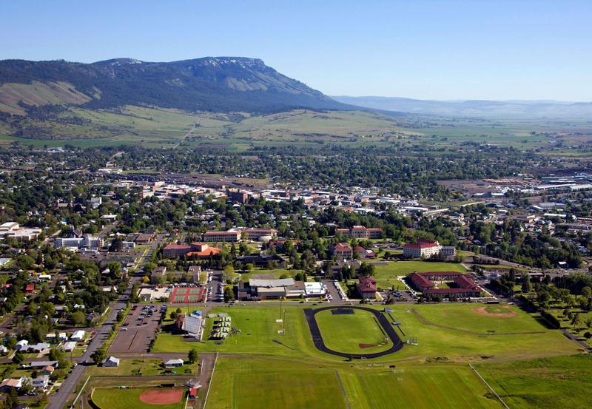
Business Policy & Strategy
Sample Research Projects
Eastern Oregon University
University Advancement
Fieldhouse + Turf

Slide 8

Business Policy & Strategy
Sample Research Projects
Union County
Buffalo Peak Golf Course
Economic Development

Slide 9
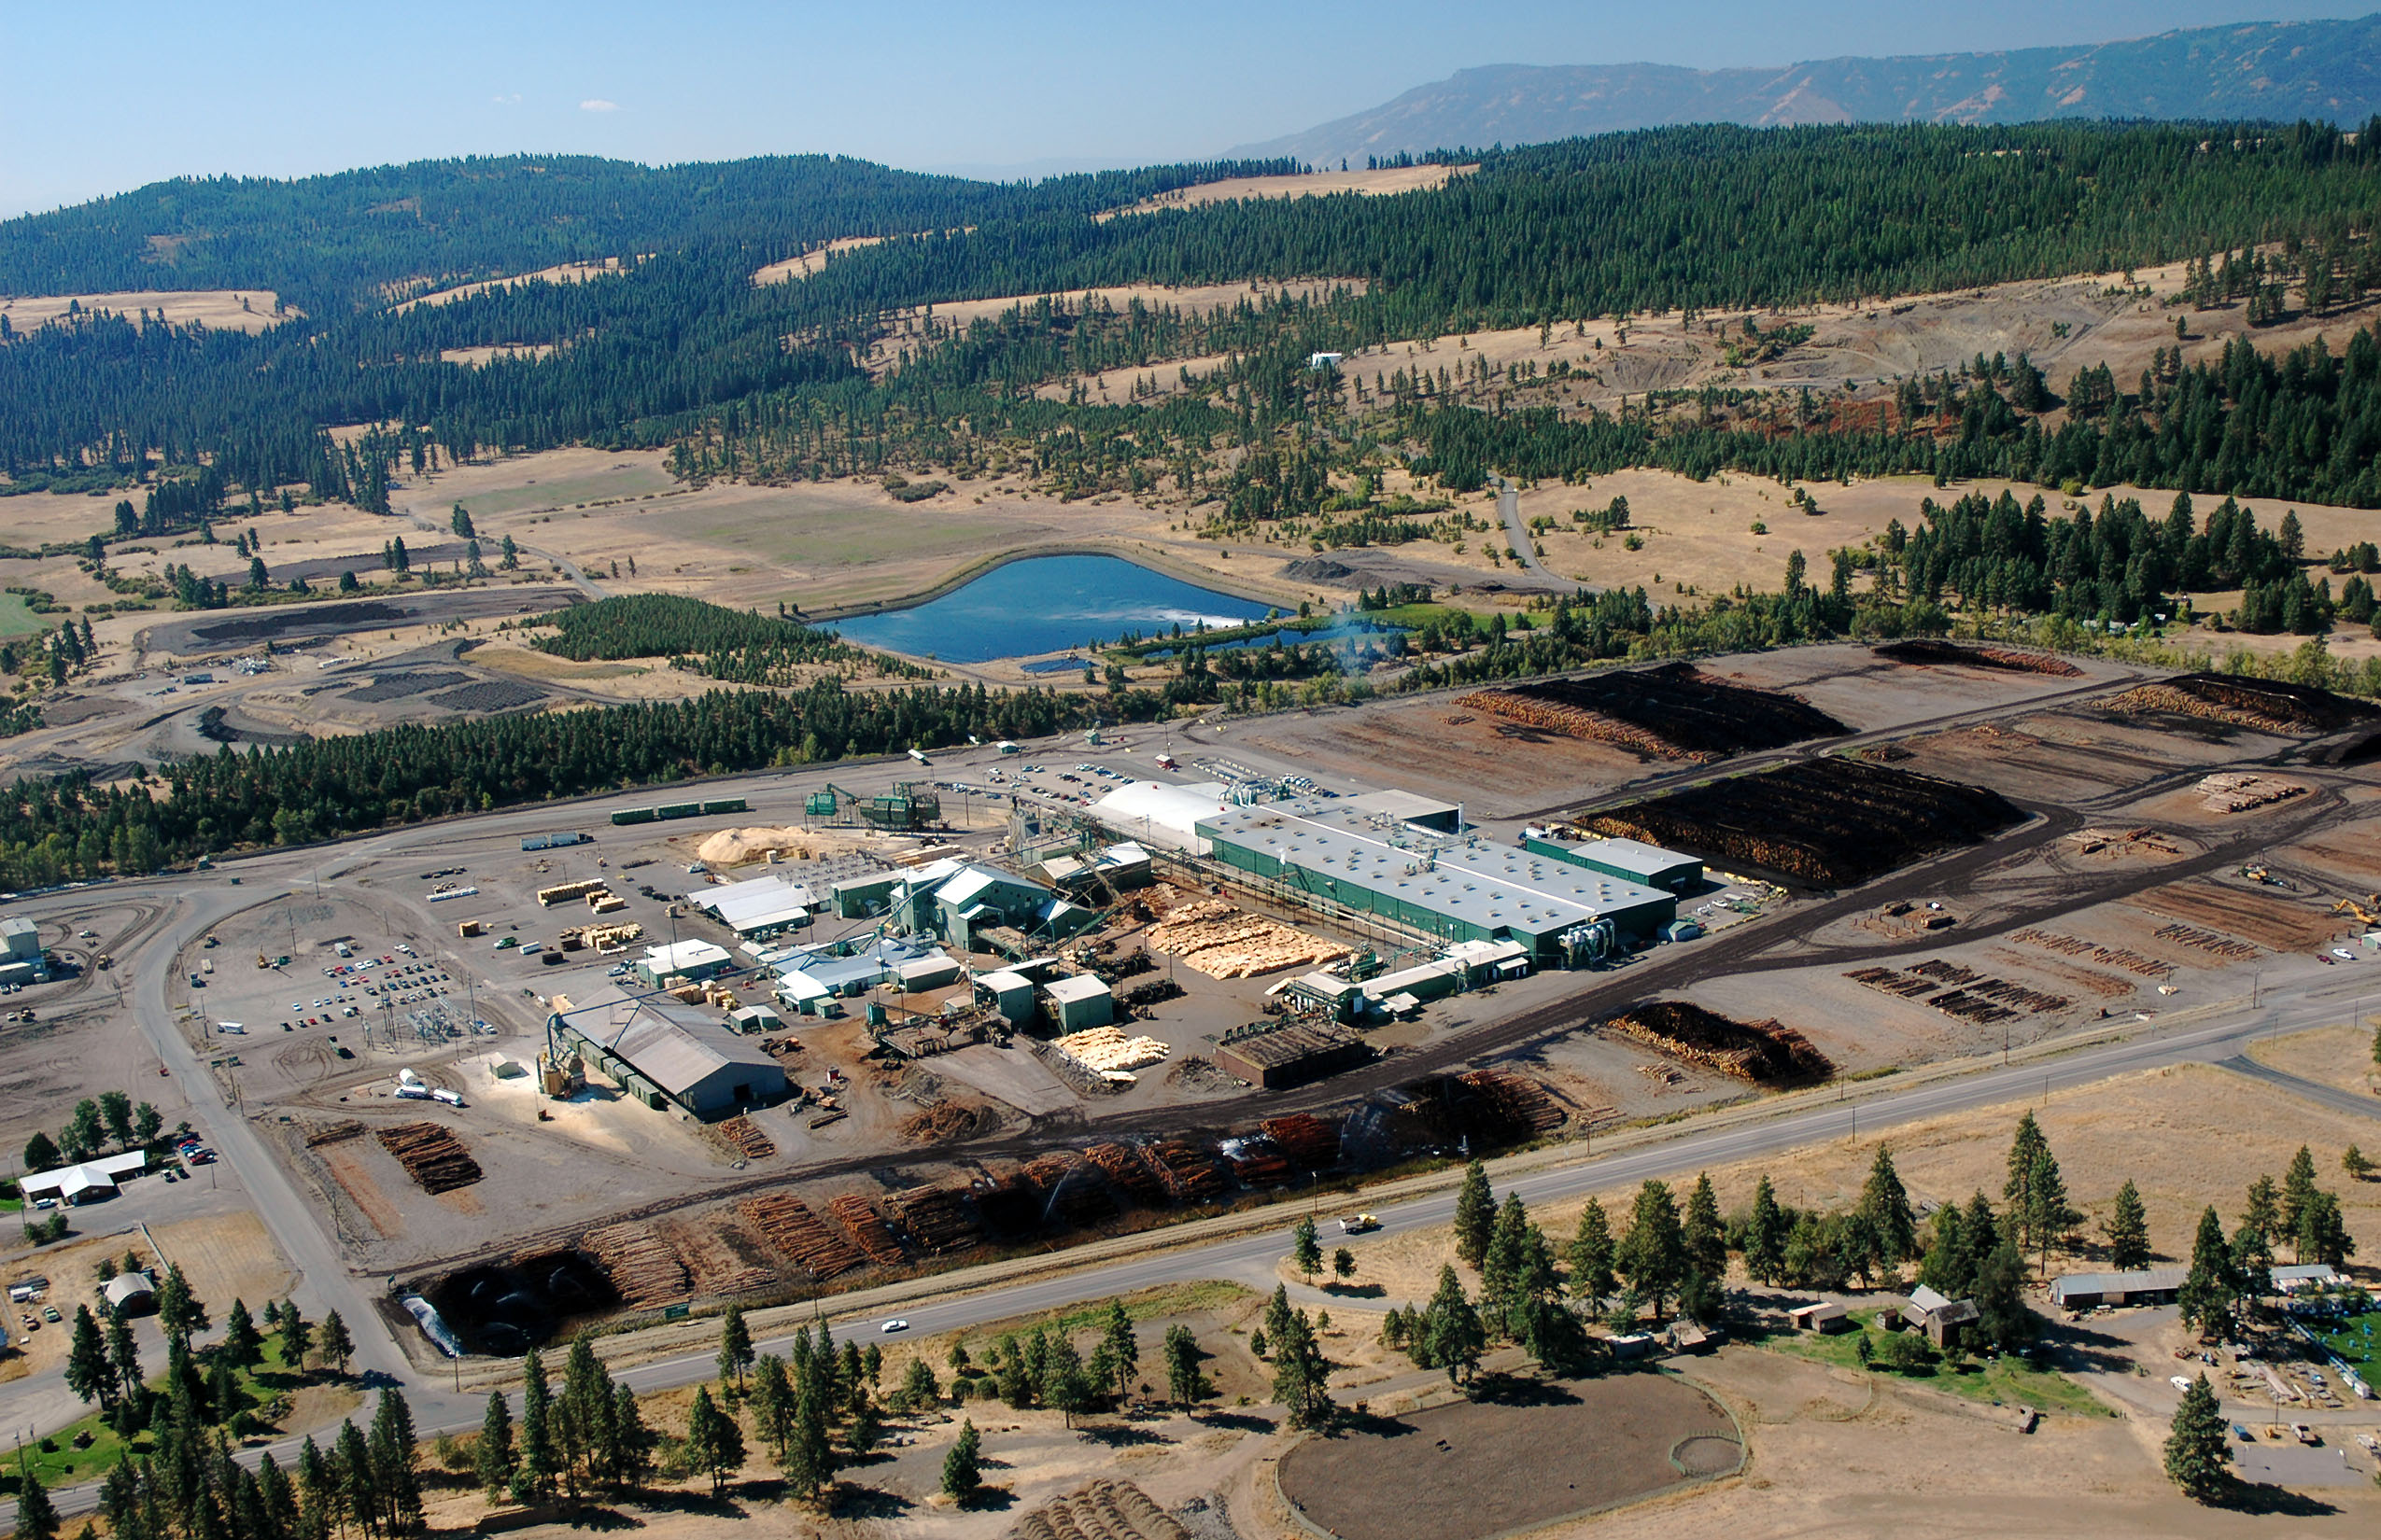

Business Policy & Strategy
Sample Research Projects
Boise Cascade
NE Oregon Region
Timber Supply

Slide 10
Business Policy & Strategy
Research Project: Client + Deliverables
Client: (See Samples)
One student team per project
Negotiate Statement of Work (SoW)
20 - 40 slide PowerPoint (with notes pages)
Notes should be equivalent to 20 page paper
Include at least 20 high quality references
Class time assigned (as needed)
Client presentation

Slide 11


Business Policy & Strategy
Research Project: Timeline
Week 1: Project overviews
Team selection
Week 2: Client discussion (in-class)
Draft SoW (examples on Canvas)
Week 3: Approved SoW
Week 3 – 6: Conduct initial research
Build draft presentation
Week 6: Client progress presentation
Week 7-9: Revise & refine
Expand (as required)
Week 10: Final client presentation
Week 11: Project Due (Monday @ 5:00)

Slide 12

Business Policy & Strategy
Research Project: Timeline
Research Project due Monday, finals week, at 5:00 PM
Late Projects will NOT be accepted
Please Plan Accordingly

Slide 13
Business Policy & Strategy
Online Changes
Week 1: Project overview
Team selection
Week 2: Written Summary + Contact Info
Draft SoW (examples on Canvas)
Week 3: Approved SoW
Week 3 – 6: Conduct initial research
Build draft presentation
Week 6: Client progress presentation
Week 7-9: Revise & refine
Week 10: YouTube Presentation
Discussion Post
Week 11: Project Due (Monday @ 5:00)
Missing Class Work
Sessions & Co-ordination

Slide 14
Business Policy & Strategy
Online Challenges
Week 1: Project overview
Team selection
Week 2: Written Summary + Contact Info
Draft SoW (examples on Canvas)
Week 3: Approved SoW
Week 3 – 6: Conduct initial research
Build draft presentation
Week 6: Client progress presentation
Week 7-9: Revise & refine
Week 10: YouTube Presentation
Discussion Post
Week 11: Project Due (Monday @ 5:00)
Contact Sporadic
Re-write Infrequent
Participation
& Progress Lacking…
Late Engagement
Technical Problems
Product Quality

Slide 15
Business Policy & Strategy
Online Changes (potential)
Week 1: Project overview
Team selection
Week 2: Written Summary + Contact Info
Draft SoW (examples on Canvas)
Week 3: Approved SoW
Week 3 – 6: Conduct initial research
Build draft presentation
Week 6: Client progress presentation
Week 7-9: Revise & refine
Week 10: YouTube Presentation
Discussion Post
Week 11: Project Due (Monday @ 5:00)
Online Office Hours
Conference Call or Recorded Interview
Weekly Team Calls
Short Status Update
Smaller Deliverables (?)
Mac instructions
Peer Review (each stage)

Slide 16

Business Policy & Strategy
Ideas & Suggestions

Slide 17



