Slide 1

Austin Winegar, James Creason, MacKenzie Kissell, Riley Strong, Tim Kilpatrick
Notes:
The purpose of this presentation is to provide Skip-Line with a comprehensive report on the business. These slides include a SWOT analysis identifying Skip-Line’s strengths, weaknesses, opportunities, and threats in the current and future market. Both a comprehensive description and evidence will be included for the analysis. An internal and external analysis is included, along with

Slide 2
Mission Statement:
Skipline
Innovation comes from the relentless pursuit of safer roadways.
Vision is to remain the industry's source for road marking control and information management systems.
Skipline vows to continue making the road marking industry safer and more efficient through innovation, automation, and integration.
As a family-oriented company, Skip-Line’s mission is to protect our family of road workers while making the roadways safer for yours.

Slide 3

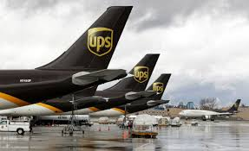
Skipline:
Core Competencies
Embedded Software For Commercial Line-Striping Trucks
Quick turnaround on new and existing products
Notes:
-Discuss software integration on paint trucks
-Customer service
-Include any other core competencies for Skip-Line
-Lack of core comp?

Slide 4
Overview:
Current Situation
Market Power
Different Models:
  Models/replacement service/parts
    Machines 30+ years old
  Next day shipping
Growth 6-8%
Seeking Innovation
  Boost growth 20-25%

Slide 5
Competition:
National/International Companies
Epic Solutions Fargo, North Dakota
  M7 Material Monitoring System
Borum - European
  Self-Propelled
  Thermoplastic and Cold Paint
Stim - European
  Retro-Reflective Road Studs
Hofmann - European
  Expert advice and guidance for our customers
Notes:
Competition in this industry is few and far between. The only major domestic competitor to Skip-Line is Epic Solutions producing sophisticated data logging equipment with electronic controllers. International competition consists of Borum, Stim, and Hofmann Who all produce painting equipment with attached controllers. Skip-Line may be able to market to these companies as they do with Graco. The European producers could purchase Skip-Line controllers to be used on their road equipment.
Epic Solutions: When it comes to pavement marking in respect to data logging, we feel that Epic Solutions has set the industry standard with their M7 Material Monitoring System. From installation to customer service, they have been a trusted vendor for Griffin Pavement Striping, Inc. for over a decade. Their vast experience in the striping industry and commitment to product development has helped them create a reliable and effective tool that helps ensure proven pavement marking application.`
Borum: Borum is one of the leading suppliers worldwide of professional self-propelled line marking machines and equipment. Borum road marking solutions can be equipped for thermoplastic, cold paint, and two component applications, covering any road marking challenge anywhere in the world.
Stim: At the end of 2013 our company celebrated its 20th anniversary. Right from the start, our focus was on retro-reflective road studs and over the years, we have successfully introduced this highly effective traffic safety device into our domestic market, followed by most of the East European countries. Despite other products on offer, road studs remain our major business orientation expressed by our own snow ploughable stud EN 1463 with certification in 2006.
Hofmann: Since 1948 Walter Hofmann has developed agricultural machinery and equipment upon request. Based on his experience amongst others at the company ZF in Friedrichshafen/Germany, he specialized himself in the improvement of transmission constructions.
In 1951 Hans Gubela visited Walter Hofmann in Hamburg for private reason. During their conversation he asked about the development of a new type of line marking machine "from practice - for practice".
Hans Gubela, owner of the very famous company Gubela which is one of the largest line marking companies in Germany as well as Walter Hofmann himself realized that as a result of the increase in demand for cars and trucks the need for well-developed roads with appropriate high quality markings will become immense.
Convinced of this idea, Walter Hofmann founded the company HOFMANN in 1952 as a sole proprietorship for line marking.
With our wide product range, every facet of line marking technology is covered: from small machines up to road marking trucks.
Products designed to costumer's specific requests, are a challenge for us.
Clients profit by HOFMANN's close contacts to both R&D as well as practical application. Traditionally there is an annual meeting as HOFMANN's TECHNOLOGY DAY to enhance the communication of the participants in line marking: paint producers and ministerial authorities, roadmarkers and scientific tutors.
Expert advice and guidance for our customers from the point of purchase to commissioning as well as training by our engineers go without saying.
Modern communication and logistics systems guarantee a quick service and a rapid spare part supply worldwide

Slide 6

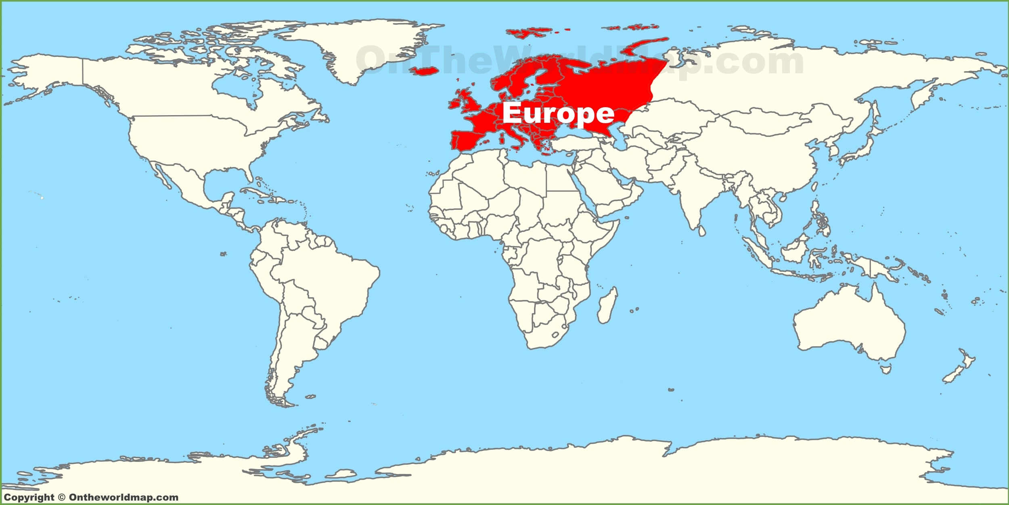
Skipline:
International Markets
Oceanic Region
  New Zealand
  Australia
Potential
  Europe
  Already in Canada
Notes:
-Potential market integration
- “Taking over” other country markets

Slide 7
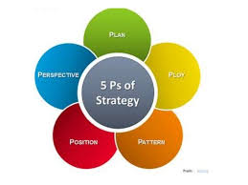
Marketing Mix:
The 5 P’s
Product: Road Marking Controllers
People: Truck Manufacturers/Distributors
Price: On average $6,000
Place: (distribution channel, Physical location, where buyers look for product/service)
Promotion: Trade Shows, Magazines, Word-of-Mouth
Notes:
Skip-Line’s marketing mix consists of five categories: Product, People, Price, Place, and Promotion. The current products consist mainly of electronic controllers which control paint striping equipment. Support is provided by training and maintaining equipment when a new product is released or a controller has a problem. Skip-Line’s current sales network is to truck manufacturers and companies who use electronic controlling units on painting equipment. Each sale generates roughly $12,000 USD for Skip-Line. Repairs cost labor and parts, but are not the focus of each sale.

Slide 8
SWOT:
Strengths
North American Market Leader
50 Years Positive Growth
24 Hour Repair Turn-Around
Low Operating Costs
Established Distribution Network
Embedded Software Core Competency

Slide 9
SWOT:
Weaknesses
Declining Growth Rate
Product Planning/Management
Access to Talent/Travel
Legacy Software/Technology
Niche Application in Larger Market
Small Recurring Revenue Stream
Mechanical Design not Core Competency
Notes:
Skip-Line’s weaknesses begin with the declining growth rate. A declining growth rate is a symptom of either the end of a product’s life cycle or a saturated market. Skip-Line does not show any signs of a product planning cycle which plans product’s integration while phasing out old equipment.
La Grande is a small community giving Skip-Line good rates on real estate and labor costs. The location does hinder Skip-Line’s ability to pull in talent from other locations and requires travel expenses to be higher. The software language hinder’s Skip-Line’s ability to write more complex software which would perform more complex tasks. The addition of a more advanced language would require Skip-Line to make large adjustments to their current product line.
Assembly Language Hampers Development

Slide 10
SWOT:
Opportunities
Data Management as a Service
Notification Service to Approaching Vehicles
Expand Manufacturer Partnerships
New GPS/Laser Technology
Robotic Arm Painting
Notes:
Skip-Line has the opportunity to build a service based product collecting and maintaining data gathered by the state regarding road miles and type of paint used. The current system is maintained on a detailed excel spreadsheet and paper notes. Skip-Line is presented with the opportunity to incorporate state data with their current systems. Compensation may be subscription based, leading to increased quarterly revenues. The collected data should be incorporated into Skip-Line’s controlling units giving operators road data on site and real time.
Automobile collision is a threat to operators and drivers alike. Operators have stated near misses are commonplace while painting roads, especially freeways. A slow moving vehicle is a danger to those driving freeway speeds. Distracted driving is a known factor and is out of the operator’s hands. A notification system is an opportunity for Skip-Line to pursue. Drivers who are using a navigation system near the paint striper should be notified of its presence. GPS position is already being recorded on current stripers and should include a way to let drivers know to slow down and use caution.

Slide 11
SWOT:
Threats
Graco paint sprayers, Wagner SprayTech, Kelly-Creswell Paint & Bead Guns, and Fuji Spray
Economic Downturn
Reduction in Federal Highway Spending
New Technologies

Slide 12
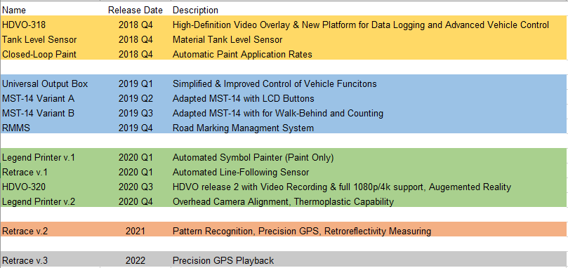
Product Road Map:
SkipLine
Product Life Cycle
Continuous modification
Notes:
Soldifying schedule for new technology for continuous improvement
Reduce repair old designs,

Slide 13
Overview:
Market Size
https://docs.google.com/spreadsheets/d/1Ex4BtBG8EA-BIPj_2PQWpjeF6NFjYmLrknj6vW7viq4/edit?usp=sharing

Slide 14
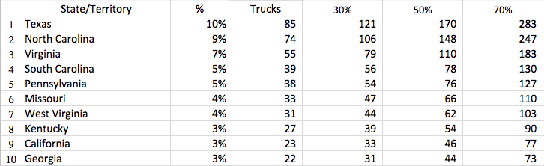
Market by State:
Approximations

Slide 15
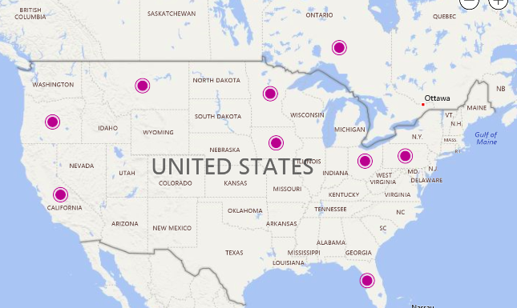
Overview:
Distributor Locations

Slide 16
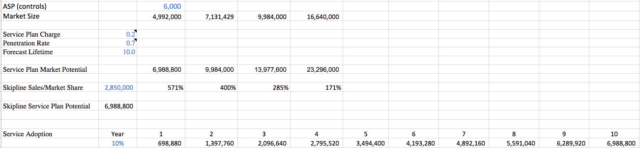
Fleet Size:
Estimation
https://docs.google.com/spreadsheets/d/1Ex4BtBG8EA-BIPj_2PQWpjeF6NFjYmLrknj6vW7viq4/edit?usp=sharing

Slide 17
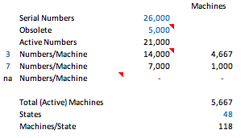
Machines in Operation:
Total Estimate

Slide 18
Integration:
Vertical
Paint - Many Suppliers
  Beads - A special manufacturing process
Paint Sprayers - Manufacturing
Paint Truck - Assembling Paint Trucks
Material and accessories required to assemble product
Notes:
Forward, backward, horiz. Forward minimal (retailers and wholesalers). Backward Suppliers

Slide 19
Integration:
Horizontal
Epic Solution
  Preferent to data logger
Minimal competition from others

Slide 20
Recommended Strategies:
Cloud Services
How can I sell more?
Channel remodel
  Subscription based software maintenance
  Cloud Services
Product Management Functions
  Pursue IOT Platform + Services

Slide 21
Recommended Strategies:
Adjacent Markets
How can I sell more?
Controllers
  More systems per truck
  Other road maintenance trucks
  Rumble strip milling machine controller

Slide 22
References
A. (2016). DISTRIBUTORS AND RESELLERS. Retrieved from http://novoinnovation.co.nz/contact/distributors/
Borum line marking solutions. (2017). Retrieved from http://borum.as/
David, F. R., & David, F. R. (2015). Strategic management: Concepts and cases: A competitive advantage approach. Boston: Pearson.
EPIC SOLUTIONS. (2018). Retrieved from http://epicsolutions.us/
I. (2017, October 25). HOFMANN: About Us. Retrieved from https://www.hofmannmarking.de/en/hofmann/about-us/
I. (2016). STIM, spol. s r.o. - The roads are safer with us! Retrieved from http://www.stim.eu/

Slide 23
References
Lu, W. (2010). Improved SWOT Approach for Conducting Strategic Planning in the Construction Industry. Journal Of Construction Engineering & Management, 136(12), 1317-1328. doi:10.1061/(ASCE)CO.1943-7862.0000240
NIOAŢĂ, A., & STĂNCIOIU, A. (2013). STRATEGIC MANAGEMENT ROLE IN CHANGING THE ORGANIZATIONAL CULTURE OF THE COMPANY. Fiability & Durability / Fiabilitate Si Durabilitate, (1), 326-329.
Robbins, F. (1994). The Teaching of Marketing Strategy. Marketing Education Review, 4(1), 10-15.
Skip-Line (2018). OUR INNOVATION COMES FROM THE RELENTLESS PURSUIT OF SAFER ROADWAYS. Retrieved June 4, 2018, from http://skipline.com/


Slide 24
References
VAGDIENĖ, B., & PERKUMIENĖ, D. (2017). EVALUATION OF COMPETITIVENESS FACTORS OF RURAL COMMUNITIES. Proceedings Of The International Scientific Conference: Rural Development, 1344-1349. doi:10.15544/RD.2017.211

Slide 25
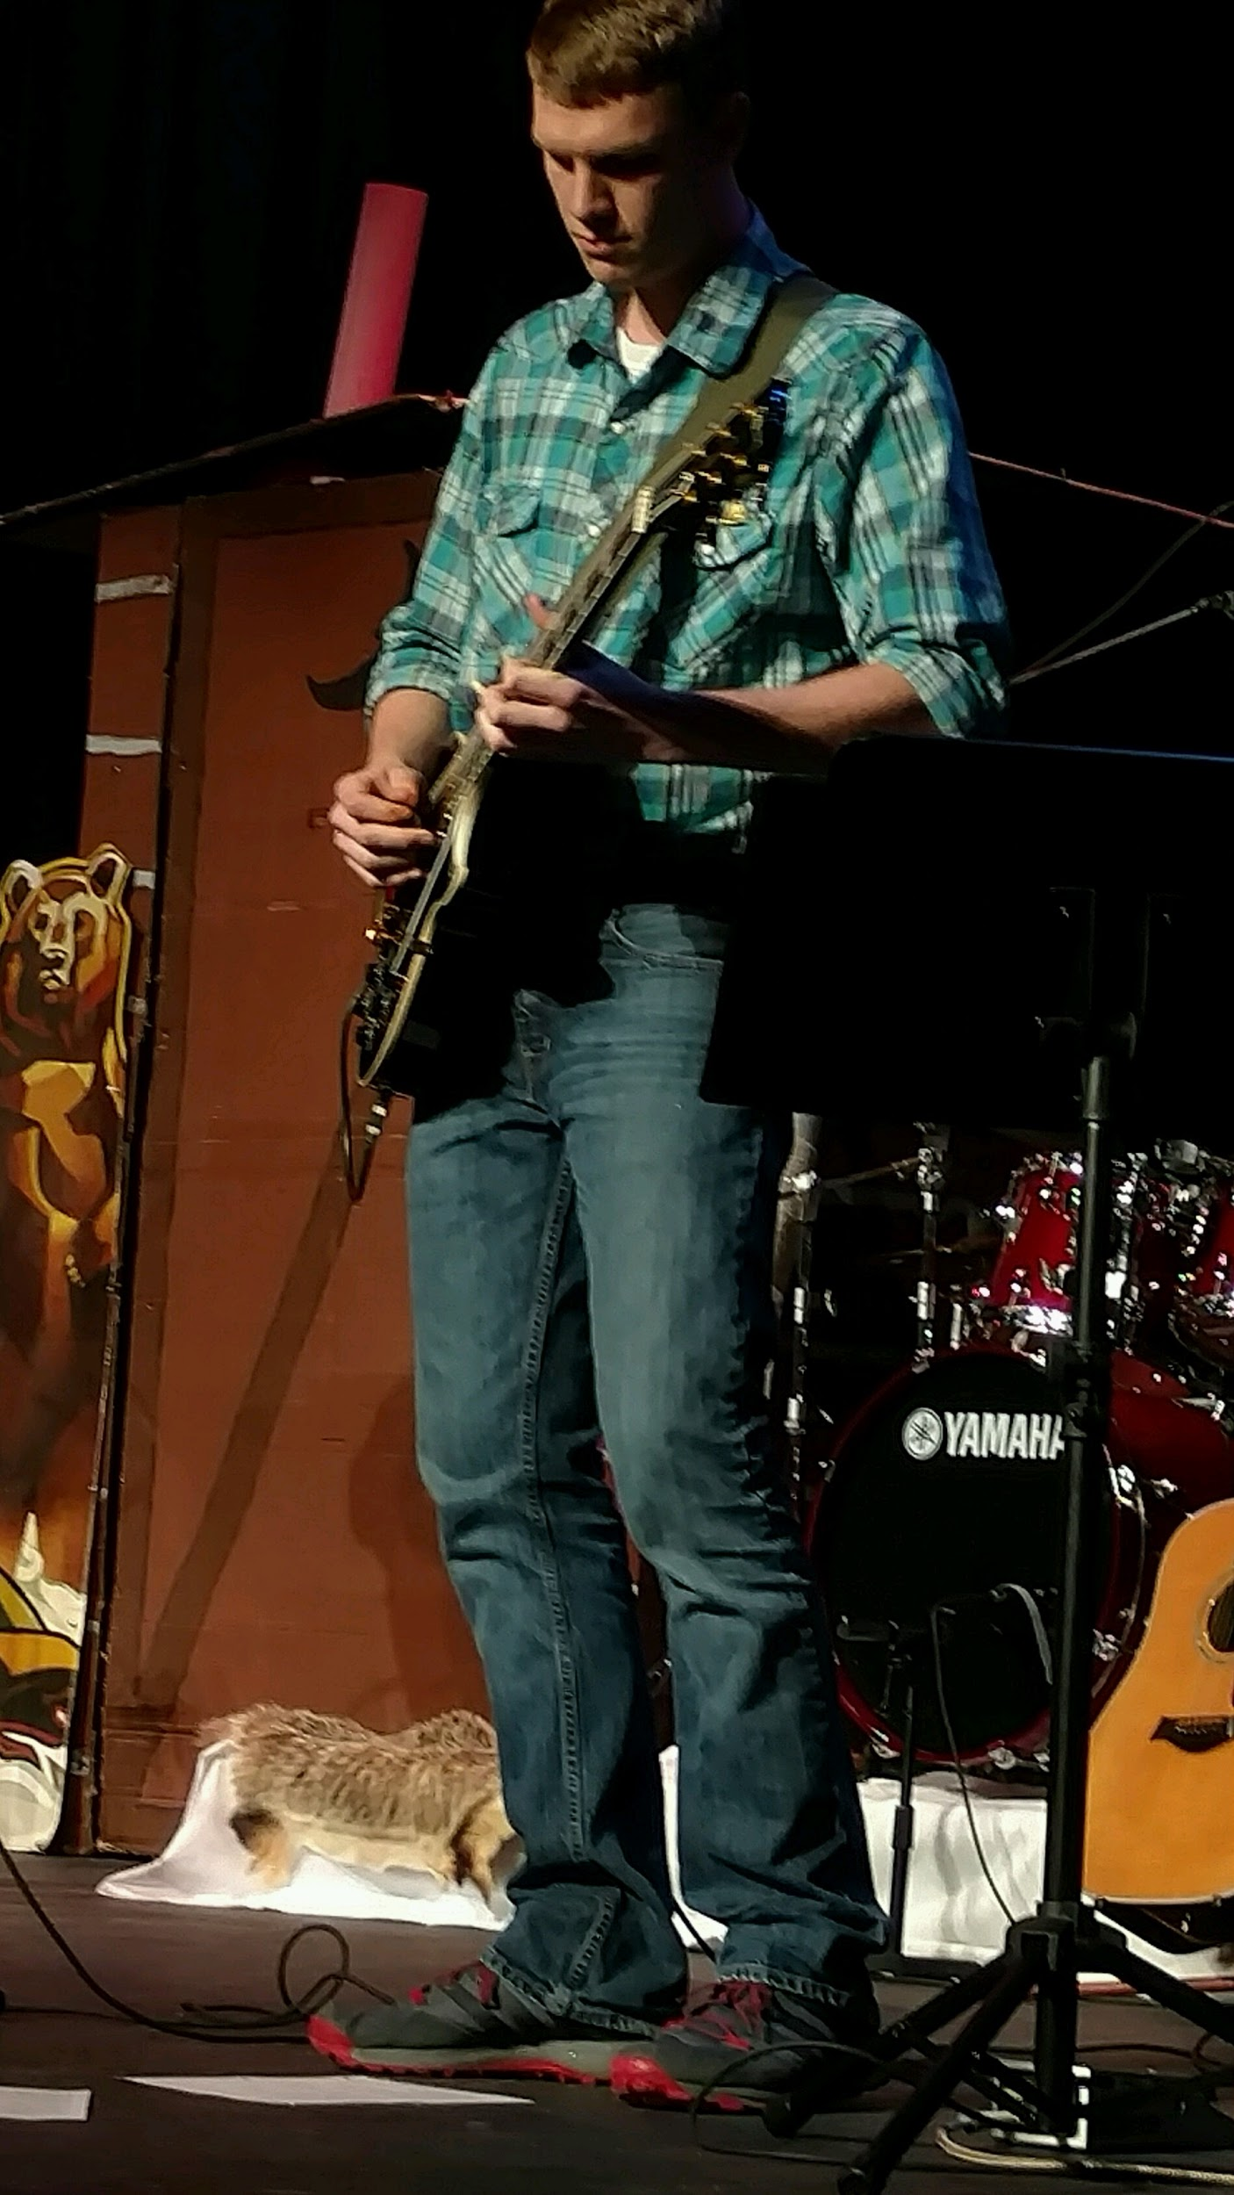
BIOS
James Creason
Irrigon, OR
Graduating EOU with B.S.
Head of Agriculture Infrared Baron Inc.

Slide 26

BIOS
MacKenzie Kissell
Weiser, Idaho
2018 EOU GRADUATE - B.S.B.A
Future Business Professional
KEEP OREGON GREEN

Slide 27
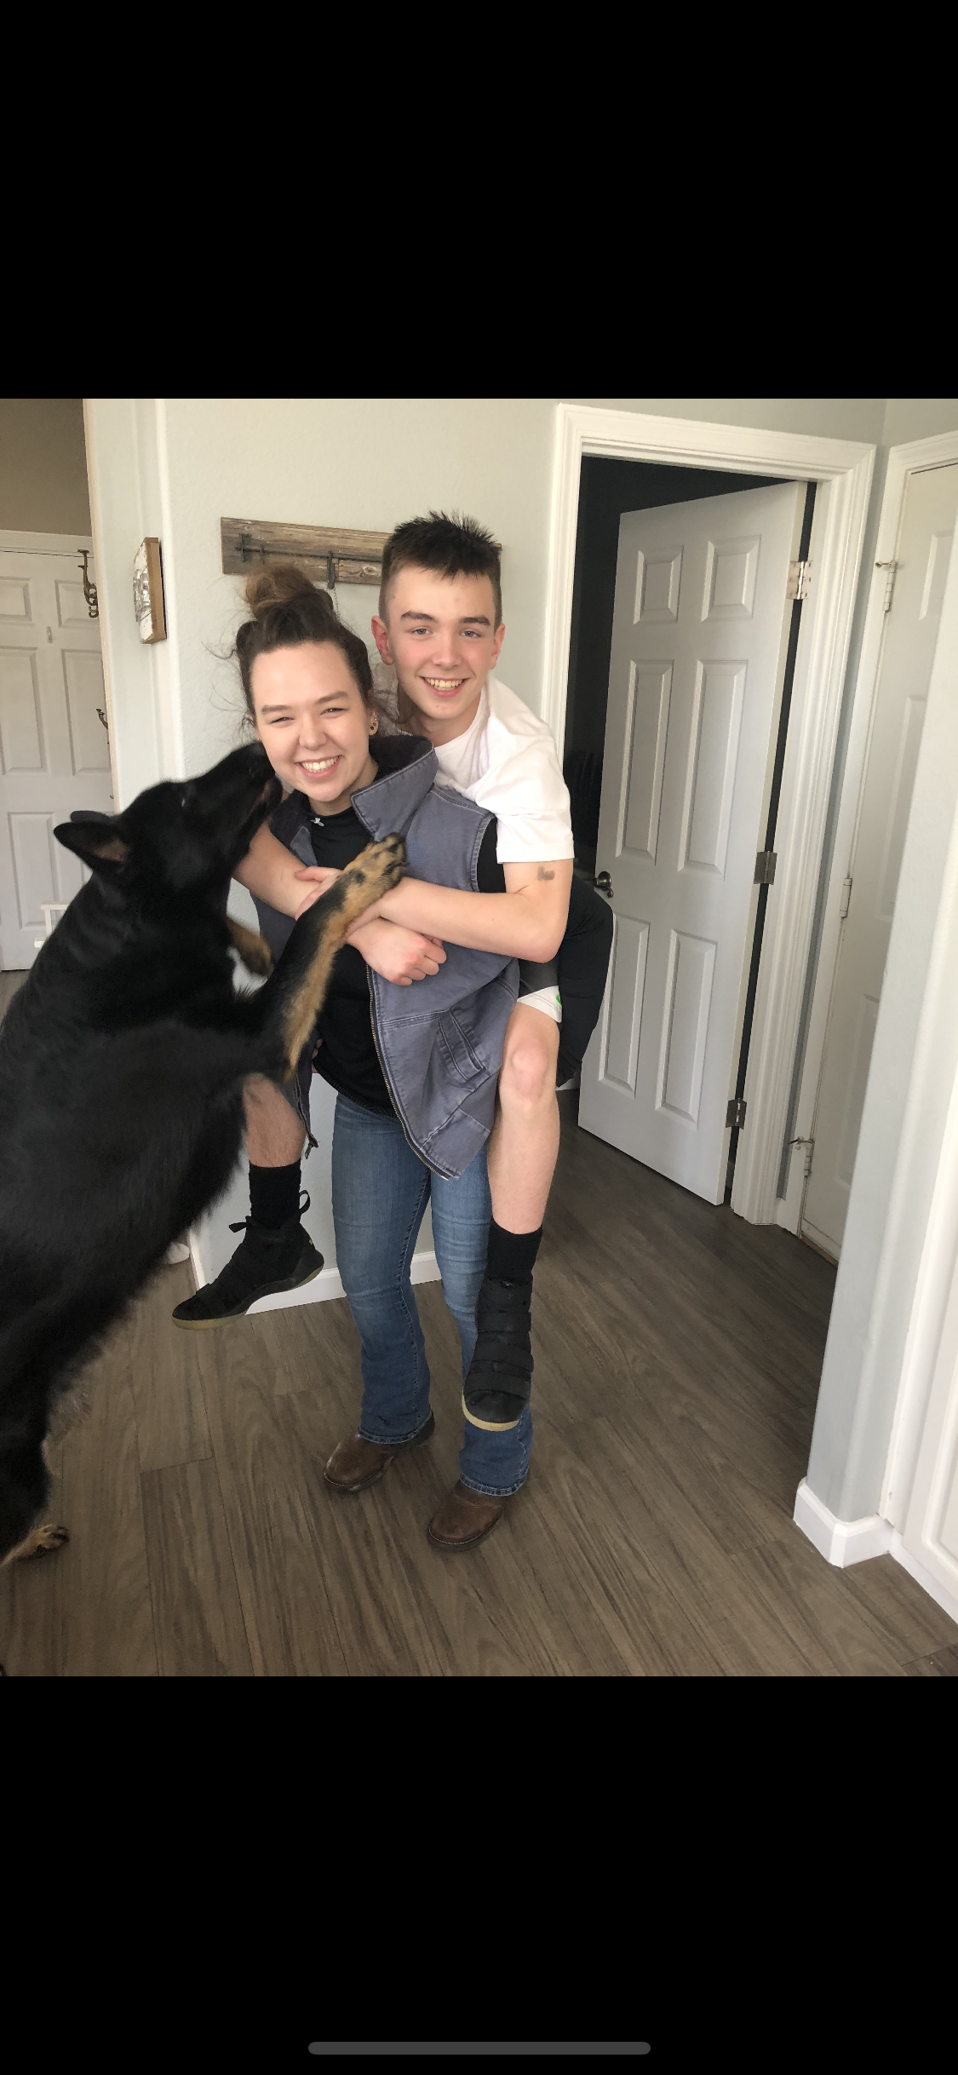
BIOS
Riley Strong
Portland, OR
Graduating EOU with a BS in Business Admin.
Starting Masters in Human Resources EOU Fall of 2019

Slide 28

BIOS
Austin Winegar
Weiser, ID
EOU Basketball
Graduating June 16 with B.S. in Business Admin.
Proud Husband and Father

Slide 29
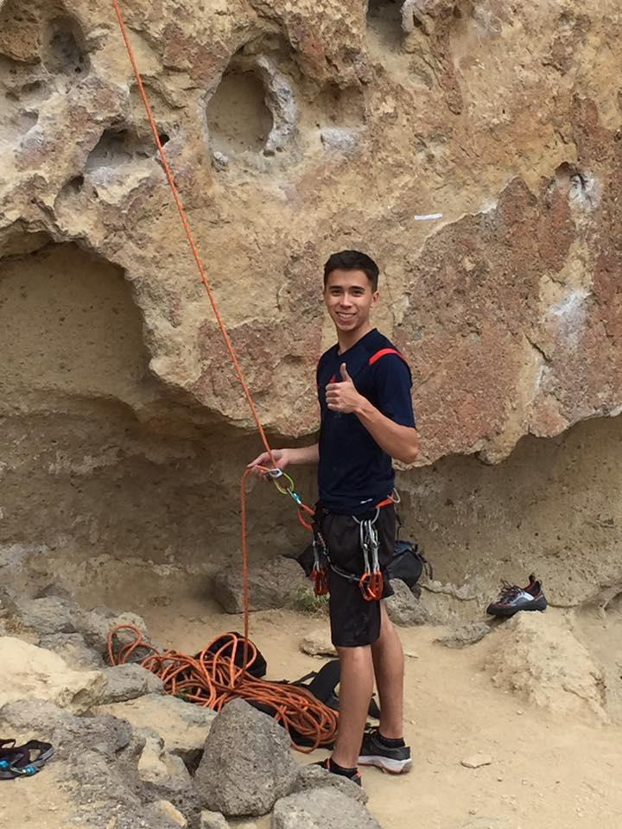
BIOS
Tim Kilpatrick
Imbler, Oregon
EOU Climbing Club
Graduating with BS in Business Administration in 2019

