Slide 1

Presented By: Steven Beaudry, Julie Hernandez, Jorge Chavez Vazquez, Devin Allen
Notes:
This presentation is for the company Eastern Oregon Net inc, Or EONI for short. The purpose is to examine and find a viable marketing solution for the company. The notes throughout the presentation will be reflective of before we presented, and includes feedback and information in retrospect after we presented.

Slide 2
About EONI
EONI is a small internet company based in La Grande, Oregon founded in 1996 by Kelly Mutch and Jeff Crews.
Three revenue streams: Phone systems, phone services, and internet.
Focused on providing internet services to residential customers.
Notes:
EONI is small, and has local roots in La Grande. Kelly Mutch and Jeff Crews both graduated from Eastern Oregon, and are in essence, Locals. We know they are both invested in this community from their business, to their families. Because of that, They care deeply for the community. Jeff and Kelly will be at the presentation, so we could address them in person.
We have identified their three revenue sources, and need to discuss later on the rapidly dying phone services. We spoke with Jeff briefly about it on our tour of the EONI facility, however, we didn’t know if he felt the same way regarding the lifetime of the consumer phone systems. We can assume he is, considering this is his industry.
It is known that providing Internet is going to be the most stable and surefire route for EONI to pursue.
As Jeff stated, they are mostly focused on bringing internet to the residential customers, however they are not as profitable as businesses, they still encompass most of their customers, and will likely be their best opportunity for expansion. Understanding this aspect is something that is pivotal in determining their target demographics. As we’ve been told, providing residential customers is tricky, especially when dealing with competitors, but with fiber, that could change everything.
The overall purpose of this slide is to bring awareness to the listener about the local roots of the company, and for the customer, to show that we know their company at least to the extent of what we’ve been told.

Slide 3
How can we aid EONI?
We have all been studying business administration the past four years here at EOU.
We’re all eager to put what we have learned into real life situations.
The classes that have prepared us to deliver this project are Principles of Marketing, Operations Management, Marketing Research, and Business Policy and Strategy.
Notes:
In this slide, we effectively have to give ourselves some merit to the subject of which we are speaking. Set up the fact that we are using elements of our education to reflect into this project.
Talking about our backgrounds in business and show that we have a genuine interest in providing quality work to EONI, to the best of our abilities.
That way we can show interest to their needs and wants. EONI has never had a marketing plan before, large in part because they simply are not sold on the concept of marketing. Their customers have, for the most part, just come to them.
However, as Jeff stated, he is interested in pursuing several avenues of marketing, and capitalizing on the opportunities afforded to them through the changing market, and technologies.
Through this occasion we can learn the basic layout of EONI, and provide ourselves with a real world learning experience.
We don’t need to remember the exact names of the classes we have taken leading up to this point. However, we should mention how these classes have helped us to learn the basic doctrines of business over the last four years here. Again, showing that we didn’t just coast through.

Slide 4
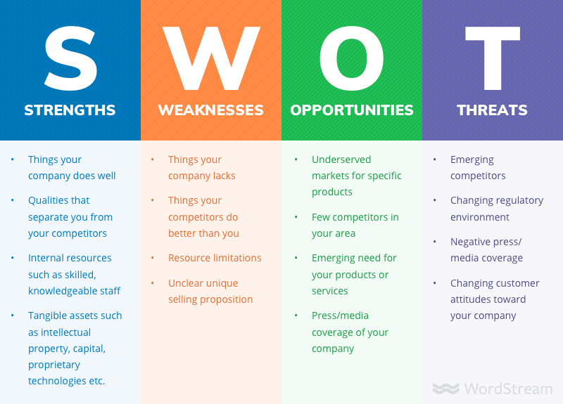
SWOT
SWOT analysis (strengths, weaknesses, opportunities and threats analysis) is a framework for identifying and analyzing the internal and external factors that can have an impact on the viability of a project, product, place or person.
Notes:
“A SWOT analysis is a strategic planning technique used to help a person or organization identify strengths, weaknesses, opportunities, and threats related to business competition or project planning.”
In this slide we are setting up to the audience, if they are not familiar, to the concept of a SWOT analysis. Letting them know beforehand that the SWOT analysis’s purpose for this particular business. A SWOT analysis can be a very positive and constructive breakdown of a business compared to others in the industry. Talking about the strengths and weaknesses of a business can be touchy, but it is absolutely an essential step in identifying the areas that need work, and the areas that need little to no improvement. It provides an outlet where you can identify larger opportunities, and take a project, or business, in that direction.

Slide 5
EONI Strengths
Local Business
Only local internet provider in town
Rural Communities
Able to provide internet service where others cannot, or will not
Customer Service
Personal connection based in La Grande
Notes:
EONI is a local business, and in the small communities of Eastern oregon, being local can mean something very significant. It presents EONI with many unique opportunities, and favorability within the communities in the region. As well, being local can allow them better understanding of the needs and wants of the local population when it concerns internet consumption.
EONI is willing, and able, to reach the smaller communities, and rural individuals, providing high speeds where others cannot. This flexibility is just simply not achievable by the larger companies, and puts them at a major advantage when competing. Granted these communities may not be able to provide the volume that a more densely populated area would, providing wireless internet to them is relatively simple. EONI’s competition is little to none, putting you in a position where you can set the price for product at a comfortable level.
Customer service, for the most part, is not a deal breaker when deciding internet services. However, having the convenience of calling your ISP and an actual person answers, and you’re not put on hold is absolutely a strength that needs to be recognized.

Slide 6
EONI Weaknesses
Pricing
Consumers getting more for their money elsewhere
Lack of strong internet connections in most regions
Out of all the towns only strong connections in Joseph, Enterprise, Lostine, Wallowa, North Powder, Elgin, Summerville, and Union.
No marketing plan
Not currently investing in getting new customers
Relies on word of mouth
Notes:
EONI being local is big, however, there is still a distinct issue with their pricing that will need to be addressed. It’s just hard to EONI to compete with Charter in La Grande at its current state. It is understood that they don’t want to, “wrestle that gorilla,” but it’s important to prepare for that. In recognizing their price differences, EONI can get a baseline of what others are getting, and can strive to be competitive at those prices in the future. Likely will come when Fiber does.
Having poor connection in most regions is simply lost opportunity. Improving those conditions will obviously help to net more customers. It can also help provide better reputation.
Having no market plan has not been an issue up to this point, however, if EONI plans on expanding outwards, and picking up more residential customers, having a marketing plan is absolutely and essential step in that process. Speaking empirically, allot of people do not know what EONI is, let alone know they’re and internet option. After some further review, it can also be noted that the website is not reflecting current prices, and it could potentially mislead some customers.

Slide 7
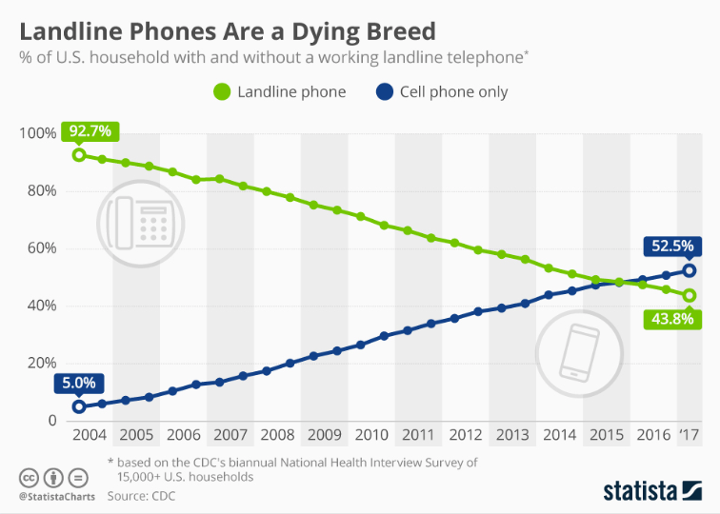
Phone systems
Notes:
As stated in an earlier slide, It is important to convey the idea of dying phone systems, especially when it comes to residential customers. It’s, again, likely that Jeff and Kelly are more than aware of the declining use of phone systems, and the rise of cell phone usage in it’s place. However, it’s an absolutely essential reality that needs to be addressed in this SWOT. If anything, it can help Jeff and Kelly to know that we are on the same page. Jeff and Kelly did acknowledge during the presentation that they were more than aware of the dying of phone systems. Especially since people are beginning to move away from DSL, it’s almost encouraged.

Slide 8
Charter Versus EONI Price Comparisons
 | EONI | Charter
Bronze Package | $29.95 (2 mbps) | $44.99 (100 mbps)
Silver Package | $39.95 (5 mbps)
Gold Package | $54.95 (10 mbps)
Platinum Package | $69.95 (15 mbps)
Month to Month Installation Fee | $200 | $49.99
1 Year Installation Fee | $100
2 Year Installation Fee | $50
Notes:
The purpose of this slide is to show a side by side comparison of the, “Gorilla,” vs EONI. However, very different technologies are used in the makings of these two products, this does provide an overview of what they need to compete against.
As Kelly pointed out, their site, where we got the information is no longer accurate, and needs to be updated.

Slide 9
Frontier Versus EONI Price Comparisons
 | EONI | Frontier
Bronze Package | $29.95 (2 mbps) | $41.99 (5-18mbps)
Silver Package | $39.95 (5 mbps)
Gold Package | $54.95 (10 mbps)
Platinum Package | $69.95 (15 mbps)
Month to Month Installation Fee | $200 | $49.99
1 Year Installation Fee | $100
2 Year Installation Fee | $50
Notes:
As Jeff stated EONI is happy to compete with Frontier in anyplace. That’s simply because Frontier is not only slow, they have terrible customer service and reliability issues. Again, EONI’s site is not updated, so these numbers provided are not accurate when reflecting EONI’s available packages.

Slide 10
Wallowa Valley Networks Versus EONI Price Comparisons
 | EONI | Wallowa Valley Networks
Bronze Package | $29.95 (2 mbps) | $49.95 (20 mbps)
Silver Package | $39.95 (5 mbps) | $59.95 (30 mbps)
Gold Package | $54.95 (10 mbps) | $99.95 (50 mbps)
Platinum Package | $69.95 (15 mbps)
Month to Month Installation Fee | $200 | $250
1 Year Installation Fee | $100
2 Year Installation Fee | $50 | $55
Notes:
Wallowa valley Networks, as Jeff stated is smaller than them. They are more than happy to not only compete against them, they will encourage it. Their speeds may be decent, but the areas that they can cover is pretty small, making them extremely limited compared to EONI.

Slide 11
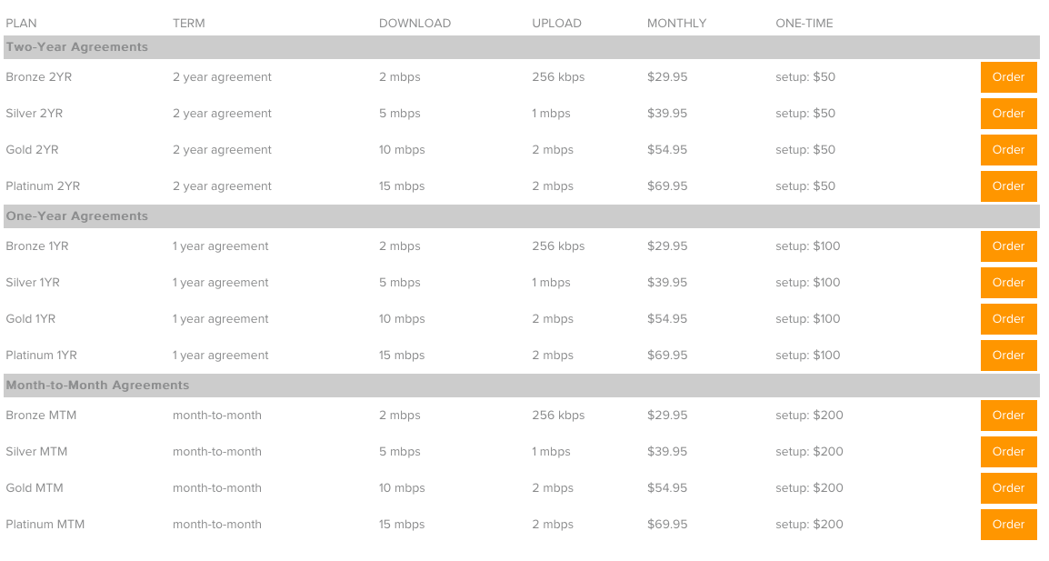
EONI Prices
Notes:
This page can be used to show the audience the breakdown of ENOI’s packages, and show basic installation fees. Internet speeds ranging from 2 mbps all the way to 15 mbps. Breaks further down into two year, one year, and month to month payments. Commiting for two years is obviously the most economic option, considering setup costs. Granted, the monthly rates are the exact same for each bandwidth rate. Could go into detail regarding the perceived need for faster internet speeds vs what people actually need. Again, we’ve been informed that these numbers no longer reflect their actual packages. They have simplified down into two packages, making things easier for their customers.

Slide 12
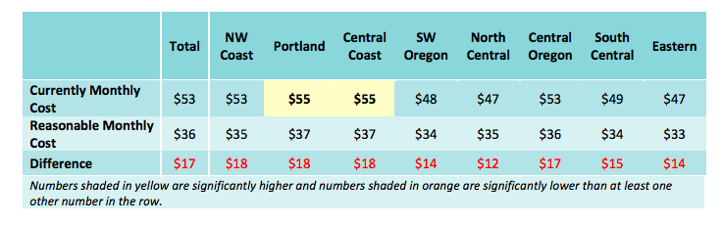
Pricing
https://www.puc.state.or.us/telecom/ORBroadbandAdoptionSurveyReport2014.pdf
Notes:
This spreadsheet shows what people believe is a reasonably priced high speed connection vs what the average cost is in a region. National Telecommunications and Information Administration, and the Oregon Business Development Department (OBDD) conducted this survey as a part of their Oregon Broadband advisory report.
It will be a little off considering the the report was conducted in 2014. However, should still reflect relative customer opinion when it comes to their broadband connection.
Not listed here, but it should be noted that eighty-seven percent of adults in oregon use internet, which is the average throughout the entire U.S. Internet is becoming a utility overtime, and with the increase in households using internet daily, having a fast and reliable connection is a must. There is always factors that will be unforeseen when considering the future, but counting on getting faster and more reliable is a must. It’s good to point out that you can not get fast internet for around $33. It’s simply not a viable option for ISPs to provide their services at such low costs.

Slide 13
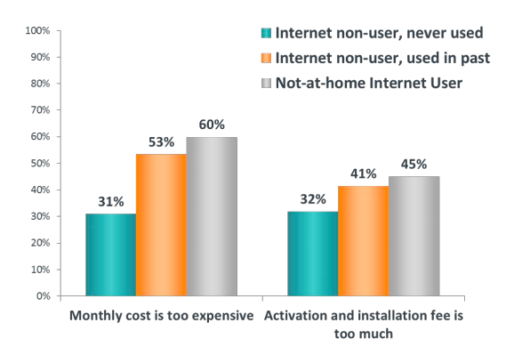
Pricing
https://www.puc.state.or.us/telecom/ORBroadbandAdoptionSurveyReport2014.pdf
Notes:
This survey was conducted by the Oregon Broadband Adoption Survey, in conjunction with the OBDD, similar to the last slide. Used funds from the State Broadband Data and Development
Program grant, which helps to better understand internet usage and development throughout Oregon.
Respondents were asked to rate each of ten reasons why they may not be using the Internet at home. Ratings are based on a 1 to 5 scale where 1 means “Not at all a reason” and 5 means “A major reason for not using the Internet.” The chart displays the top box ratings (a 4 or 5 rating) given by respondents who said they do not have Internet access at home. This excludes dial-up users and people who said it’s not available where they live. Cost-related reasons are the highest-rated overall, especially among not-at-home Internet users, 60% of whom rated monthly cost a 4 or 5. The percentage who rated the cost-related reasons a 4 or 5 is similar to the percentage in 2010. Among those who have never used the Internet, cost-related reasons are not as common as are reasons pertaining to discomfort and perceived need.

Slide 14
Lack of Strong Connection in Most Regions
Union County, Baker County, and Wallowa County are made of 19 towns/cities that range from 69 to 13,137 people.
EONI has strong connections in 8 of these 19 towns.
Able to provide strong internet connection to 11,579 people throughout the three counties out of 33,645 total people.
Missing out on 66% of the market due to weak connection.
Able to capture 34% of the market with strong connection.
Rural town focus
https://factfinder.census.gov/faces/tableservices/jsf/pages/productview.xhtml?src=CF
https://factfinder.census.gov/faces/nav/jsf/pages/community_facts.xhtml https://factfinder.census.gov/faces/nav/jsf/pages/community_facts.xhtml
Notes:
Showing the demographics of the region is important in getting a better idea of where to head. Understanding the more densely populated areas vs the more rural areas is a great way for EONI to target specific demographic groups. EONI has the best opportunities because of their use of wireless internet services. They can reach a lot of those little towns that nobody has ever really heard of, and it won’t be too expensive to be able to do it either.
EONI may only have a strong connection in half of the 19 cities/towns in the three county region, but out of the three counties can reach over a third of these individuals. This presents a great opportunity to EONI to expand in the future to not only capture more of the households who either do not have internet, but possible get customers from other ISPs that have dissatisfied customers in the past.
The two thirds of the counties that are not able to be reached is obviously a problem that will get fixed overtime.

Slide 15
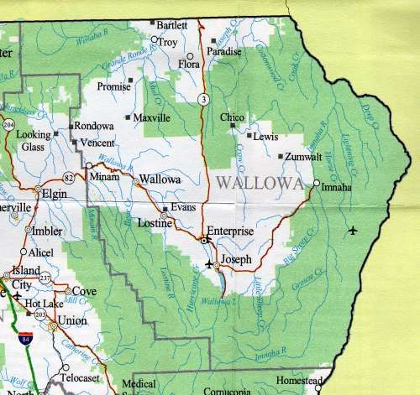
Where EONI has Strong Internet Connections
North Powder
Notes:
This map gives a visual representation of where EONI is the strongest. Wrestling with Charter in La Grande is a problem because EONI simply cannot offer lower prices to compete with them, however, with the advent of fiber optic cables, Charter will be alot easier to deal with. Granted, it’s an expensive project, it’s a must in the future.

Slide 16
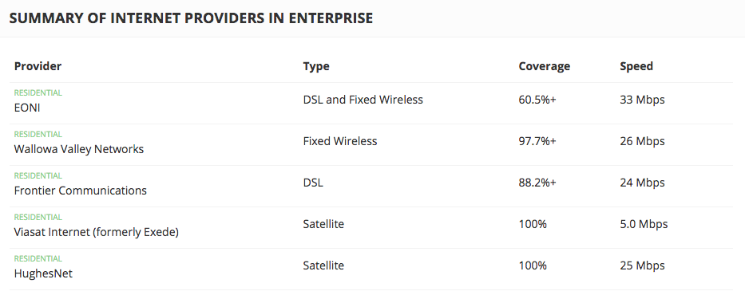
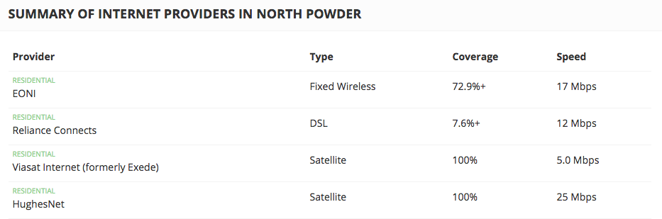
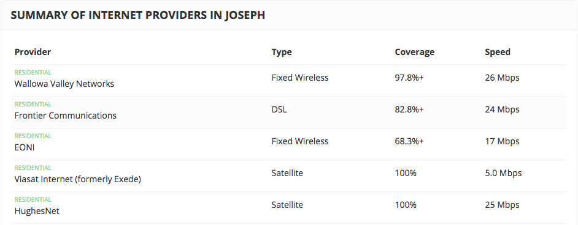
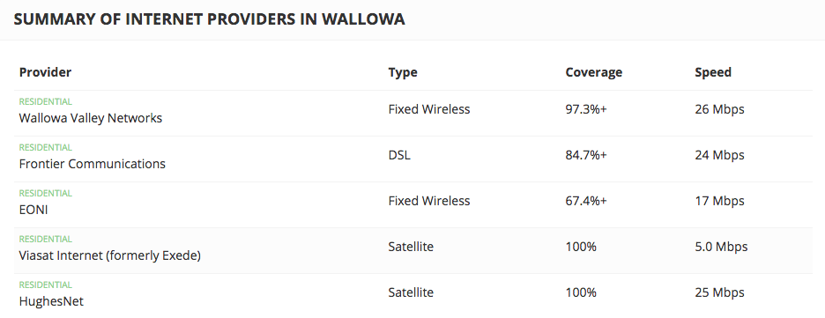
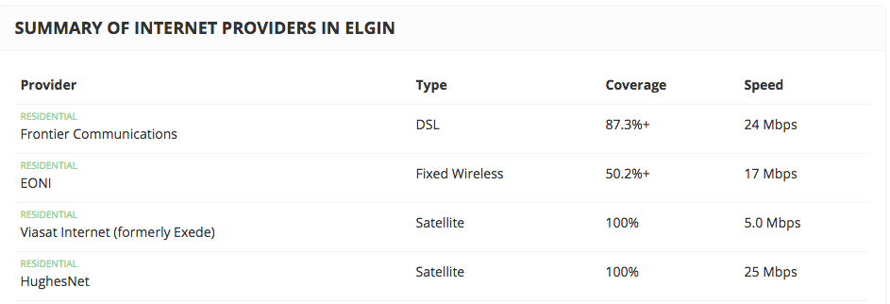
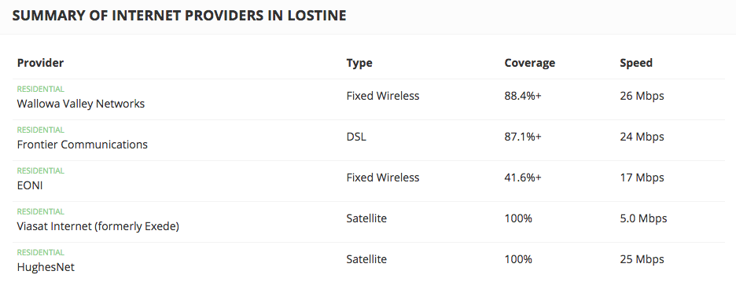
Notes:
Provided is a list of all the internet providers in some of the cities/towns where EONI is the strongest.
On these sheets listed is also the amount of ground they cover in those areas, and the speeds of those connections.
EONI’s primary tool of choice is the fixed wireless connection, which can provide speeds up to 33 Mbps in enterprise. In the other towns, the speeds are capped off right around 17 Mbps. In comparison to the other ISPs listed, EONI is very competitive. It is, however, hard to believe that satellite connection can provide 25 Mbps anywhere, let alone in 100% of these places.

Slide 17
Interactive Map of EONI Availability
https://broadbandnow.com/EONIcom
Notes:
In this slide, it shows an interactive map of the internet coverage of the region. The maps has several overlays: DSL, which is one of the slower options and is being phased out all over, as are phone lines. Fiber, which very few places currently have fiber optic internet, but, as stated plenty in earlier notes, is an essential step forward. Next is fixed wireless, which is EONI’s primary coverage tool. It is viable in all three counties, and can continue to provide fast reliable internet. The last is copper, which as far as we know, isn’t super popular for household consumers, but is for some businesses. We can see That EONI covers just about every county with DSL. Strongest in Baker and in Union with this service, and is available to approximately 22,000 people. EONI’S wireless connections are strongest in Wallowa county. In total, EONI can cover 15,000 people, including union and baker counties. Their fiber connection is the smallest, covering only in La Grande, but is not available for residential use. Their copper connection covers both Baker, Union, and Wallowa counties. However, no data is available to the use of this equipment.

Slide 18
Fixed Wireless Vs. DSL
DSL | Fixed Wireless
Accessibility of internet options | Flexible bandwidth
Cheaper for consumer than most other internet options in most areas | Fast speeds
Distance from ISP Hub | “Line of sight”
Not available everywhere | Share internet connection with neighbors
Pros
Cons
http://www.plugthingsin.com/internet/dsl/
https://www.wirefly.com/compare-internet-providers/cable-vs-dsl
Notes:
Talking about the DSL vs Wireless connections is going to be just preaching to the choir, in regards to talking to Kelly and Jeff. However, for the rest of the clases sake, it can provide a better insight to the differences in the equipment. DSL, as the graph shows, DSL is very accessible. This is because most house are equipped with DSL lines. As well, DSL lines are exclusive to one house, and does not share connection with its neighbors. The share the same connections as most phone lines. Granted, they are limited by the latency issue. Meaning there is a large distance from the ISP hub, where the internet actually comes from. The current has to travel that far for a reliable connection. As well, DSL is plagued by the limiting speeds. As Jeff pointed out during the presentation, DSL is lucky to get 18 Mbps tops, despite the fact that DSL could ideally get 24 Mbps. The other aspect is that DSL, despite being available almost everywhere EONI is, is not available in places where utilities have not been developed. In these areas Wireless, and satelite is the only option. Wireless connection, while having it’s issues is for the most part, is far superior to DSL. The bandwidth speeds of Wireless can be very flexible, ranging all the way to 100 Mbps. Meaning an ISP can better tailor a package for their customer based on need, rather than giving them one fixed package. The other large plus is the accessibility of wireless intern. Because of it’s through the air connection, it is available in places that DSL or other physical cables are not. Now, for that same reason it can be limited. The line of sight, as the cons states refers to the physical barriers that may impede an internet connection. The other problem is the issue with Sharing the connection with neighbors. Which can spell slow speeds if everyone in the neighborhood is on their internet at the same time.

Slide 19
EONI Opportunities
Advertising
Sporting Events
More frequent social media presence
Increasing Mbps
Providing customers more for their money
Sponsoring Local events
Getting involved in the community
Networking with locals
Grants to Fund Rural Broadband
Advantage over competitors
Help build out capacity
Notes:
For EONI, their advertising opportunities are only as limited as they are willing to go. Especially never having an advertisement campaign, they can really capitalize on the fact that many people in the area aren’t even aware that they are a viable option. This comes down to just getting their name out in the community by throwing up banners at sporting events, and around the college. As well, becoming more aggressive on social media to expand outreach that way. Paying for a couple of ads on facebook isn’t too expensive, and could test the waters in terms of social networking.
The largest opportunity that EONI has is their ability to increase speeds in the future. Guaranteed the largest reason anyone chooses their ISP is because they feel like they are getting the most speed for the money. That is where charter is thriving, and where EONI can in the future.
Sponsoring local events can be as simple as throwing some money into a handful of youth sports teams. Even setting a booth at the EOU tailgate zone could be a viable option. This would allow for an opportunity to network with some more of the locals, and potentially college students. It would really help compliment the local business aspect that EONI possesses. The federal government stimulus package under the Obama administration included funds available for rural development projects. The purpose behind it is to assist the infrastructure of small communities and provide the population with higher speed internet. EONI could utilize some of the $4.7 Billion allocated to this program to expand some of the range where they offer internet, or increase the strength of their network. Unknown if other competitors are utilizing the program. We were informed during the presentation that they have attempted to utilize the program before without success.

Slide 20

Opportunities (Rural Broadband Grants)
United States Department of Agriculture, Rural Development, and Rural Utility Service
Broadband Technology Opportunity Program (BTOP) partnering with the Telecommunications and Information Administration
Deploying broadband internet infrastructure, enhancing and expanding public computer centers, and encouraging the adoption of broadband service
Help to fund improvements or construction of facilities and land that are necessary to provide broadband in Rural America
https://www2.ntia.doc.gov/
https://www.rd.usda.gov/programs-services/community-connect-grants
Notes:
Expanding on the rural internet grants: Given the large potential impact broadband access may have on the economic development of rural America, concern has been raised over a “digital divide” between rural and urban or suburban areas with respect to broadband deployment. While there are many examples of rural communities with state-of-the-art telecommunications facilities, recent surveys and studies have indicated that, in general, rural areas tend to lag behind urban and suburban areas in broadband deployment. EONI possibly may qualify for this program, and the money could be used to get an edge on their competitors. Again, we were informed about the reality of the situation during our presentation. EONI has attempted to acquire this money before, however, it is typically a, “turf to turf,” basis. Meaning that proving that you provide the most coverage out in a rural area will allowing you to net the money. Satellite internet companies typically get these grants because they tend to be able to cover these areas that are the most rural. Granted, their speeds do not get any better, and as Jeff stated, ‘if the people out in these communities knew that they could have something better than satellite, they would be out with pitchforks.’

Slide 21
EONI Threats
New business emerging
Competition increasing
Competitors providing more Mbps for less
Cheaper contracts and set up cost
Expense of running advertising
How much is willing to be spent?
Notes:
As with any industry, the possibility for an emerging company is always present. Granted, it may be difficult to enter the Internet service provider industry due to regulations, and expenses with initial entry. As well, providing enough speed to convince even an entry level of customers to switch would be very difficult. The possibility of expansion from another business is a more likely threat. More and more people want faster, more reliable, and cheaper internet, even if they don’t need it. With the nature of the market behaving like this, it is more than likely that Charter and frontier have plans to not only expand their range, but their capacity and speed as well. Again, not meaning to beat the dead horse, but fiber is the future, and the first one to provide it in the region has a major upper hand. As stated previously, EONI is only limited by it’s willingness to advertise. There are obviously more simple and inexpensive methods available for advertisements such as mail ads, and maybe a handful of promotionals. There are more expensive ones, like billboards, TV and radio ads and such.

Slide 22
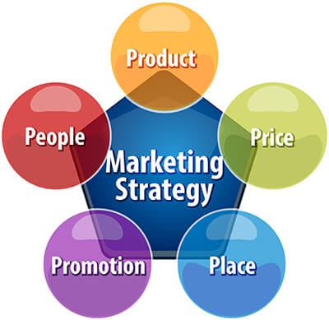
Broadband Internet service. DSL (or Digital Subscriber Line), also fiber-optic, cable, and satellite
Median age:
39 Union county
47 Baker county
52 Wallowa county
(U.S. median is 38)
Wifi $29-$69
(2mbps-15mbps)
Small rural communities in, Union, Baker, and Wallowa counties
Mail Ads
Facebook
Sporting events
Notes:
Here we have a basic marketing strategy pentagon. It’s used to identify the product you are trying to sell the most, the price at which it is to be sold, the location, the medium, and then finally the demographics of the people you are trying to sell to. As stated in the second slide, the primary product that needs to be sold is the broadband internet connection. Whether that is through DSL, wireless, and eventually fiber optic. The price that EONI offers can range from their 2Mbps package at $29 a month, or their 15 Mbps package, which is $69 per month. Again, needs to be restated that the prices that we had prior to the presentation do not actually reflect their actual prices now. The places that need to be targeted is the communities in Union, baker, and Wallowa counties. Methods through promotion can include mail ads, social media through facebook, twitter, and instagram. As well as sporting events, and other community activities. The median age in the Three counties is 46. So tailoring specific ads to this general demographic may help EONI.

Slide 23
Population Statistics
Wallowa County Total:52.7+/-0.7 Male 52.5+/-1.0 Female 52.9+/-0.9 | Union County Total:39.8+/-0.7 Male 38.3+/-0.9 Female 41.1+/-0.8
Baker County Total:47.9+/-0.5 Male 45.3+/-0.8 Female 49.2+/-1.0
https://factfinder.census.gov/faces/tableservices/jsf/pages/productview.xhtml?src=CF
Notes:
Again, understanding the demographics of the people EONI is trying to sell to could help them focus their advertisement resources in those particular directions. We know that most individuals in Baker and Wallowa county are boomers, so perhaps putting ads on facebook is the best route to go for packages tailored specifically for them. They may not need as much bandwidth as younger individuals too. This could put other problems, in terms of capacity expansion, in at least wallowa county at ease. Moreover, Union county’s demographic may be younger, but it could potentially being dragged lower by the college. But that, again, could spell unique opportunities to target that demographic through promotionals.

Slide 24
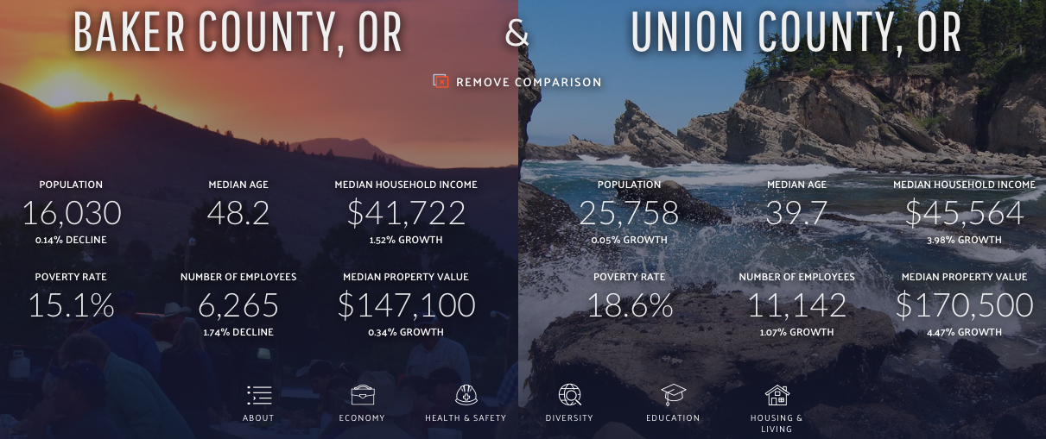
https://datausa.io/profile/geo/baker-county-or/?compare=union-county-or
Notes:
The demographics of Baker and Union county and factoring for income. This data could be beneficial when deciding expansions to these areas. In Baker county, not very much of the county is covered by Charter. It is mostly concentrated in the city itself. Presenting EONI with an opportunity to push into that area and capture the more rural individuals.

Slide 25
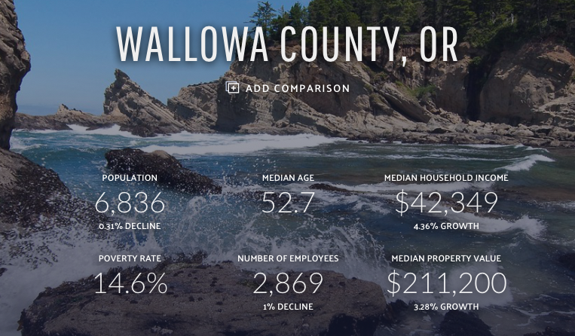
https://datausa.io/profile/geo/baker-county-or/?compare=union-county-or
Notes:
Wallowa county is, as previously stated, predominantly boomers. Since EONI’s coverage in this county is very high, and the competition is relatively small, netting most individuals in the area shouldn’t be hard, and it seems like EONI is already doing that.

Slide 26
Places (Market Presence)
Strong Presence
Wallowa County
Joseph
Lostine
Enterprise
Wallowa
Union County
North Powder
Elgin
Summerville
Biggest Competition
Union County
La Grande
Island City
Union
Baker County
Baker
https://broadbandmap.fcc.gov/#/provider-detail?version=jun2017&direction=d&hoconums=130235,130258,190130
Notes:
With these demographics known, EONI can map out their existing customers, and determine the next best place to expand into. Wallowa for the large in part is covered by EONI already, and is the most dominant ISP in the area. In Union county, however, it is split. La Grande and Island City is, as it stands, pretty untouchable until further development comes along. Union being in a rural location could still present opportunities for EONI to capture individuals in less need of what charter has to offer. However, getting prices low enough may prove to be a challenge. North powder, Elgin, and Summerville’s options in terms of ISPs is pretty limited, so competition in non-existant, allowing an easy entry market where EONI dominates. Baker is not all the way covered, as spoke about previously, and could bring potential from more rural customers.

Slide 27
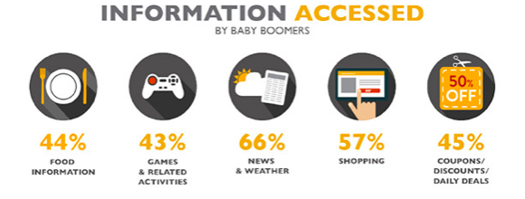
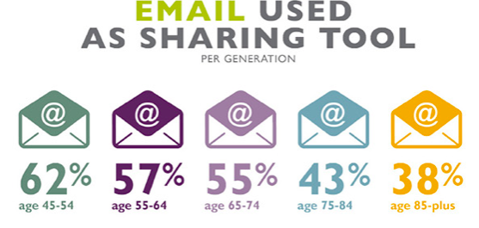
http://creatingresults.com/what-people-do-online-infographic-by-age
Notes:
Coming back to the topic of Baby Boomers, this slide shows what Boomers most access. To put it simply, Boomers don’t need a whole lot of bandwidth, and that’s why tailoring specific packages to them could be a very viable option. Knowing the demographics of Wallowa and Baker allows EONI better discernment on what to offer them. As it can be seen, their tastes aren’t too demanding, maybe aside from the occasional video streaming, which in most cases, as long as only one stream is happening at a time, a low bandwidth option could work. Although trying to explain to individuals who have not grown up with internet, or are educated on networking, that they don’t need the fastest speeds possible may be futile. That is why, it may be easier to break things down for them in a more simple way, such as have them tell you what they plan on doing with their internet connection, and EONI makes a plan that works for them. It can add a very human element to the whole process too. The only issue again, is bringing prices lower than competitors and still breaking even. This will allow the possibility of using resources elsewhere in terms of development, and keeping the same equipment in areas where the population is aging, and require little bandwidth.

Slide 28

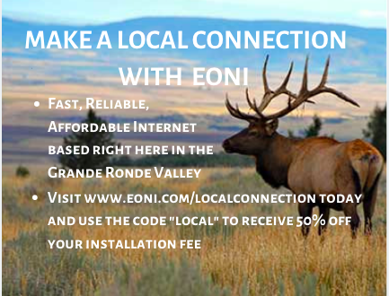
Promotion
“23 years of business”
“23 Years of Serving our community”
Notes:
Potential promotional that could be run. Something that is unique, and speaks to a more rural client. When selling products or services, values-based marketing is an appeal to a customer's values and ethics. It shifts marketing from a product-centric approach to a customer-centric one. A company's advertising and promotions to its customers express its values as part of its core brand message. We believe that EONI running most of their marketing on a value basis could help attract boomers and older generations. As well as using slogans such as, “twenty three years of business, and twenty three years of serving our community.” As well, attracting individuals to like and leave positive feedback on EONI’s facebook page could be achieved through a promotional opportunity. Such as 10% off next months bill if you go and leave a review. That way, you can get better customer feedback. The problem with most feedback is that only disgruntled individuals tend to leave comments, resulting in poor reviews. As Kelly was talking about, dealing with individuals that leave nasty comments should be very diligent, yet not too invested. Don’t sit there and go back and forth. Obviously disclosing information regarding their own personal circumstances cannot be done, but simply stating that there situation is unique, and apologizing for their poor experience is perhaps the best way to deal with this problem. Be Brief.

Slide 29
Promotion Opportunities
Mailer or door hanger
Rate and speed specific to the area
Social Media
Facebook
Being more frequent
Slogan
A sentence that people can relate to and interest them
“Refer a friend credit”
Credit towards existing customers account for referring a friend
Advertising at local sporting events
LHS Booster Club
EOU advertising in gym
Notes:
The biggest and best idea that we all liked, and Jeff liked, was the idea of door hangers, or targeted email/mail ads. The door hangers could be very attractive, especially since it cuts the cost of mailing out, and could be a better tailored to the individual. Especially when moving into new areas, specifically with the advent of Fiber optic connection, putting a door hanger on that simply reads, “It’s here,” with the price and speed the customer can get. EONI could utilize the new mail addresses that are on public record and send targeted mail to these individuals. As well, providing a specific tailored message to show them exactly what speeds at what price they can get, but also throws a unique and human aspect into the advertisements. From a social media perspective, just being more frequent and consistent with posts, and showing the day to day operation that EONI does can help the customer to get a well grounded feeling with the company. A Slogan for EONI should be something, as previously stated, Value based. A simple slogan that truly fits the company's core values. Referring a friend for credit on their already existing account. This could help spread EONI through word of mouth, and build up a reputation for rewarding loyal customers. This program is already in place. Driving home that local connection aspect that EONI offers over the competitors is huge. Having those resources, and the investment in the community is about as value based as a company can get. Sponsoring local events, and showing presence in these areas, at the very least, gets EONI exposure that it would otherwise not have.

Slide 30
Final Thoughts
EONI poses unique opportunities to expand its market share.
EONI can capitalize on the shortcomings of other ISPs
We hope our insight can aid EONI
Notes:
The Unique aspects of EONI being small allows them to be flexible, and have a better reputation that much larger companies, who don’t have great track records. With that said, we still believe that EONI can capitalize on the shortcomings of Charter and other ISPs. It’s known that all ISPs have their shortcomings, and will experience outages every once and awhile. However, impreically, we can state that Charter is not loved by this community, and their inconsistent speeds, and regular outages really wares on people in La Grande. When EONI develops the capacity to compete with Charter in price and speed, EONI’s core values, community centeredness, and reliability will win customers. Again, We hope that our research and presentation can provide insightful, and can serve as a platform for EONI to grow and thrive in this industry.

Slide 31
Questions?
Thank You

