Slide 1
PRICE
General Model
Value-Based Pricing
Perceived Value
$$$
Competitive Solutions
Market-Based Pricing
Price Range
$
Cost of Goods Sold (COGS)
Cost-Based Pricing
(mark-up)

Slide 2
PRICE
Price/Product Relationship
Price
Product
Perceived Value
Augmented Product
(market offering)
brand
selection guidance fitting alterations
financing terms insurance**
timing environment*
newness novelty
scarcity
$$$
supply & demand
Functional Value
Price Range
Core Product
core features
incremental features
$
Cost of Goods Sold (COGS)
Raw Materials
*took took story and weather in Bangkok, popsicle in summer vs. popsicle in winter
** auto dealership business model
(scarcity) ride during rush-hour (Uber)
Craig’s List vs. used car lot vs. car dealership

Slide 3
PRICE
maximize the amount of perceived value captured
perceived value vs. functional value
Perceived Value
$$$
Competitive Solutions
Price Range
brand can increase perceived value beyond functional value of competing solutions … but doesn’t always
(e.g., Apple vs. Southwest Airlines)
$
Cost of Goods Sold (COGS)
pricing floor unless we are buying business, making up for an error, or betting on lifetime customer value (LCV)
(e.g., HP printers)

Slide 4
PRICE
Perceived Value
Augmented Product
(market offering)
brand
selection guidance fitting alterations
financing terms insurance**
timing environment*
newness novelty
scarcity
$$$
supply & demand
Functional Value
Price Range
Core Product
core features
incremental features
$
Cost of Goods Sold (COGS)
*took took story and weather in Bangkok, popsicle in summer vs. popsicle in winter
** auto dealership business model
(scarcity) ride during rush-hour (Uber)
Craig’s List vs. used car lot vs. car dealership

Slide 5
PRICE
Value-Based Pricing
Perceived Value
Market-Based Pricing
$$$
Competitive Solutions
Price Range
$
Cost of Goods Sold (COGS)
Cost-Based Pricing

Slide 6
PRICE
Perceived Value
$$$
Competitive Solutions
Price Range
$
Cost of Goods Sold (COGS)
Retail Keystone: 2x Cost
used when we need to assure costs are covered, but we are unsure of perceived value. The perceived value will be slightly different for different customers.
depends on magnitude of price, turn-over frequency, and business model
On average, barely 5 per cent of a dealer's profit comes from new car sales. The majority (about 50 per cent) comes from parts and service, while the remainder comes from finance and insurance (30 per cent) and the balance is from used cars (15 per cent).

Slide 7
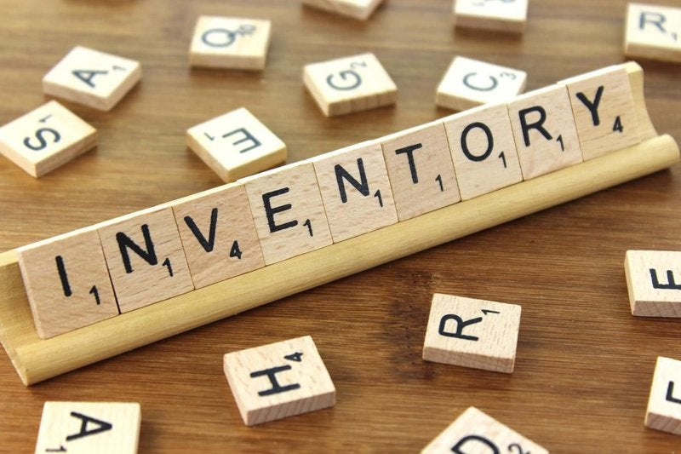
PRICE
Inventory Turnover
Gas Station
TURNOVER
Jewelry Store
Industry ratios (benchmarking): Inventory turnover (days) (readyratios.com)
How Do Retailers Sell Things for So Cheap? (azcentral.com)

Slide 8
PRICE
Perceived Value
$$$
Competitive Solutions
Price Range
$
C_{a}
differential cost basis
increase margins or undercut competitors
some require higher operating margins to cover operating costs
(e.g., Walmart…)
price -> volume -> cost
C_{b}
Cost of Goods Sold (COGS)
C_{c}

Slide 9
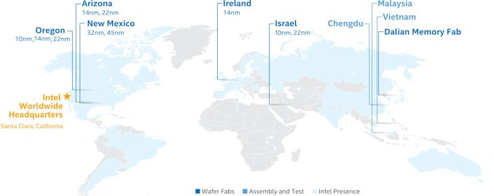
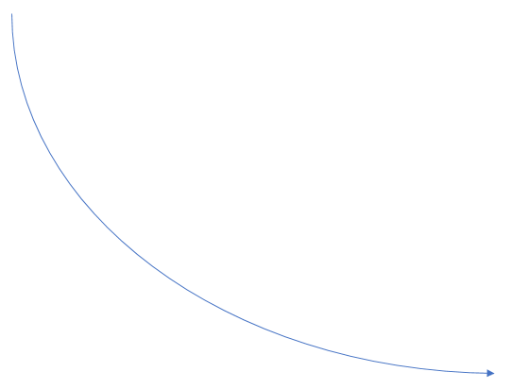
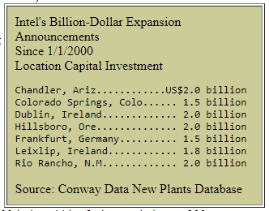
Intel Example
Forward Pricing
$ $ $ $ $
$ $ $ $
$ $ $
market
requirement
$ $
unit cost
$
0
v
Hillsboro, OR (2019) . . . . . . . . . . . $5.0 billion
Leixlip, Ireland (2019) . . . . . . . . . . $8.0 billion
Qiryat Gat, Israel (2019) . . . . . . . . $11.0 billion

Slide 10
PRICE
Perceived Value
$$$
Competitive Solutions
Price Range
Nash Equilibrium
reduce price to point sales margin equals operating cost + required profit
operate in a competitive range and preserve margin for all players
(e.g., gas station)
tacit collusion
$
Cost of Goods Sold (COGS)

Slide 11
PRICE
short-term vs. long-term price equilibrium
Perceived Value
Competitive Solutions (C_{b}, C_{c}, … C_{n})
$$$
C_{a} Price
Price Range
pushing price below value creates purchase pressure – especially if time-limited
differential cost basis allows pushing price below competitors
If not time-limited then it becomes the perceived value over time
(e.g., $5 foot-long…)
$
Cost of Goods Sold (COGS)
sales promotions
premiums
coupons
(e.g., $5 Friday…)

Slide 12


promotions/specials
private labels
maximize cart value
cost-based pricing
price
volume
cost

Slide 13
Pricing Strategy
Market Penetration
Skimming the Cream
COGS, perceived value, competition
Price elasticity
forward pricing
variable cost-based pricing

Slide 14
PRICE – Other Models
Value-Based
Market-Based -> status quo, dynamic pricing
Cost-Based -> Keystone, target margin
Costco
Amazon Prime
OPEC
Uber surge pricing (equilibrium)
eBay (supply vs. demand), Get a Trailer…
Acquisition Cost -> Margin -> LCV
Promotions, premiums, coupons
BOGO (price -> volume -> cost or lost leader)
Maximize margin of “the cart”
relationship between pricing model and business model

Slide 15
Business Strategy
Business Model
Resource
Model
Operating
Model
Marketing
Model
supply chain
Output
- products
- services
people
product
promotion
place
price
Process
- capabilities
- core competencies
source(s)
composition
integration
brand
strategy
Input
- tangible (land, labor, capital)
- intangible
velocity/volume (v²)
own, insource, outsource, offshore

