Slide 1
Student Engagement
Community Enrichment
Experiential Learning
Wilson Zehr, PhD, MBA
TLTR Presentation
November 5, 2020
The Ascent 2029 ...
Goal 5: Relevance and Interconnection – Serve as the educational, economic, and cultural engine for rural places

Slide 2

Student Engagement
Another View
November 13, 2019
TLTR - W. Zehr
student
faculty
student
course
student
university
+ community
add value in all the communities we serve

Slide 3

BA 498
CoB Capstone
Life-Long Learning
Politics
Networking
Career
Communication
Policy & Strategy
Education
EOU, PSU, Concordia

Slide 4
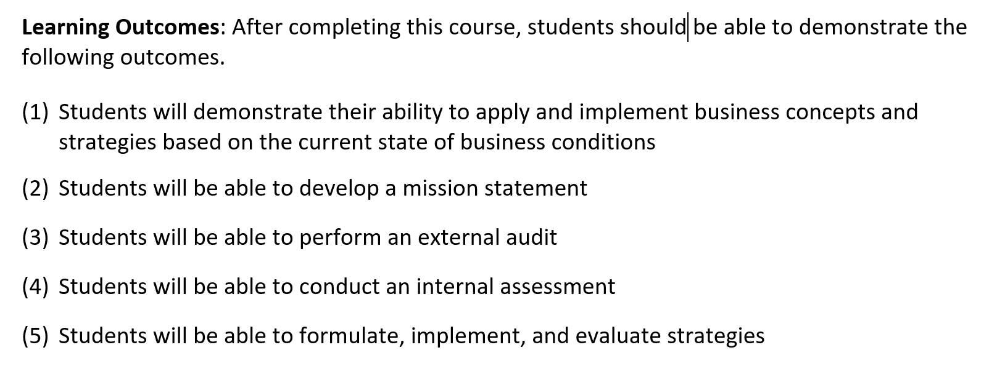
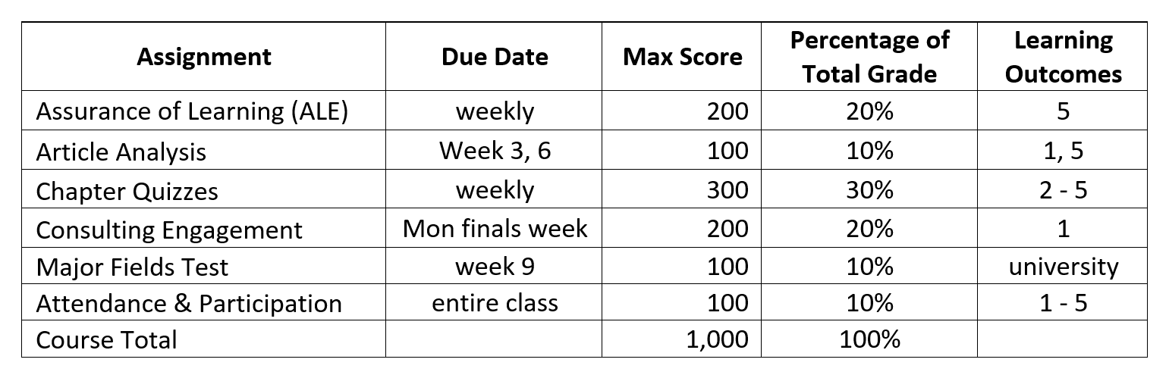
BA 498
Outcomes + Assignments

Slide 5

BA 498
Sample Projects
State of Oregon
Charter Ranger District/DEQ
Biomass Fuel

Slide 6
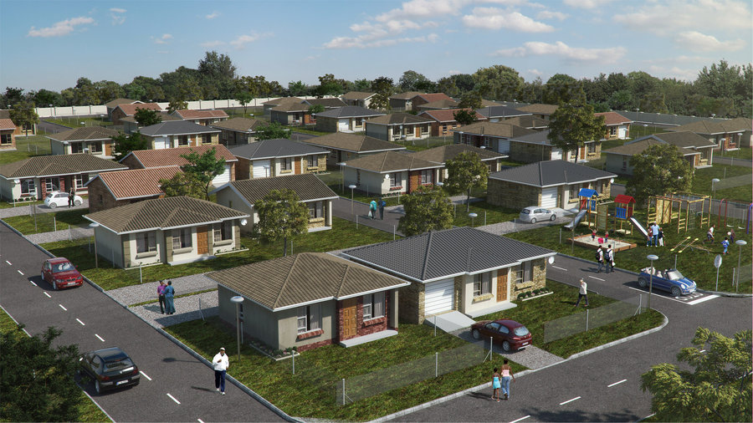
BA 498
Sample Projects
State of Oregon
Regional Task Force
Workforce ($15/hr+) Housing

Slide 7
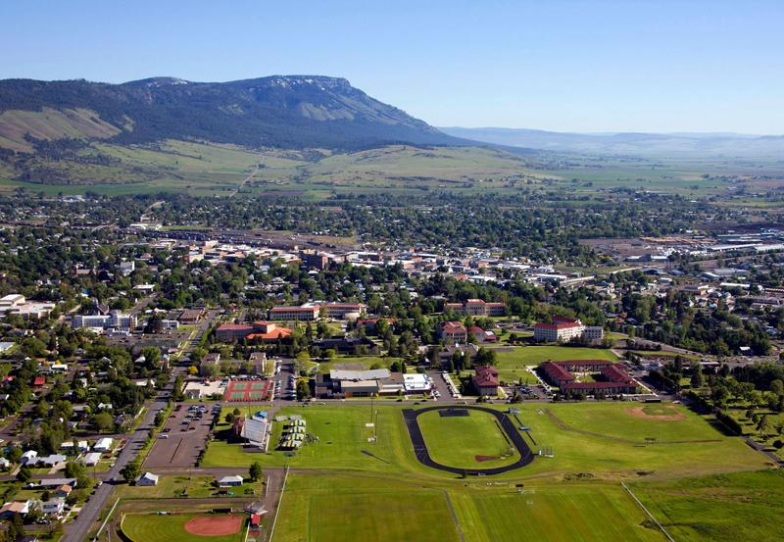
BA 498
Sample Projects
Eastern Oregon University
University Advancement
Fieldhouse + Turf

Slide 8

BA 498
Sample Projects
Union County
Buffalo Peak Golf Course
Economic Development

Slide 9

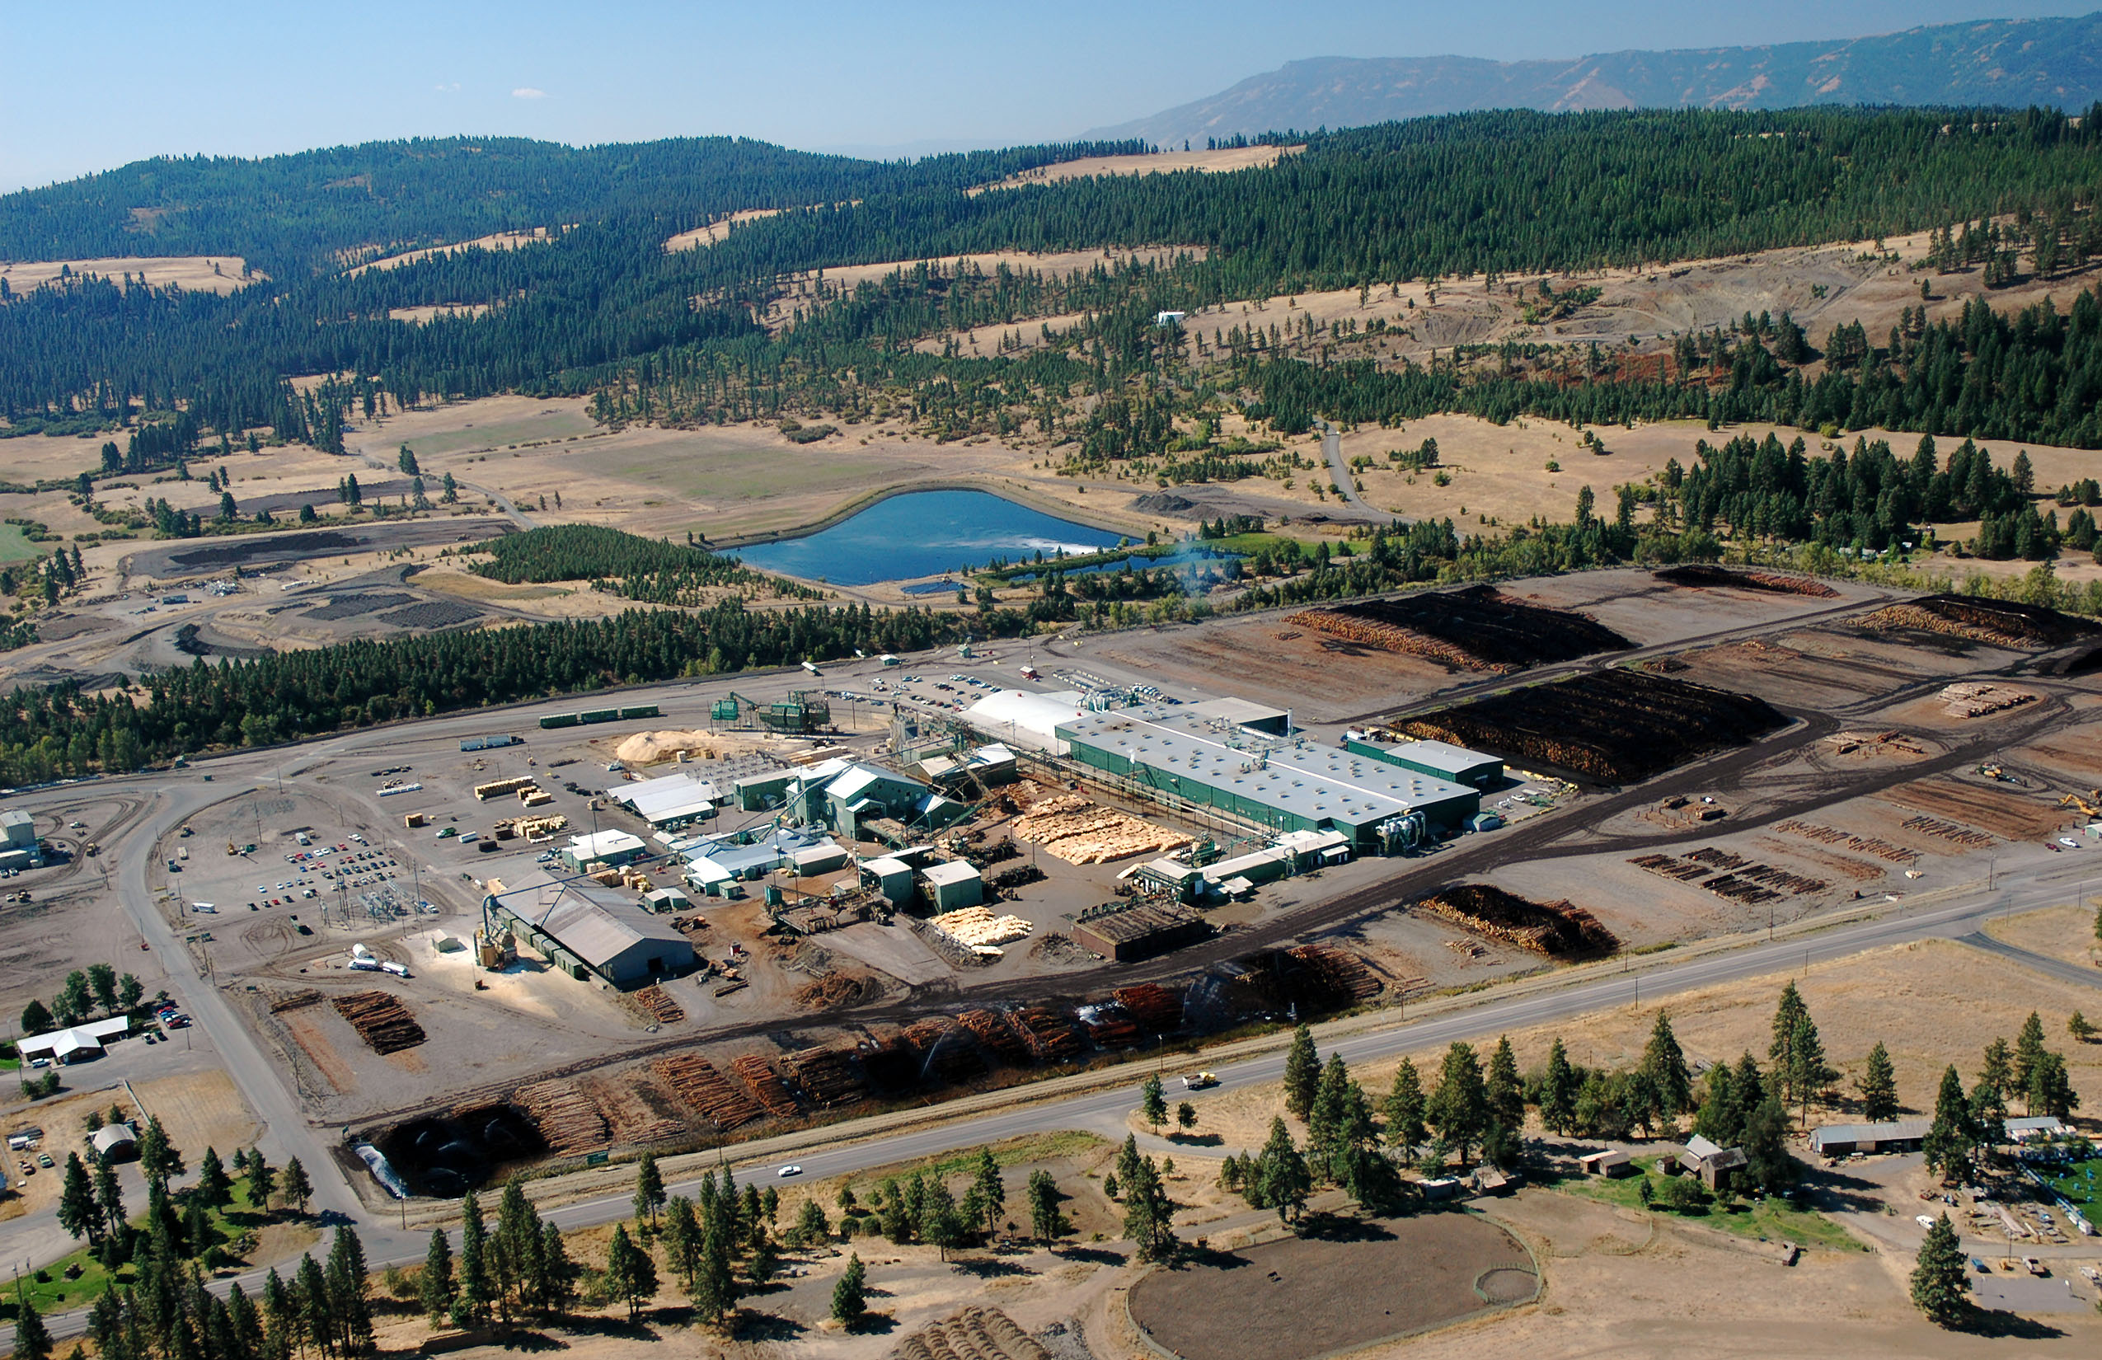
BA 498
Sample Projects
Boise Cascade
NE Oregon Region
Timber Supply

Slide 10
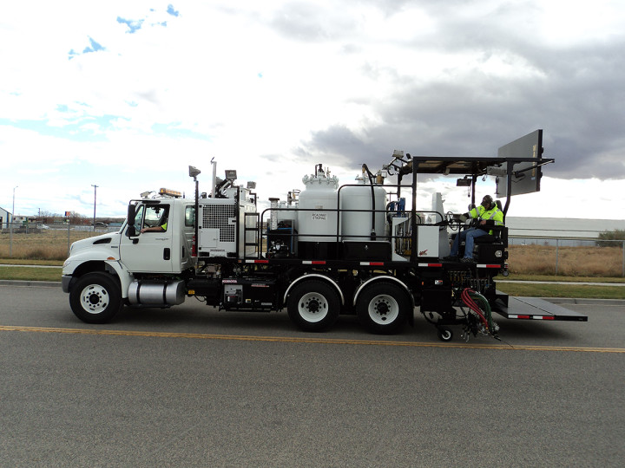
BA 498
Sample Projects
Spec-Rite
Skip-Line Division
Market Dynamics & Strategy
Cloud Computing Transition
Zero Carbon Offset

Slide 11

BA 498
Sample Projects
Nicole Lewis Music
Nicole Lewis
Music Industry & Career
Hallelujah
video 4:47
Cowboy Take Me Away
video 4:07
Keep it Kind
video 3:40
Pub Talk

Slide 12
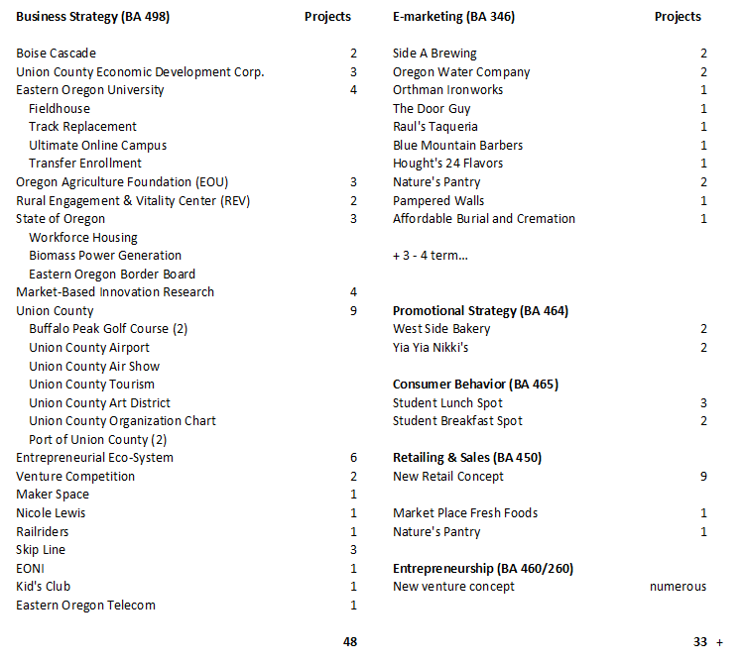
BA 498
Sample Projects
Projects - https://livestream.com/eou/ba498
not complete – representative sample

Slide 13

BA 498
Curriculum + Consulting
business strategy curriculum
university
knowledge
tools
value
relationships
training
application of concepts
students
experience
consulting engagement
community
faculty
10 weeks
advice &
guidance

Slide 14
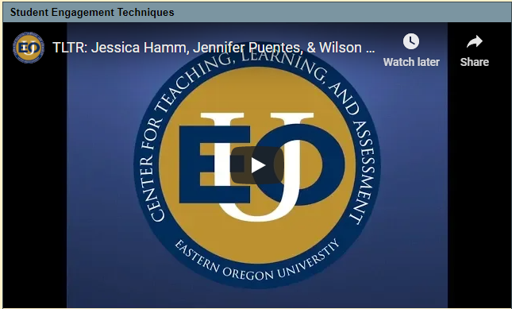

Student Engagement
Principles in Action
online
common
core
on
campus
Welcome
Weekly announcement
Week in the term (encouragement)
Connect university/community
What needs to be done
Weekly module
Readings, articles, videos
Presentation slides
Assignments
Discussion – content + community
Group project(s)
video: 31:40

Slide 15
BA 498
Research Project: Client + Deliverables
Client: (See Samples)
One student team per project
Negotiate Statement of Work (SoW)
20 - 40 slide PowerPoint (with notes pages)
Notes should be equivalent to 20-page paper
Include at least 20 high quality references
Class time assigned (as needed)
Client presentation
On-campus – formal presentation (recorded)
Online – YouTube video

Slide 16


BA 498
Research Project: Timeline
Start your engines…
Research Project due Tuesday, finals week, at 5:00 PM
Late Projects will NOT be accepted
Please Plan Accordingly

Slide 17



BA 498
Research Project: Timeline
deadlines, ambiguity,
incomplete information…
Week 1: Project overviews
Team selection
Week 2: Client discussion (in-class)
Draft SoW (examples on Canvas)
Week 3: Approved SoW
Week 3 – 6: Conduct initial research
Build draft presentation
Week 6: Client progress presentation
Week 7-9: Revise & refine
Expand (as required)
Week 10: Final client presentation
Week 11: Project Due (Tuesday @ 5:00)
coaching, coaxing,
encouragement…

Slide 18




BA 498
Project Pipeline
It can take time to cultivate projects
(sales cycle)
networking
relationships
promotion
relevant
achievable
valuable
understand
challenge(s)
identify &
frame project
set expectations (critical)

Slide 19

BA 498
CoB Capstone
Life-Long Learning
CAPSTONE
Career
Student Engagement
Community Enrichment
Experiential Learning
Education

