Slide 1
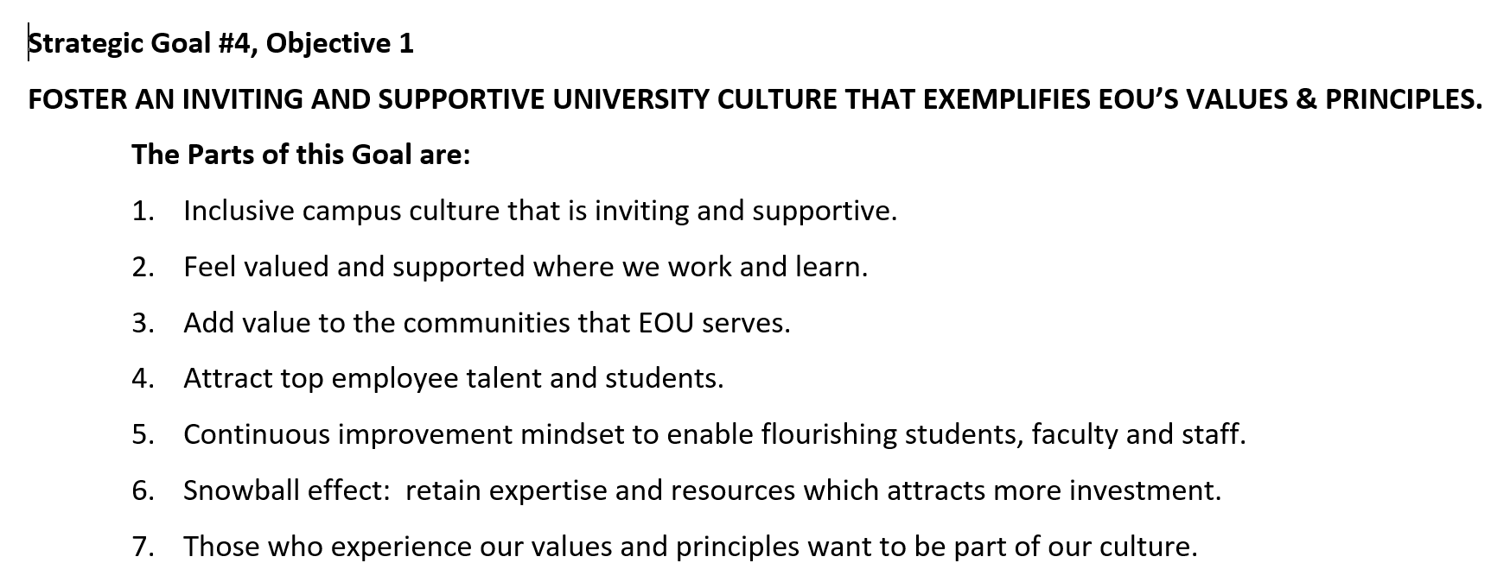
University Council – Goal 4
The Start
Sub-Committee: Ramon, Luke, Cassie, Kyle, Wilson, Chris

Slide 2
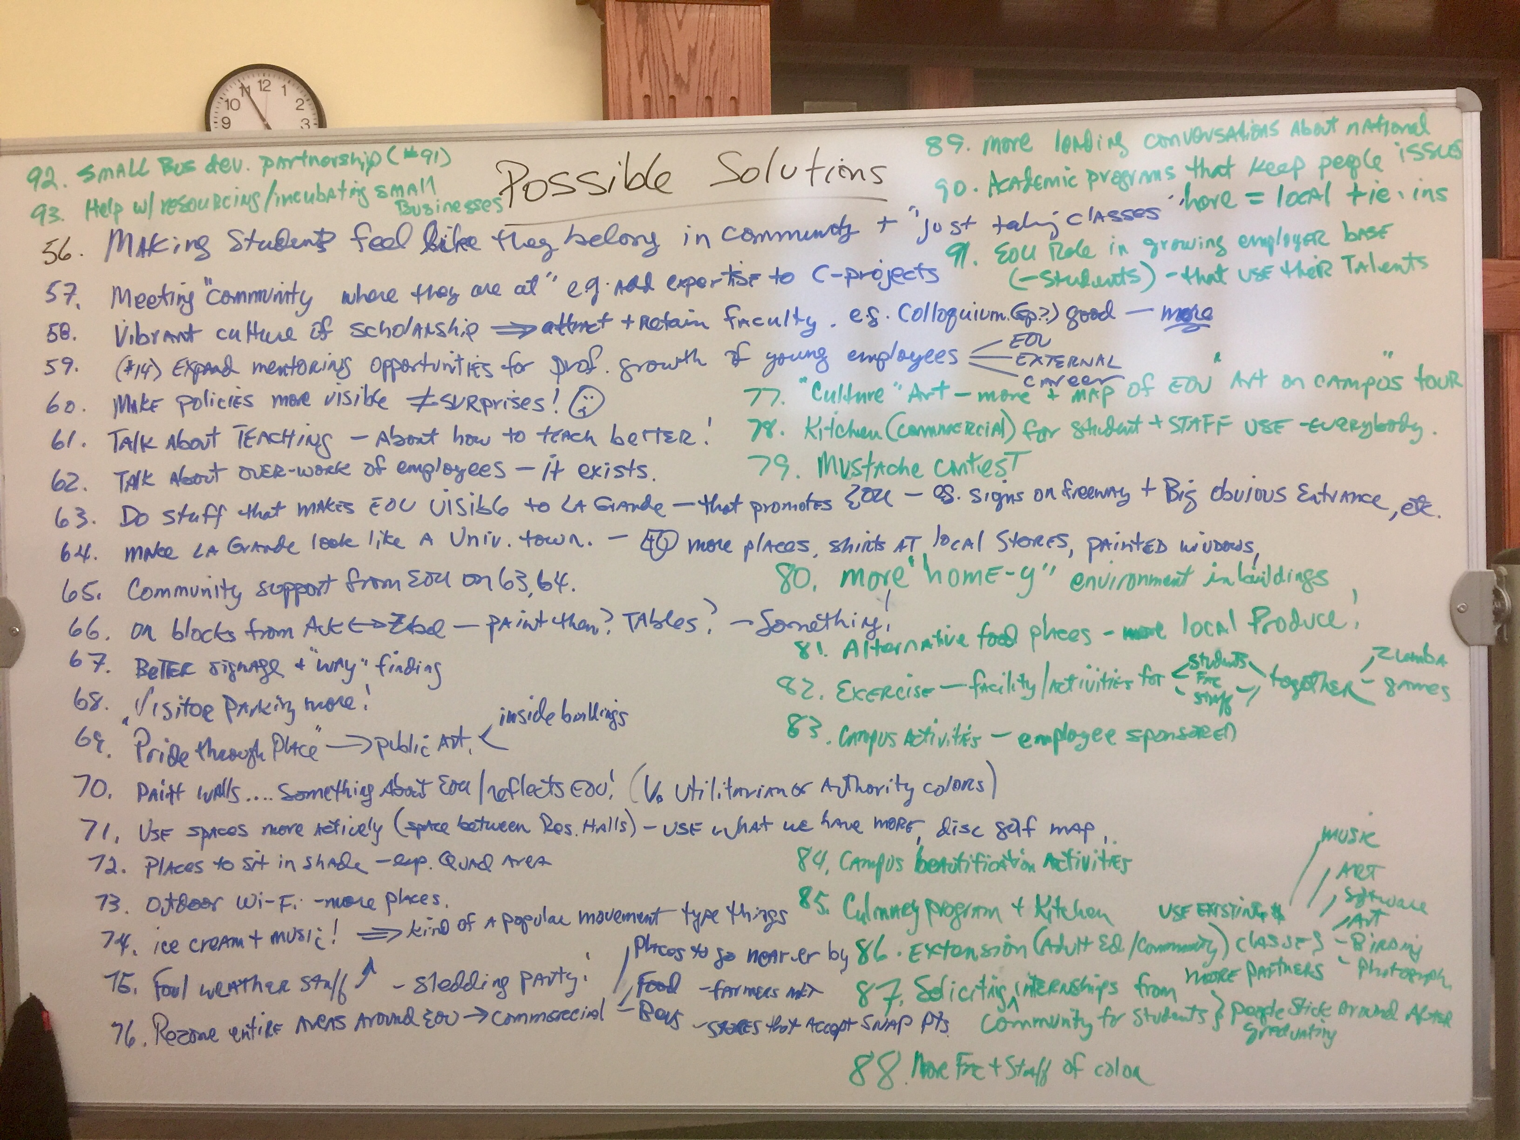
University Council – Goal 4
Brainstorm Ideas
accordion technique

Slide 3
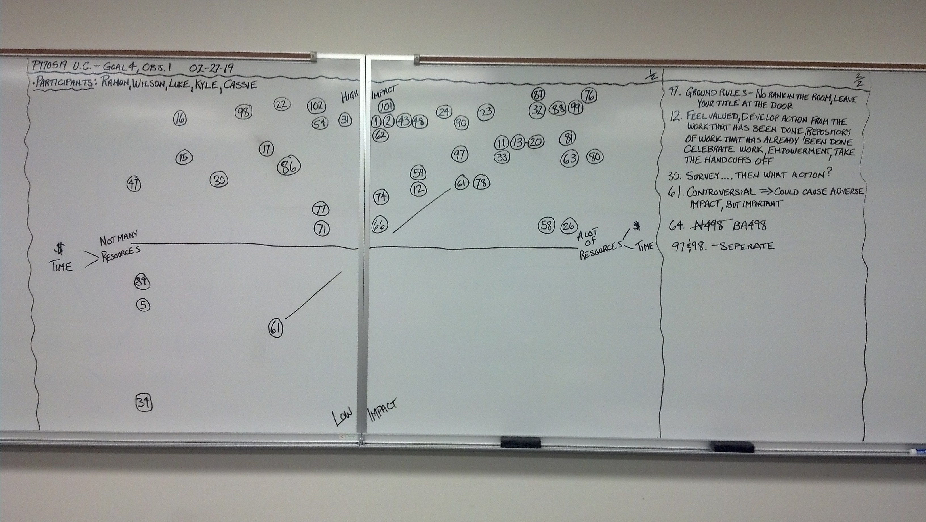
University Council – Goal 4
Prioritize Ideas

Slide 4
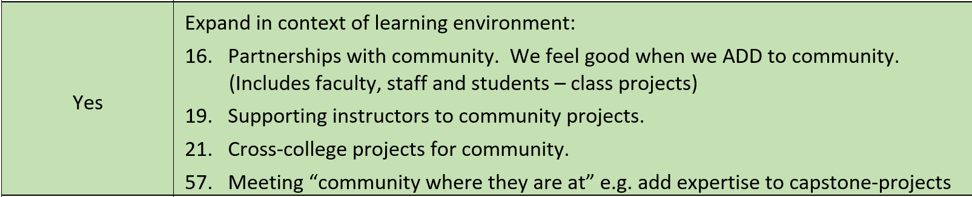
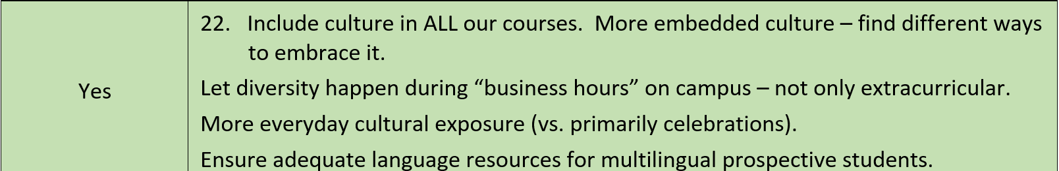
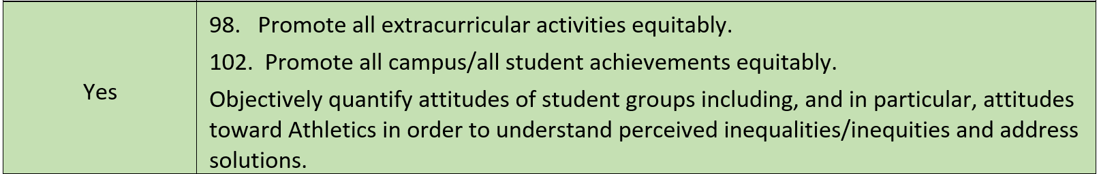
University Council – Goal 4
High Impact/Low Resources
https://www.dropbox.com/s/rmm2hw5xej8a69s/UC%20Work%20Session%2002.13.19%20with%20Priorities%20Indicated.docx?dl=0

Slide 5
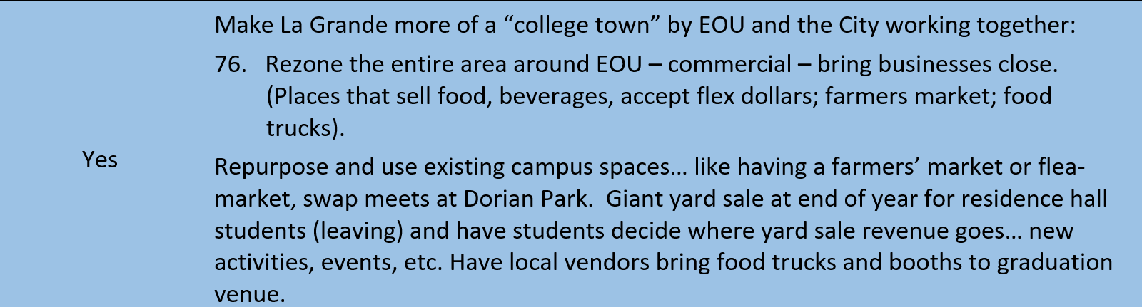
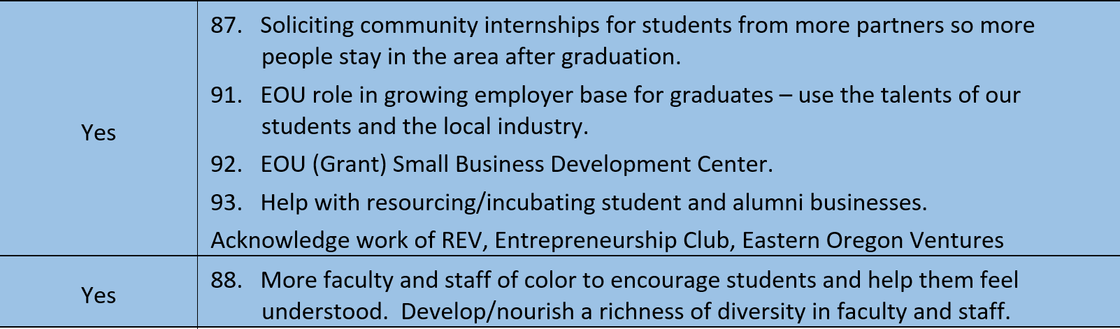
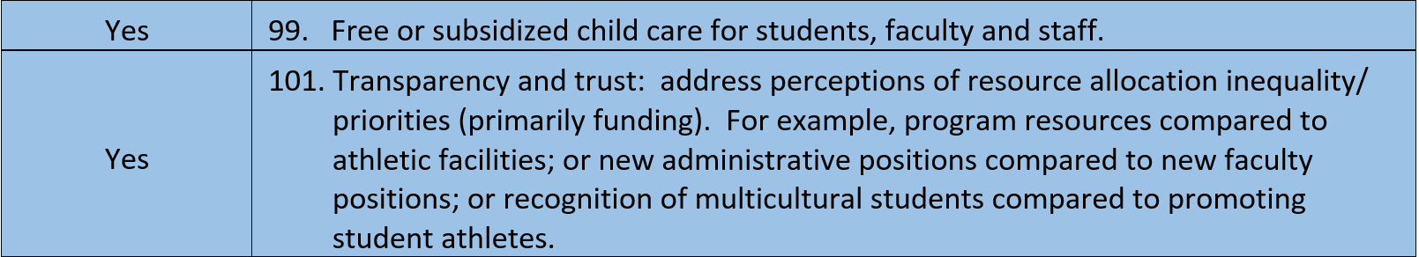
University Council – Goal 4
High Impact/High Resources

Slide 6
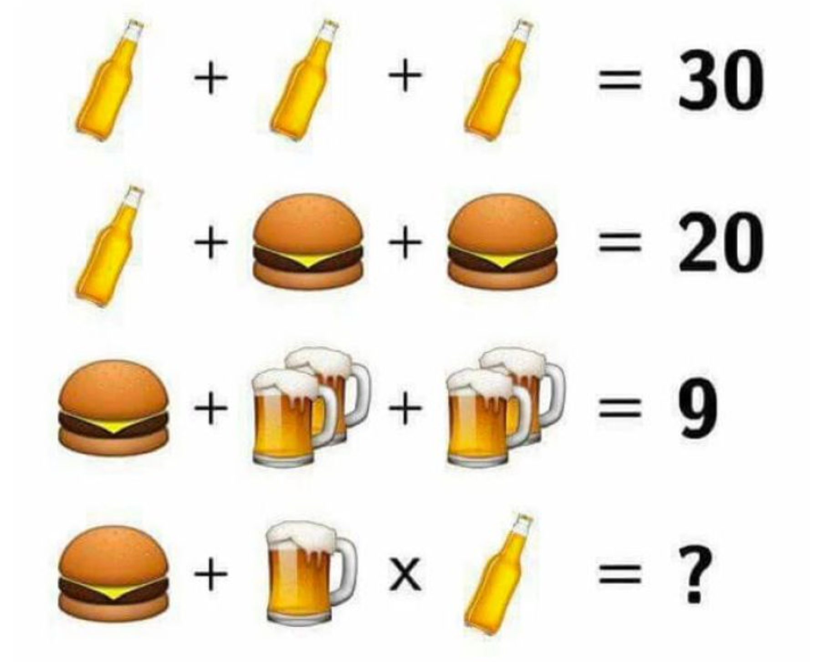
Business Policy & Strategy
Red Eye Exercise

