Slide 1
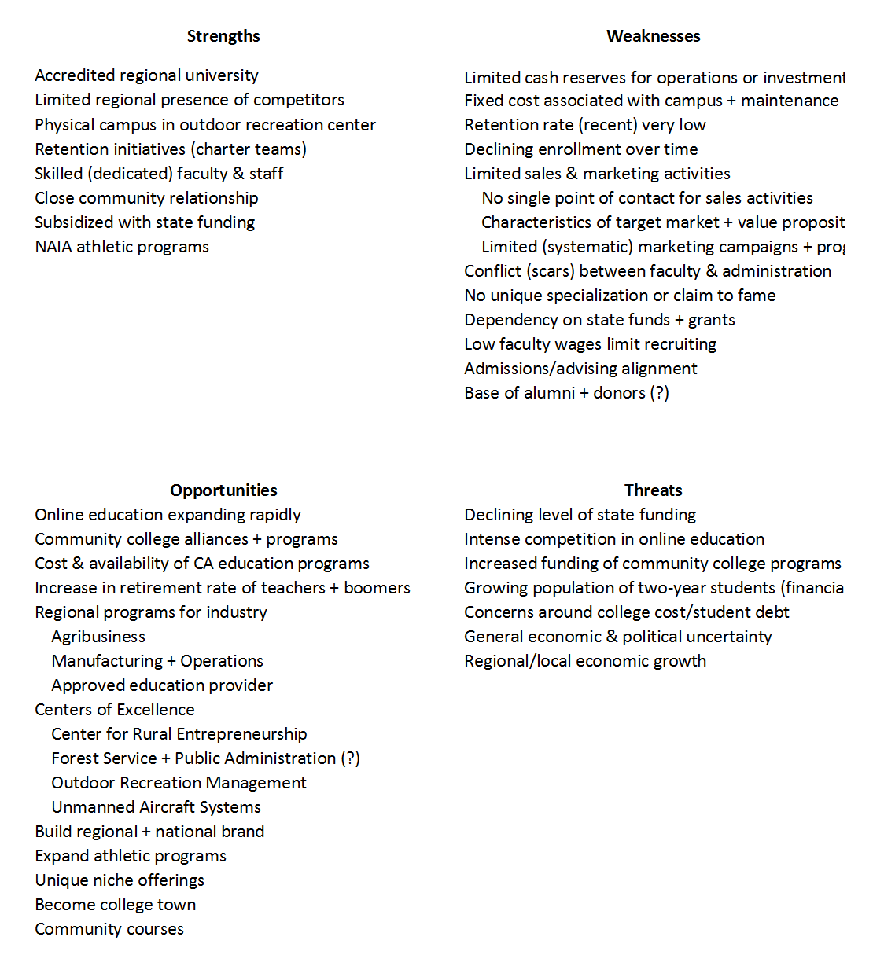

Eastern Oregon University
SWOT

Slide 2
The Landscape
Student Population
On-Campus
Online
Onsite
1,614
49%
1,387
43%
260
8%
COBE
Transfer ~70%
State $$ -
Lifecycle
4
Lifecycle
2
Transfer ~50%
Masters ~40%
‘16 -48%
‘16 +10%
‘16 -9%
Fixed Cost +
Subsidy
State $$ +
data reliability
- audit
- real-time

Slide 3
The Landscape
Onsite Consolidation
On-Campus
Online
Onsite
Connect Education to
People not Places
artifact
shrinking base
no community programs
1,614
49%
1,387
43%
260
8%
COBE
Focus +
MHCC
KFCC
Fixed Cost -
Re-imagine how
we service regional needs (online)…
Subsidy
Notes:
This is an artifact of a decaying model. We could ride it into the ground or re-invent it. Smaller organizations require focus. Three modalities is too many. Two may be too many, but on campus will not stand without online. Onsite can be served with online or hybrid. We need to focus on building a robust online program and discover how regional audiences can also tap into that experience.

Slide 4
The Landscape
Regional University
HS Grads (addressable)
% college bound
% EOU
CC push
facilities
On-Campus
Online
Capacity (1,400)*
1,874
57%
1,387
43%
State $$ -
MHCC
KFCC
online shrinkage will
Impact viability
Fixed Cost +
Regional Offering
Athletics (30%)
Cost
Subsidy
State $$ +
* 1,940 (2012) - high water mark

Slide 5
The Landscape
National University
On-Campus
Online
Centers of
Excellence
National
Brand
facilities
faculty
Capacity (1,400)
1,874
57%
1,387
43%
State $$ -
MHCC
KFCC
online shrinkage will
Impact viability
Fixed Cost +
Subsidy
State $$ +

Slide 6
The Landscape
Online Expansion
On-Campus
Online
Tune Programs
- different student
- flexibility
- quality
Marketing Engine
- systematic
- training
- funding
Capacity (1,400)
1,874
57%
1,387
43%
State $$ -
community
colleges
Lifecycle
2
Competitive
Market Space
OR, WA, ID (CC alliances)
CA ++ (online marketing)
Fixed Cost +
Subsidy +
State $$ +
Flexibility (70%)
Availability (55%)
Cost (28%)
Invest in Capacity
Invest in Talent

Slide 7
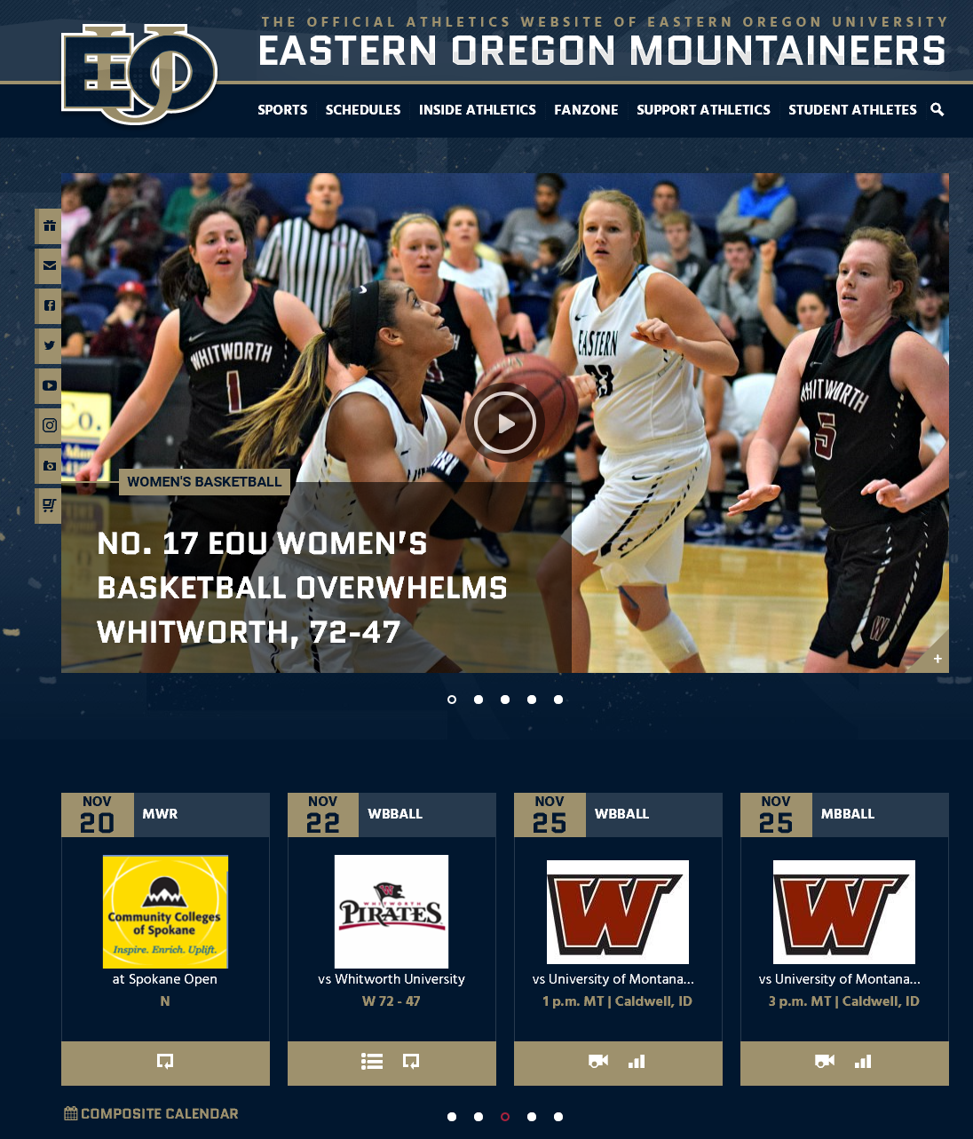
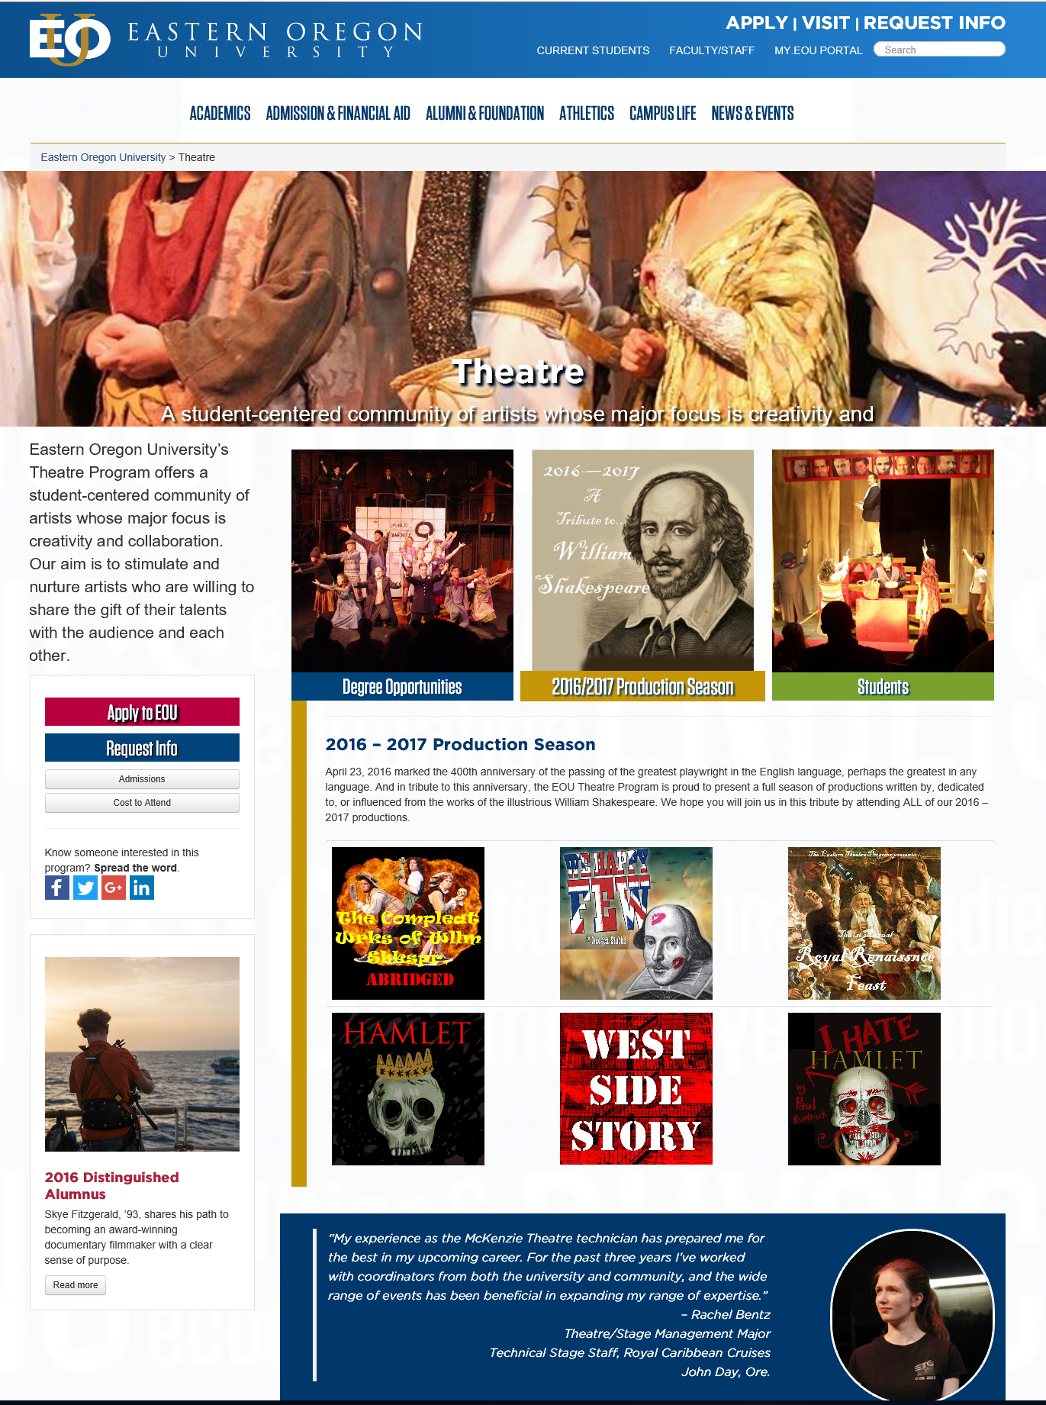

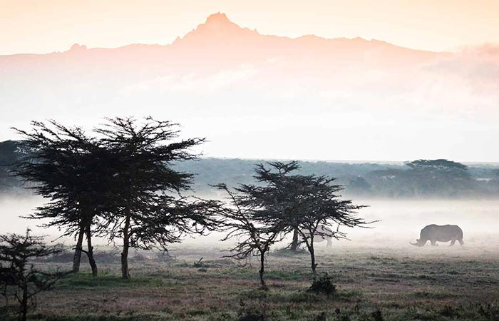
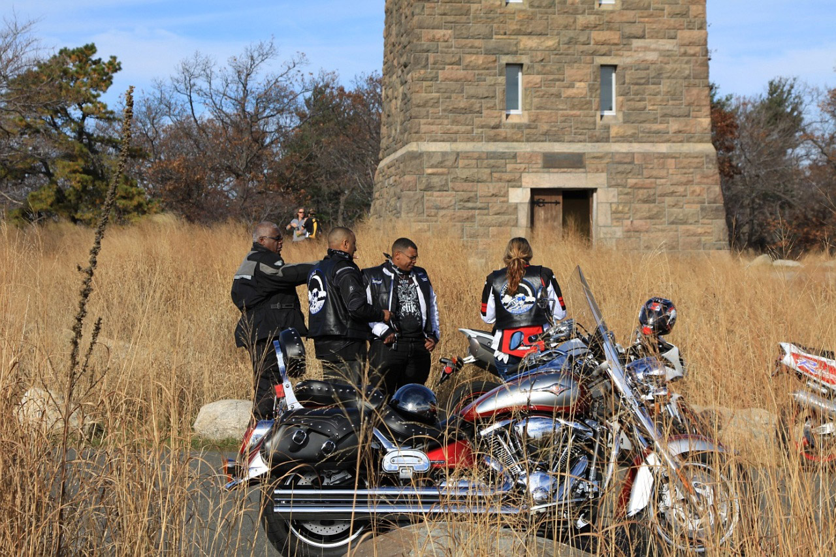
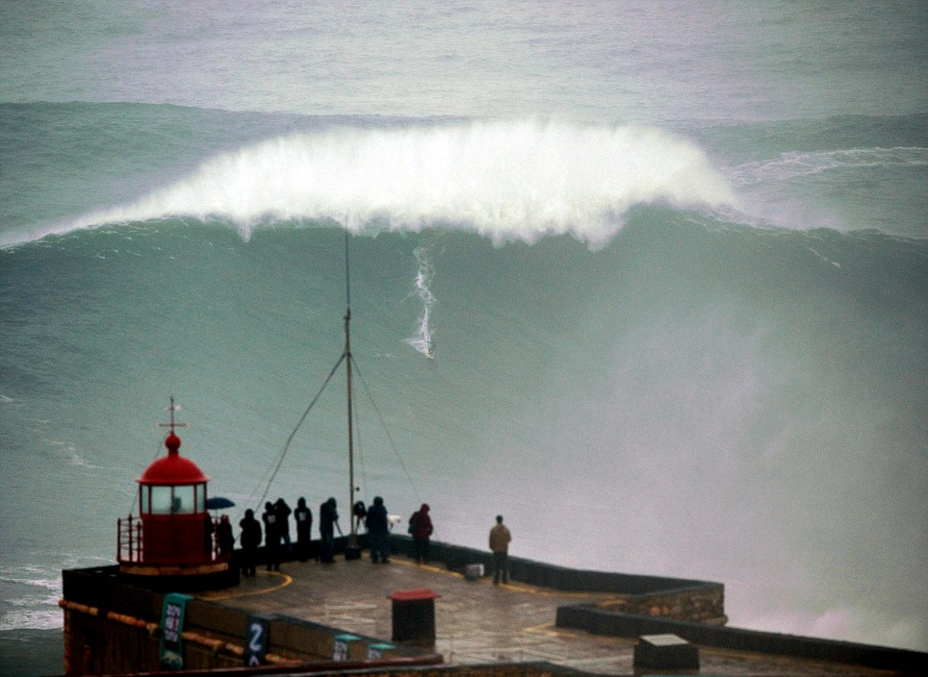
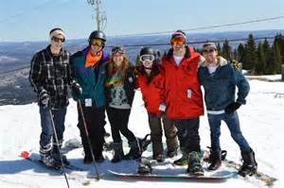

The Landscape
Online “Campus”
Education is not a class
Education is not an activity
Education is an experience!
24 x 7 – any minute, of any day, there should be something interesting and exciting happening for a Mountaineer…
We can do this because we have a place…
Art, Culture, &
Entertainment
Sports
Clubs
global scope
university curated
student sponsored
Community programs (onsite evolution + online enrichment)
Deliver regional needs
Leverage global content
Tap into offerings of others
Diverse tapestry of offerings
Deliver Campus to People
… no matter the place

Slide 8
The Landscape
Acquisition
On-Campus
Online
Horizontal Integration
- OSU
- OHSU
- PSU
- …
Online offerings
- Phoenix
- Capella
- …
Vertical Integration
- BMCC
- MHCC
- PCC
- …
Capacity (1,400)
1,874
57%
1,387
43%
State $$ -
Fixed Cost +
Subsidy +
Proactivity
Preserves Value

Slide 9
The Landscape
Implied Strategy
Onsite Consolidation
Sharpen focus
Reduce expense
Online Growth
Increase cash-flow
Expand reach
On Campus Growth
Slow play
Bootstrap
National Reach - aspirational
unsuccessful
or unwilling
Acquisition
Strategy*
* deal from position of power (not forced)

Slide 10
The Landscape
Demographics + Trends
Back-up Material

Slide 11
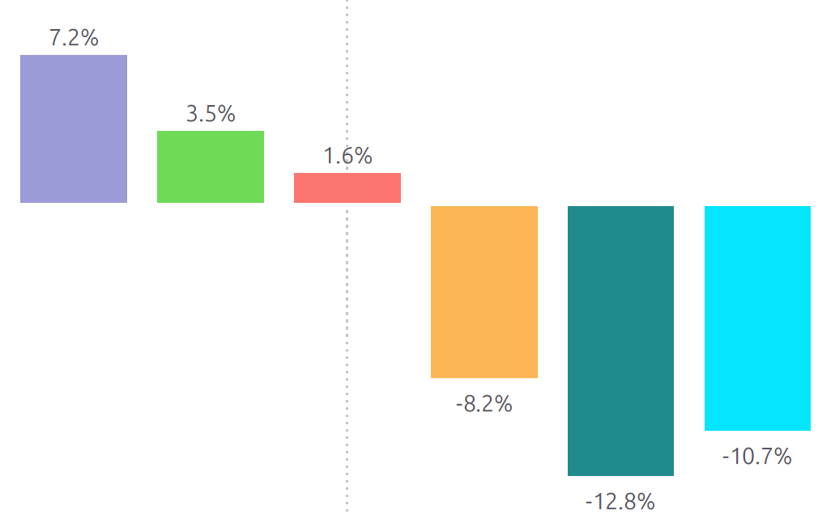
Student Population
On-Campus Demographics
Female: 787 (57%)
Male: 600 (43%)
Median Age: 21
Average Credit Load: 12
White: 1,066 (77%)
Minority: 261 (19%)
Unknown: 60 ( 4%)
Eastern Oregon 660 (48%)
Other Oregon 276 (20%)
Idaho/Washington 311 (22%)
Beyond 141 (10%)
On-Campus
1,387
43%
2010
2011
2012
2013
2014
2015
Regional
Athletics (30%)
Cost
Trend
2010 - 2015

Slide 12
Student Population
Online Demographics
Online
Female: 1,095 (68%)
Male: 519 (32%)
Median Age: 32
Average Credit Load: 8
White: 1,252 (77%)
Minority: 236 (15%)
Unknown: 126 ( 8%)
Eastern Oregon 407 (25%)
Other Oregon 818 (51%)
Idaho/Washington 191 (12%)
Beyond 198 (12%)
1,614
49%
transfer
~70%
2010
2011
2012
2013
2014
2015
Flexibility (70%)
Availability (55%)
Cost (28%)
Trend
2010 - 2015

Slide 13
Student Population
Onsite (COBE) Demographics
Female: 185 (71%)
Male: 75 (29%)
Median Age: 29
Average Credit Load: 10
White: 202 (78%)
Minority: 34 (13%)
Unknown: 24 ( 9%)
Eastern Oregon 60 (23%)
Other Oregon 142 (55%)
Idaho/Washington 48 (18%)
Beyond 10 ( 4%)
Onsite
260
8%
COBE
2010
2011
2012
2013
2014
2015
transfer
~50%
masters
40%
8.5%
8.9%
4.0%
-8.1%
- 13.5%
Trend
2010 - 2015
-21.7%

