Slide 1
Advising Charter
Jun – Dec 2016
Team Sponsor (TLT): Tressa Seydel
Team Leader: Wilson Zehr
Team (the talent):
Karen Wilburn
Christine Cronin
Naomi Tuinstra
Mandy Johnson
Marianne Sipe
Kevin Townsend
Kaki Morehead
Sam McCumber
Brooke Hewitt
Kevin Walker
Will Lehnertz*
Vicky Romano*
Special Guests:
Luke Aldrich Holly Chason Kathleen Brown
* Technology & Tools Sub-team

Slide 2
Advising + Retention Charter
Jun – Sep 2016
Milestones:
Launch Advising Sub Team by Friday, July 15, 2016
Identify short-term high impact projects by Wednesday, July 27, 2016.
Identify and launch secondary efforts as necessary by September 15, 2016.
Adjourn Advising Sub Team by December 16, 2016
Deliverables:
Increase Fall 2016 Off Campus enrollments by 75 HC, 50 FTE over trend
Increase second year retention of On Campus Fall 2015 FTF Cohort to 60%
Current Projection: 41%
= 60 HC, 53 FTE over trend
Increase second year retention of Off Campus Fall 2015 Transfer Cohort to 75%
Current Projection: 65%
= 32 HC, 20 FTE over trend
Create Project Plan for Fall 2013 FTF Cohort Completion
Current retention at 44% - 40% is TLT Deliverable

Slide 3
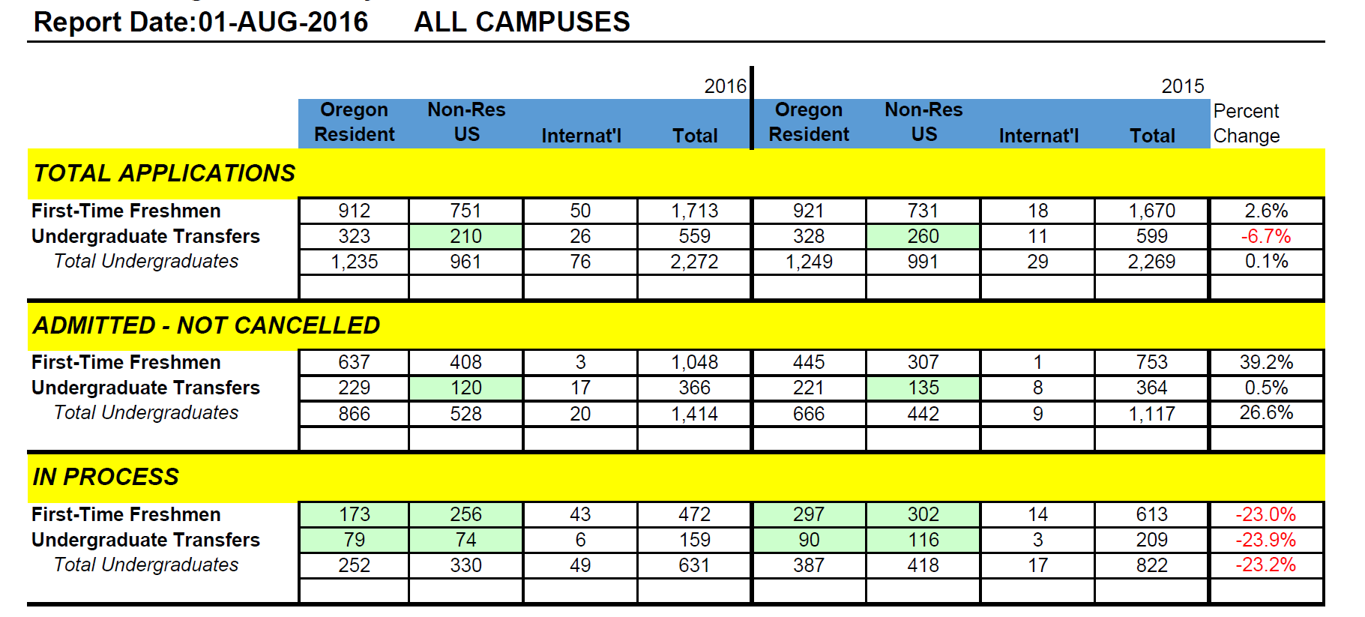
Fall Applications
Entire University (Fall 2016)
Shortage of online out of state compared to 2015…
Out of state online could be related to $50 application fee for online students who don’t know how their credits will transfer…

Slide 4
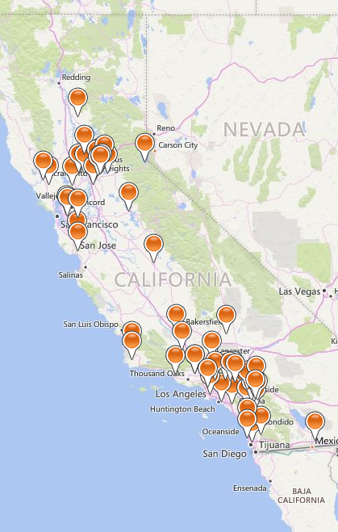
Advising + Retention Charter
Jun – Sep 2016
Understand Current Progress + Deficits
Identify Stages in Student Funnel
Explore Funnel Activity
  Online drip – call campaign (green, red, black (2))
  Application – un-submitted
  Application – incomplete
  Admitted – not registered
  Scholarship email blasts
Create Marketing Financial Model (on-campus)
Summer 2016
62 current CA online

Slide 5
Recruitment Funnel
EOU Admissions
Universe
Inquiry
Applicant
Admit
Financial Aid
inquiry – purchased name
inquiry – online drip campaign
inquiry – info require/admissions
app – un-submitted
app – submitted
app – incomplete
app – complete
admit – incomplete
admit – pending appeal
admit – denied
admit – early admit/conditional
admit – non-conditional
Register
admit – not registered
admit – registered
Retention

Slide 6
Advising + Retention Charter
Jun – Sep 2016
Student Segmentation + Profiles
Online (CA) Student Research
  CA student mapping
  Survey (400+ respondents)
Identify Former On-site Programs
  Week-end programs
  Certificates

Slide 7
The Landscape
Separate Value Proposition(s)
On-Campus
Online
Onsite
1,540
47%
1,387
43%
334
10%
transfer
~70%
transfer
~50%
Regional
Athletics (30%)
Cost
Flexibility (70%)
Availability (55%)
Cost (28%)

Slide 8
Advising + Retention Charter
Jun – Sep 2016
Understand Existing Advisor Structure (CAS, COB, COE)
Student Lifecycle Model
  Document existing actions/programs
  Identify gaps
  Propose changes

Slide 9
Student Lifecycle
Undergraduate - Traditional
ADMITTED
FRESHMAN
SOPHOMORE
JUNIOR
SENIOR
GRADUATE
ALUMNI
welcome
where to find
what to do
problem solver
buddy
clubs & activities
active classes
entertainment
pro school admit
professional development
career fairs
networking
engagement +
commitment
Voluntary Advising
referrals
giving
Mandatory Advising
marketing
prospecting
Week of Welcome
t
0
1
2
3
4
5 …

Slide 10
Student Lifecycle
Undergraduate - Transfer
ADMITTED
JUNIOR
SENIOR
GRADUATE
ALUMNI
engagement +
commitment
Faculty Advising
Center Director Advising
Group Projects
Online Office Hours
Faculty Videos
marketing
prospecting
Program Videos
referrals
giving
t
0
1
2
3 …

Slide 11
Advising Charter
Sep – Dec 2016
Milestones:
Launch Advising Sub Team by Friday, July 15, 2016
Identify short-term high impact projects by Wednesday, July 27, 2016.
Identify and launch secondary efforts as necessary by September 15, 2016.
Adjourn Advising Sub Team by December 16, 2016
Deliverables:
Increase Fall 2016 Off Campus enrollments by 75 HC, 50 FTE over trend
Increase second year retention of On Campus Fall 2015 FTF Cohort to 60%
Current Projection: 41%
= 60 HC, 53 FTE over trend
Increase second year retention of Off Campus Fall 2015 Transfer Cohort to 75%
Current Projection: 65%
= 32 HC, 20 FTE over trend
Create Project Plan for Fall 2013 FTF Cohort Completion
Current retention at 44% - 40% is TLT Deliverable

Slide 12
Advising + Retention Charter
Sep – Dec 2016
Three Sub-Committees
Sophomore Retention (Naomi Tuinstra)
Advising Best Practices (Mandy Johnson)
Technology & Tools
Other Items
On-campus student survey
Outline advising workflow
College town partnership

Slide 13
Advising + Retention Charter
Sophomore Retention
Sophomore Working Lunch (1) + Talk Finance & Chill (2)
  Real-time problem solving sessions
  Advising, Financial Aid, Student Accounts, TRiO, others…
  Convenient time/location for students
  75+ students attended
  Positive feedback
Outcome & Recommendations
  75+ students attended – extremely positive feedback
  Problem solving and bonding opportunity
  Offer these sessions each term
  Expand format to other topics

Slide 14
Advising + Retention Charter
Advising Best Practices
Short-term Projects
  Faculty advisor training opportunities
  Creation of class-level advising syllabus
  Orientation program new admits (Winter)
  Checklists for faculty advisors use during advising
  eMail reminder for seniors to apply for graduation
Recommendations
  Mandatory advising all students – Spring 2017
  Annual Advisor summit – discussion, training, best practices
  Welcome back event all students (orientation every term)
  Degree completion plan for all sophomores

Slide 15
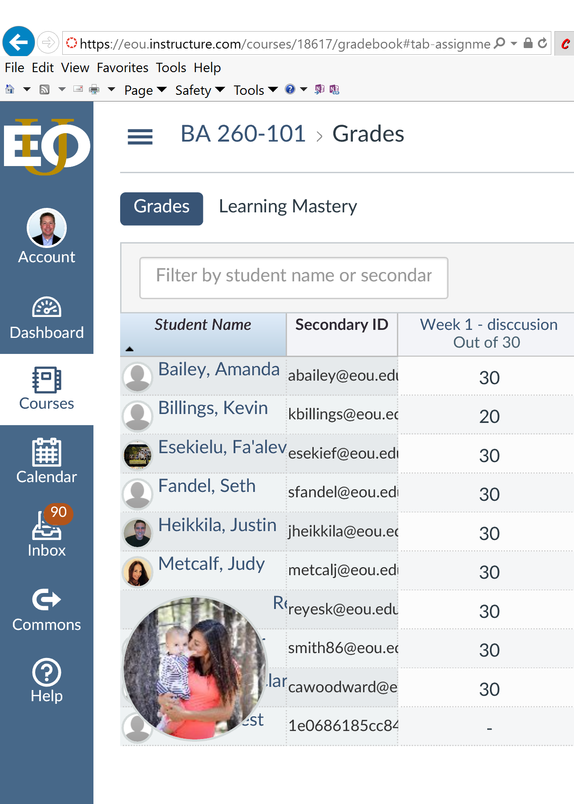
Advising + Retention Charter
Technology & Tools
How do we use our current technology to enhance the student + faculty engagement and increase retention…
Current Projects
  Photo’s in all profiles - enlarge photo with mouse over.
  10-15 minute tech tip session every faculty meeting
  Mandatory student training on Canvas (fun!!)
  Review faculty survey items (audio + video)
Recommendations (+complete current)
  Mandatory use of Canvas gradebook
  President “welcome”/”welcome back” video - every student
  Re-imagine on-campus + online to embrace tech tools
  Create online campus (next slides (2))

Slide 16
Advising + Retention Charter
“Online Campus”
Education is not a class…
Education is not an activity…
Education is an experience!
EOU has a “place” – a beautiful spot with amazing people
EOU has a major presence in online learning (~50% students)
Online growth represents $$ with limited cost
Leadership is required
  Discard legacy models
  Embrace best practices
  Create new paradigms that rock
Re-imagine online education (EOU style)
Deliver Campus to People
… no matter the place
We will need a marketing “engine” as well…

Slide 17
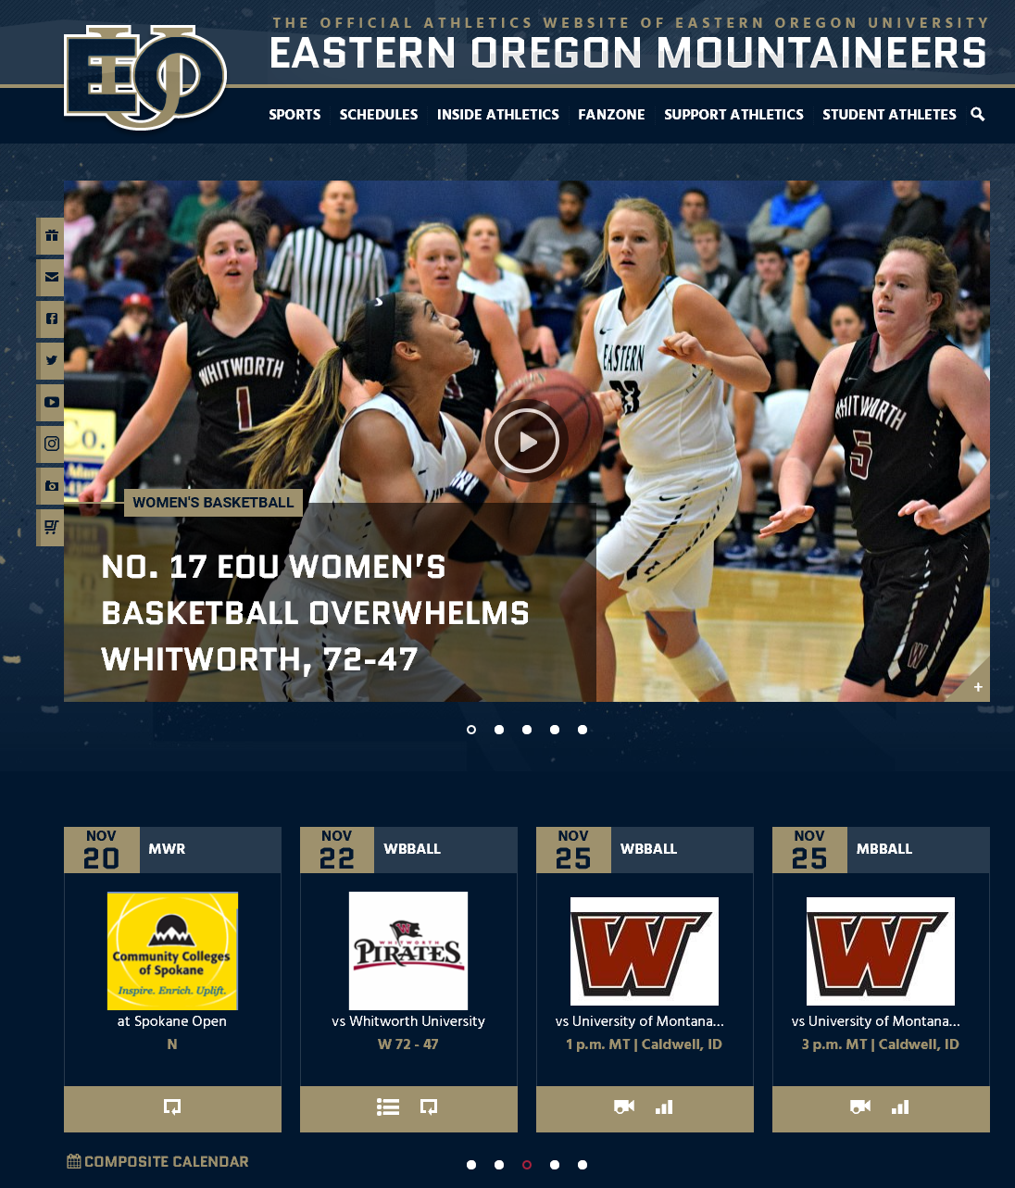
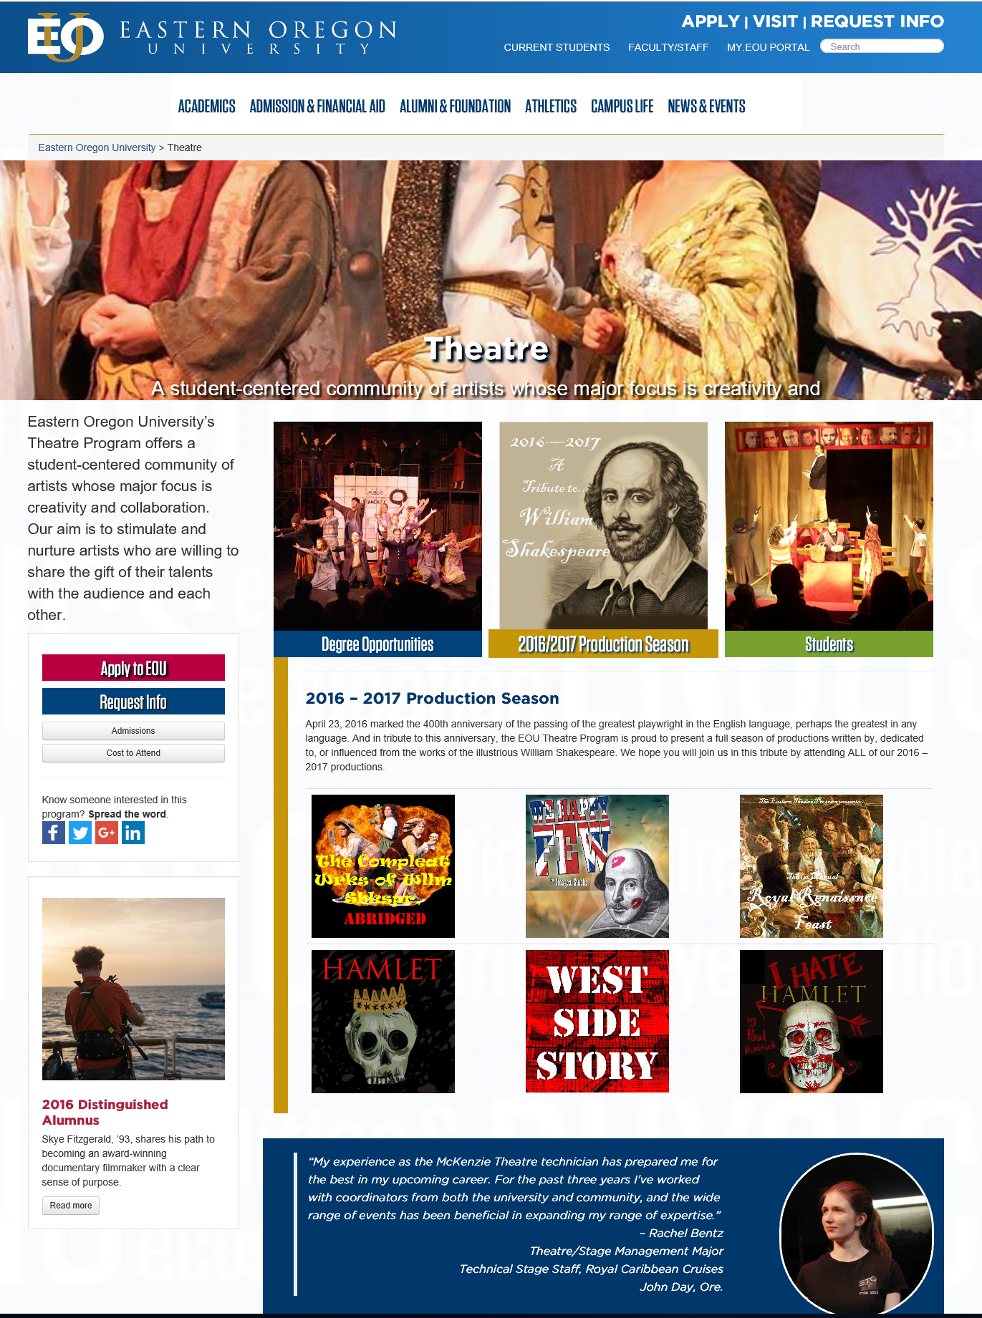


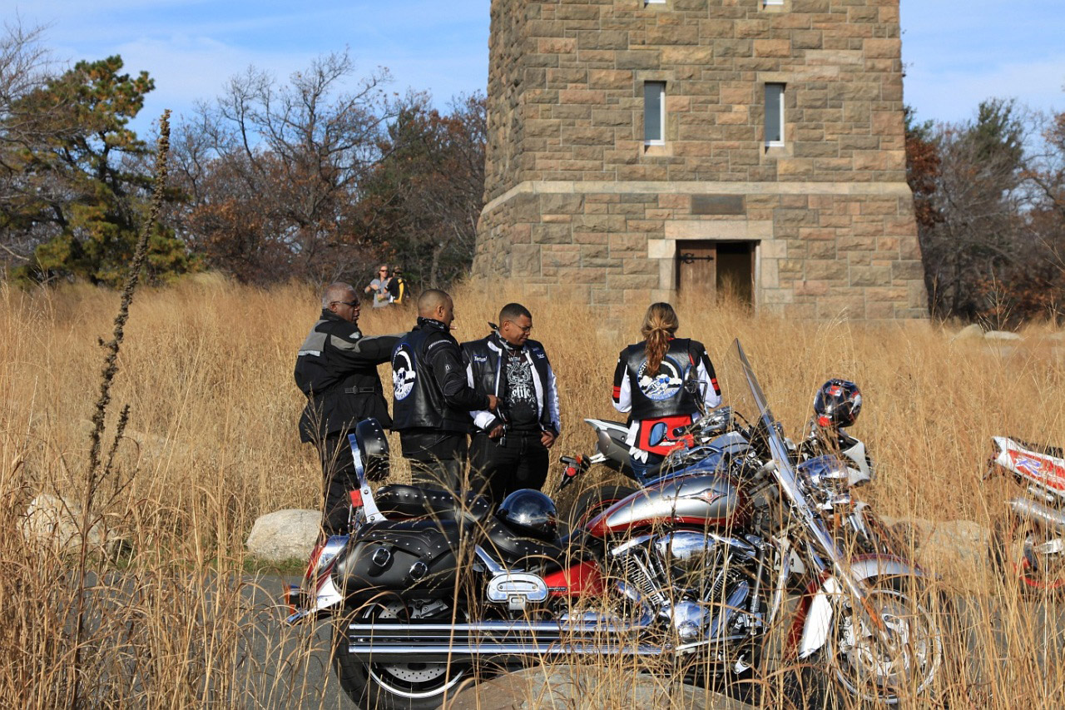
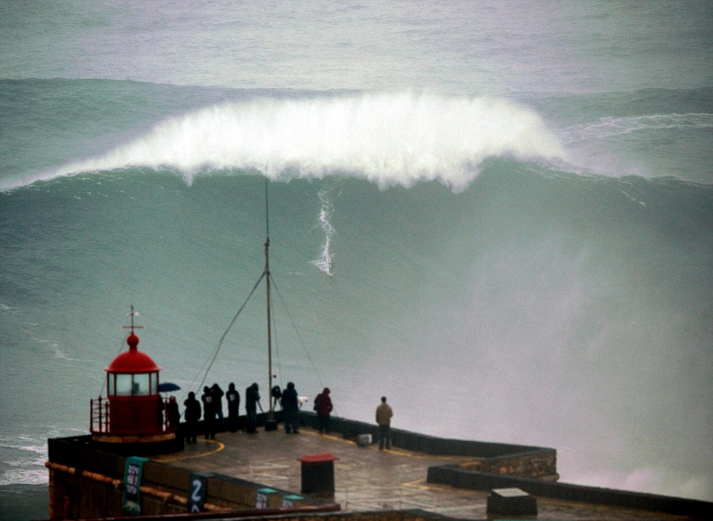
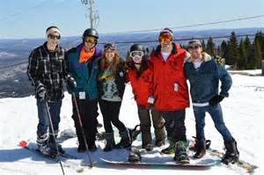

Advising + Retention Charter
“Online Campus”
We can do this because we have a place…
24 x 7 – any minute, of any day, there should be something interesting and exciting happening for a Mountaineer…
Art, Culture, &
Entertainment
Sports
Clubs
global scope
university curated
student sponsored
Community programs (onsite evolution + online enrichment)
Deliver regional needs
Leverage global content
Tap into offerings of others
Diverse tapestry of offerings

Slide 18
Advising + Retention Charter
Other Activities
Online Students Callbacks
  Survey response callback requires
  Gathered high fives & suggestions
  Great “punch list” (lots of low hanging fruit)
Fall 2013 Cohort Update
  Spring 2016
    Outreach to inactive transfer students
  Fall 2016 (OHSU/OSU excluded)
    Scrub student records – confirm current major
    Update Degree Works (+inactive)
    Update/re-assign advisors

Slide 19
Advising + Retention Charter
Other Activities (Next Steps)
Active Students
  140 credit eMail alert
  Faculty Advisor training
  College Advistor support – proactive outreach
Inactive Students
  Keep records updated/accurate
  Drip campaign to maintain relationship
  Increase targeted outreach by Advisors 2017-2018
ALL Students
  Current student lifecycle – document + augment
  Great college experience (retention) not an accident
  Script the EOU college experience

Slide 20
Advising + Retention Charter
Student Lifecycle (Capture/Fill Gaps)
Online +
On Campus
ADMITTED
FRESHMAN
SOPHOMORE
JUNIOR
SENIOR
GRADUATE
ALUMNI
welcome
where to find
what to do
problem solver
buddy
clubs & activities
active classes
entertainment
pro school admit
professional development
career fairs
networking
engagement +
commitment
Voluntary Advising
referrals
giving
Mandatory Advising
marketing
prospecting
Week of Welcome
t
0
1
2
3
4
5 …
Great college experience cannot be left to chance …
We need to define the EOU experience!

Slide 21
Advising + Retention Charter
Other (Useful) Material
Back-up Material

Slide 22
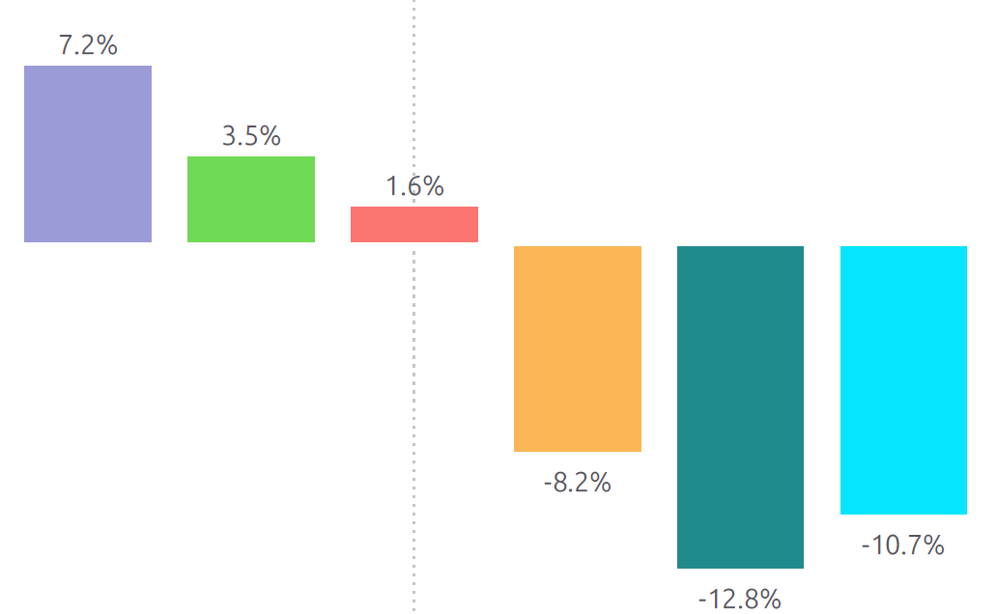
Student Population
On-Campus Demographics
Female: 787 (57%)
Male: 600 (43%)
Median Age: 21
Average Credit Load: 12
White: 1,066 (77%)
Minority: 261 (19%)
Unknown: 60 ( 4%)
Eastern Oregon 660 (48%)
Other Oregon 276 (20%)
Idaho/Washington 311 (22%)
Beyond 141 (10%)
On-Campus
1,387
43%
2010
2011
2012
2013
2014
2015
Regional
Athletics (30%)
Cost
Trend
2010 - 2015

Slide 23
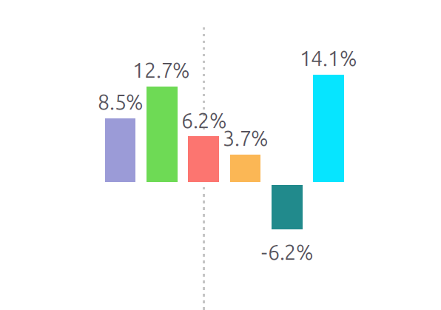
Student Population
Online Demographics
Online
Female: 1,046 (68%)
Male: 494 (32%)
Median Age: 34
Average Credit Load: 9
White: 1,194 (78%)
Minority: 228 (15%)
Unknown: 119 ( 8%)
Eastern Oregon 376 (24%)
Other Oregon 791 (51%)
Idaho/Washington 183 (12%)
Beyond 190 (12%)
1,540
47%
transfer
~70%
2010
2011
2012
2013
2014
2015
12.7%
14.1%
8.5%
6.2%
3.7%
Flexibility (70%)
Availability (55%)
Cost (28%)
Trend
2010 - 2015
- 6.2%

Slide 24
Student Population
Onsite (COBE) Demographics
Female: 185 (71%)
Male: 75 (29%)
Median Age: 29
Average Credit Load: 10
White: 202 (78%)
Minority: 34 (13%)
Unknown: 24 ( 9%)
Eastern Oregon 60 (23%)
Other Oregon 142 (55%)
Idaho/Washington 48 (18%)
Beyond 10 ( 4%)
Onsite
260
8%
COBE
transfer
~50%
masters
40%
2010
2011
2012
2013
2014
2015
8.5%
8.9%
4.0%
-8.1%
- 13.5%
Trend
2010 - 2015
-21.7%

Slide 25
Recruitment Funnel
Open Issues (Opportunities)
Out of state enrollment
  $50 enrollment fee
  Uknown how credits transfer
Regional employer approval
  HR Directors, 200+ employees, 200 mile radius
  783 records (683 w/phones) - $425

Slide 26
Recruitment Funnel
Open Issues (Opportunities)
Regional Center Marketing Plan/Calendar
Daily Dispatch (Fire Safety)
  eMail Newsletter
  Potential partnership
Standard Signature Block
  Regional Directors
  Advisors
Pop-up Chat Box Tool
Research How Others Use Video (Chris/Kevin)

