Slide 1
Advising Charter
Jun – Sep 2016
Milestones:
Launch Advising Sub Team by Friday, July 15, 2016
Identify short-term high impact projects by Wednesday, July 27, 2016.
Identify and launch secondary efforts as necessary by September 15, 2016.
Adjourn Advising Sub Team by December 16, 2016
Deliverables:
Increase Fall 2016 Off Campus enrollments by 75 HC, 50 FTE over trend
Increase second year retention of On Campus Fall 2015 FTF Cohort to 60%
Current Projection: 41%
= 60 HC, 53 FTE over trend
Increase second year retention of Off Campus Fall 2015 Transfer Cohort to 75%
Current Projection: 65%
= 32 HC, 20 FTE over trend
Create Project Plan for Fall 2013 FTF Cohort Completion
Current retention at 44% - 40% is TLT Deliverable

Slide 2
Advising Charter
Jun – Sep 2016
Understand Current Progress + Deficits
Identify Stages in Student Funnel
Explore Funnel Activity
Online drip – call campaign (green, red, black (2))
Application – un-submitted
Application – incomplete
Admitted – not registered
Scholarship email blasts
Create Marketing Financial Model (on-campus)
Online (CA) Student Research
CA student mapping
Survey (400+ respondents)

Slide 3
Advising Charter
Jun – Sep 2016
Identify Former On-site Programs
Week-end programs
Certificates
Understand Existing Advisors (CAS, COB, COE)
Student Segmentation + Profiles
Student Lifecycle Model
Document existing actions/programs
Identify gaps
Propose changes

Slide 4
Recruitment Funnel
EOU Admissions
Universe
Inquiry
Applicant
Admit
Financial Aid
online drip
app – un-submitted
app – incomplete
app – complete
admit
admit – conditional
admit – not registered
Register
Retention

Slide 5
The Landscape
Separate Value Proposition(s)
On-Campus
Online
Onsite
1,540
47%
1,387
43%
334
10%
Regional
Athletics (30%)
Cost
Flexibility (70%)
Availability (55%)
Cost (28%)

Slide 6
Student Population
Segmentation
On-Campus
Online
Onsite
1,540
47%
260
8%
COBE
1,387
43%
transfer
~50%
masters
40%
transfer
~70%
74
2%
other
Regional
Athletics (30%)
Cost
Flexibility (70%)
Availability (55%)
Cost (28%)

Slide 7
The Landscape
Fall 2015 – First Term Students
On-Campus
Online
Onsite
47%
40%*
13%
new
Freshman
COBE 0%
Other 1%
62%
2%
1%
new
Transfer
33%
64%
35%
COBE 35%
Other 1%
momentum
graduate +
non-degree
5%
34%
63%
COBE 42%
Other 22%
* Warning signal – fastest growing piece of the market, but we are down as a proportion of total population. Could be due to focus on on-campus recruiting…

Slide 8
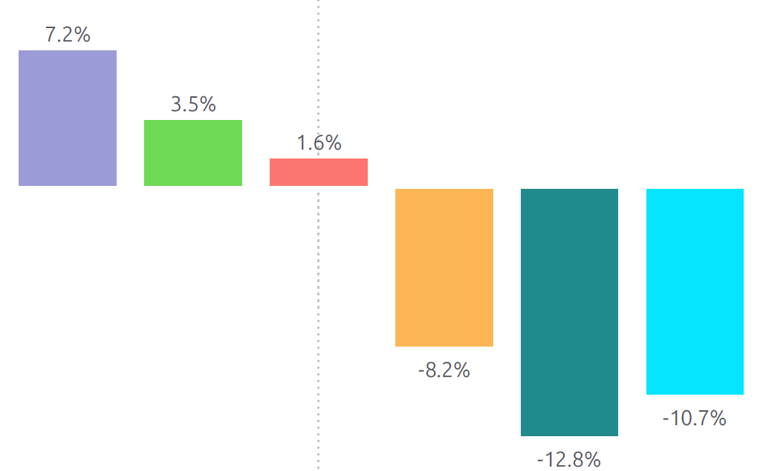
Student Population
On-Campus Demographics
Female: 787 (57%)
Male: 600 (43%)
Median Age: 21
Average Credit Load: 12
White: 1,066 (77%)
Minority: 261 (19%)
Unknown: 60 ( 4%)
Eastern Oregon 660 (48%)
Other Oregon 276 (20%)
Idaho/Washington 311 (22%)
Beyond 141 (10%)
On-Campus
1,387
43%
2010
2011
2012
2013
2014
2015
Regional
Athletics (30%)
Cost
Trend
2010 - 2015

Slide 9
Student Population
On-campus Growth
Build Regional Brand
High-school visits (get faculty involved)
Local PR (accomplishments + hero’s)
Community involvement
Expand Athletic Programs
Inclusiveness in existing programs
Explore others (low cost/large enrollment boost)
Swimming (low effort)
Create Centers of Excellence (3)
Become College Town

Slide 10
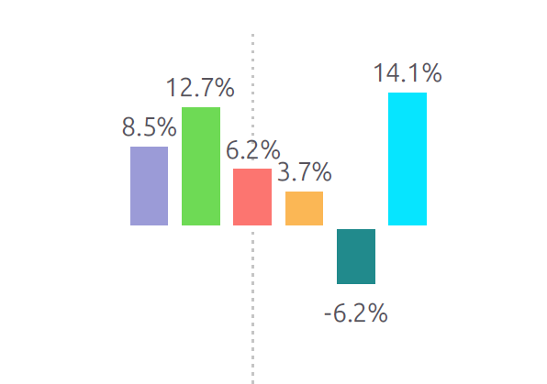
Student Population
Online Demographics
Online
Female: 1,046 (68%)
Male: 494 (32%)
Median Age: 34
Average Credit Load: 9
White: 1,194 (78%)
Minority: 228 (15%)
Unknown: 119 ( 8%)
Eastern Oregon 376 (24%)
Other Oregon 791 (51%)
Idaho/Washington 183 (12%)
Beyond 190 (12%)
1,540
47%
transfer
~70%
2010
2011
2012
2013
2014
2015
12.7%
14.1%
8.5%
6.2%
3.7%
Flexibility (70%)
Availability (55%)
Cost (28%)
Trend
2010 - 2015
- 6.2%

Slide 11
Student Population
Online Growth
Build Brand (online + offline)
Expanded PR (US News, Ed pubs, …)
Online marketing (website + SEO + social + …)
Direct response (employers, prospects, …)
Strategic Alliances (Community Colleges)
Articulation agreements
On-site marketing activities
Ambassador visits (faculty, admin, sports hero, …)
CA transfers (explore others)
Unique niche offerings

Slide 12
Student Population
Onsite (COBE) Demographics
Female: 185 (71%)
Male: 75 (29%)
Median Age: 29
Average Credit Load: 10
White: 202 (78%)
Minority: 34 (13%)
Unknown: 24 ( 9%)
Eastern Oregon 60 (23%)
Other Oregon 142 (55%)
Idaho/Washington 48 (18%)
Beyond 10 ( 4%)
Onsite
260
8%
COBE
transfer
~50%
masters
40%
2010
2011
2012
2013
2014
2015
8.5%
8.9%
74
2%
other
4.0%
-8.1%
- 13.5%
Trend
2010 - 2015
-21.7%

Slide 13
Student Population
Onsite (COBE) Growth
Regional PR
Strategic Alliances (Community Colleges)
Articulation agreements
On-site marketing activities
Ambassador visits (faculty, admin, sports hero, …)
Unique (niche) offerings
MBA (blue collar)
Specialized MBA
FSA…

Slide 14
Student Population
Onsite (other) Demographics
Female: 49 (66%)
Male: 25 (34%)
Median Age: 31
Average Credit Load: 5
White: 58 (78%)
Minority: 8 (11%)
Unknown: 8 ( 11%)
Eastern Oregon 31 (42%)
Other Oregon 27 (36%)
Idaho/Washington 8 (11%)
Beyond 8 (11%)
Onsite
260
8%
COBE
transfer
~50%
masters
40%
2010
2011
2012
2013
2014
2015
74
2%
other
-0.8%
-13.2%
-16.9%
-29.8%
- 36.5%
Trend
2010 - 2015
-72.7%

Slide 15
Student Population
Onsite (other) Growth
Joint Offerings (community driven)
Re-visit popular weekend courses (FTE)
Research cost/benefit
Certificates
Onsite marketing
Regional PR

Slide 16
Recruitment Funnel
Open Issues (Opportunities)
Out of state enrollment
$50 enrollment fee
Uknown how credits transfer
Regional employer approval
HR Directors, 200+ employees, 200 mile radius
783 records (683 w/phones) - $425

Slide 17
Recruitment Funnel
Open Issues (Opportunities)
Regional Center Marketing Plan/Calendar
Daily Dispatch (Fire Safety)
eMail Newsletter
Potential partnership
Standard Signature Block
Regional Directors
Advisors
Pop-up Chat Box Tool
Research How Others Use Video (Chris/Kevin)

Slide 18
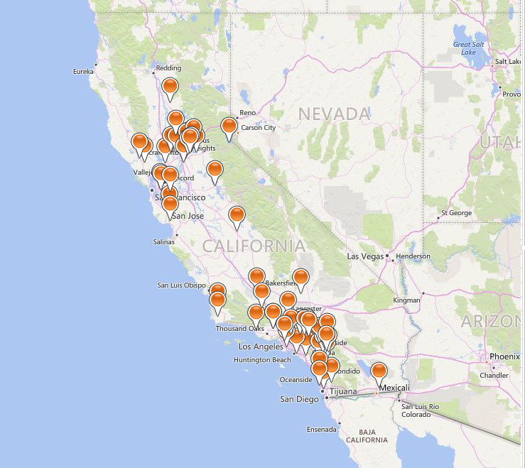
Summer 2016
62 current CA online

Slide 19
Recruitment Funnel
EOU Admissions
Universe
Inquiry
Applicant
Admit
Financial Aid
Example
online drip
100% 1,000
app – un-submitted
app - incomplete
app - complete
3% 30
admit
admit – conditional
admit – not registered
22% 7
Register
Retention

Slide 20
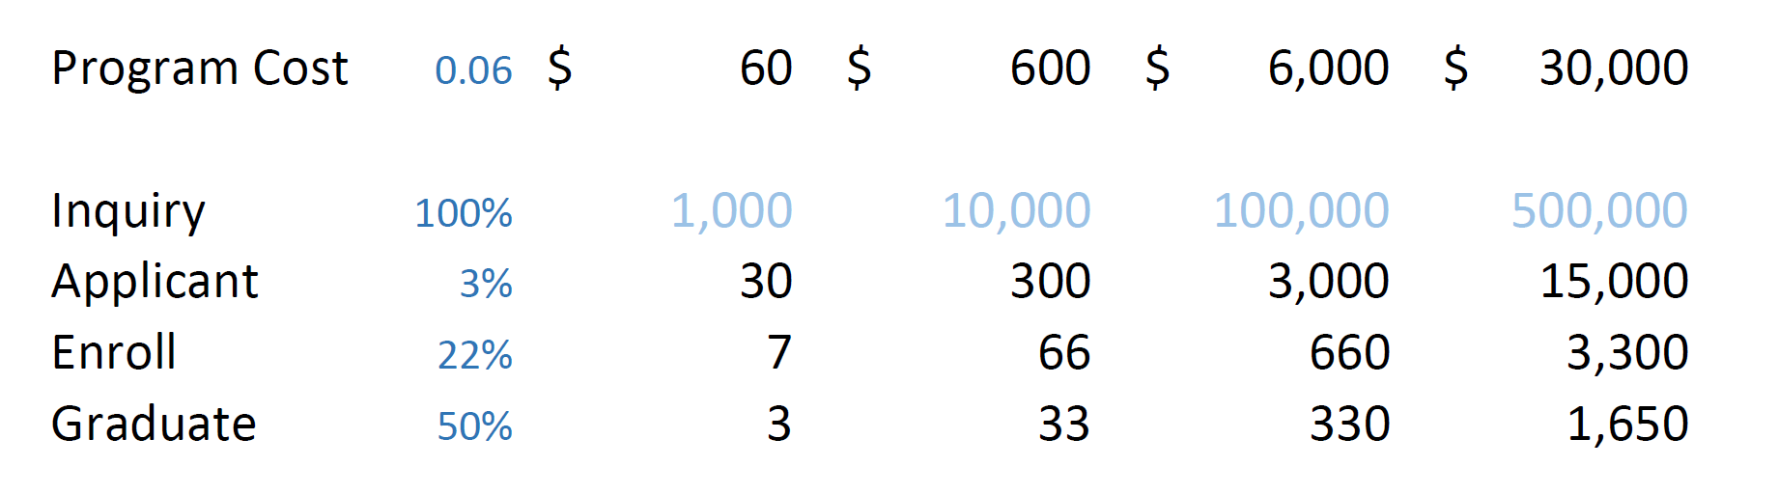
Lead Generation Model
EOU Admissions

